Slide 1
BBM 201 Data structures
Lecture 1:
Basic concepts for data structures
2015-2016 Fall

Slide 2
About the course
This course will help students understand the basic data structures such as matrices, stacks, queues, linked lists, etc.
BBM 203 Programming Laboratory: The students will gain hand-on experience via a set of programming assignments supplied as complementary.
Requirements: You must know basic programming (i.e. BBM101).

Slide 3
References
Data Structures Notes, Mustafa Ege.
Fundamentals of Data Structures in C. Ellis Horowitz and Sartaj Sahni, 1993.
Data Structures A Pseudocode Approach with C. Richard F. Gilberg, Behrouz A. Forouzan
Data Structures and Algorithm Analysis in C++. Mark Allen Weiss.
Problem Solving and Program Design in C, 7th Edition. Jeri Hanly and Elliot Koffman, Pearson, 2013
The C Programming Language, 2nd Edition. Brian Kernighan and Dennis Ritchie, Prentice Hall, 1988
Practical C Programming 3rd Edition. Steve Oualline, O'Reilly Media, 1997

Slide 4
Communication
The course web page will be updated regularly throughout the semester with lecture notes, programming assignments, announcements and important deadlines. http://web.cs.hacettepe.edu.tr/~bbm201

Slide 5
Getting Help
Office hours
See the web page for details
BBM 203 Programming Laboratory
Course related recitations, practice with example codes, etc.
Communication
Announcements and course related discussions through
BBM 201: https://piazza.com/hacettepe.edu.tr/fall2015/bbm201
BBM 203: https://piazza.com/hacettepe.edu.tr/fall2015/bbm203

Slide 6
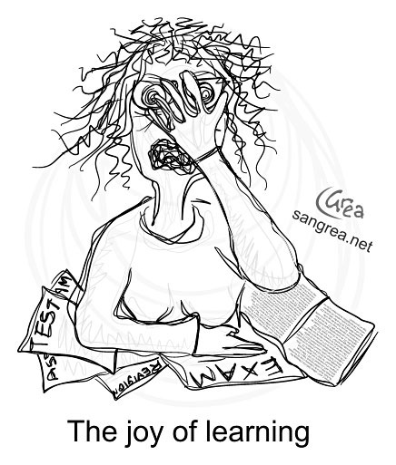
Course Work and Grading
2 midterm exams (50%)
Closed book and notes
Final exam (45%)
Closed book
To be scheduled by the registrar
Class Attendance (5%)
Attempting to create false attendance (e.g., signing in the attendance list on behalf of someone else) will be punished.

Slide 7
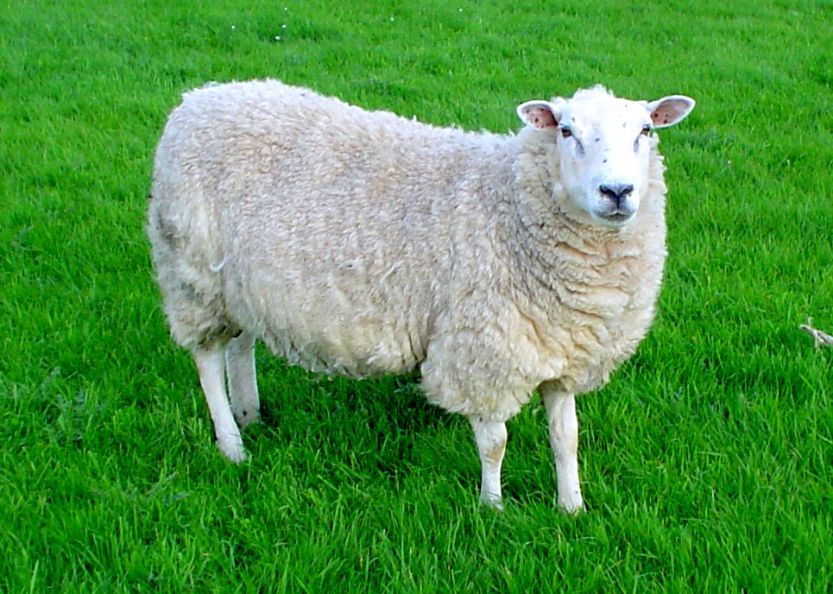
Course Overview
Week | Date | Title
1 | 14-Sep | Basic concepts for data structures
2 | 21-Sep | Holiday!
3 | 28-Sep | Performance analysis
4 | 5-Oct | Multidimensional arrays
5 | 12-Oct | Matrices
6 | 19-Oct | Stacks&Queues
7 | 26-Oct | Midterm Exam 1
8 | 2-Nov | Evaluation of expressions
9 | 9-Nov | Multiple Stacks and Queues
10 | 16-Nov | Array-based linked list
11 | 23-Nov | Linked lists using dynamic memory
12 | 30-Nov | Midterm Exam 2
13 | 7-Dec | Implementation of singly linked lists
14 | 14-Dec | Doubly linked lists
15 | 21-Dec | Wrap Up

Slide 8
BBM 203 Programming Laboratory I
Programming assignments (PAs)
Four assignments throughout the semester.
Each assignment has a well-defined goal such as solving a specific problem.
You must work alone on all assignments stated unless otherwise.
Important Dates
See the course web page for schedule.

Slide 9
Policies
Work groups
You must work alone on all assignments stated unless otherwise
Submission
Assignments due at 23:59 (no extensions!)
Electronic submissions (no exceptions!)
Lateness penalties
Get penalised 10% per day
No late submission is accepted 3 days after due date

Slide 10
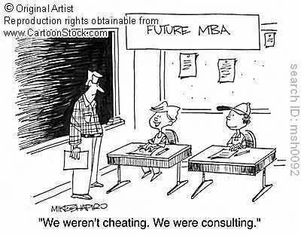
Cheating
What is cheating?
Sharing code: by copying, retyping, looking at, or supplying a file
Coaching: helping your friend to write a programming assignment, line by line
Copying code from previous course or from elsewhere on WWW
What is NOT cheating?
Explaining how to use systems or tools
Helping others with high-level design issues

Slide 11
Cheating
Penalty for cheating:
Removal from course with failing grade
Detection of cheating:
We do check: Our tools for doing this are much better than most cheaters think!

Slide 12
BASIC CONCEPTS
FOR DATA STRUCTURES

Slide 14
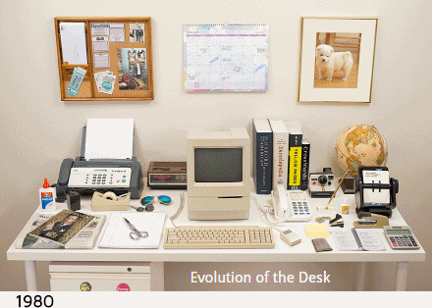

Slide 17
Data Structures→Data StructurING
How do we organize information so that we can find, update, add, and delete portions of it efficiently?

Slide 18
Data Structure Example Applications
How does Google quickly find web pages that contain a
search term?
What’s the fastest way to broadcast a message to a network of computers?
How can a subsequence of DNA be quickly found within the genome?
How does your operating system track which memory (disk or RAM) is free?
In the game Half-Life, how can the computer determine which parts of the scene are visible?

Slide 19
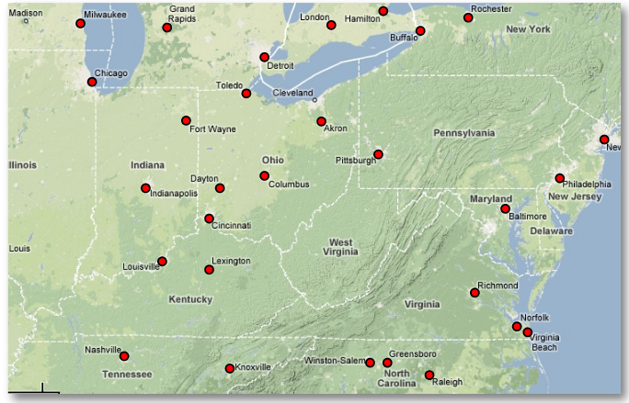
Suppose You’re Google Maps…
You want to store data about cities (location, elevation, population)…
What kind of operations should your data structure(s) support?

Slide 20
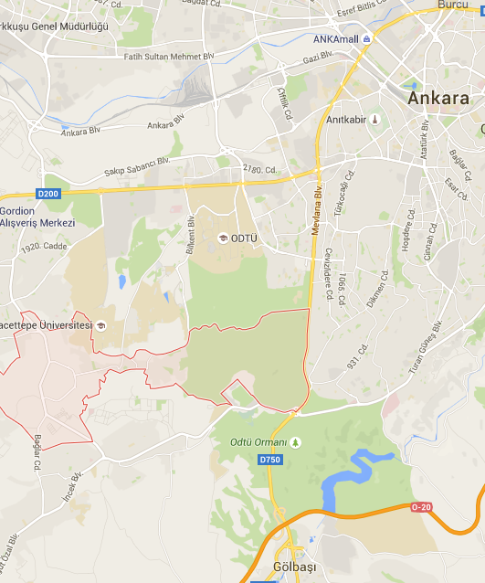
Operations to support the following scenario…
Finding addresses on map?
Lookup city by name...
Mobile user?
Find nearest point to me...
Car GPS system?
Calculate shortest-path between cities…
Show cities within a given window…
Political revolution?
Insert, delete, rename cities

Slide 21
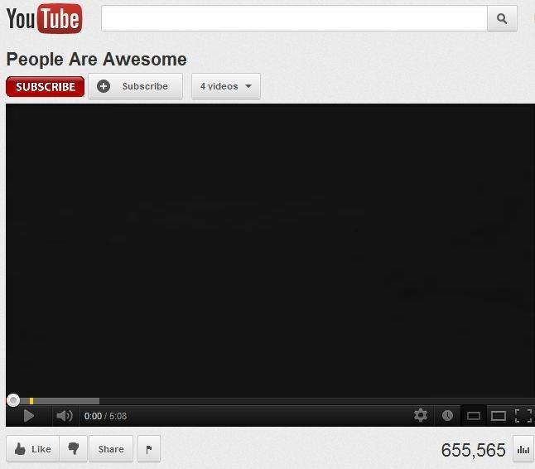
How will you count user views on YouTube?
Lets write a userViewCount() function
int userViewCount (int current_count)
{
int new_count;
new_count =current_count + 1;
return new_count;
}
Will this implementation work all the time?

Slide 22
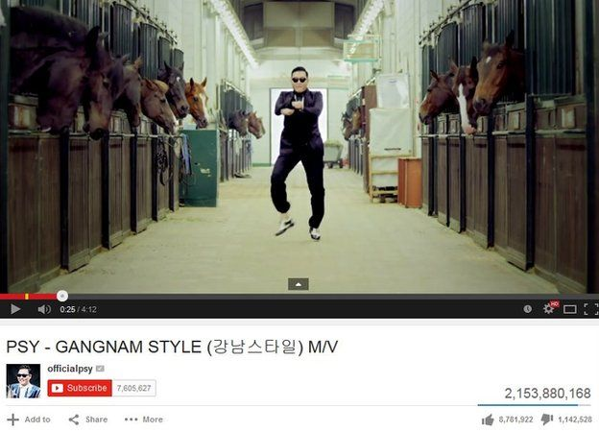
How will you count user views on YouTube?
%99.9 times yes.

Slide 23
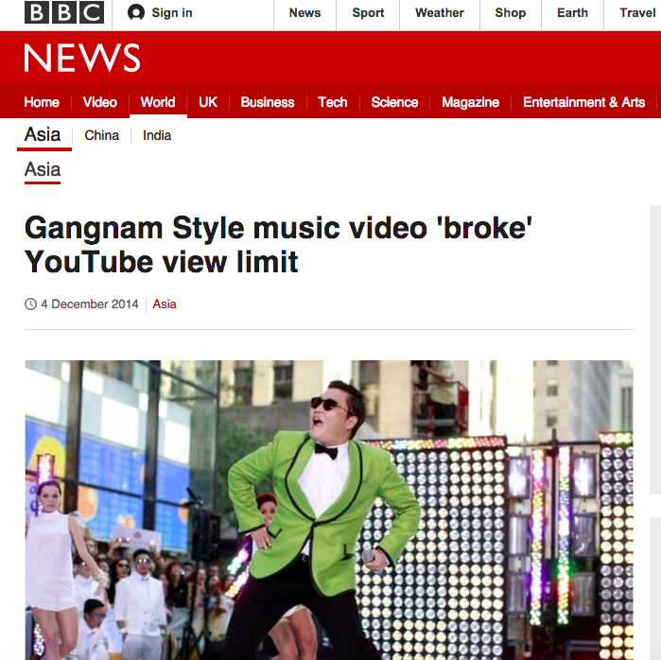
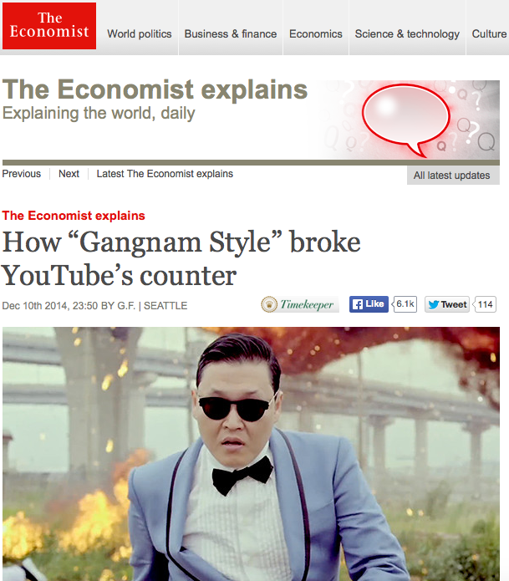
How will you count user views on YouTube?
YouTube's counter previously used a 32-bit integer
YouTube said the video - its most watched ever - has been viewed more than 2,147,483,647 times.
It has now changed the maximum view limit to 9,223,372,036,854,775,808, or more than nine quintillion.
http://www.bbc.com/news/world-asia-30288542
http://www.economist.com/blogs/economist-explains/2014/12/economist-explains-6

Slide 24
How bad can it be?
June 4, 1996
Ariane 5 rocket launched by the European Space Agency
After a decade of development costing $7 Billion
(~21 Billion in Turkish Liras, just for comparison Istanbul’s third bridge cost estimates are 4.5 Billion TL)
Exploded just 40 seconds after its lift-off
The destroyed rocket and its cargo were valued at $500 million
Reason?

Slide 25
How bad can it be?
Reason?
Inertial reference system error: specifically a 64 bit floating point number relating to the horizontal velocity of the rocket with respect to the platform was converted to a 16 bit signed integer.
The number was larger than 32,767, the largest integer storable in a 16 bit signed integer, and thus the conversion failed.
$500 Million rocket/cargo
Time and effort

Slide 26
Goals
“I will, in fact, claim that the difference between a bad programmer and a good one is whether he considers his code or his data structures more important. Bad programmers worry about the code. Good programmers worry about data structures and their relationships.”
Linus Torvalds, 2006

Slide 27
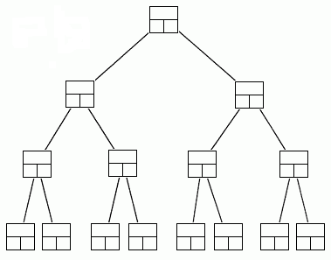
Data Structures
A data structure is a way to store and organize data in computer, so that it can be used efficiently.
Some of the more commonly used data structures include lists, arrays, stacks, queues, heaps, trees, and graphs.
Binary Tree

Slide 28
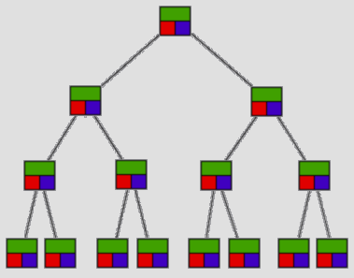
Choosing Data Structures
Queue vs Binary Tree
---Which one to use for what task?

Slide 29
Why So Many Data Structures?
Ideal data structure:
“fast”, “elegant”, memory efficient
Generates tensions:
time vs. space
performance vs. elegance
generality vs. simplicity
one operation’s performance vs. another’s
The study of data structures is the study of tradeoffs. That’s why we have so many of them!

