Slide 1
RECITATION 1 ANALYSIS OF ALGORITHMS 24.02.2017

Slide 2
Why do we analyze the algorithms?
Focus on the goal of better quantifying the relationship between problem size and running time.
-You are likely to be able to solve the some problems for 1 million integer in a reasonable amount of time
on your computer with the linearitmic algorithm,but you would have to wait quite a long time to do it with the
quadratic algorithm.
As the problem size increasing,the running time of algorithms increase,too.
-Effective, efficient and faster algorithms

Slide 3
Exercises 1
Write a program that, given two sorted arrays of N int values, prints all elements that appear in both arrays, in sorted order. The running time of your program should be proportional to N in the worst case.

Slide 4
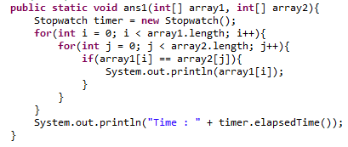
Solution1
Running Time??
public class Q1 {
public static void run(){
ans1(IOUtils.readSortedArray("resources\\q1\\arr1k_1.txt"),IOUtils.readSortedArray("resources\\q1\\arr1k_2.txt"));
}

Slide 5
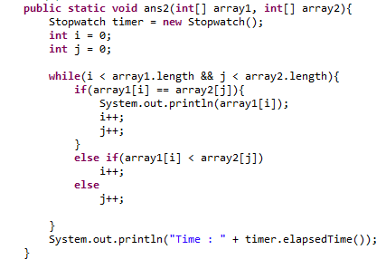
Solution1
Running Time??

Slide 6
Exercises 2
Local minimum of an array. Write a program that, given an array a[] of N distinct integers, finds a local minimum: an entry a[i] that is strictly less than its neighbors. Each internal entry (other than a[0] and a[N-1]) has 2 neighbors. Your program should use ~2 lg N compares in the worst case.

Slide 7
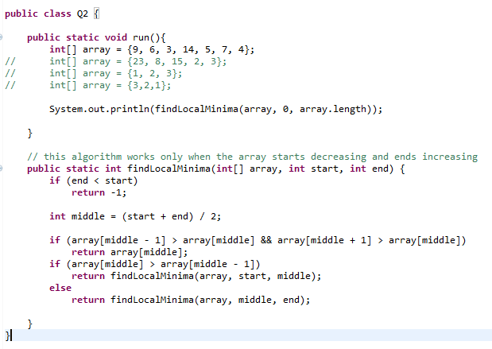
Solution 2
Running Time??

Slide 8
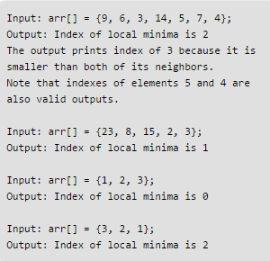
Solution 2

Slide 9
Exercises 3
Faster 3-sum. As a warmup, develop an implementation TwoSumFaster that uses a linear algorithm to count the pairs that sum to zero after the array is sorted (instead of the binary-search-based linearithmic algorithm). Then apply a similar idea to develop a quadratic algorithm for the 3-sum problem.

Slide 10
public static int twoSum(int[] array){
Stopwatch timer = new Stopwatch();
int count = 0;
for(int i = 0; i < array.length; i++)
for(int j = i + 1; j < array.length; j++)
if(array[i] + array[j] == 0){
count++;
}
System.out.println("Time : " + timer.elapsedTime());
Running Time??

Slide 11
public static int twoSumFast(int[] array){
Stopwatch timer = new Stopwatch();
int count = 0;
for(int i = 0; i < array.length; i++)
if(Algorithms.binarySearch(array, -array[i]) > i)
count++;
System.out.println("Time : " + timer.elapsedTime());
return count;
}
Running Time??

Slide 12
public static int twoSumFaster(int[] array){
Stopwatch timer = new Stopwatch();
int count = 0;
int start = 0;
int end = array.length - 1;
while(start < end){
if(array[start] + array[end] == 0){
count++;
start++;
end--;
}
else if(array[start] + array[end] > 0){
end--;
}
else
start++;
}
System.out.println("Time : " + timer.elapsedTime());
return count;
Running Time??

Slide 13
public static int threeSum(int[] array){
Stopwatch timer = new Stopwatch();
int count = 0;
for(int i = 0; i < array.length; i++)
for(int j = i + 1; j < array.length; j++)
for(int k = j + 1; k < array.length; k++)
if(array[i] + array[j] + array[k] == 0){
count++;
}
System.out.println("Time : " + timer.elapsedTime());
return count;
Running Time??

Slide 14
public static int threeSumFast(int[] array){
Stopwatch timer = new Stopwatch();
int count = 0;
for(int i = 0; i < array.length; i++)
for(int j = i + 1; j < array.length; j++)
if(Algorithms.binarySearch(array, -1 * (array[i] + array[j])) > j)
count++;
System.out.println("Time : " + timer.elapsedTime());
return count;
Running Time??

Slide 15
public static int threeSumFaster(int[] array){
Stopwatch timer = new Stopwatch();
int count = 0;
for(int i = 0; i < array.length - 2; i++){
int start = i + 1;
int end = array.length - 1;
while(start < end){
if(array[i] + array[start] + array[end] == 0){
count++;
end--;
start++;
}
else if(array[i] + array[start] + array[end] > 0)
end--;
else
start++;
}
}
System.out.println("Time : " + timer.elapsedTime());
return count;
Running Time??

