Slide 1
BBM 204 Algorithms Lab
Recitation 2: Merge and Quick Sort
Işıl Karabey

Slide 2
Index
Sorting
Merge Sort
Quick Sort
Implementation of Merge Sort
Implementation of Quick Sort

Slide 3
Merge Sort
Source: https://ocw.mit.edu/courses/electrical-engineering-and-computer-science/6-006-introduction-to-algorithms-fall-2011/lecture-videos/MIT6_006F11_lec03.pdf

Slide 4
Split and Merge
Source: http://www.cs.umd.edu/~meesh/351/mount/lectures/lect6-divide-conquer-mergesort.pdf

Slide 5
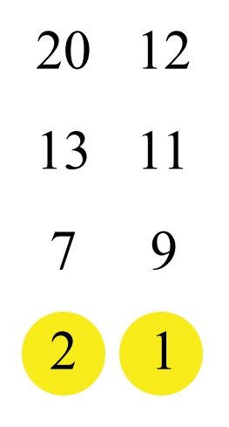
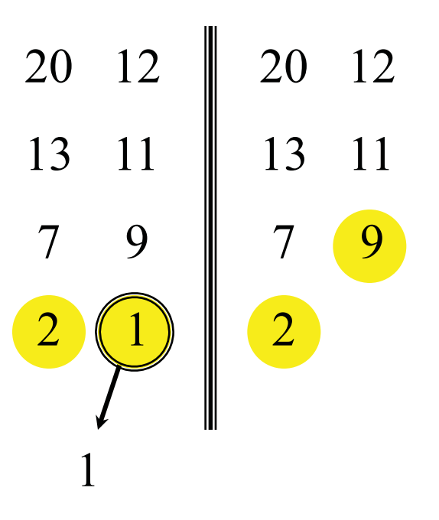
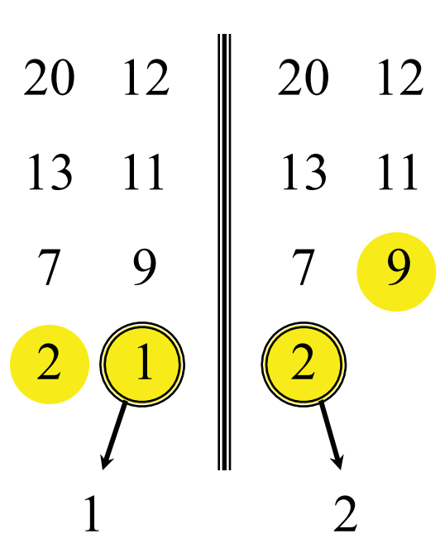
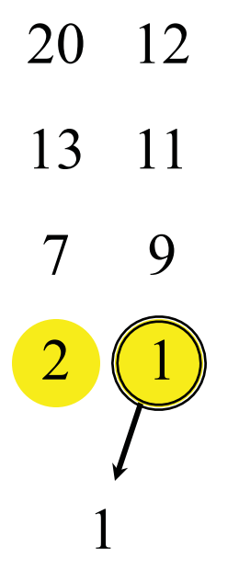
Merging two sorted arrays-1
Source: https://ocw.mit.edu/courses/electrical-engineering-and-computer-science/6-006-introduction-to-algorithms-fall-2011/lecture-videos/MIT6_006F11_lec03.pdf

Slide 6
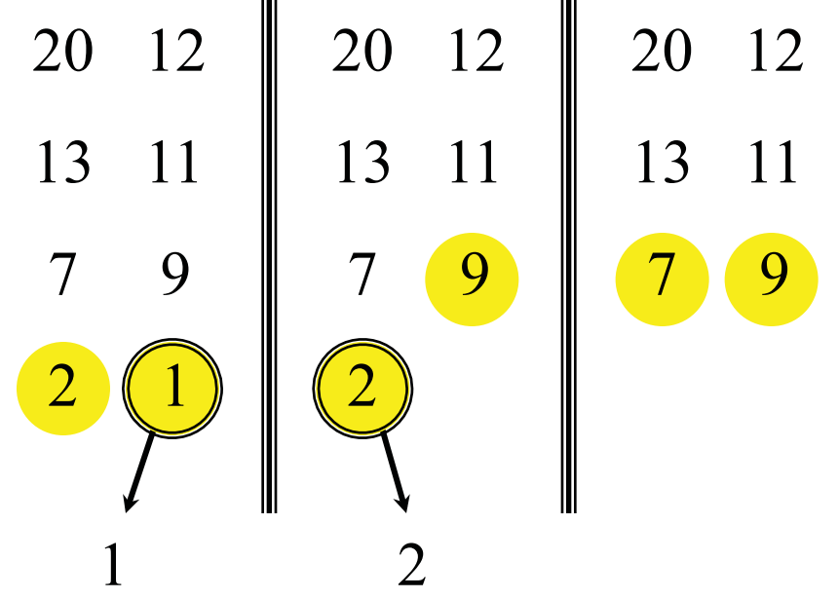
Merging two sorted arrays-2
Source: https://ocw.mit.edu/courses/electrical-engineering-and-computer-science/6-006-introduction-to-algorithms-fall-2011/lecture-videos/MIT6_006F11_lec03.pdf

Slide 7
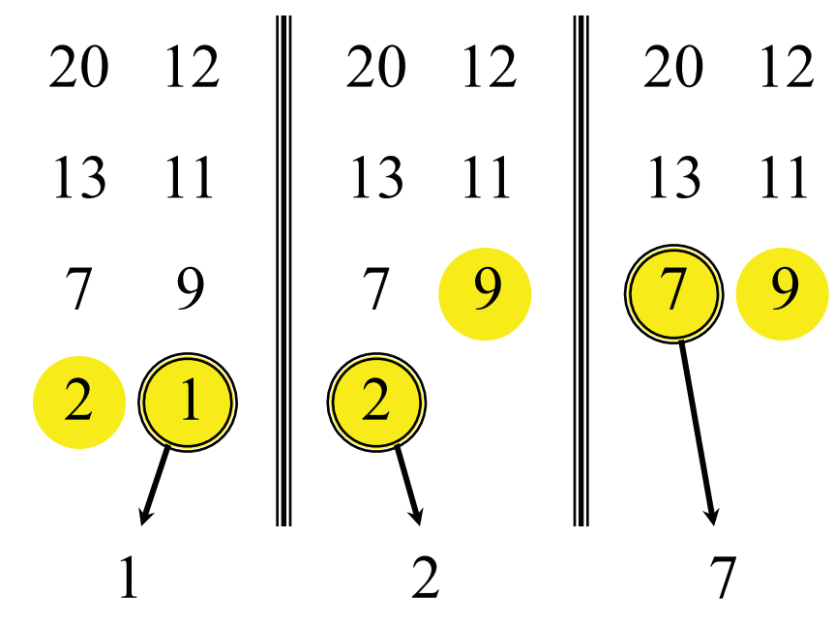
Merging two sorted arrays-3
Source: https://ocw.mit.edu/courses/electrical-engineering-and-computer-science/6-006-introduction-to-algorithms-fall-2011/lecture-videos/MIT6_006F11_lec03.pdf

Slide 8
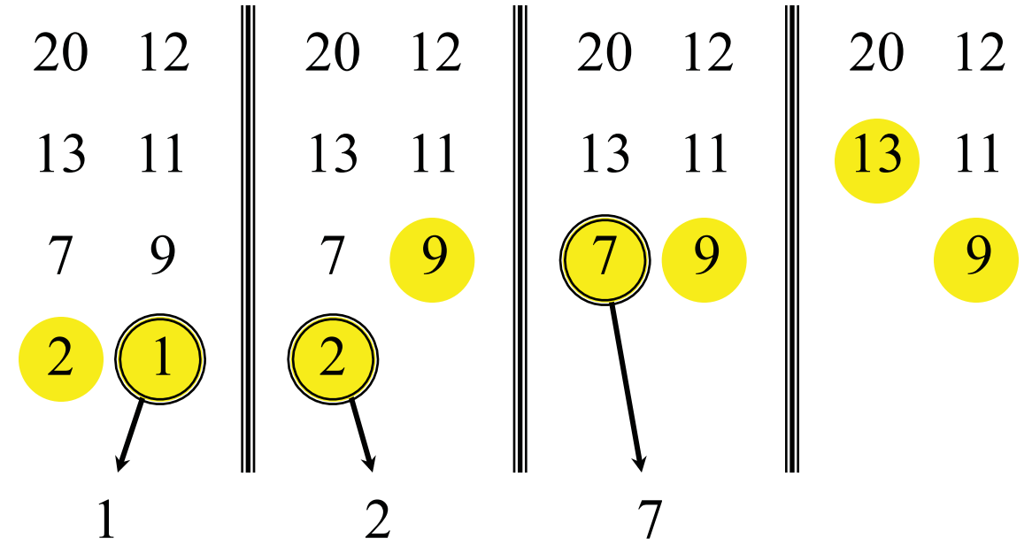
Merging two sorted arrays-4
Source: https://ocw.mit.edu/courses/electrical-engineering-and-computer-science/6-006-introduction-to-algorithms-fall-2011/lecture-videos/MIT6_006F11_lec03.pdf

Slide 9
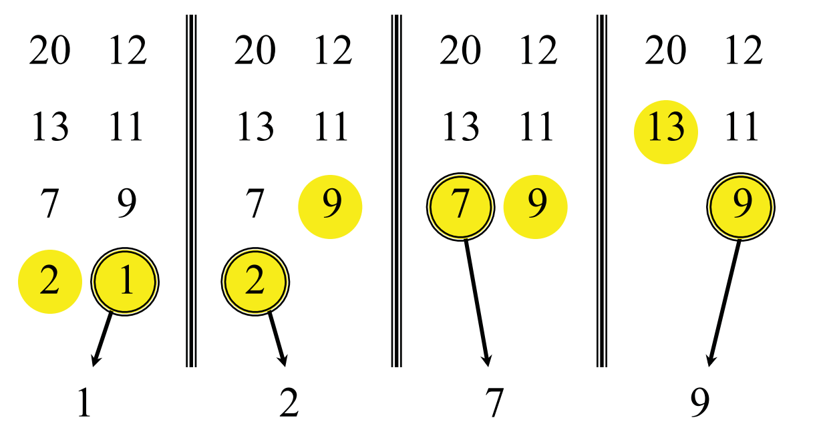
Merging two sorted arrays-5
Source: https://ocw.mit.edu/courses/electrical-engineering-and-computer-science/6-006-introduction-to-algorithms-fall-2011/lecture-videos/MIT6_006F11_lec03.pdf

Slide 10
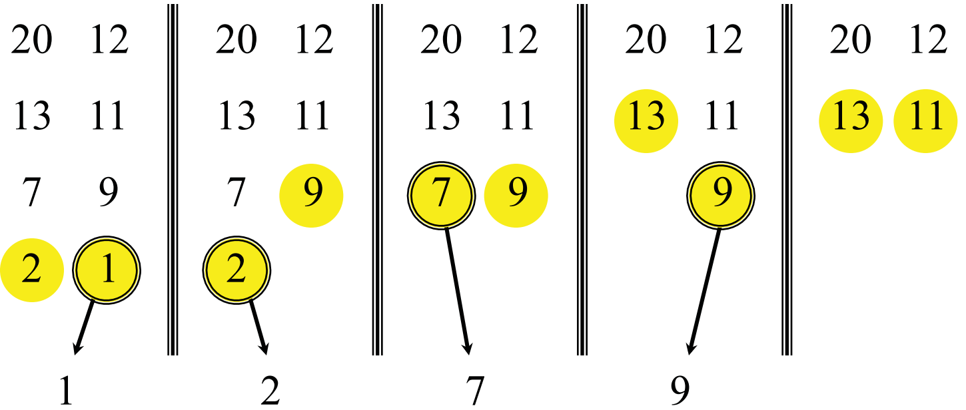
Merging two sorted arrays-6
Source: https://ocw.mit.edu/courses/electrical-engineering-and-computer-science/6-006-introduction-to-algorithms-fall-2011/lecture-videos/MIT6_006F11_lec03.pdf

Slide 11
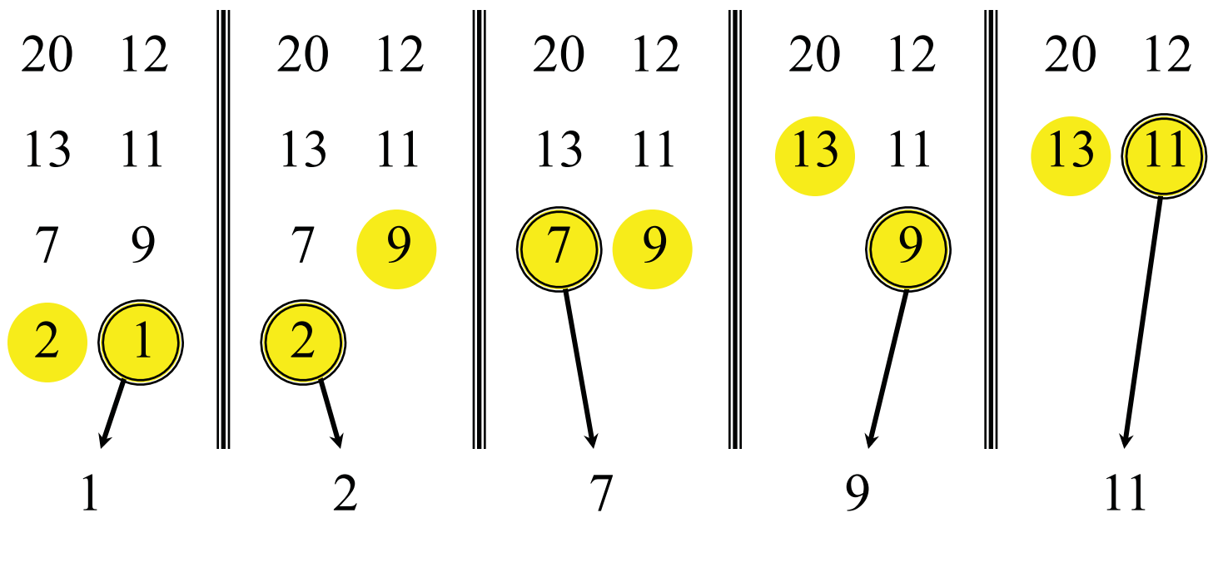
Merging two sorted arrays-7
Source: https://ocw.mit.edu/courses/electrical-engineering-and-computer-science/6-006-introduction-to-algorithms-fall-2011/lecture-videos/MIT6_006F11_lec03.pdf

Slide 12
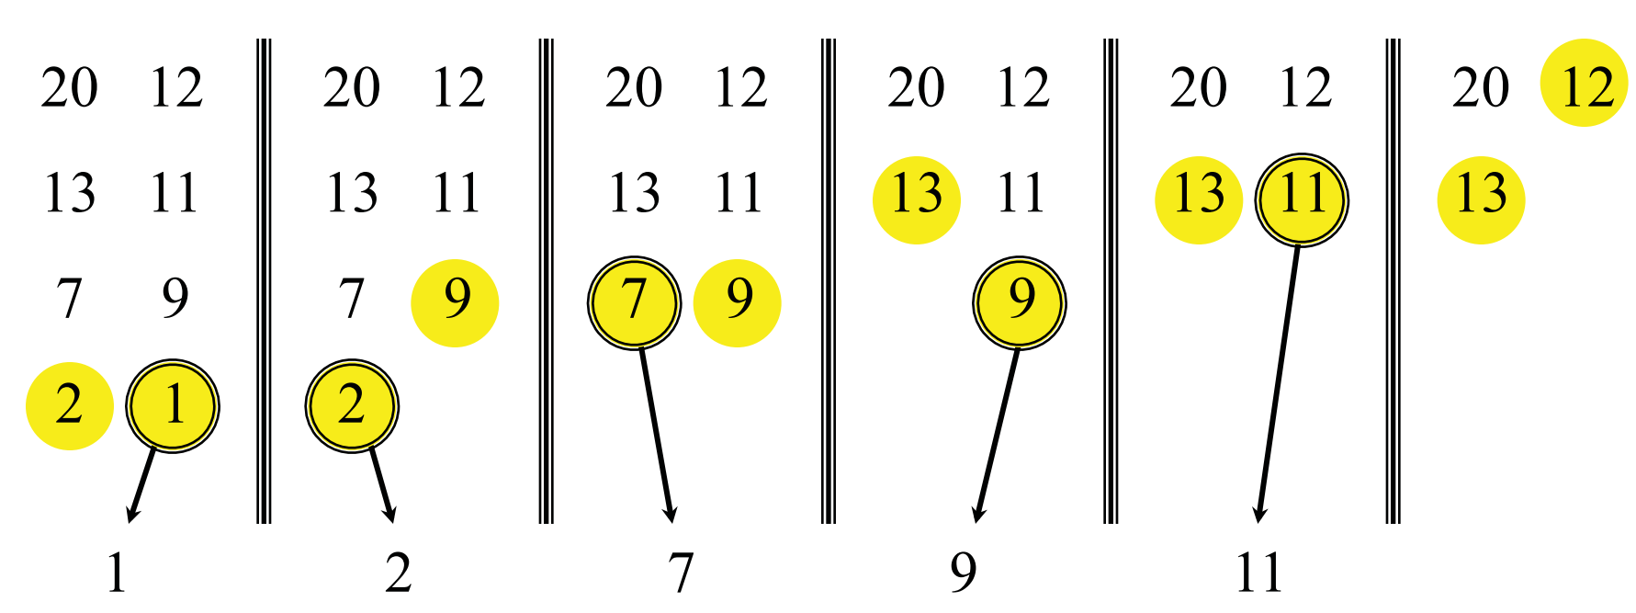
Merging two sorted arrays-8
Source: https://ocw.mit.edu/courses/electrical-engineering-and-computer-science/6-006-introduction-to-algorithms-fall-2011/lecture-videos/MIT6_006F11_lec03.pdf

Slide 13
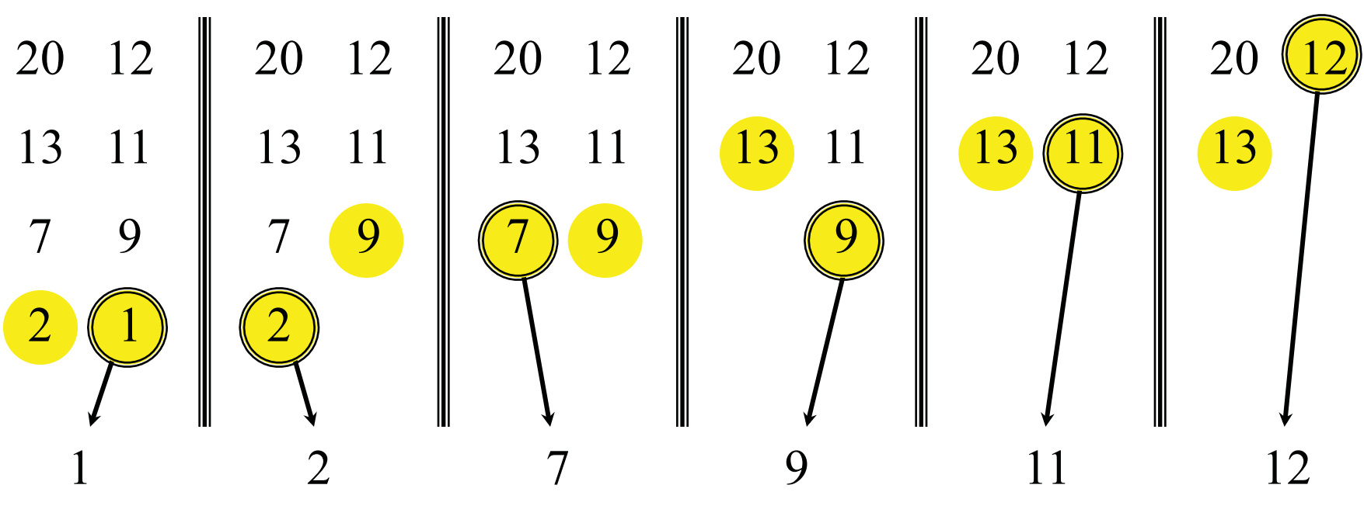
Merging two sorted arrays-9
Source: https://ocw.mit.edu/courses/electrical-engineering-and-computer-science/6-006-introduction-to-algorithms-fall-2011/lecture-videos/MIT6_006F11_lec03.pdf

Slide 14
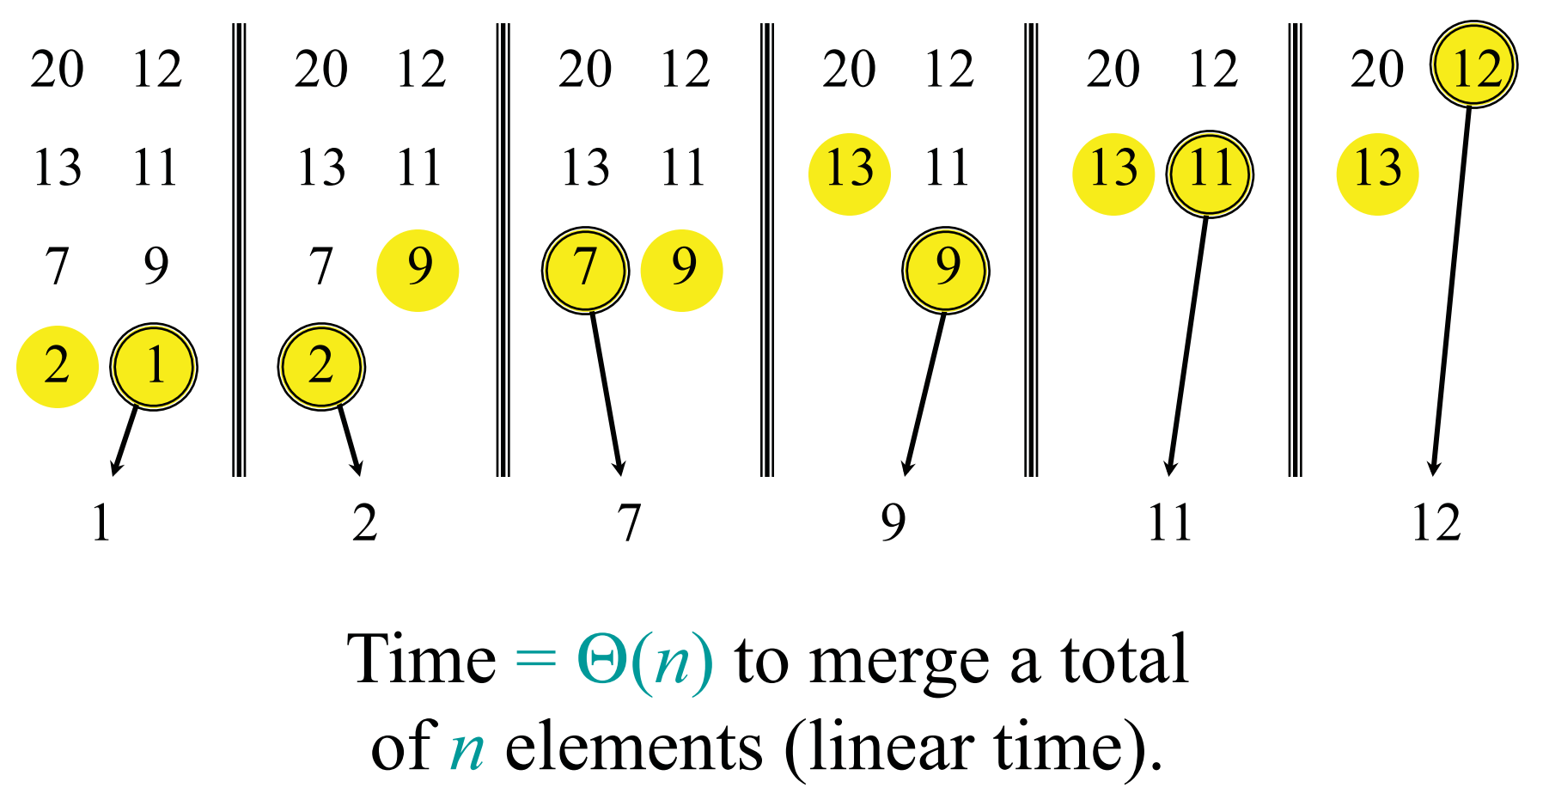
Merging two sorted arrays-10
Source: https://ocw.mit.edu/courses/electrical-engineering-and-computer-science/6-006-introduction-to-algorithms-fall-2011/lecture-videos/MIT6_006F11_lec03.pdf

Slide 15
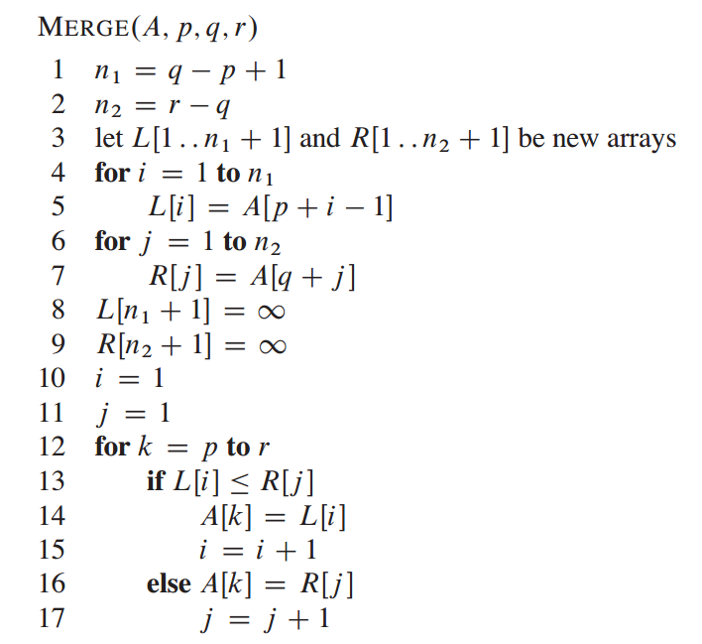
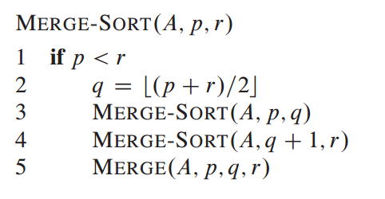
Pseudocode of Merge Sort
Source: http://ce.bonabu.ac.ir/uploads/30/CMS/user/file/115/EBook/Introduction.to.Algorithms.3rd.Edition.Sep.2010.pdf

Slide 16
Exercise-1
3-way mergesort: Suppose instead of dividing in half at each step, you divide into thirds, and combine using 3-way merge. What is the order of growth of the running time of this algorithm?
Source: Algorithms, 4th Edition, R. Sedgewick and K. Wayne, Addison-Wesley Professional, 2011 (Chapter 2, Experiments 2.2.22, pp. 286)

Slide 17
Quick Sort
Source: http://homepage.divms.uiowa.edu/~hzhang/c31/notes/ch08.pdf

Slide 18
Example
Source: https://ece.uwaterloo.ca/~cmoreno/ece250/quick-sort-complete-example.pdf

Slide 19
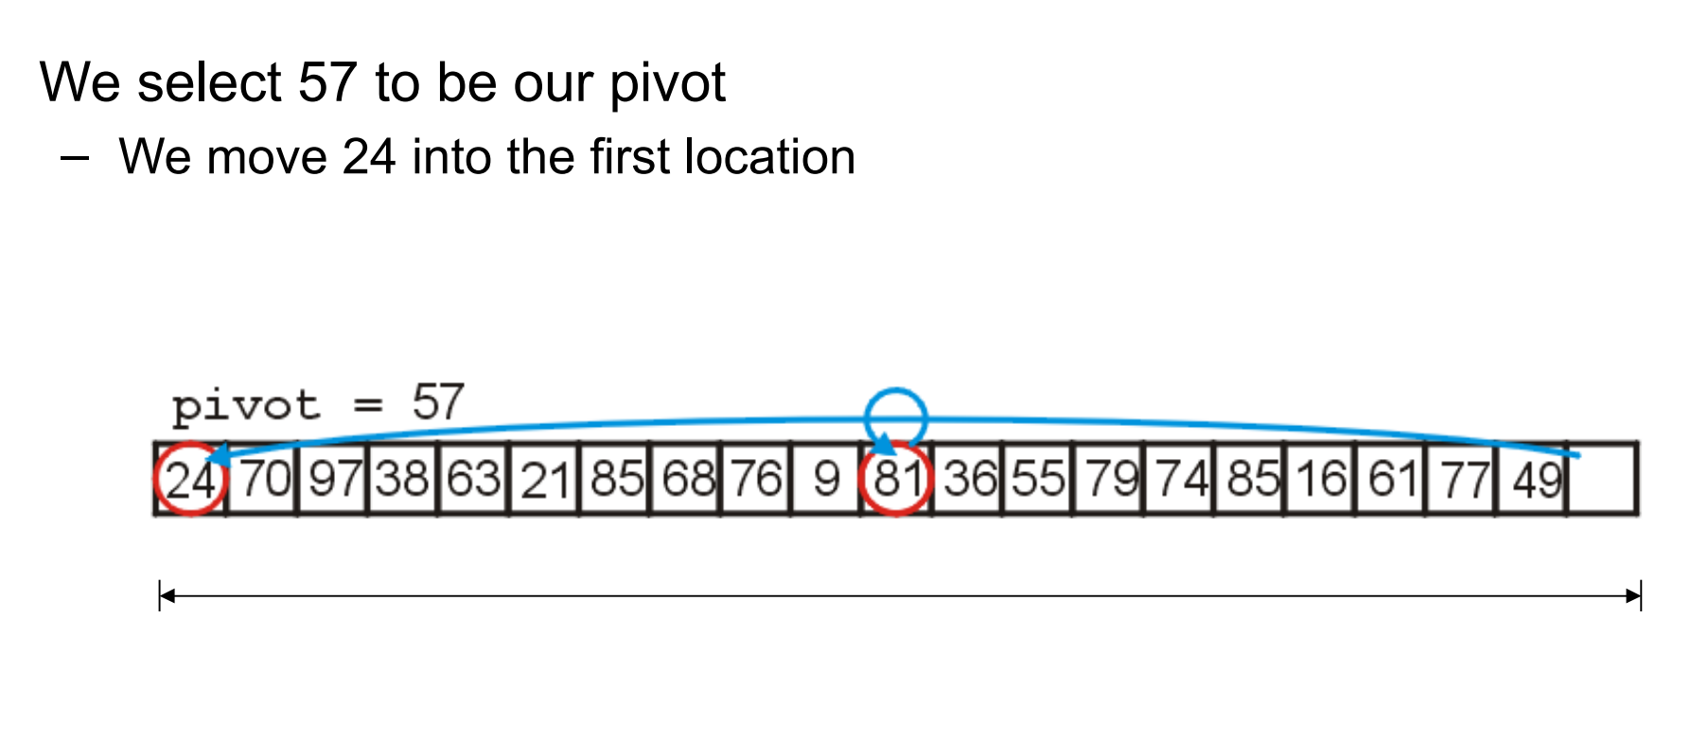
Example (cont.)
Source: https://ece.uwaterloo.ca/~cmoreno/ece250/quick-sort-complete-example.pdf

Slide 20
Example (cont.)
Source: https://ece.uwaterloo.ca/~cmoreno/ece250/quick-sort-complete-example.pdf

Slide 21
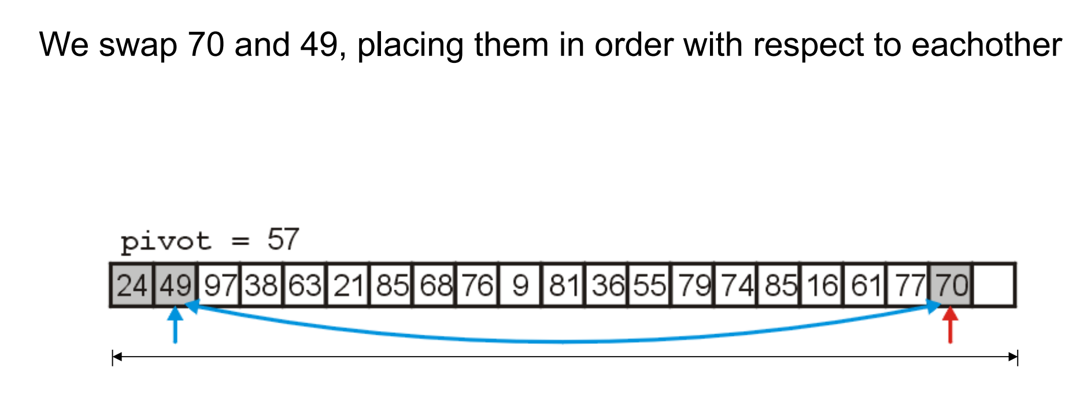
Example (cont.)
Source: https://ece.uwaterloo.ca/~cmoreno/ece250/quick-sort-complete-example.pdf

Slide 22
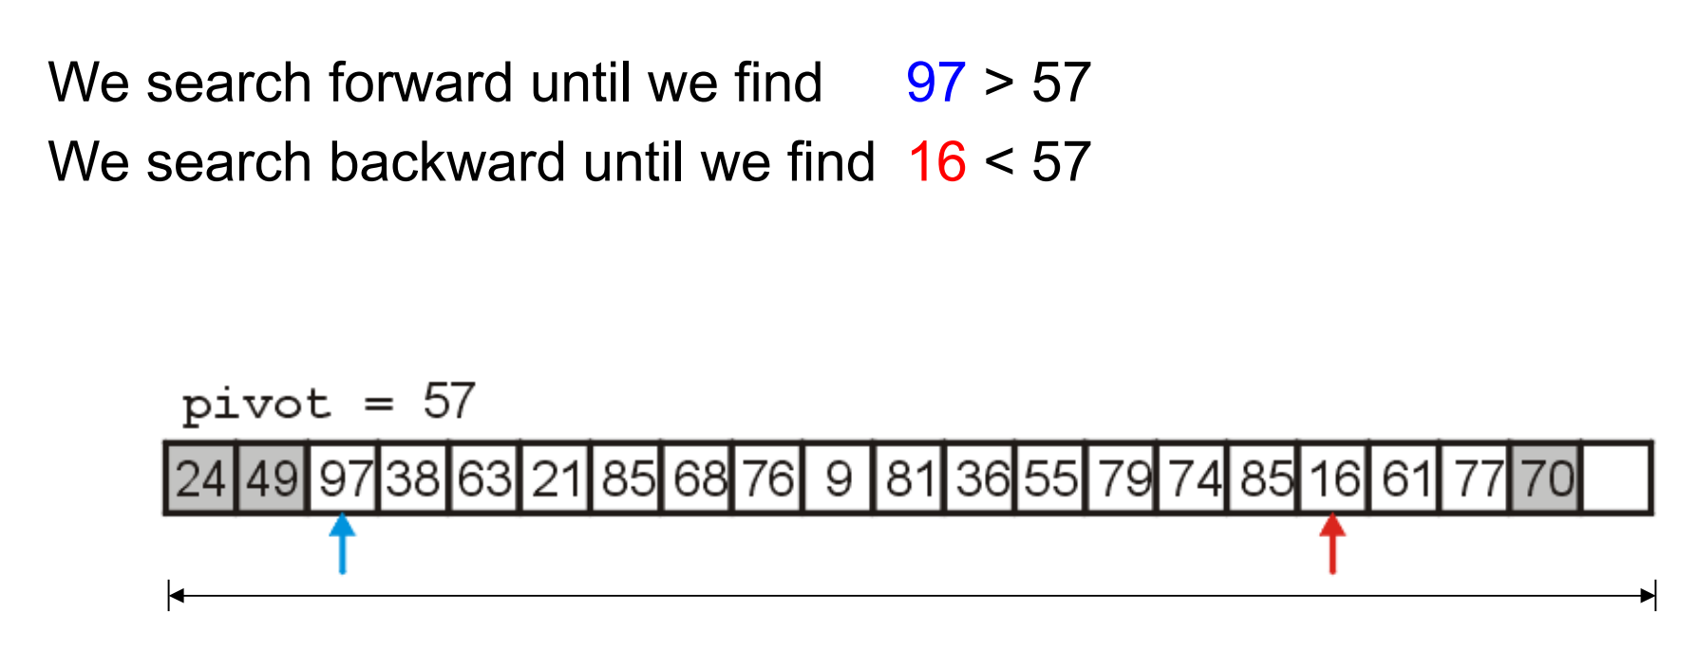
Example (cont.)
Source: https://ece.uwaterloo.ca/~cmoreno/ece250/quick-sort-complete-example.pdf

Slide 23
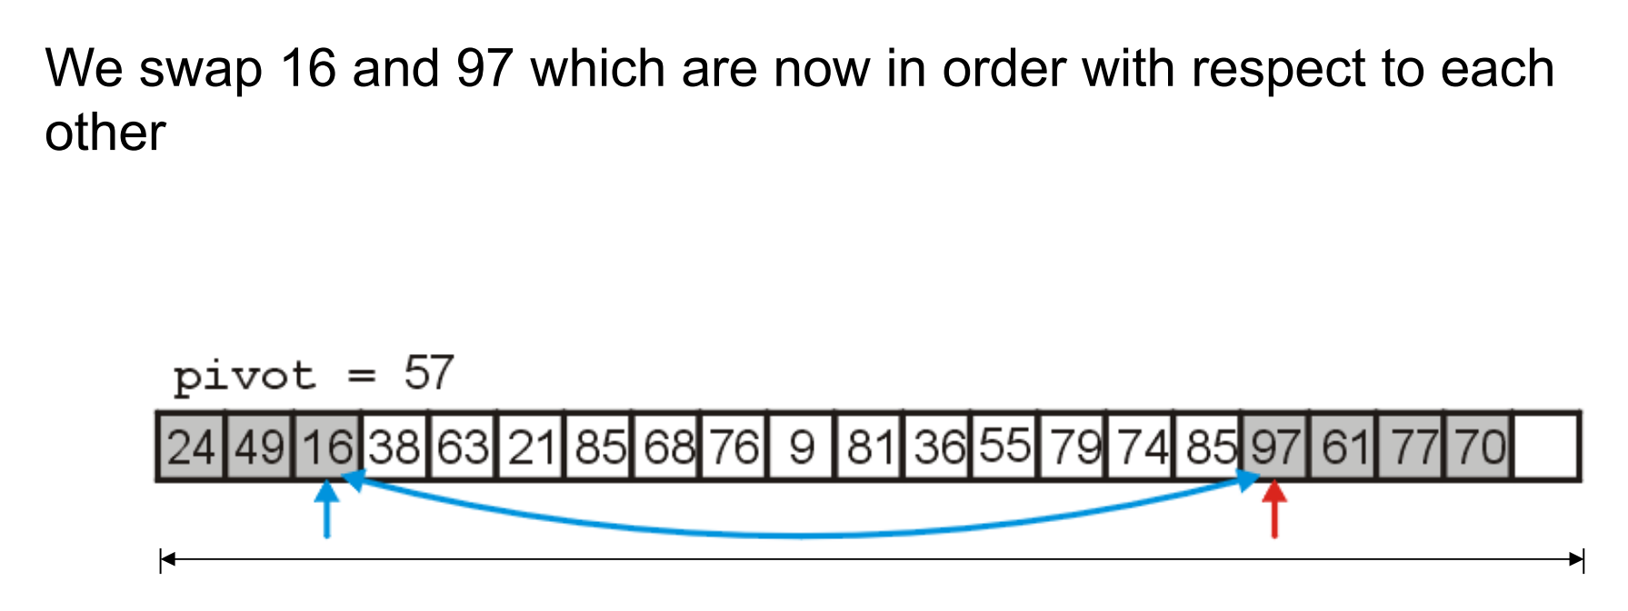
Example (cont.)
Source: https://ece.uwaterloo.ca/~cmoreno/ece250/quick-sort-complete-example.pdf

Slide 24
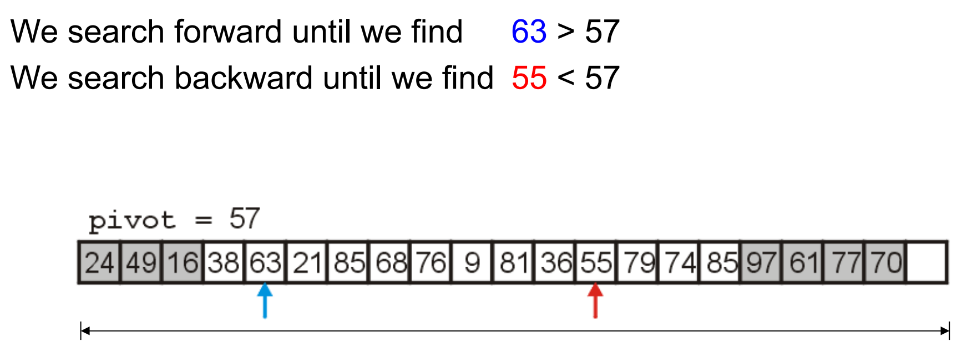
Example (cont.)
Source: https://ece.uwaterloo.ca/~cmoreno/ece250/quick-sort-complete-example.pdf

Slide 25
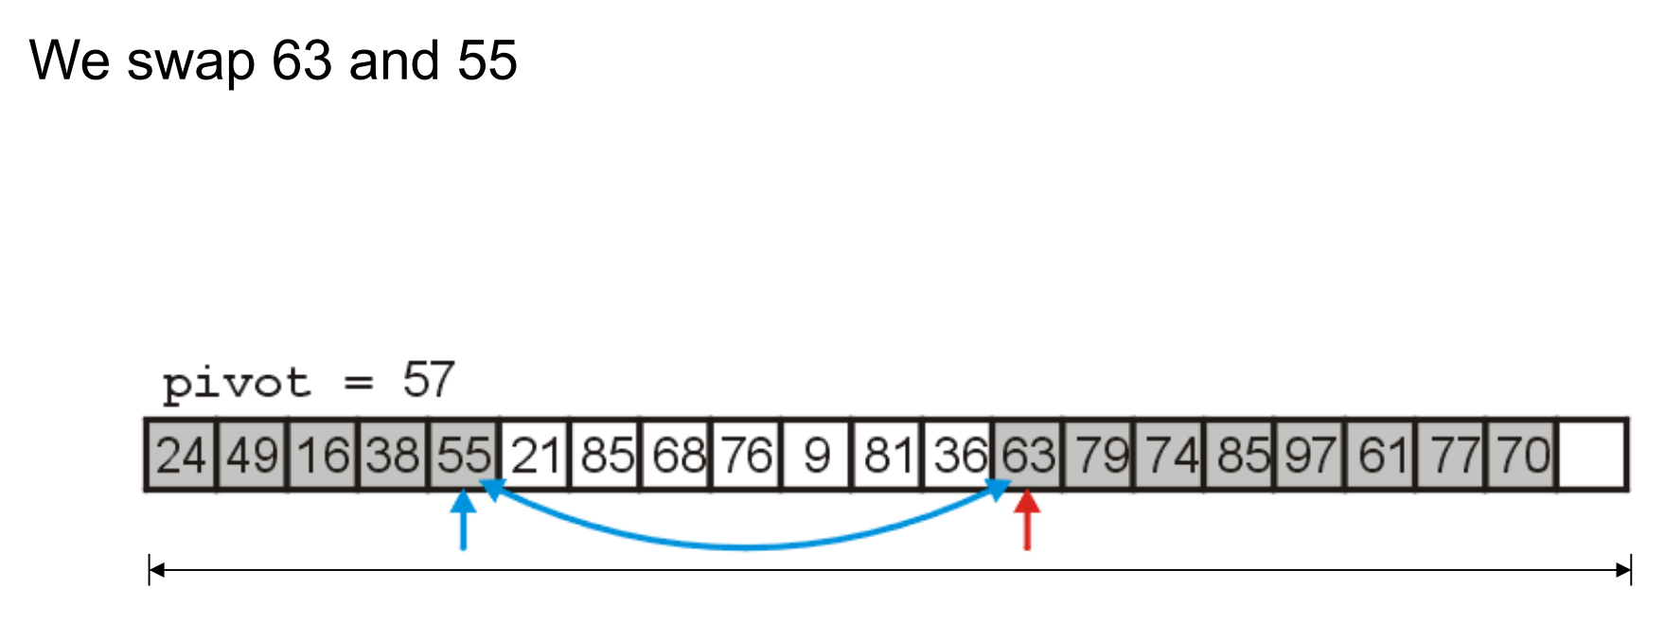
Example (cont.)
Source: https://ece.uwaterloo.ca/~cmoreno/ece250/quick-sort-complete-example.pdf

Slide 26
Example (cont.)
Source: https://ece.uwaterloo.ca/~cmoreno/ece250/quick-sort-complete-example.pdf

Slide 27
Example (cont.)
Source: https://ece.uwaterloo.ca/~cmoreno/ece250/quick-sort-complete-example.pdf

Slide 28
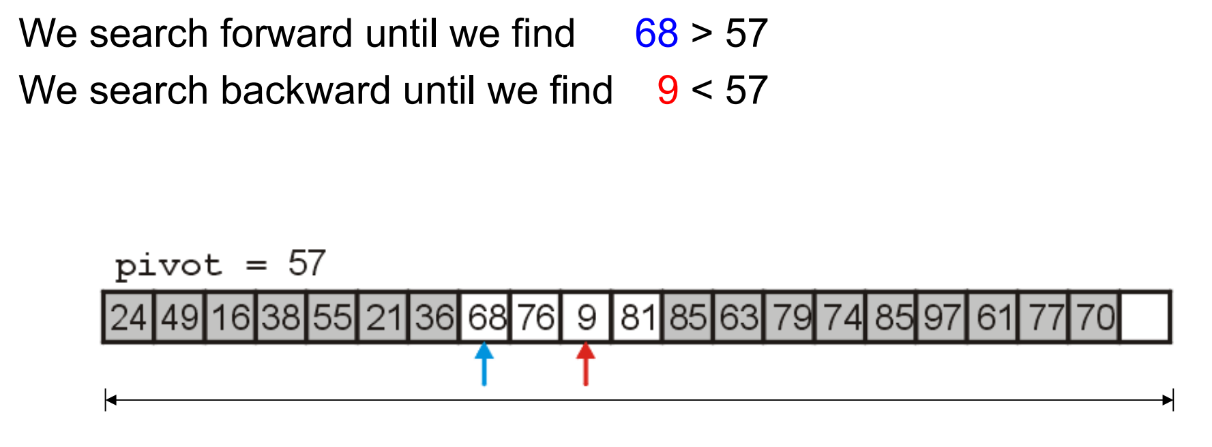
Example (cont.)
Source: https://ece.uwaterloo.ca/~cmoreno/ece250/quick-sort-complete-example.pdf

Slide 29
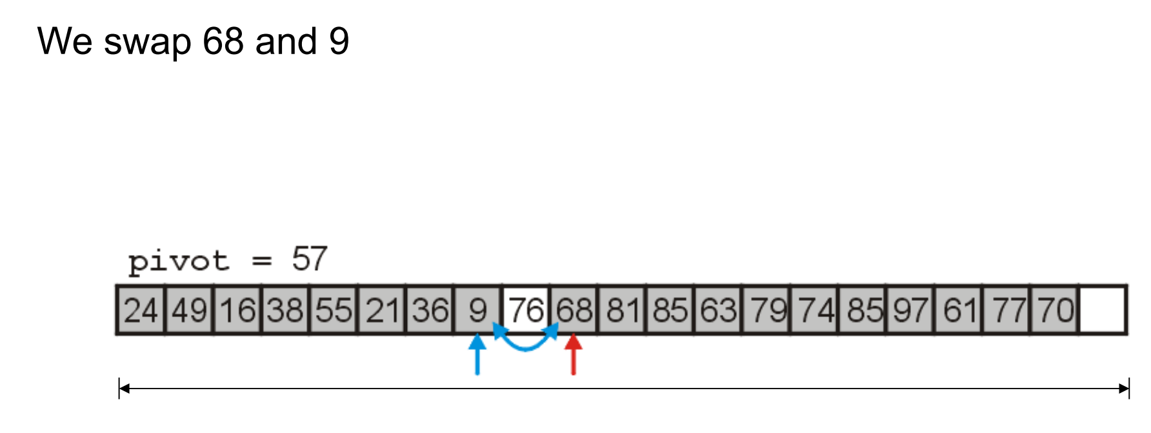
Example (cont.)
Source: https://ece.uwaterloo.ca/~cmoreno/ece250/quick-sort-complete-example.pdf

Slide 30
Example (cont.)
Source: https://ece.uwaterloo.ca/~cmoreno/ece250/quick-sort-complete-example.pdf

Slide 31
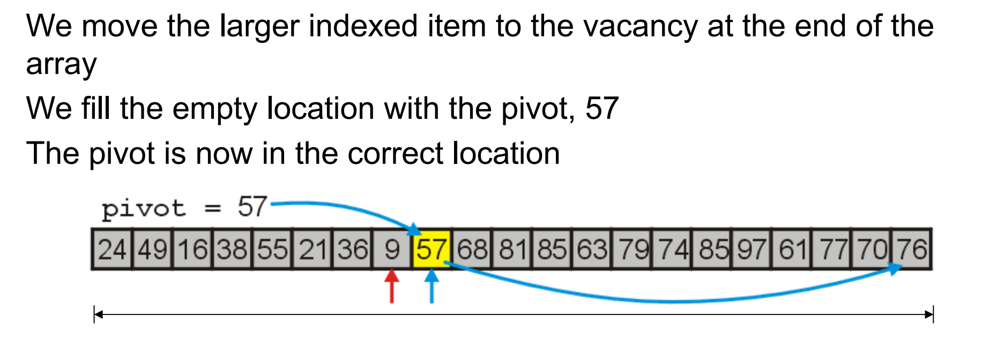
Example (cont.)
Source: https://ece.uwaterloo.ca/~cmoreno/ece250/quick-sort-complete-example.pdf

Slide 32
Example (cont.)
Source: https://ece.uwaterloo.ca/~cmoreno/ece250/quick-sort-complete-example.pdf

Slide 33
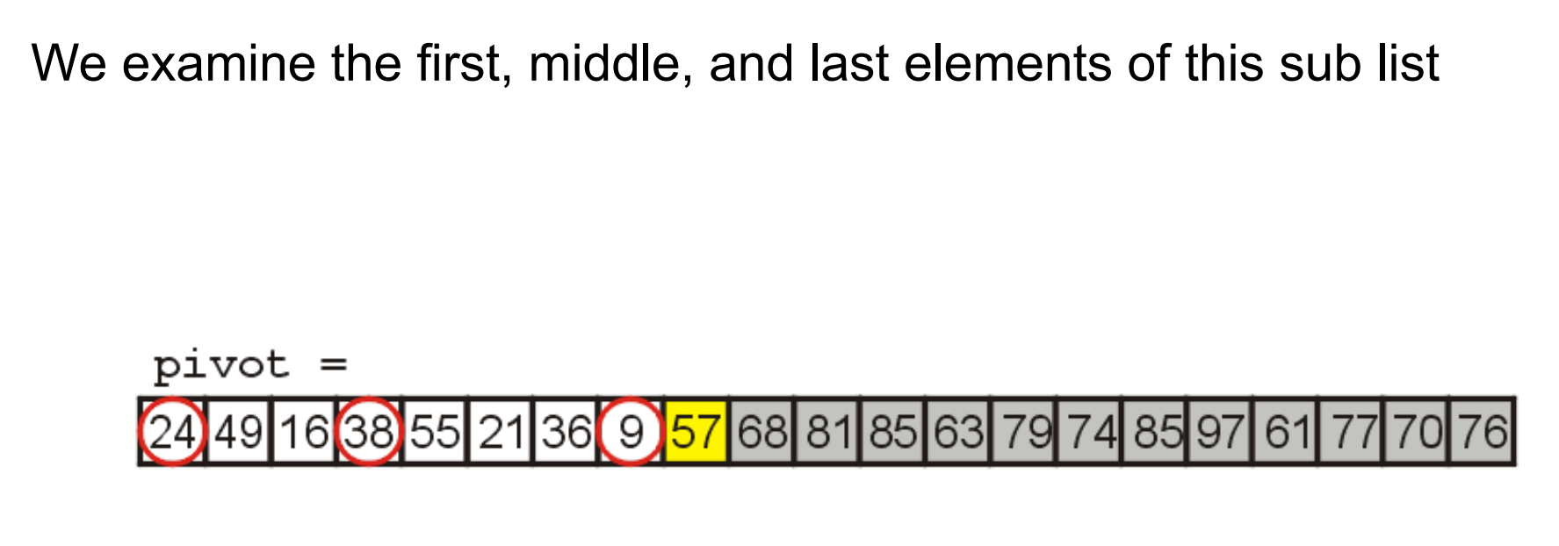
Example (cont.)
Source: https://ece.uwaterloo.ca/~cmoreno/ece250/quick-sort-complete-example.pdf

Slide 34
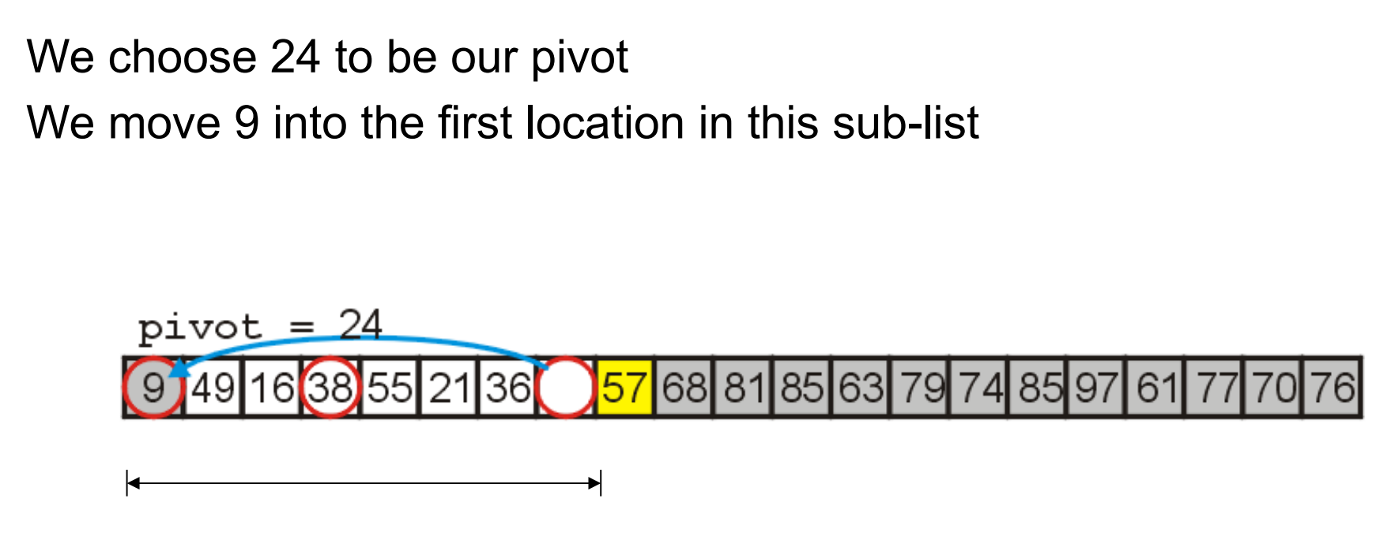
Example (cont.)
Source: https://ece.uwaterloo.ca/~cmoreno/ece250/quick-sort-complete-example.pdf

Slide 35
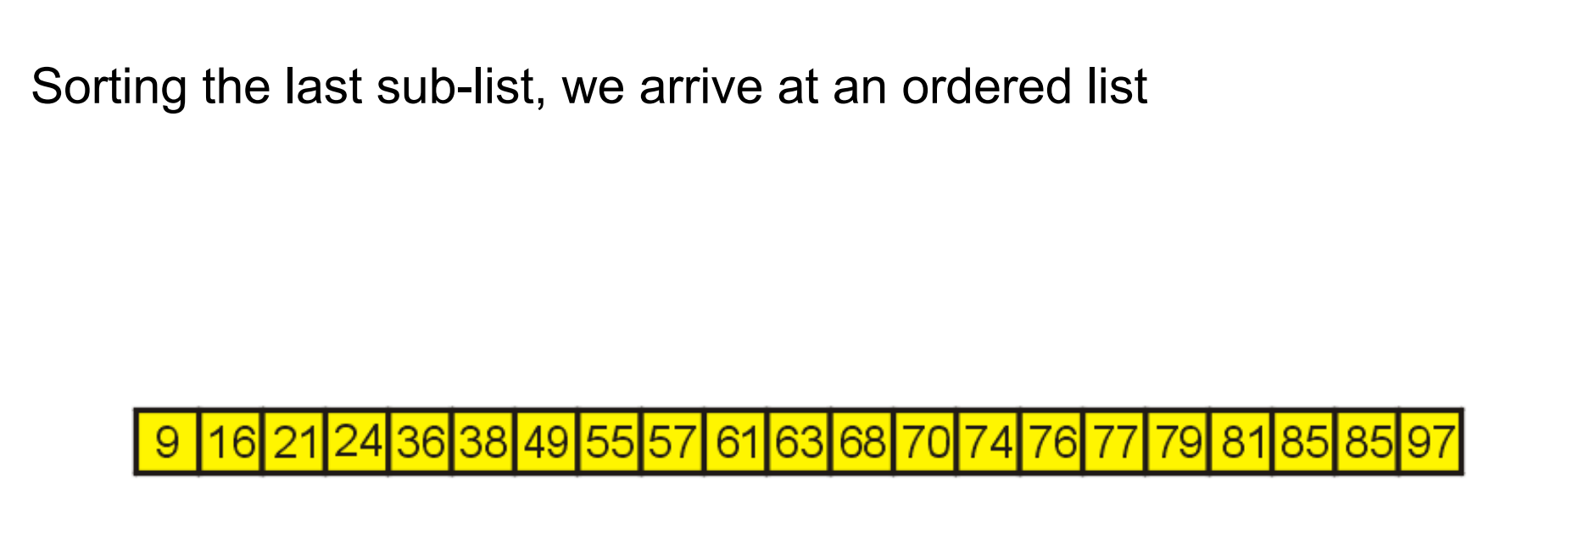
Example (..cont)
Source: https://ece.uwaterloo.ca/~cmoreno/ece250/quick-sort-complete-example.pdf

Slide 36
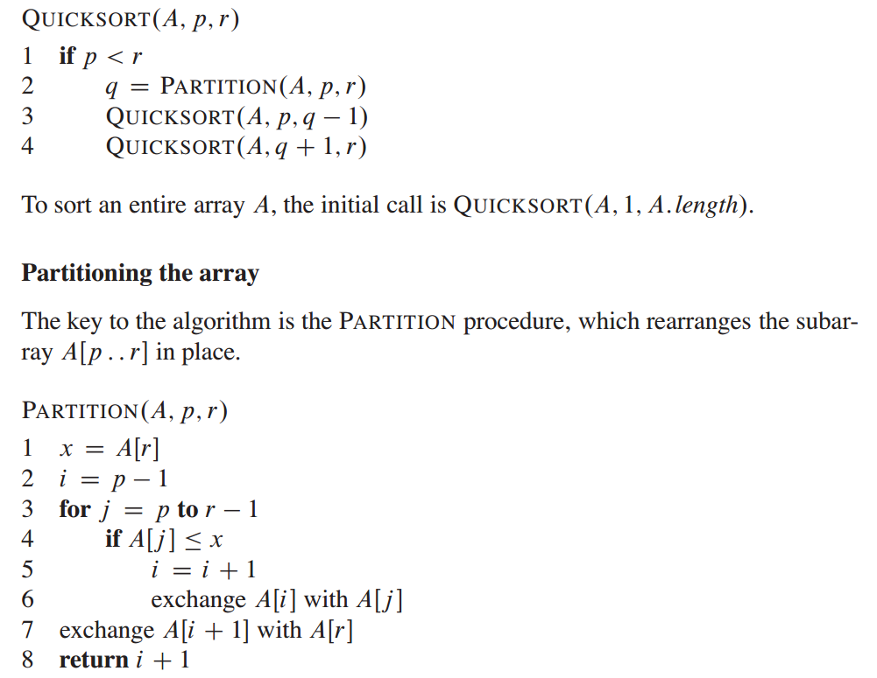
Pseudocode of Quick Sort
Source: http://ce.bonabu.ac.ir/uploads/30/CMS/user/file/115/EBook/Introduction.to.Algorithms.3rd.Edition.Sep.2010.pdf

Slide 37
Exercise-2
Nuts and bolts. (G. J. E. Rawlins): You have a mixed pile of N nuts and N bolts and need to quickly ﬁnd the corresponding pairs of nuts and bolts. Each nut matches exactly one bolt, and each bolt matches exactly one nut. By ﬁtting a nut and bolt together, you can see which is bigger, but it is not possible to directly compare two nuts or two bolts. Give an efﬁcient method for solving the problem.
Source: Algorithms, 4th Edition, R. Sedgewick and K. Wayne, Addison-Wesley Professional, 2011 (Chapter 2, Experiments 2.2.25, pp. 287)

