Slide 1
Recitation 3 (Heap Sort and Binary Search Tree)
10.03.2017

Slide 2
Heap Sort
In this sorting algorithm,first build a heap using the given elements.
If we want to sort the elements in ascending order,we create a Min Heap
And to sort the elements in descending order,we create a Max Heap

Slide 3
Priority Queue
Definition: A priority queue is a data structure of items with keys which supports two basic operations: insert a new item, and remove the item with the largest key.
(The above definition is assuming a maximizing priority queue. In a minimizing priority queue, the remove operation would remove the item with the smallest key. For these notes, we assume a maximizing priority queue).
It means remove the largest or smallest item.

Slide 4
Binary Trees
Recursive definition
An empty tree is a binary tree
A node with two child subtrees is a binary tree
All the numbers on the left of the root are smaller than the root and all the numbers on the right are bigger than the root.
Is this a binary tree?
56
26
200
18
28
190
213
12
24
27

Slide 5
Exercises 1
Suppose that the sequence P R I O * R * * I * T * Y * * * Q U E * * *U * E
(where a letter means insert and an asterisk means remove the maximum) is
applied to an initially empty priority queue. Give the sequence of letters returned by the remove the maximum operations.

Slide 6
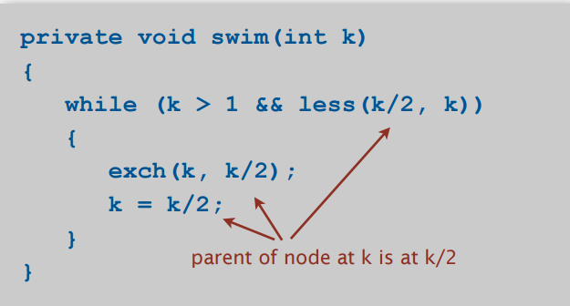
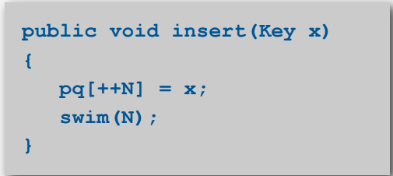
Insertion

Slide 7
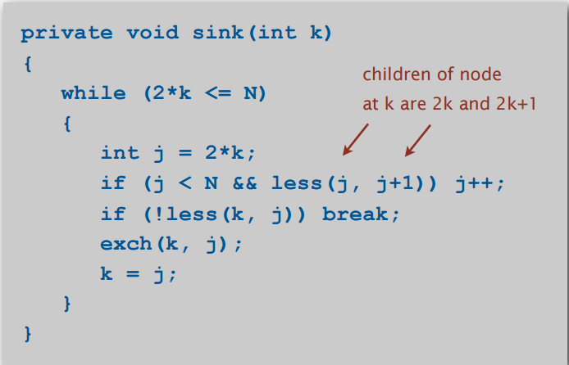
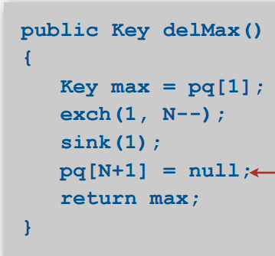
Deletion

Slide 8
P→P
R→R [P]
I→R [P I]
O→R [P [O] I]
*→P [O I]
R→R [P [O] I]
*→P [O I]
*→O [I]
I→O [I I]
*→I [I]
T→Y [I I]
*→I [I]
*→I

Slide 9
*→
Q→Q
U→U [Q]
E→U [Q E]
*→Q [E]
*→E
*→
U→U
*→
E→E

Slide 10
Solution
RRPOTYIIUQEU

Slide 11
Exercises 2
Using the conventions of Exercise 2, give the sequence of heaps produced when the operations P R I O * R * * I * T * Y * * * Q U E * * * U * E are performed on an initially empty max-oriented heap.

Slide 12
Solution
E

Slide 13
Exercises 3
Draw the BST that results when you insert the keys E A S Y Q U E S T I O N, in that order (associationg the value i with the ith key, as per the convention in the text) into an initially empty tree. How many compares are needed to build the tree?

Slide 14
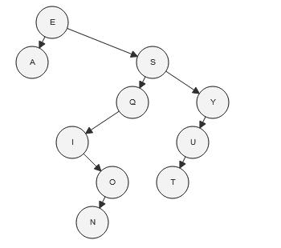
Solution
The total number of comparisons made to build binary search tree is 28(1+1+2+2+3+1+2+4+3+4+5).

Slide 15
Exercises 4
Level-order traversal. Write a method printLevel() that takes a Node as argument and
prints the keys in the subtree rooted at that node in level order (in order of their distance from the root, with nodes on each level in order from left to right). Hint: Use a Queue.

Slide 16
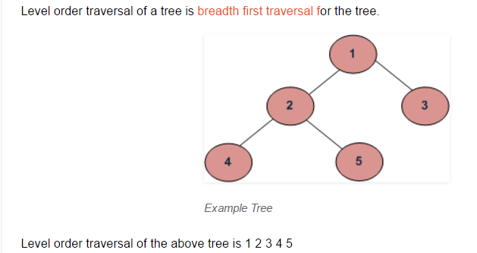
BFS is an algorithm for traversing or searching tree or graph data structures.It starts at the root and explores
the neighbour nodes first,before moving to the next level neighbours.

Slide 17
Algorithm of the level order traversal
For each node, first the node is visited and then it’s child nodes are put in a FIFO queue.
printLevelorder(tree) 1) Create an empty queue q 2) temp_node = root /*start from root*/ 3) Loop while temp_node is not NULL a) print temp_node->data. b) Enqueue temp_node’s children (first left then right children) to q c) Dequeue a node from q and assign it’s value to temp_node

Slide 18
