Slide 1
BBM 204 Algorithms Lab
Recitation 4
2-3 search trees
Red-black BSTs
Işıl Karabey

Slide 2
Index
Balanced Search Trees
2-3 search trees
Red-black BSTs
Exercises for 2-3 and Red-black trees

Slide 3
Why do we need a balanced tree?
Source: http://ee.usc.edu/~redekopp/cs104/slides/L19_BalancedBST_23.pdf

Slide 4
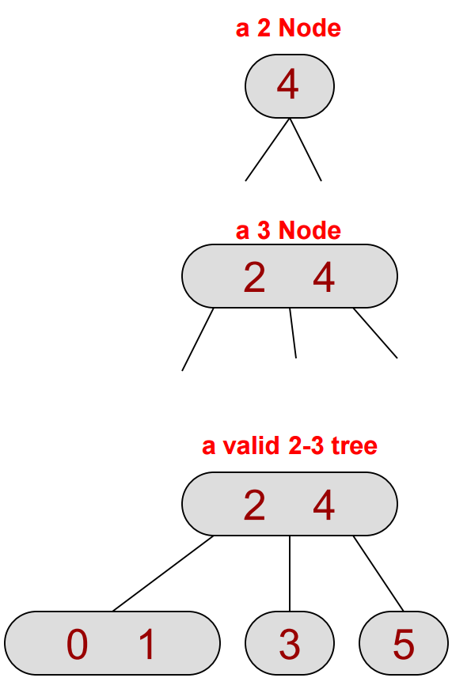
2-3 Search Trees
Each internal node has either 2 or 3 children
All leaves are at the same level
Find, insert and remove operations take O(logn) time
Source: http://ee.usc.edu/~redekopp/cs104/slides/L19_BalancedBST_23.pdf

Slide 5
2-3 Search Trees
Source: http://ee.usc.edu/~redekopp/cs104/slides/L19_BalancedBST_23.pdf

Slide 6
Exercise-1: 2-3 Insertion
Draw the 2-3 tree that results when you insert the keys
E A S Y Q U T I O N
in that order into an initially empty tree
Source: Algorithms, 4th Edition, R. Sedgewick and K. Wayne, Addison-Wesley Professional, 2011 (Chapter 3, Exercises 3.3.1, pp. 449)

Slide 7
Exercise-2 (Your turn ☺)
Draw the 2-3 tree that results when you insert the keys
Y L P M X H C R A E S
in that order into an initially empty tree
Source: Algorithms, 4th Edition, R. Sedgewick and K. Wayne, Addison-Wesley Professional, 2011 (Chapter 3, Exercises 3.3.2, pp. 449)

Slide 8
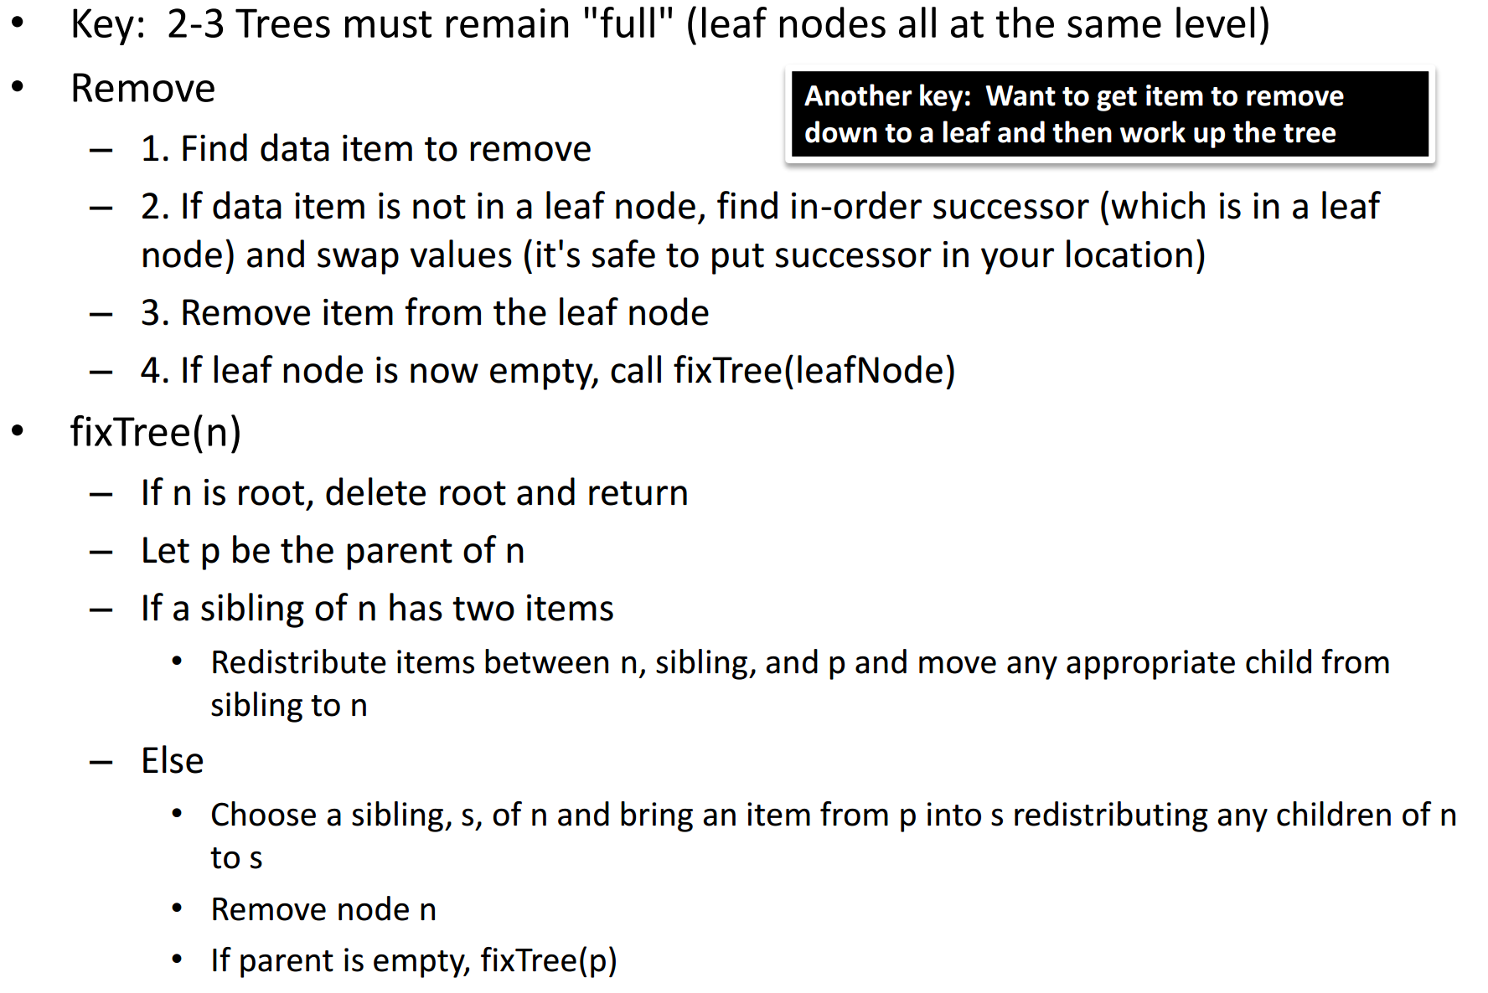
2-3 Search Tree Removal
Source: http://ee.usc.edu/~redekopp/cs104/slides/L19_BalancedBST_23.pdf

Slide 9
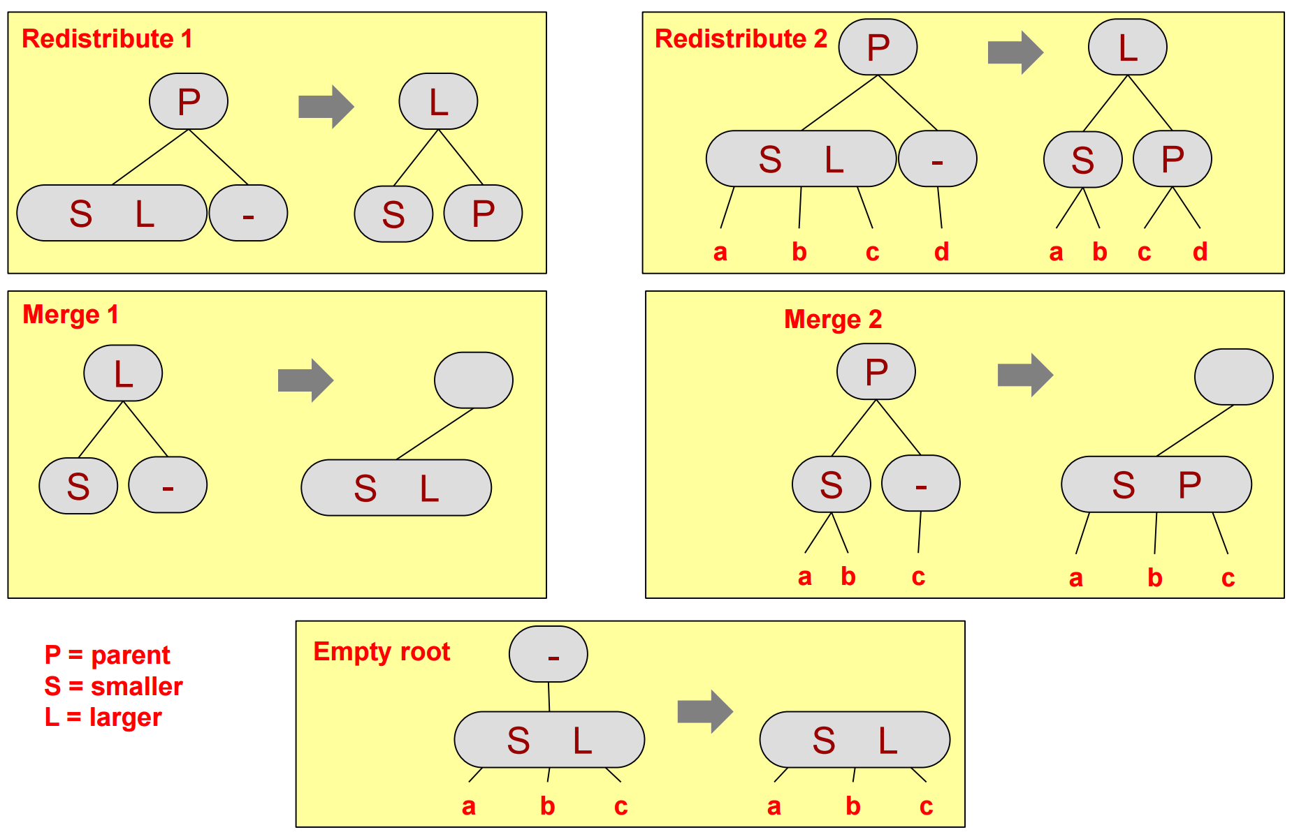
Remove cases of 2-3 Trees
Source: http://ee.usc.edu/~redekopp/cs104/slides/L19_BalancedBST_23.pdf

Slide 10
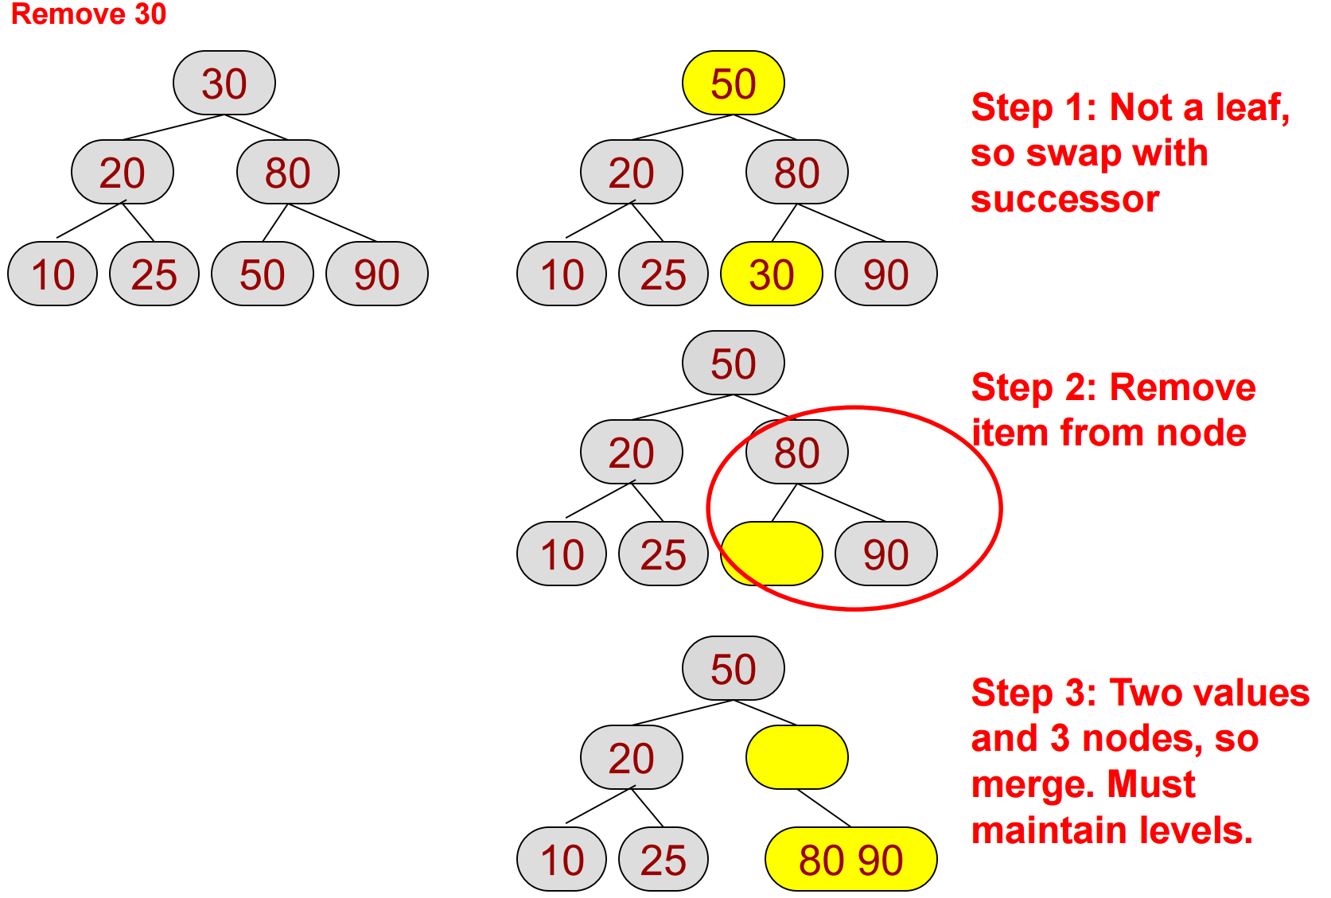
Remove Exercise 1
Source: http://ee.usc.edu/~redekopp/cs104/slides/L19_BalancedBST_23.pdf

Slide 11
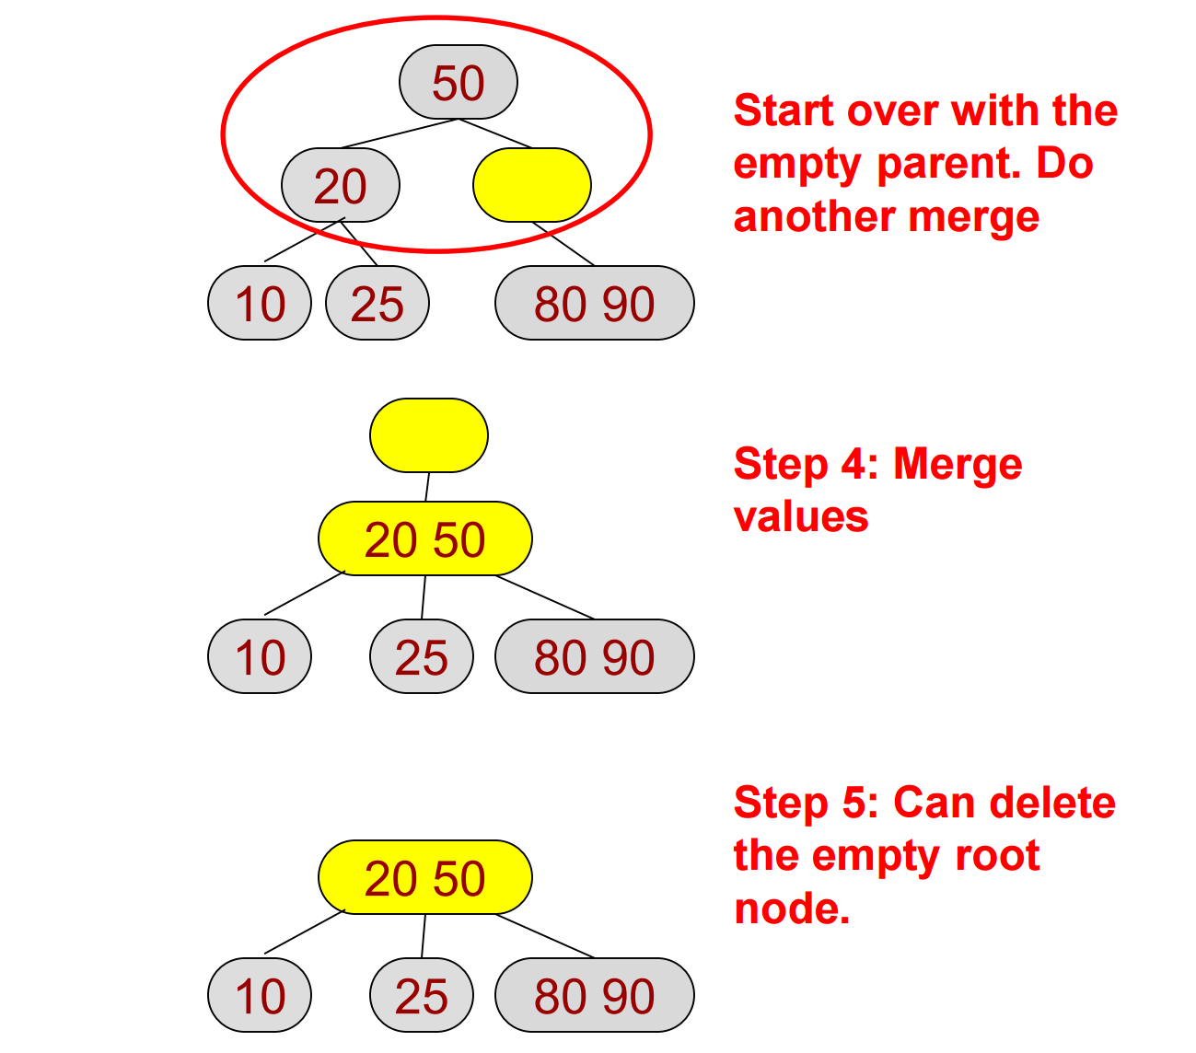
Remove Exercise 1 (cont.)
Source: http://ee.usc.edu/~redekopp/cs104/slides/L19_BalancedBST_23.pdf

Slide 12
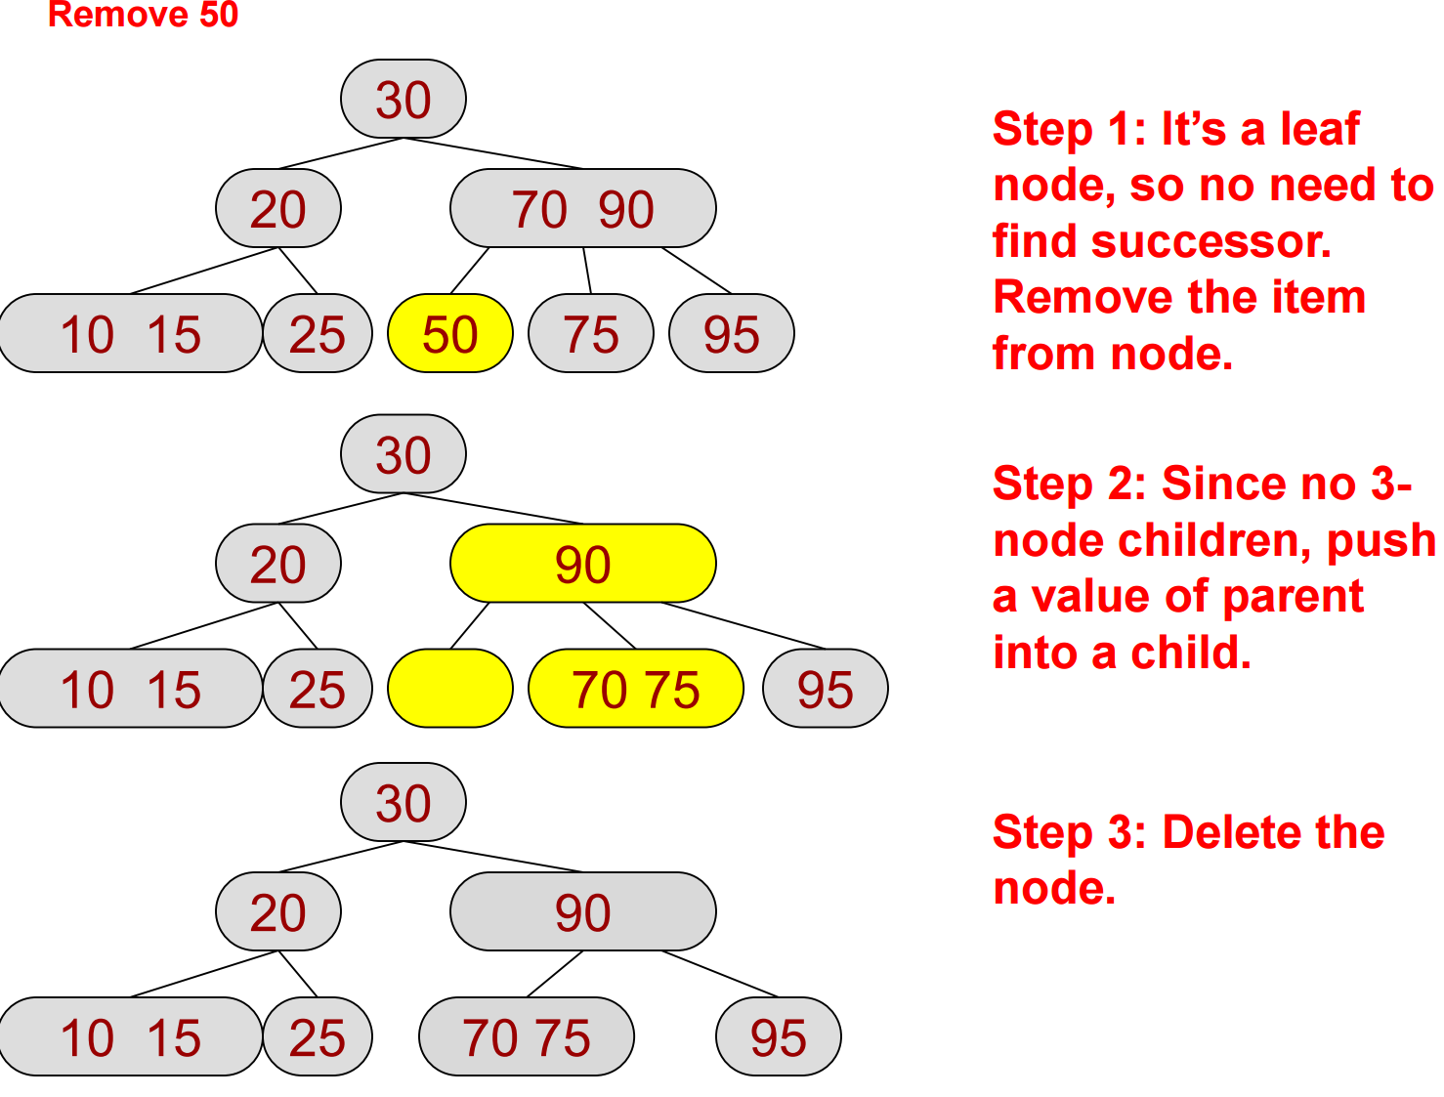
Remove Exercise 2
Source: http://ee.usc.edu/~redekopp/cs104/slides/L19_BalancedBST_23.pdf

Slide 13
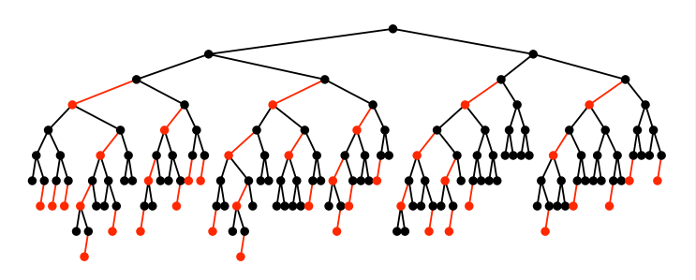
Red-black BSTs
Every node is either red or black.
If a node has a NULL child, that "child" is considered black
If a node is red, then both of its children are black
Every simple path from a node to a descendant NULL child has the same number of black nodes, (including the black NULL child)
The root is black
Source: http://web.cs.hacettepe.edu.tr/~sever/bil367/lectures/redblack16.pdf

Slide 14
Relation between Red-black BSTs and 2-3 tree
Source: http://web.cs.hacettepe.edu.tr/~bbm202/slides/09-balanced-trees.pdf

Slide 15
Insertion Cases for Red-black BSTs
Case 1: Right child red, left child black → rotate left
Case 2: Left child, left-left grandchild red → rotate right
Case 3: Both children red → flip colors
Source: http://web.cs.hacettepe.edu.tr/~bbm202/slides/09-balanced-trees.pdf

Slide 16
Exercise-3: Red-black BSTs Insertion
Draw red-black BST that results when you insert the keys
E A S Y Q U T I O N
in that order into an initially empty tree
Source: Algorithms, 4th Edition, R. Sedgewick and K. Wayne, Addison-Wesley Professional, 2011 (Chapter 3, Exercises 3.3.10, pp. 449)

Slide 17
Exercise-4 (Your turn ☺)
Draw red-black BST that results when you insert the keys
Y L P M X H C R A E S
in that order into an initially empty tree
Source: Algorithms, 4th Edition, R. Sedgewick and K. Wayne, Addison-Wesley Professional, 2011 (Chapter 3, Exercises 3.3.11, pp. 449)

