Slide 1
BBM 204 Algorithms Lab
Recitation 5
Hash functions
Sequential Chaining
Linear Probing
Double Hashing
Işıl Karabey

Slide 2
Index
Hashing
Hash functions
Sequential chaining
Linear probing
Double hashing
Exercises for sequential chaining, linear probing and double hashing

Slide 3
Hashing
Data records are stored in a hash table
The position of a data record in the hash table is determined by its key
A hash function maps keys to positions in the hash table
If a hash function maps two keys to the same position in the hash table, then a collision occurs
Source: http://www3.cs.stonybrook.edu/~cse214/lecture_slides/unit8.pdf

Slide 4
Goals of Hashing
Source: http://www3.cs.stonybrook.edu/~cse214/lecture_slides/unit8.pdf

Slide 5
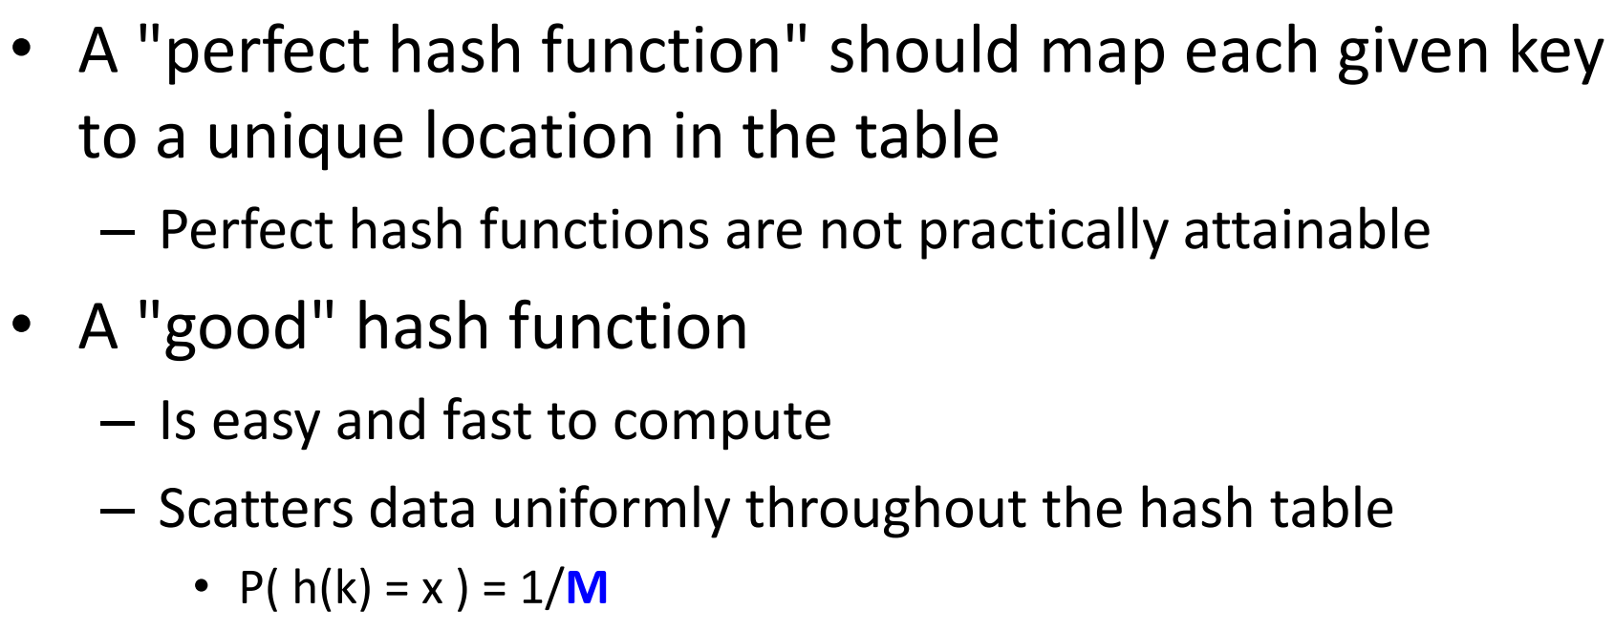
Hash Function Desirables
Source: http://ee.usc.edu/~redekopp/cs104/slides/L21_Hashing.pdf

Slide 6
Simple Example
Source: http://www3.cs.stonybrook.edu/~cse214/lecture_slides/unit8.pdf

Slide 7
Resolving Collusions
Two approaches:
Separate chaining
Open addressing
Linear probing
Double hashing
Source: http://www.cs.princeton.edu/courses/archive/spr03/cs226/lectures/hashing.4up.pdf

Slide 8
Separate Chaining
Source: http://www.eecs.wsu.edu/~ananth/CptS223/Lectures/hashing.pdf

Slide 9
Separate Chaining Exercise
Give the contents of the hash table that results when you insert items with the keys E A S Y Q U T I O N in that order into an initially empty table of M = 5 lists, using separate chaining with unordered lists
Use the hash function 11 k mod M to transform the kth letter of the alphabet into a table index, e.g., hash(I) = hash(9) = 99 % 5 = 4.
Source: Algorithms, 4th Edition, R. Sedgewick and K. Wayne, Addison-Wesley Professional, 2011 (Chapter 3, Exercises 3.4.1, pp. 480)

Slide 10
Disadvantages of Separate Chaining
Source: http://www.eecs.wsu.edu/~ananth/CptS223/Lectures/hashing.pdf

Slide 11
Open Addressing
Source: http://ee.usc.edu/~redekopp/cs104/slides/L21_Hashing.pdf

Slide 12
Linear Probing Exercise
Give the contents of the hash table that results when you insert items with the keys E A S Y Q U T I O N in that order into an initially empty table of size M = 16 using linear probing
Use the hash function 11k mod M to transform the kth letter of the alphabet into a table index.
Source: Algorithms, 4th Edition, R. Sedgewick and K. Wayne, Addison-Wesley Professional, 2011 (Chapter 3, Exercises 3.4.10, pp. 480)

Slide 13
Source: http://www.eecs.wsu.edu/~ananth/CptS223/Lectures/hashing.pdf

Slide 14
Double Hashing Exercise
Give the contents of the hash table that results when you insert items with the keys E A S Y Q U T I O N in that order into an initially empty table of size M = 16 using double hashing
Use the hash function 11k mod M for the initial probe and the second hash function (k mod 3) + 1 for the search increment
Source: http://www.cs.princeton.edu/courses/archive/spr04/cos226/exercises/hash.html

Slide 15
Source: http://www.eecs.wsu.edu/~ananth/CptS223/Lectures/hashing.pdf

Slide 16
Summary of Hash Tables
Source: http://ee.usc.edu/~redekopp/cs104/slides/L21_Hashing.pdf

Slide 17
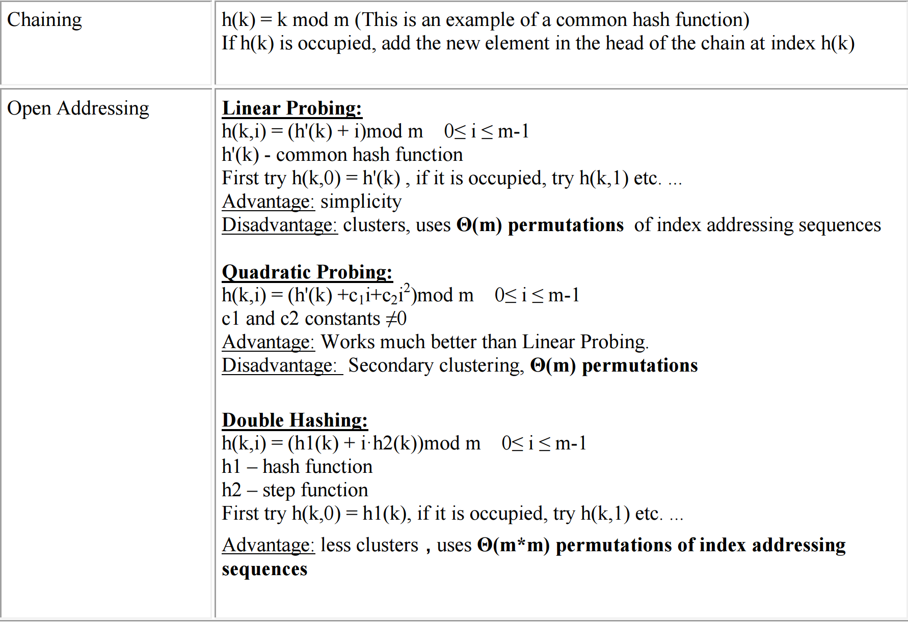
Summary of Collusion Methods
Source: https://www.cs.bgu.ac.il/~ds132/wiki.files/ds132_ps8%20-%20solutions.pdf

Slide 18
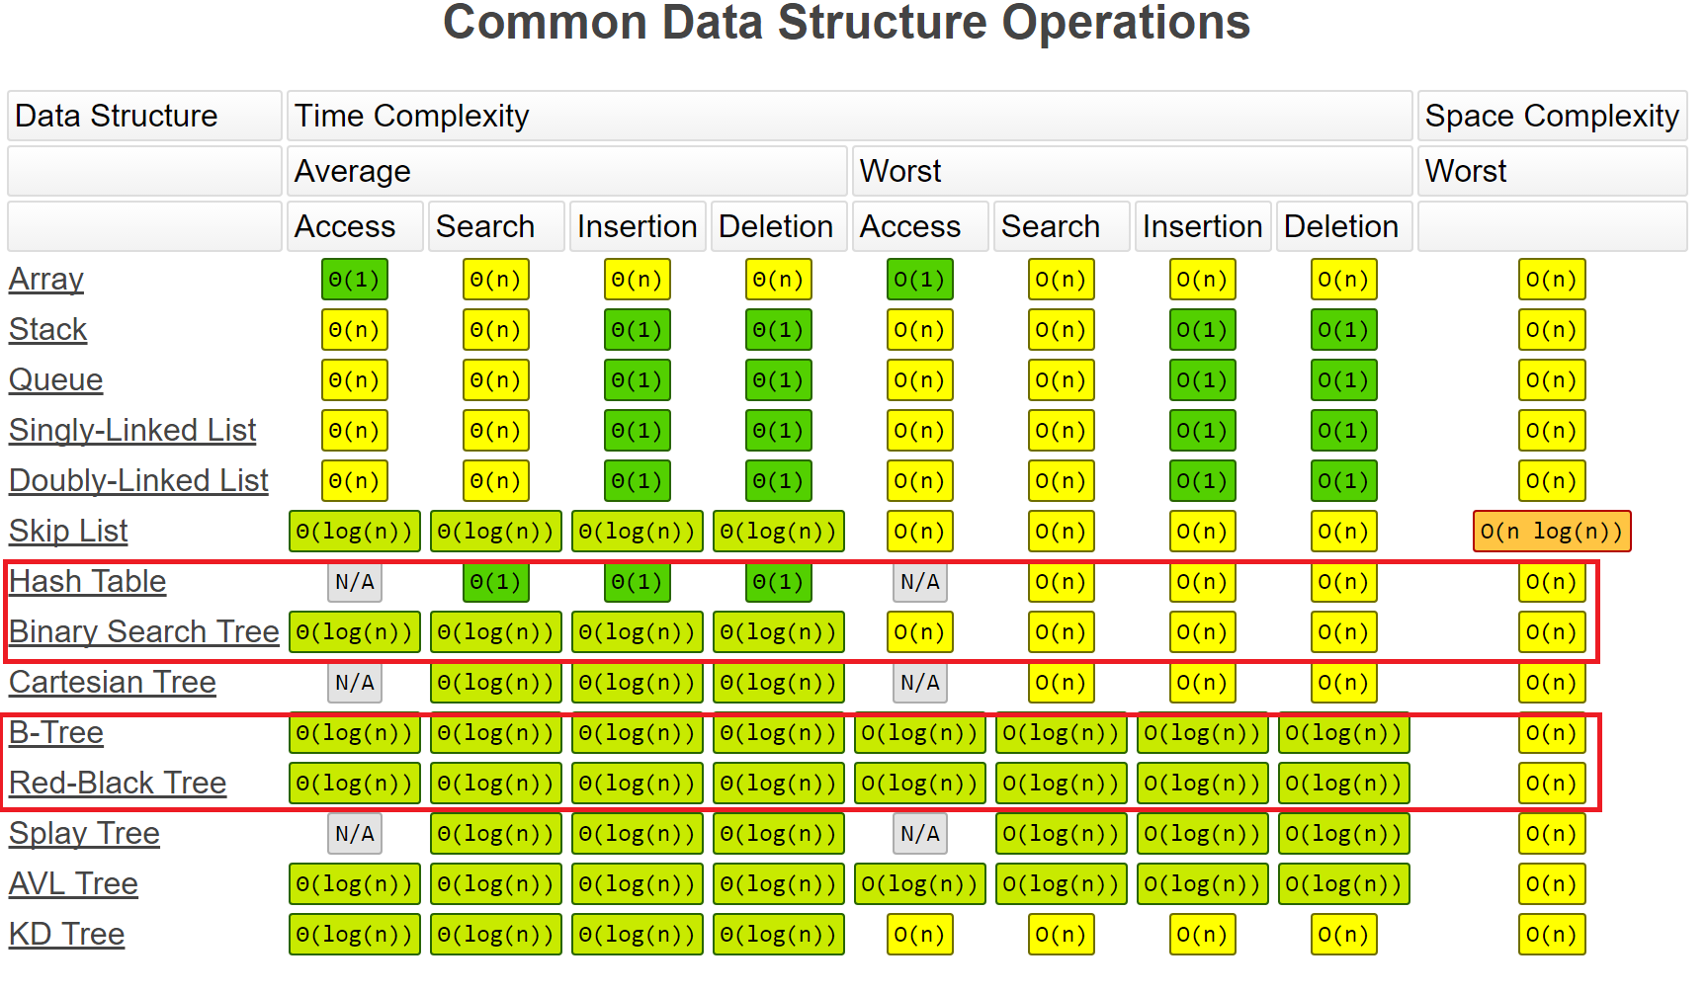
Hash Table vs Other Search Trees
Source: http://bigocheatsheet.com/

