Slide 1
BBM 204 Algorithms Lab
Recitation7
Undirected versus Directed Graphs
Directed Graphs
Strongly Components
Işıl Karabey

Slide 2
Index
Undirected versus Directed Graphs
Directed Graphs
DFS and BFS in Directed Graphs
Strongly Components
Exercises for directed graphs

Slide 3
Undirected versus Directed Graphs
Source: http://www.inf.ed.ac.uk/teaching/courses/cs2/LectureNotes/CS2Bh/ADS/lecture9.pdf

Slide 4
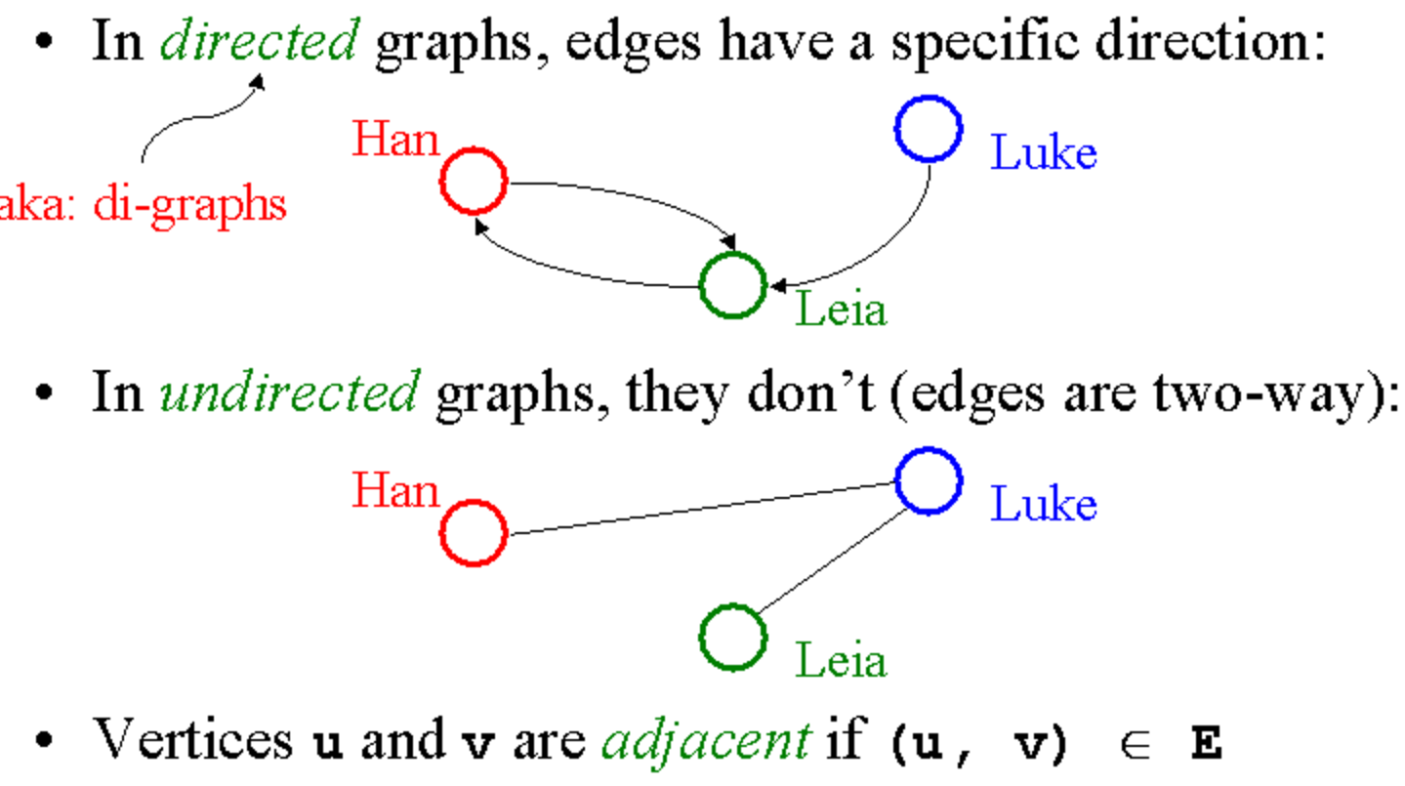
Representation of Undirected and Directed Graphs
Source: https://courses.cs.washington.edu/courses/cse326/00wi/handouts/lecture21/sld014.htm

Slide 5
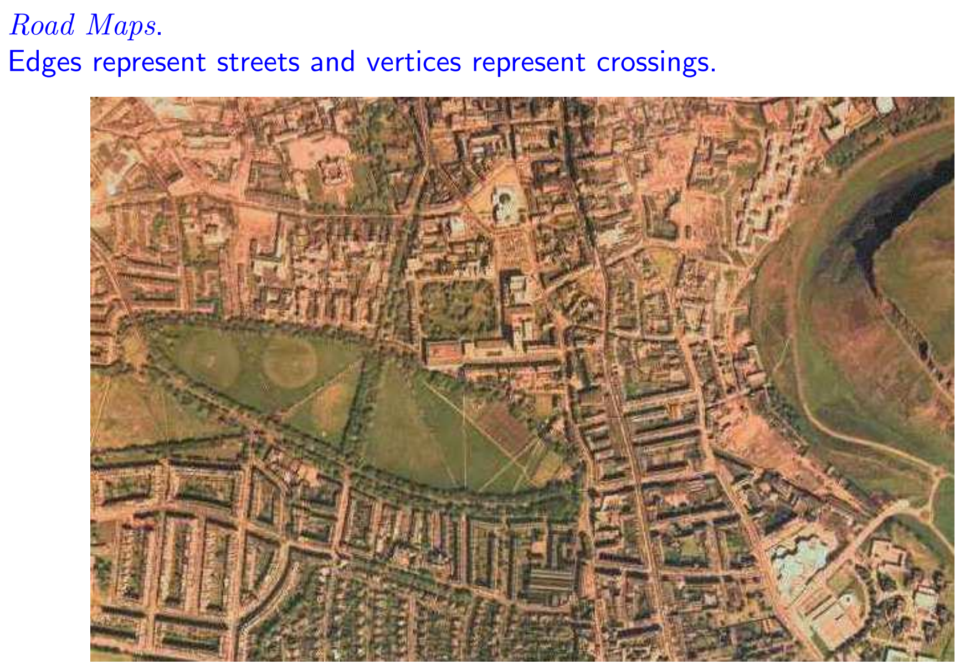
Example of Graphs in Real Life
Source: http://www.inf.ed.ac.uk/teaching/courses/cs2/LectureNotes/CS2Bh/ADS/lecture9.pdf

Slide 6
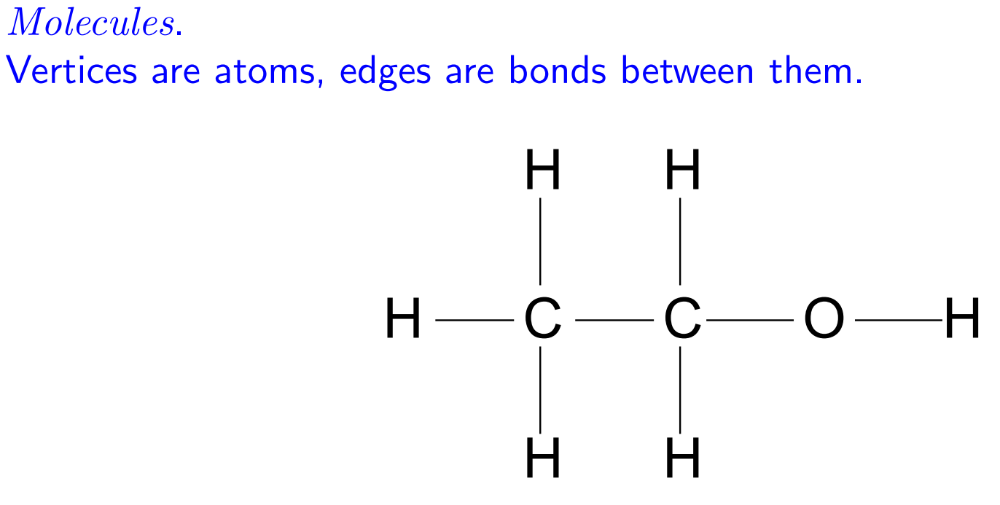
Examples Cont’d
Source: http://www.inf.ed.ac.uk/teaching/courses/cs2/LectureNotes/CS2Bh/ADS/lecture9.pdf

Slide 7
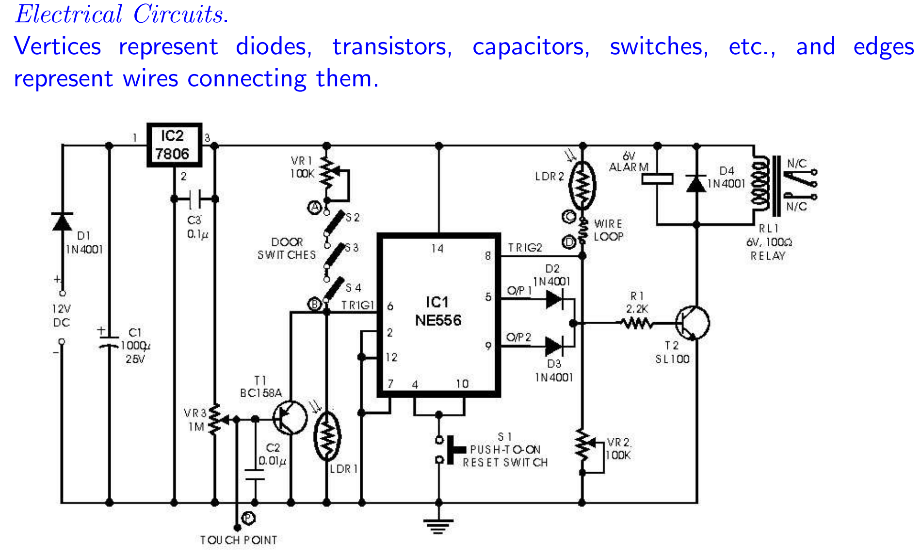
Examples Cont’d
Source: http://www.inf.ed.ac.uk/teaching/courses/cs2/LectureNotes/CS2Bh/ADS/lecture9.pdf

Slide 8
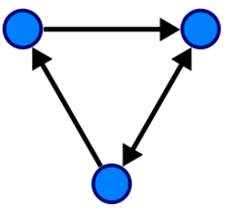
Directed Graphs
A directed graph (or digraph) is a graph that is a set of vertices connected by edges, where the edges have a direction associated with them
Source: https://en.wikipedia.org/wiki/Directed_graph

Slide 9
Digraph Representation
Source: https://www.cs.princeton.edu/~rs/AlgsDS07/13DirectedGraphs.pdf

Slide 10
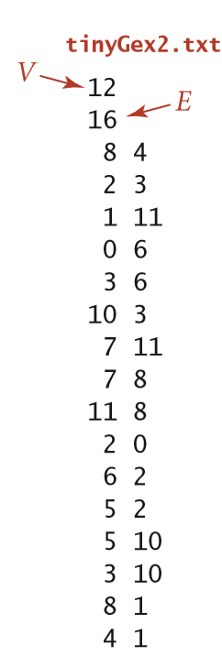
Drawing a Digraph
Source: Source: Algorithms, 4th Edition, R. Sedgewick and K. Wayne, Addison-Wesley Professional, 2011 (Chapter 4, Exercises 4.1.2, pp. 696)

Slide 11
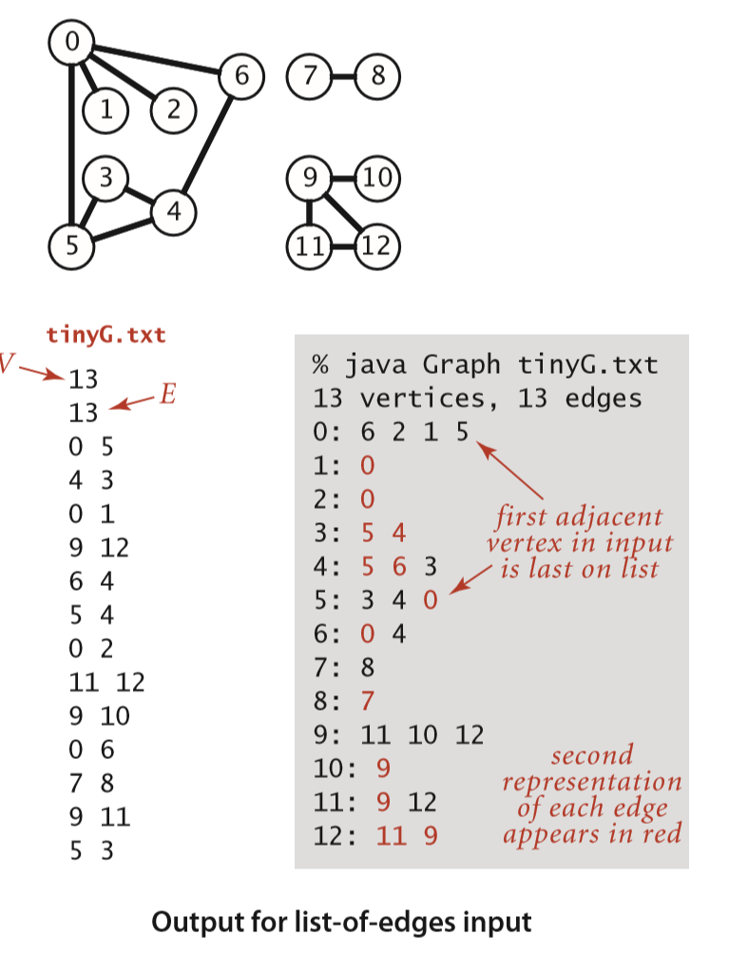
Recall
Source: Algorithms, 4th Edition, R. Sedgewick and K. Wayne, Addison-Wesley Professional, 2011 (Chapter 4, pp. 525

Slide 12
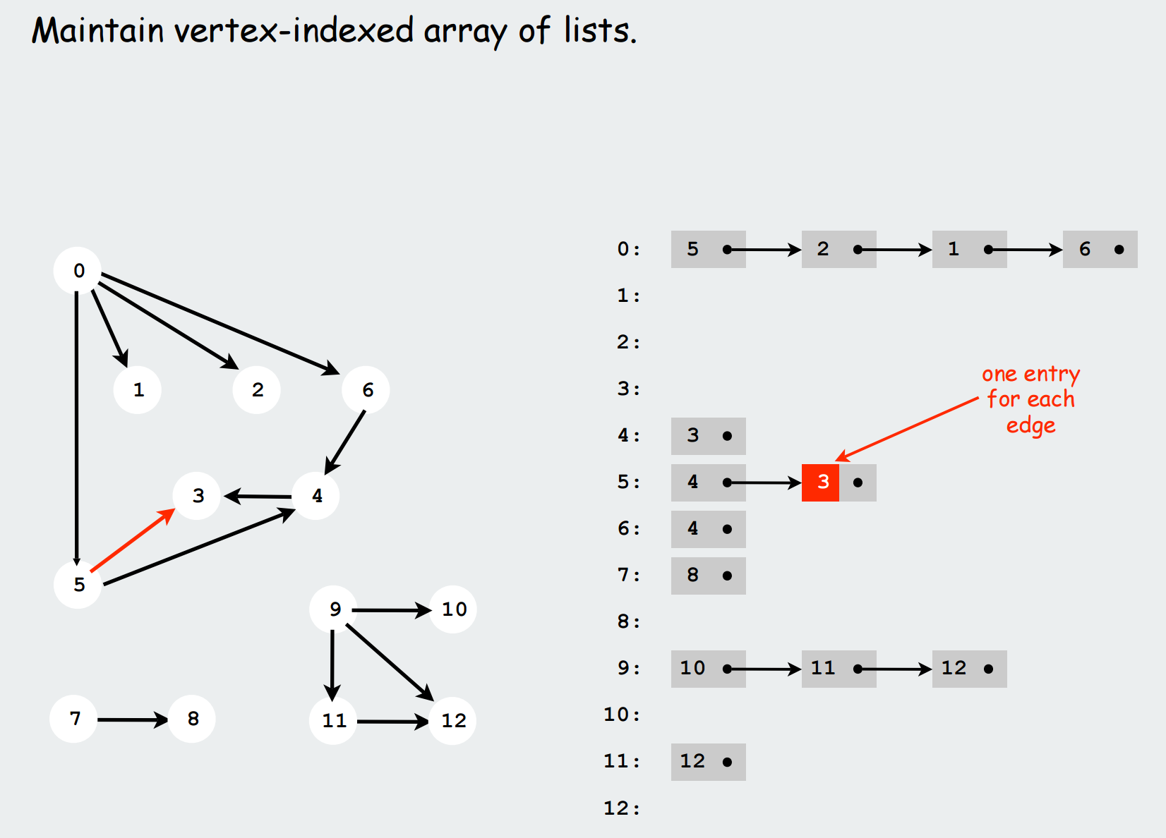
Recall Adjacency-list digraph representation
Source: https://www.cs.princeton.edu/~rs/AlgsDS07/13DirectedGraphs.pdf

Slide 13
Graph Traversals
Source: http://www.inf.ed.ac.uk/teaching/courses/cs2/LectureNotes/CS2Bh/ADS/lecture9.pdf

Slide 14
Depth-first search in digraphs
Source: https://www.cs.princeton.edu/~rs/AlgsDS07/13DirectedGraphs.pdf

Slide 15
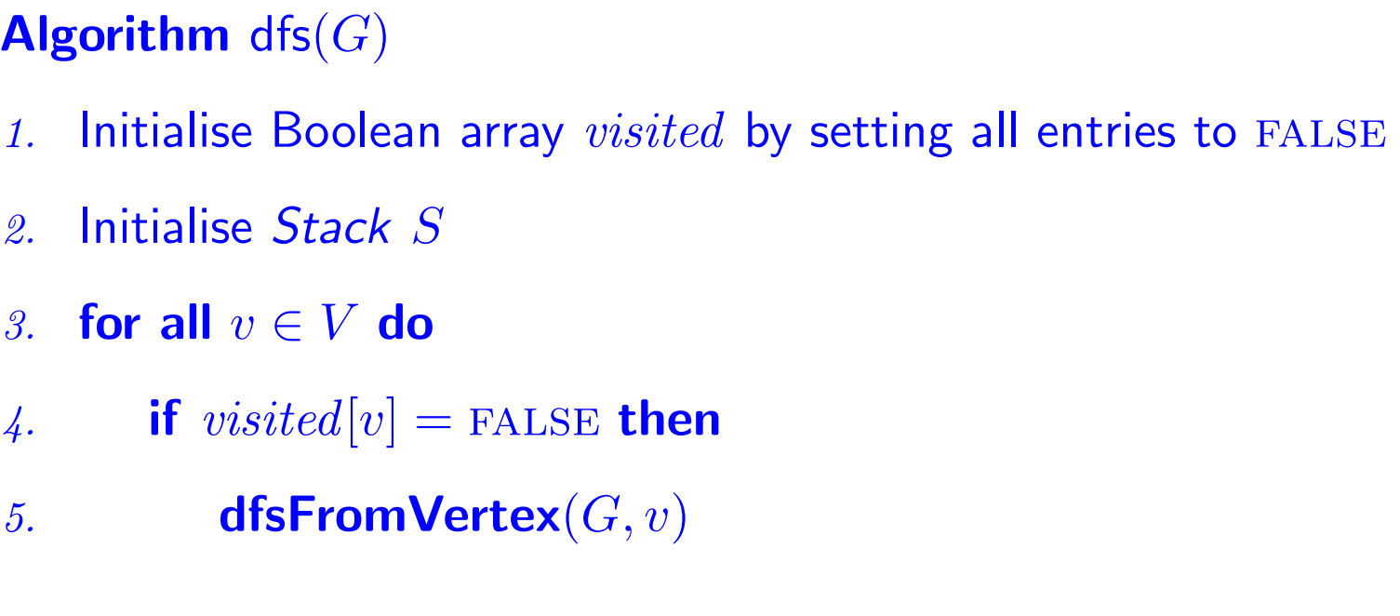
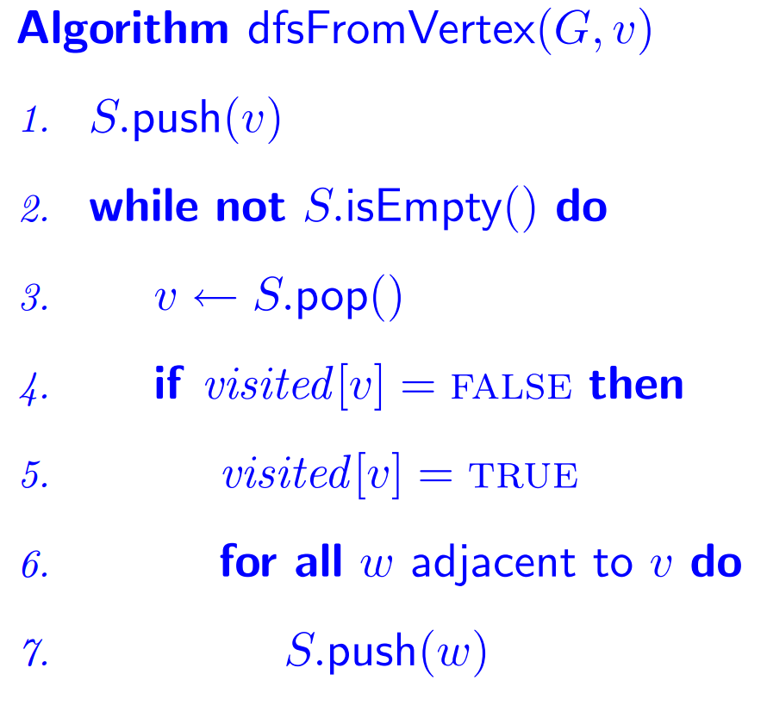
Depth-first search (single-source reachability)
Source: http://www.inf.ed.ac.uk/teaching/courses/cs2/LectureNotes/CS2Bh/ADS/lecture9.pdf

Slide 16
Depth-first search (DFS)
Source: https://www.cs.princeton.edu/~rs/AlgsDS07/13DirectedGraphs.pdf

Slide 17
Breadth-first search in digraphs
Source: https://www.cs.princeton.edu/~rs/AlgsDS07/13DirectedGraphs.pdf

Slide 18
Digraph BFS application: Web Crawler
Source: https://www.cs.princeton.edu/~rs/AlgsDS07/13DirectedGraphs.pdf

Slide 19
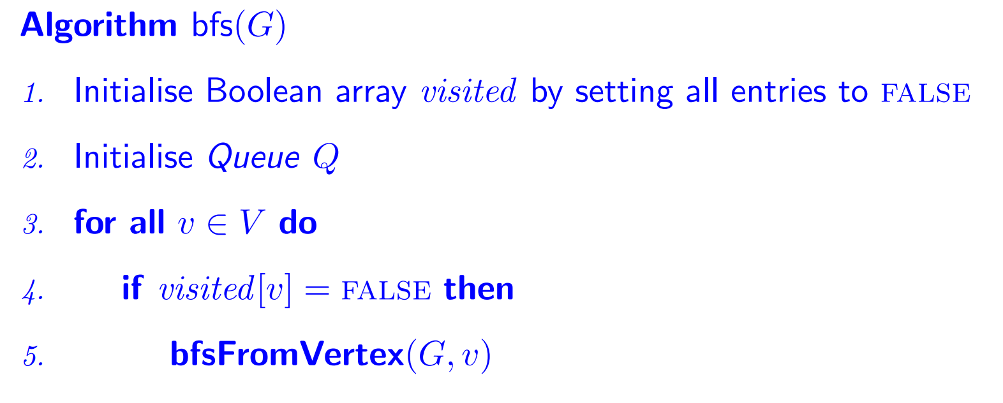
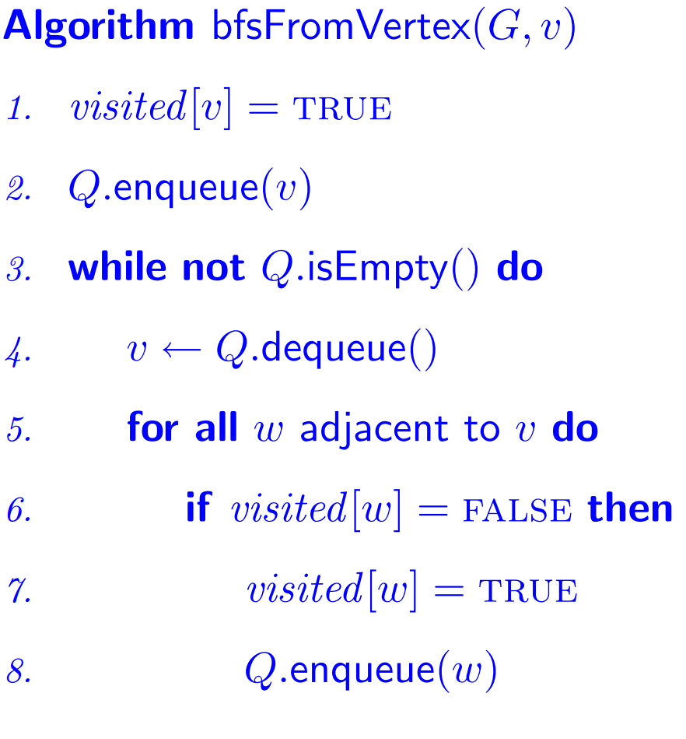
Breadth-first search (single-source reachability)
Source: http://www.inf.ed.ac.uk/teaching/courses/cs2/LectureNotes/CS2Bh/ADS/lecture9.pdf

Slide 20
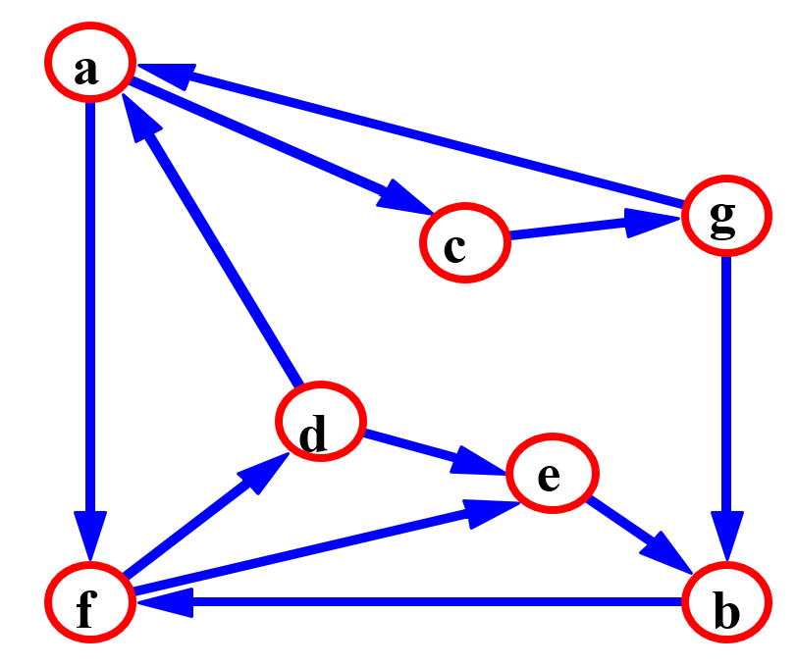
Strongly Connected Directed graphs
Every pair of vertices are reachable from each other
Source: www.cs.bu.edu/~steng/teaching/Fall2003/.../lecture16.ppt

Slide 21
Strongly Connected
Source: www.cs.bu.edu/~steng/teaching/Fall2003/.../lecture16.ppt

Slide 22
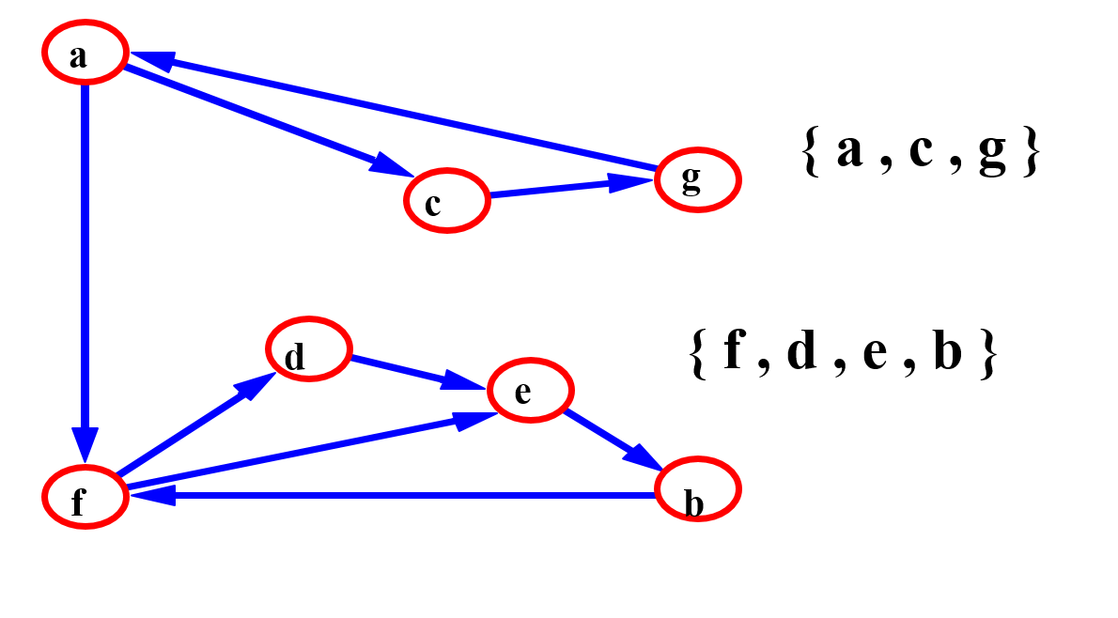
Strongly Connected Components
Source: www.cs.bu.edu/~steng/teaching/Fall2003/.../lecture16.ppt

Slide 23
Kosaraju's algorithm for Strongly Components
call DFS(G) to compute finishing times f[u] for each vertex u.
compute G^{T}
call DFS(G^{T}), but in the main loop of DFS, consider the vertices in order of decreasing f[u]
output the vertices of each tree in the depth-first forest of step 3 as a separate strongly connected component.
The graph G^{T} is the transpose of G, which is visualized by reversing the arrows on the digraph.
Source: www.cs.bu.edu/~steng/teaching/Fall2003/.../lecture16.ppt

Slide 24
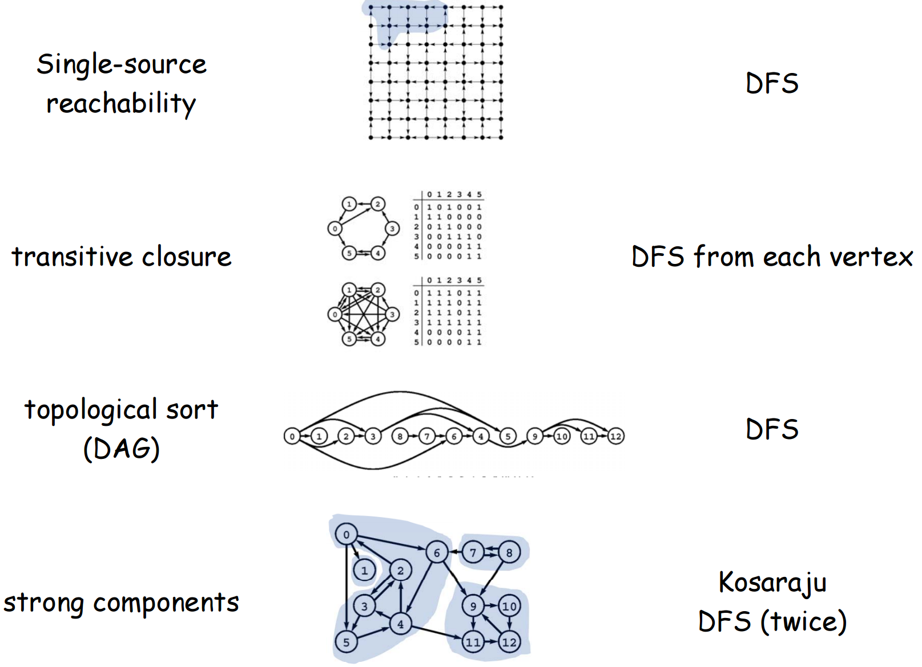
Digraph-processing summary
Source: https://www.cs.princeton.edu/~rs/AlgsDS07/13DirectedGraphs.pdf

