Slide 1
Bayesian Decision Theory
Slides are adapted from Jason Corso, George Bebis and Sargur Srihari
based on the content from Duda, Hart & Stork

Slide 2
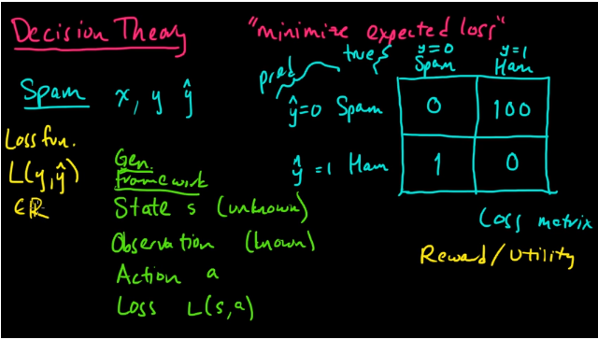
Motivation

Slide 5
Bayesian Decision Theory
Fundamental statistical approach to statistical pattern classification
Quantifies trade-offs between classification using probabilities and costs of decisions
Assumes all relevant probabilities are known

Slide 6
Bayesian Decision Theory
It is the decision making when all underlying probability distributions are known.
It is optimal given the distributions are known.
For two classes ω₁ and ω₂ ,
Prior probabilities for an unknown new observation:
P(ω₁) : the new observation belongs to class 1
P(ω₂) : the new observation belongs to class 2
P(ω₁ ) + P(ω₂ ) = 1
It reflects our prior knowledge. It is our decision rule when no feature on the new object is available:
Classify as class 1 if P(ω₁ ) > P(ω₂ )

Slide 7
Bayesian Decision Theory
Design classifiers to make decisions subject to minimizing an expected ”risk”.
The simplest risk is the classification error (i.e., assuming that misclassification costs are equal).
When misclassification costs are not equal, the risk can include the cost associated with different misclassifications.

Slide 8
Example

Slide 9
Terminology - consider the sea bass/salmon example
State of nature ω (class label):
e.g., ω₁ for sea bass, ω₂ for salmon
Probabilities P(ω₁) and P(ω₂) (priors):
e.g., prior knowledge of how likely is to get a sea bass or a salmon
Probability density function p(x) (evidence):
e.g., how frequently we will measure a pattern with feature value x (e.g., x corresponds to lightness)

Slide 10
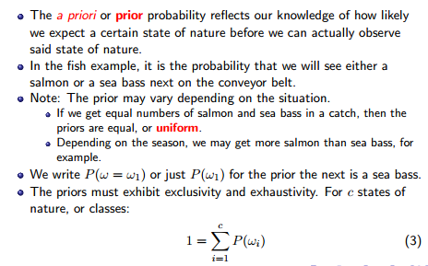
Prior Probability

Slide 11
Prior Probability
The catch of salmon and sea bass is equiprobable
P(ω₁) = P(ω₂) (uniform priors)
P(ω₁) + P( ω₂) = 1 (exclusivity and exhaustivity)

Slide 12
Decision Rule from only Priors
Favours the most likely class.
or P(error) = min[P(ω₁), P(ω₂)]

Slide 13
Features and Feature spaces

Slide 14
Class Conditional probability density p(x/ω_{j}) (likelihood) :
The class-conditional probability density function is the probability density function for x, our feature, given that the state of nature is ω
e.g., how frequently we will measure a pattern with feature value x given that the pattern belongs to class ω_{j}
P(x | ω₁) and P(x | ω₂) describe
the difference in lightness
between populations of
sea-bass and salmon

Slide 15
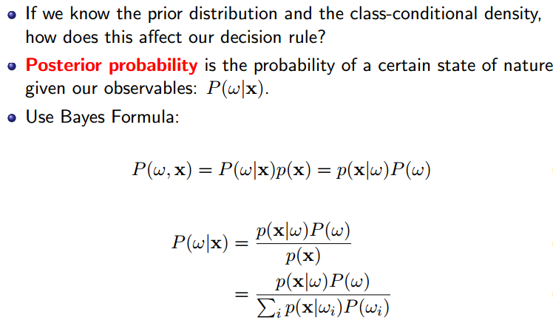
Conditional probability P(ω_{j} /x) (posterior) :
e.g., the probability that the fish belongs to class ω_{j} given feature x.

Slide 16
Decision Rule Using Conditional Probabilities
Using Bayes’ rule:
where (i.e., scale factor – sum of probs = 1)
Decide ω₁ if P(ω₁ /x) > P(ω₂ /x); otherwise decide ω₂ or
Decide ω₁ if p(x/ω₁)P(ω₁)>p(x/ω₂)P(ω₂); otherwise decide ω₂
or
Decide ω₁ if p(x/ω₁)/p(x/ω₂) >P(ω₂)/P(ω₁) ; otherwise decide ω₂
likelihood ratio
threshold

Slide 17
Decision Rule Using Conditional Probabilities (cont’d)
p(x/ω_{j})
P(ω_{j} /x)

Slide 18
Probability of error
x is an observation for which:
if P(ω1 | x) > P(ω2 | x) True state of nature = ω1
if P(ω1 | x) < P(ω2 | x) True state of nature = ω2

Slide 19
Bayes Decision Rule (with equal costs)

Slide 20
Where do Probabilities come from?
There are two competitive answers:
(1) Relative frequency (objective) approach.
Probabilities can only come from experiments.
(2) Bayesian (subjective) approach.
Probabilities may reflect degree of belief and can be based on opinion.

Slide 21
Example (objective approach)
Classify cars whether they are more or less than $50K:
Classes: C₁ if price > $50K, C₂ if price <= $50K
Features: x, the height of a car
Use the Bayes’ rule to compute the posterior probabilities:
We need to estimate p(x/C₁), p(x/C₂), P(C₁), P(C₂)

Slide 22
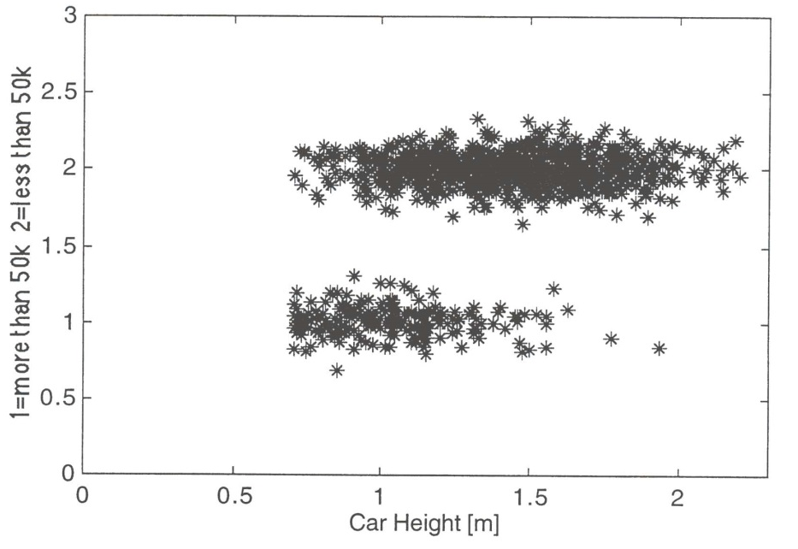
Example (cont’d)
Collect data
Ask drivers how much their car was and measure height.
Determine prior probabilities P(C₁), P(C₂)
e.g., 1209 samples: #C₁=221 #C₂=988

Slide 23
Example (cont’d)
Determine class conditional probabilities (likelihood)
Discretize car height into bins and use normalized histogram

Slide 24
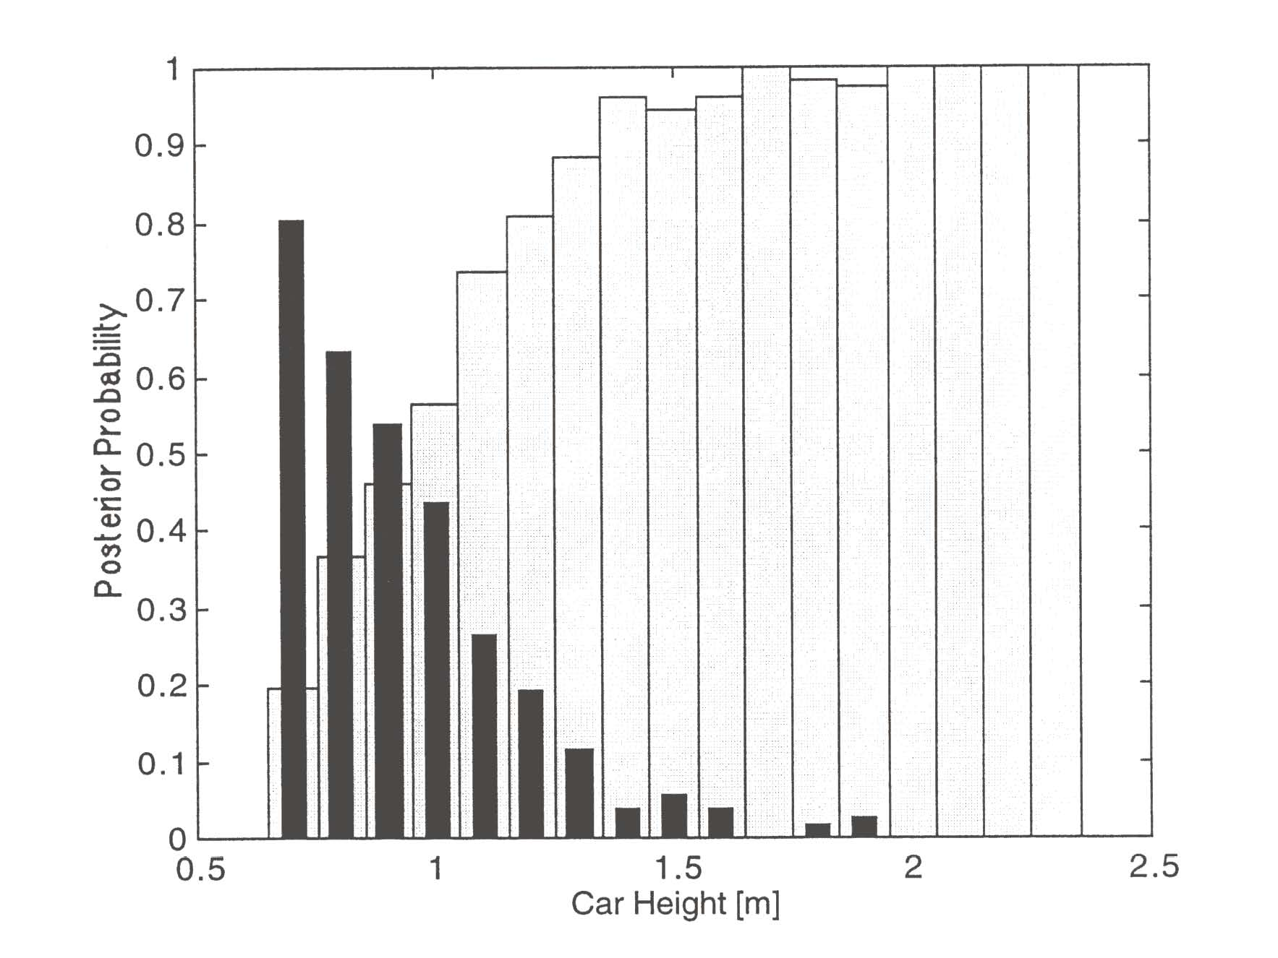
Example (cont’d)
Calculate the posterior probability for each bin:

Slide 25
A More General Theory
Use more than one features.
Allow more than two categories.
Allow actions other than classifying the input to one of the possible categories (e.g., rejection) - Refusing to make a decision in close or bad cases!.
Employ a more general error function (i.e., expected “risk”) by associating a “cost” (based on a “loss” function) with different errors.
Note that, the loss function states how costly each action taken is

Slide 26
Loss Function
If action α_{i} is taken and the true state of nature is ω_{j} then the decision is correct if i = j and in error if i ≠ j
Seek a decision rule that minimizes the probability of error which is the error rate

Slide 27
Expected loss

Slide 29
Overall Risk
Suppose α(x) is a general decision rule that determines which action α_{1,} α_{2, …,} α_{l} to take for every x.
The overall risk is defined as:
Clearly, we want the rule α(·) that minimizes R(α(x)|x) for all x.
The Bayes rule minimizes R by:
(i) Computing R(α_{i} /x) for every α_{i} given an x
(ii) Choosing the action α_{i} with the minimum R(α_{i} /x)
The resulting minimum R* is called Bayes risk and is the best (i.e., optimum) performance that can be achieved:

Slide 30
Example: Two-category classification
Define
α₁: decide ω₁
α_{2:} decide ω₂
λ_{ij} = λ(α_{i} /ω_{j})
loss incurred for deciding ω_{i} when the true state of nature is ω_{j}
The conditional risks are:

Slide 31
Example: Two-category classification
Minimum risk decision rule:
or
or (i.e., using likelihood ratio)
>
likelihood ratio
threshold

Slide 32
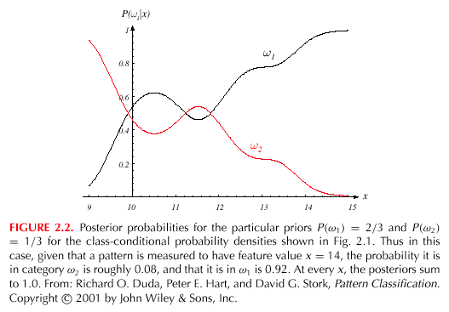
x (λ₂₁- λ₁₁)
x (λ₁₂- λ₂₂)

Slide 33
Two-Category Decision Theory: Chopping Machine
α₁ = chop
α₂ = DO NOT chop
ω₁ = NO hand in machine
ω₂ = hand in machine
λ₁₁ = λ(α₁ | ω₁) = $ 0.00
λ₁₂ = λ(α₁ | ω₂) = $ 100.00
λ₂₁ = λ(α₂ | ω₁) = $ 0.01
λ₂₂ = λ(α₁ | ω₁) = $ 0.01
Therefore our rule becomes
(λ₂₁- λ₁₁) P(x | ω₁) P(ω₁) > (λ₁₂- λ₂₂) P(x | ω₂) P(ω₂)
0.01 P(x | ω₁) P(ω₁) > 99.99 P(x | ω₂) P(ω₂)

Slide 34
Our rule is the following:
if R(α₁ | x) < R(α₂ | x)
action α₁: “decide ω₁” is taken
This results in the equivalent rule :
decide ω₁ if:
(λ₂₁- λ₁₁) P(x | ω₁) P(ω₁) >
(λ₁₂- λ₂₂) P(x | ω₂) P(ω₂)
and decide ω₂ otherwise

Slide 35
Special Case: Zero-One Loss Function
Assign the same loss to all errors:
All errors are equally costly.
The conditional risk corresponding to this loss function:
The risk corresponding to this loss function is the average probability error.

Slide 36
Special Case: Zero-One Loss Function (cont’d)
The decision rule becomes:
The overall risk turns out to be the average probability error!
or
or

Slide 37
Loss function
Let denote the loss for deciding class i when the true class is j
In minimizing the risk, we decide class one if
Rearrange it, we have

Slide 38
Loss function
Example:

Slide 39
Example
Assuming general loss:
>
Assuming zero-one loss:
Decide ω₁ if p(x/ω₁)/p(x/ω₂)>P(ω₂ )/P(ω₁) otherwise decide ω₂
assume:
(decision regions)

Slide 40
Diagram of pattern classification
Procedure of pattern recognition and decision making
subjects
Observables
X
Features
x
Inner belief
w
Action
α
X--- all the observables using existing sensors and instruments
x --- is a set of features selected from components of X, or linear/non-linear functions of X.
w --- is our inner belief/perception about the subject class.
--- is the action that we take for x.
We denote the three spaces by

Slide 41
Examples
Ex 1: Fish classification
X=I is the image of fish,
x =(brightness, length, fin#, ….)
w is our belief what the fish type is
Ω^{c}={“sea bass”, “salmon”, “trout”, …}
α is a decision for the fish type,
in this case Ω^{c}= Ω^{α}
Ω^{α} ={“sea bass”, “salmon”, “trout”, …}
Ex 2: Medical diagnosis
X= all the available medical tests, imaging scans that a doctor can order for a patient
x =(blood pressure, glucose level, cough, x-ray….)
w is an illness type
Ω^{c}={“Flu”, “cold”, “TB”, “pneumonia”, “lung cancer”…}
α is a decision for treatment,
Ω^{α} ={“Tylenol”, “Hospitalize”, …}

Slide 42
Tasks
subjects
Observables
X
Features
x
Inner belief
w
Decision
α
control
sensors
selecting
Informative
features
statistical
inference
risk/cost
minimization
In Bayesian decision theory, we are concerned with the last three steps in the big ellipse
assuming that the observables are given and features are selected.

Slide 43
Bayesian Decision Theory
statistical
Inference
risk/cost
minimization
Features
x
Inner belief
p(w|x)
Decision
α(x)
Two probability tables:
a). Prior p(w)
b). Likelihood p(x|w)
A risk/cost function
(is a two-way table)
λ(α | w)
The belief on the class w is computed by the Bayes rule
The risk is computed by

Slide 44
Decision Rule
A decision rule is a mapping function from feature space to the set of actions
we will show that randomized decisions won’t be optimal.
A decision is made to minimize the average cost / risk,
It is minimized when our decision is made to minimize the cost / risk for each instance x.

Slide 45
Bayesian error
In a special case, like fish classification, the action is classification, we assume a 0/1 error.
The risk for classifying x to class α_{i} is,
The optimal decision is to choose the class that has maximum posterior probability
The total risk for a decision rule, in this case, is called the Bayesian error

Slide 46
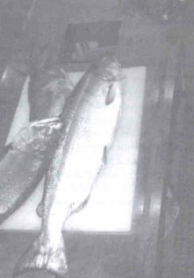
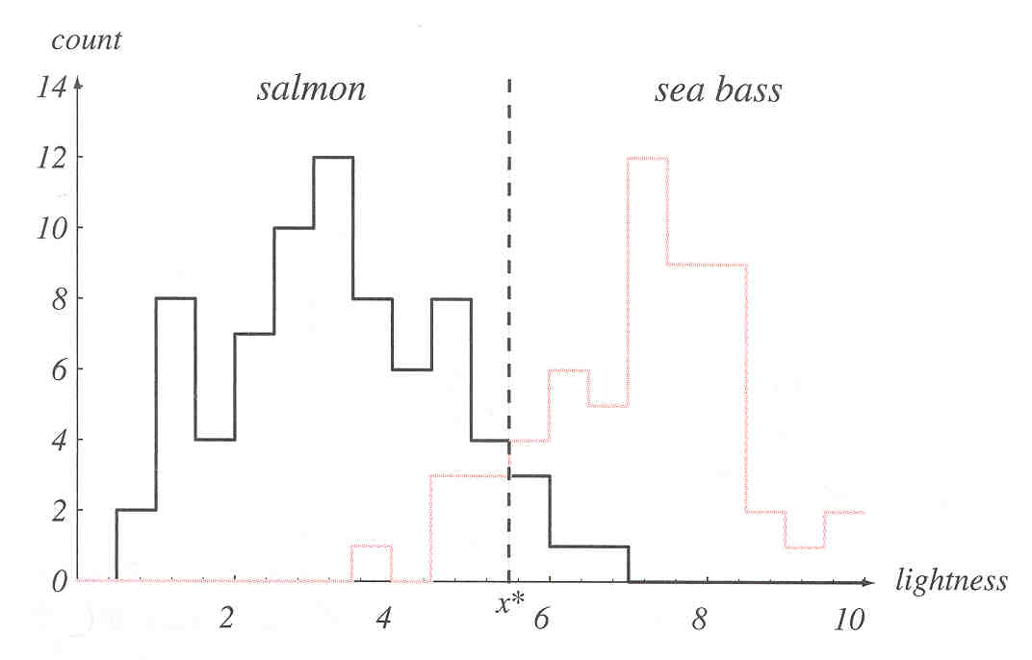
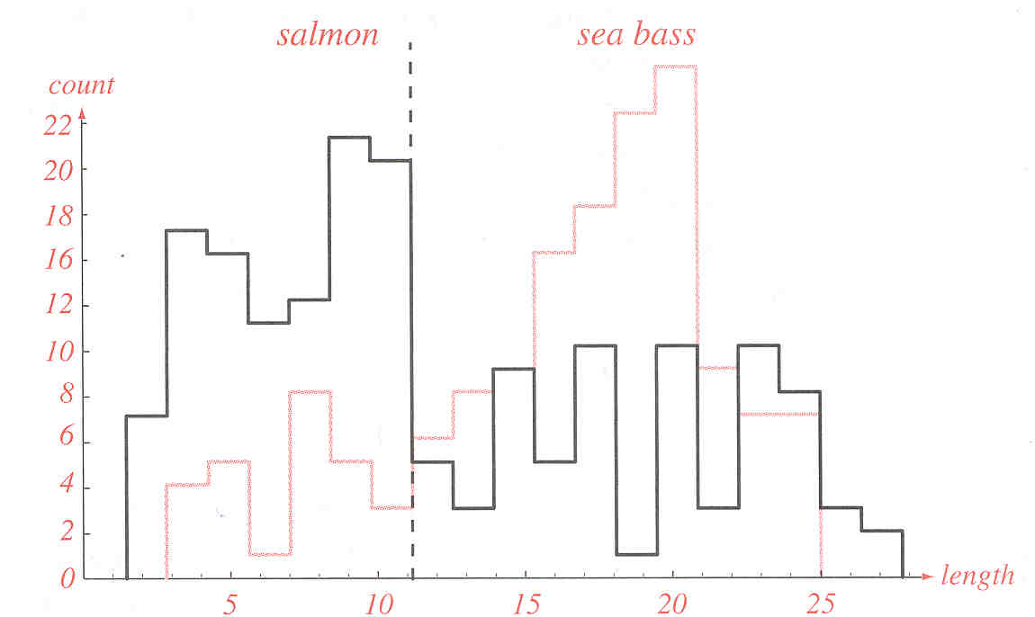
An example of fish classification

Slide 47
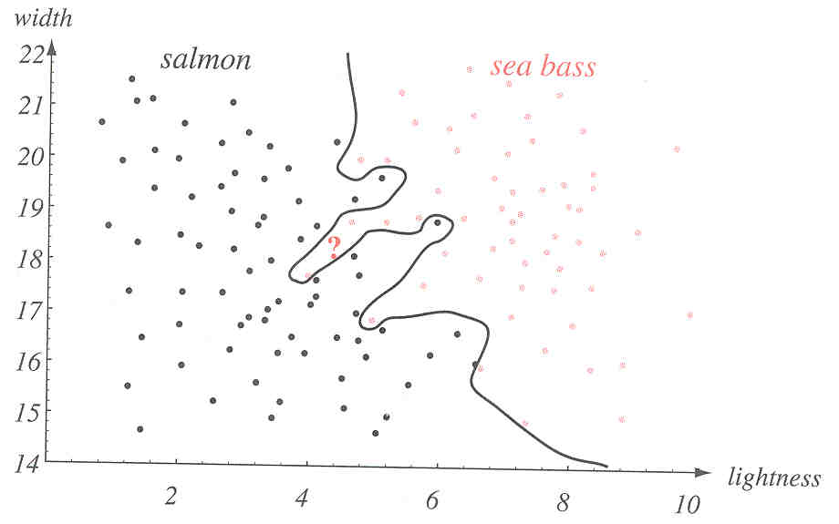
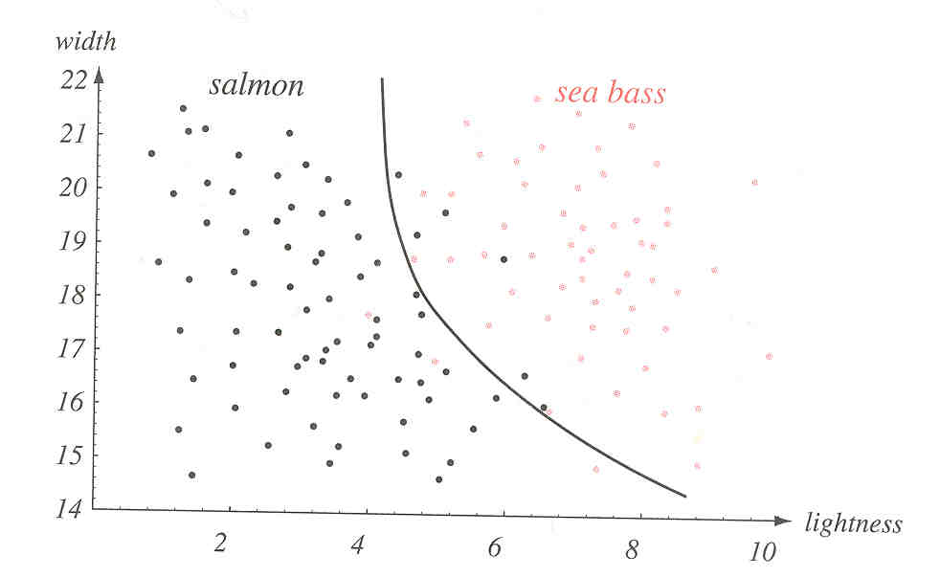
Decision/classification Boundaries

Slide 48
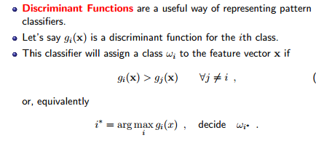
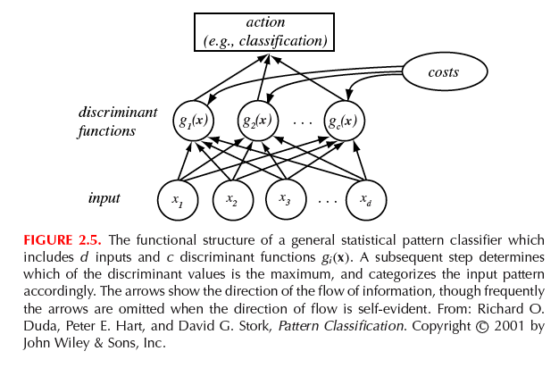
Discriminant Functions
Decision surface defined by
g_{i}(x) = g_{j}(x)

Slide 49
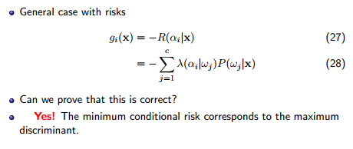
Bayes Discriminants

Slide 50
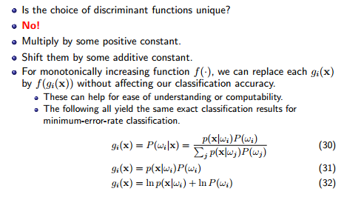
Uniqueness of discriminants

Slide 51
Decision Regions and Boundaries
Discriminants divide the feature space in decision regions R₁, R_{2, …,} R_{c}, separated by decision boundaries.
Decision boundary
is defined by:
g₁(x)=g₂(x)

Slide 52
Case of two categories
More common to use a single discriminant function (dichotomizer) instead of two:
Examples:

Slide 53
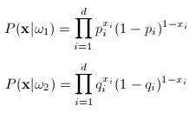
Discriminant function for discrete features
Discrete features: x = [x₁, x₂, …, x_{d} ]^{t} , x_{i}∈{0,1 }
p_{i} = P(x_{i} = 1 | ω₁)
q_{i} = P(x_{i} = 1 | ω₂)
The likelihood will be:

Slide 54
Discriminant function for discrete features
The discriminant function:
The likelihood ratio:

Slide 55
Discriminant function for discrete features
So the decision surface is again a hyperplane.

Slide 56
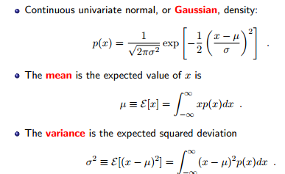
The Univariate Normal Density
Easy to work with analytically
A lot of processes are asymptotically Gaussian
Handwritten characters, speech sounds are ideal or prototype corrupted by random process (central limit theorem)

Slide 57
Univariate Normal Density

Slide 58
Entropy

Slide 59
Multivariate density: N(μ , Σ)
Multivariate normal density in d dimensions:
where:
x = (x₁, x₂, …, x_{d})^{t} (t stands for the transpose of a vector)
μ = (μ₁, μ₂, …, μ_{d})^{t} mean vector
Σ = d*d covariance matrix
|Σ| and Σ⁻¹ are determinant and inverse of Σ, respectively
The covariance matrix is always symmetric and positive semidefinite; we assume Σ is positive definite so the determinant of Σ is strictly positive
Multivariate normal density is completely specified by [d + d(d+1)/2] parameters
If variables x₁ and x₂ are statistically independent then the covariance of x₁ and x₂ is zero.

Slide 60
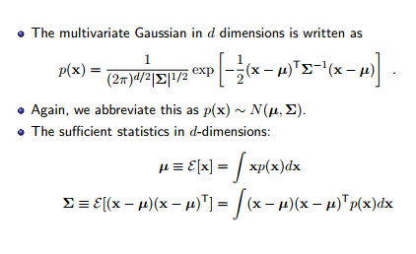
Multivariate Normal Density

Slide 61
The Covariance Matrix

Slide 62
Mahalanobis Distance

Slide 63
Reminder of some results for random vectors
Let Σ be a kxk square symmetrix matrix, then it has k pairs of eigenvalues and eigenvectors. A can be decomposed as:
Positive-definite matrix:

Slide 64
Normal density
Whitening transform:

Slide 65
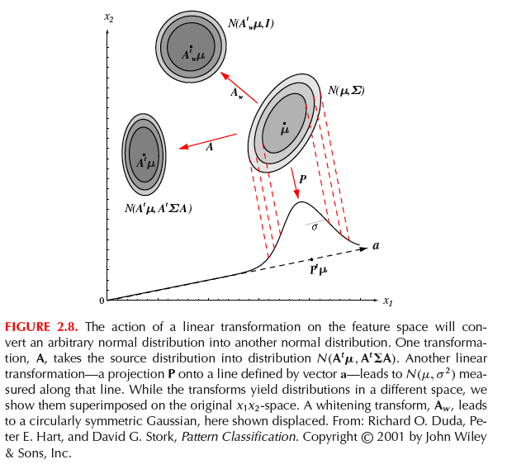
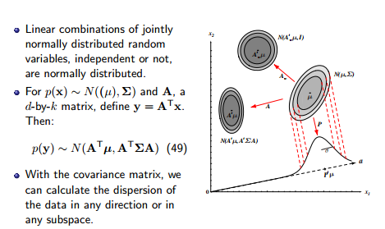
Linear Combinations of Normals

Slide 66
General Discriminant Function for Multivariate Gaussian Density
Recall the minimum error rate discriminant
N(μ,Σ)

Slide 67
Simple Case: Statistically Independent Features with Same Variance
A classifier that uses linear discriminant functions is called “a linear machine”
The decision surfaces for a linear machine are pieces of hyperplanes defined by:
g_{i}(x) = g_{j}(x)
.

Slide 68
Multivariate Gaussian Density: Case I
Σ_{i}=σ² I (diagonal matrix)
Features are statistically independent
Each feature has the same variance

Slide 69
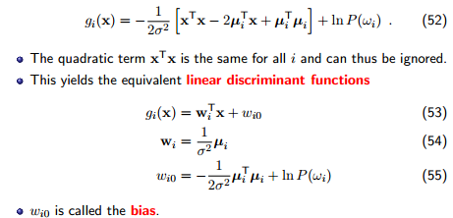
Case1 : Σ_{i}=σ² I

Slide 70
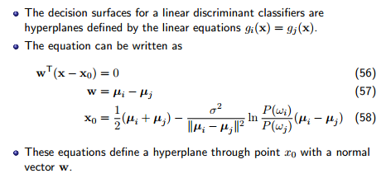
Case 1: Σ_{i}=σ² I
i.e. With equal prior, x₀ is the middle point between the two means.
The decision surface is a hyperplane, perpendicular to the line between the means.

Slide 71
Case 1: Σ_{i}=σ² I
)
)
Properties of decision boundary:
It passes through x₀
It is orthogonal to the line linking the means.
If σ is very small, the position of the boundary is insensitive to P(ω_{i}) and P(ω_{j})
When P(ω_{i}) are equal, then the discriminant becomes:

Slide 72
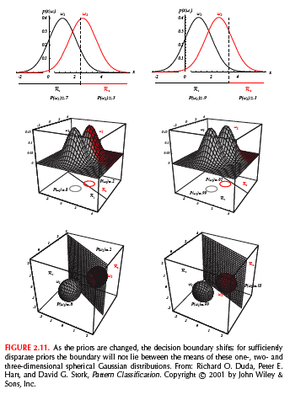
Case 1: Σ_{i}=σ² I
With unequal prior probabilities, the decision boundary shifts to the less likely mean.

Slide 73
Multivariate Gaussian Density: Case 2
Recall
Σ_{i}= Σ

Slide 74
Case 2 : Σ_{i}= Σ

Slide 75
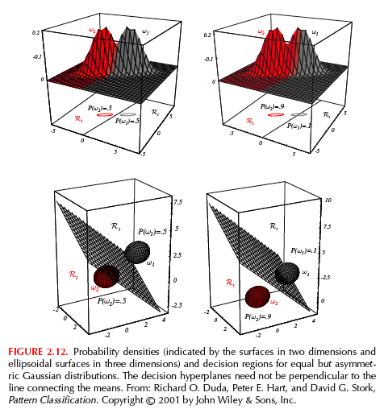
Case 2 : Σ_{i}= Σ
Properties of hyperplane (decision boundary) for equal but asymmetric Gaussian distributions
It passes through x₀
It is not orthogonal to the line between the means.
If P(ω_{i}) and P(ω_{j}) are not equal, then x₀ shifts away from the most likely category.

Slide 76
Case 2 : Σ_{i}= Σ
Mahalanobis distance classifier
When P(ω_{i}) are equal, then the discriminant becomes:

Slide 77
Multivariate Gaussian Density: Case 3
Σ_{i}= arbitrary
hyperquadrics;
e.g., hyperplanes, pairs of hyperplanes, hyperspheres, hyperellipsoids, hyperparaboloids etc.

Slide 78
Case 3: Σ_{i}= arbitrary
non-linear
decision
boundaries

Slide 79
Case 3: Σ_{i}= arbitrary

Slide 80
Case 3: Σ_{i}= arbitrary

Slide 81
Example - Case 3
decision boundary:
P(ω₁)=P(ω₂)
boundary does
not pass through
midpoint of μ₁,μ₂

Slide 82
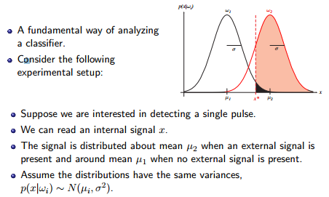
Signal Detection Theory

Slide 83
Signal Detection Theory

Slide 84
Receiver Operating Characteristics

Slide 85
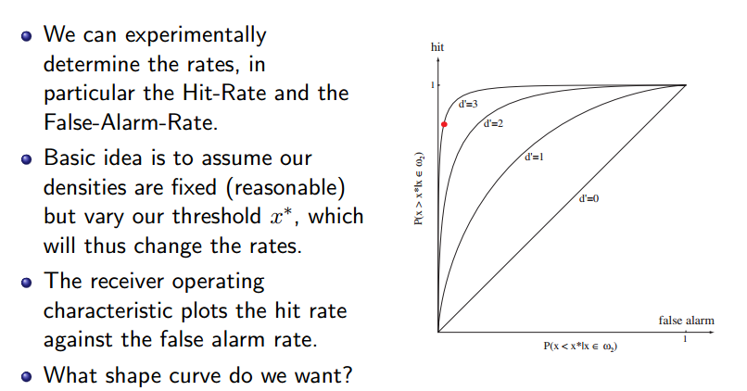
ROC

Slide 86
Example: Person Authentication
Authenticate a person using biometrics (e.g., fingerprints).
There are two possible distributions (i.e., classes):
Authentic (A) and Impostor (I)
A
I

Slide 87
Example: Person Authentication
Possible decisions:
(1) correct acceptance (true positive):
X belongs to A, and we decide A
(2) incorrect acceptance (false positive):
X belongs to I, and we decide A
(3) correct rejection (true negative):
X belongs to I, and we decide I
(4) incorrect rejection (false negative):
X belongs to A, and we decide I
correct rejection
correct acceptance
A
I
false negative
false positive

Slide 88
Error vs Threshold
ROC Curve
x* (threshold)
FAR: False Accept Rate (False Positive)
FRR: False Reject Rate (False Negative)

Slide 89
False Negatives vs Positives
ROC Curve
FAR: False Accept Rate (False Positive)
FRR: False Reject Rate (False Negative)

