Slide 1
Clustering
Slides are adapted from Aykut Erdem
Barnabas Poczos, and Aarti Singh

Slide 30
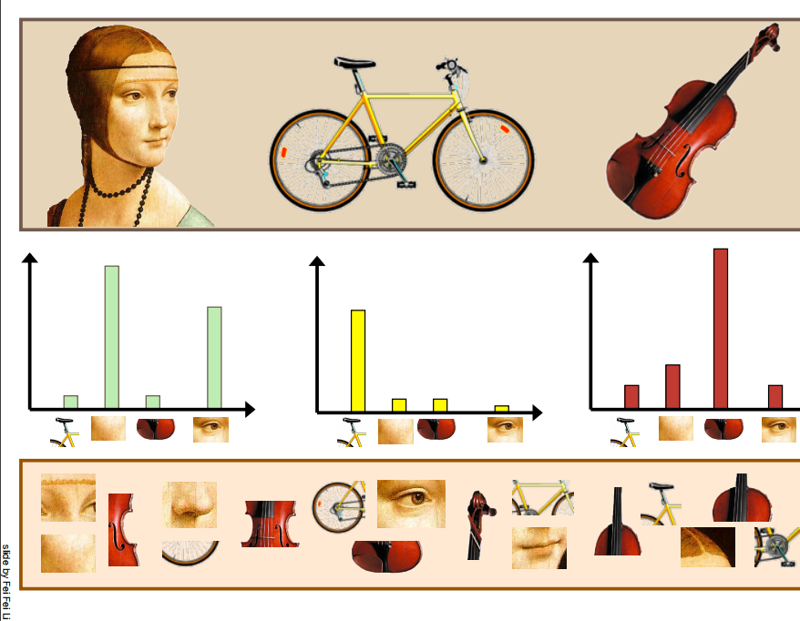

Slide 32
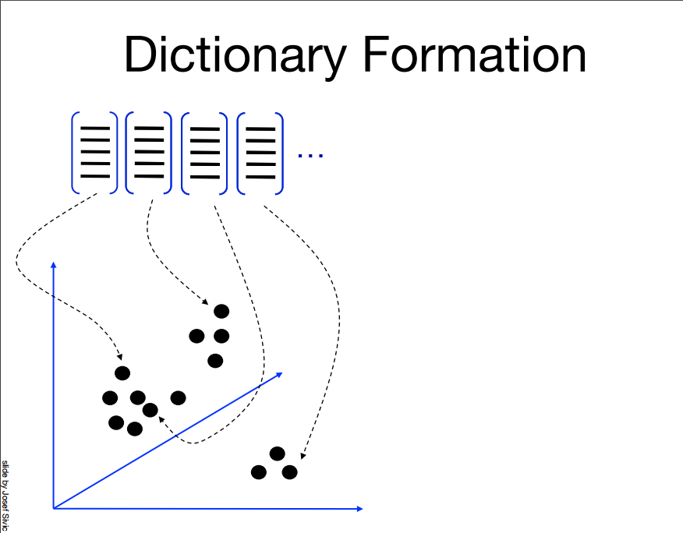

Slide 38
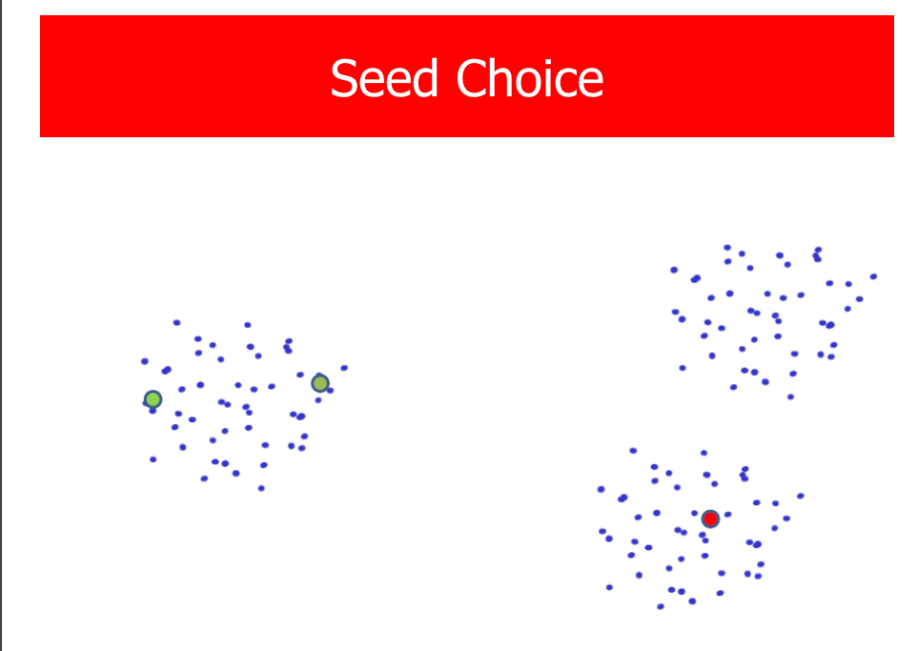

Slide 39
