Slide 1
Decision Trees, Random Forests, Boosting
Slides are adapted from Aykut Erdem

Slide 64
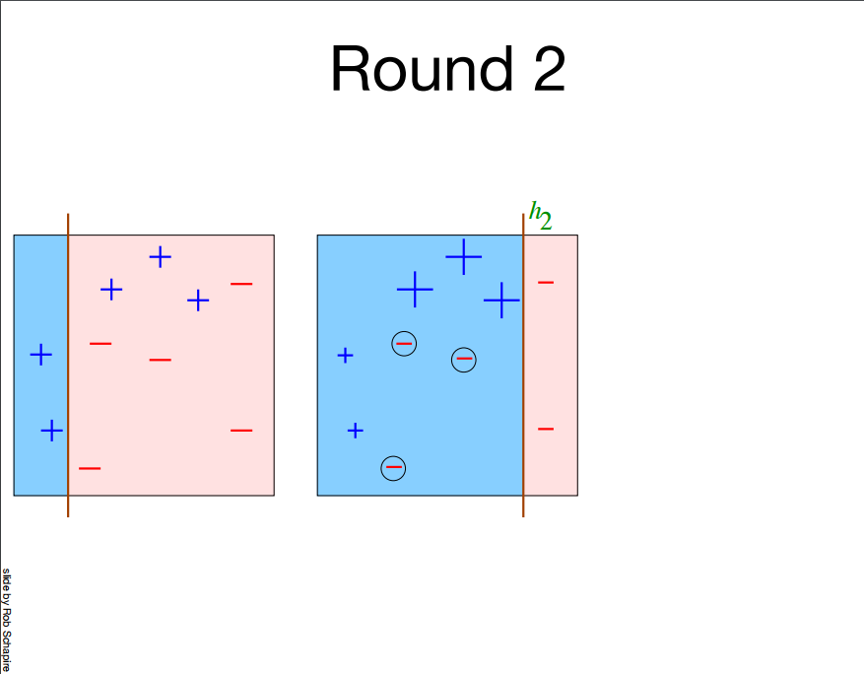

Slide 67
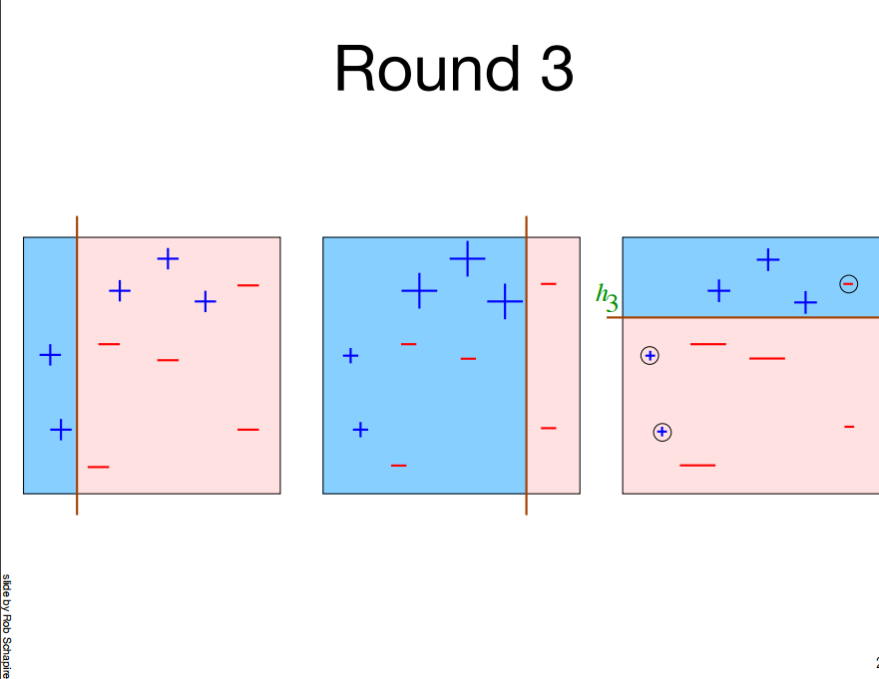

Slide 68
