Slide 1
Deep Learning
Slides are adapted from Aykut Erdem based on Yann LeCun, Marc'Aurelio Ranzato, Yisong Yue, Joan Bruna, Andrej Karpathy, Fei Fei Li, Justin Johnson

Slide 37
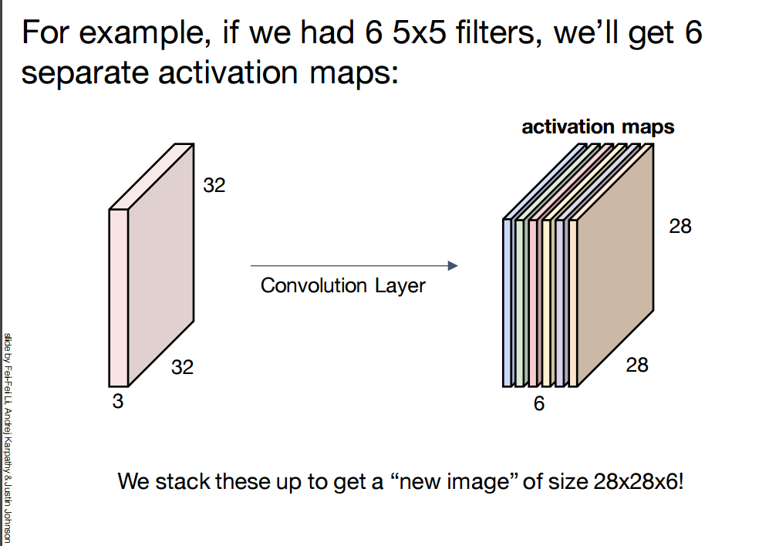

Slide 58
