Slide 1
Introduction
Slides are adapted from Sargur Srihari (CEDAR), Jason Corso (SUNY at Buffalo), Armando Vieira (Closer), Luis Gustavo Martins (Catolica), Selim Aksoy (Bilkent)

Slide 4
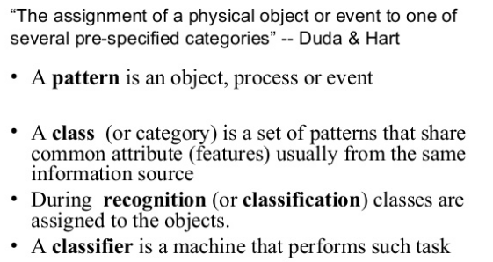
What is Pattern recognition?

Slide 5
What is Pattern recognition?

Slide 6
Human and machine perception

Slide 12
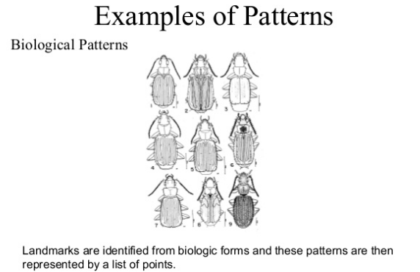

Slide 13
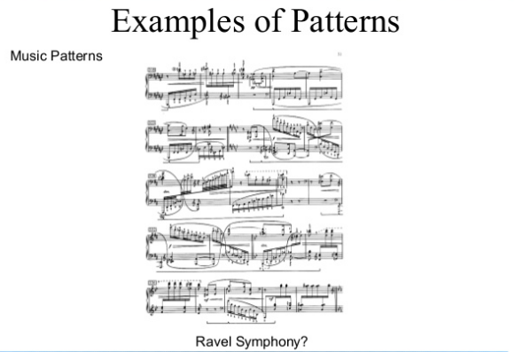

Slide 20
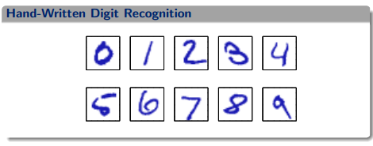

Slide 21
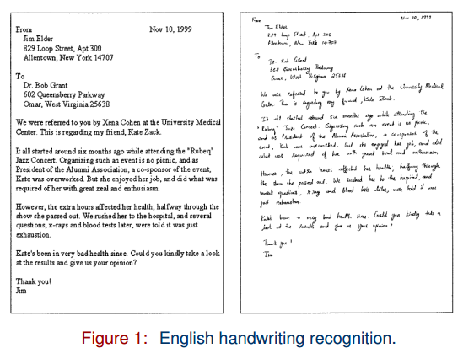

Slide 23
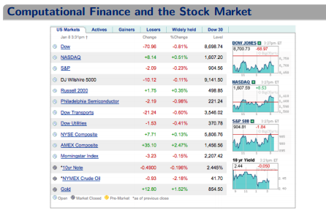

Slide 24
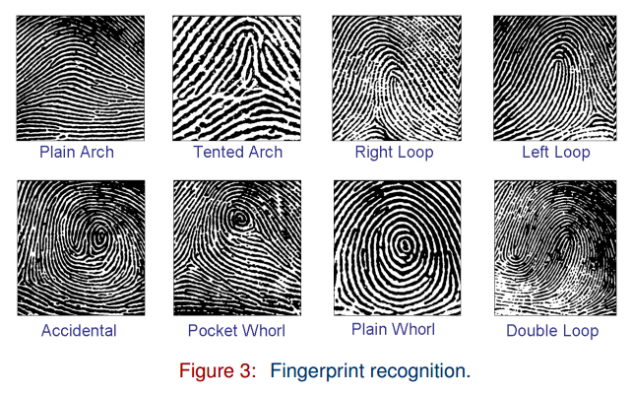

Slide 25
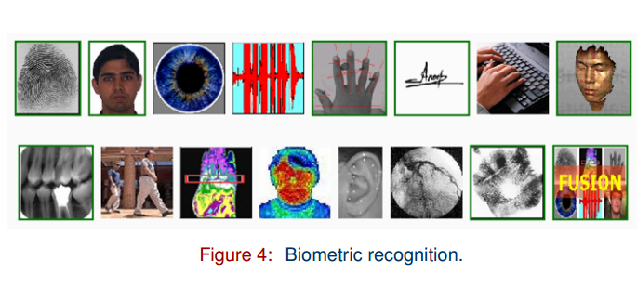

Slide 26
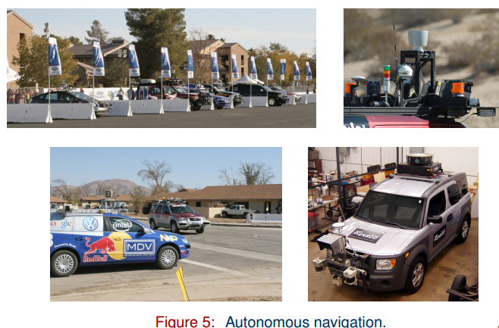

Slide 27
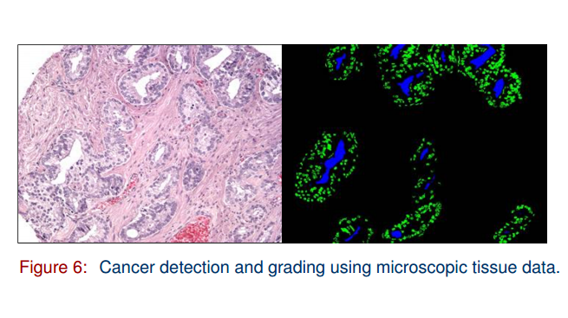

Slide 28
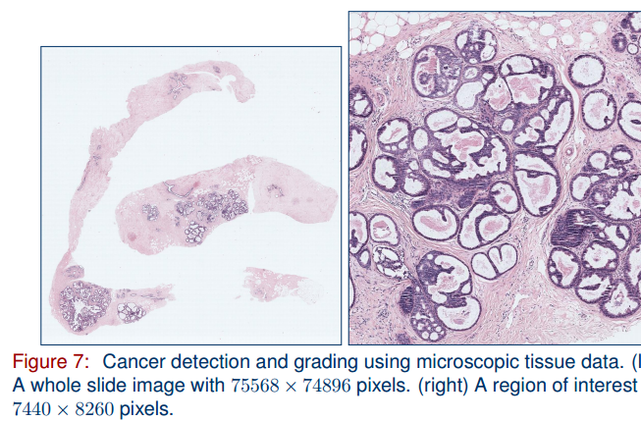

Slide 29
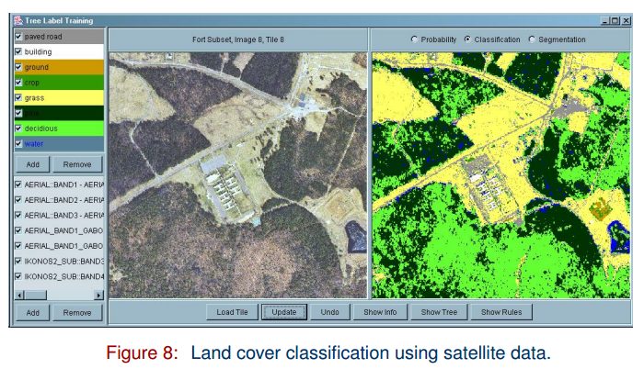

Slide 30
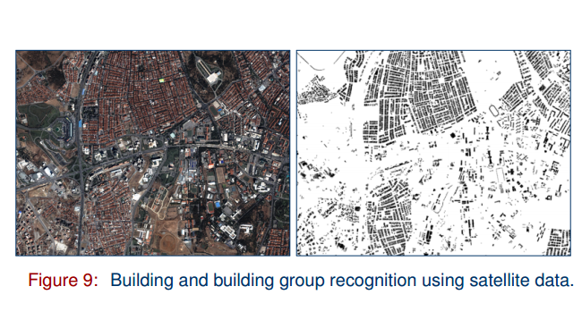

Slide 31
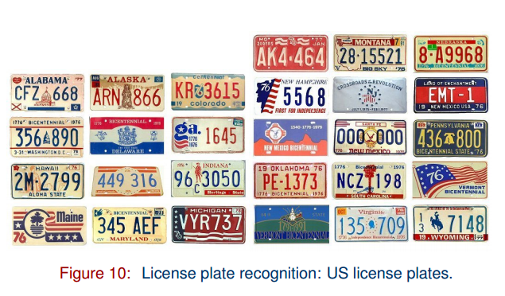

Slide 32
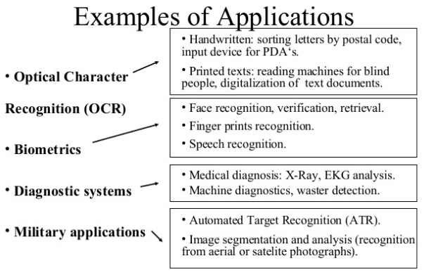

Slide 33
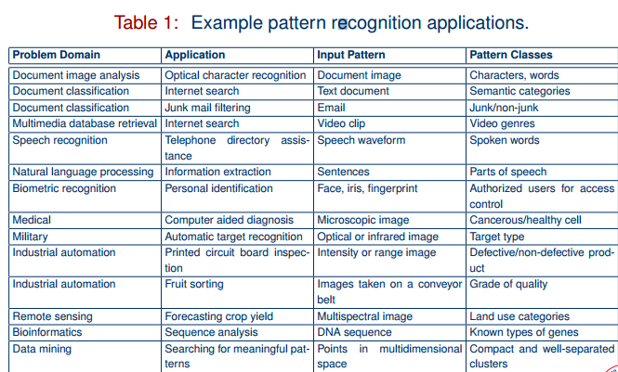

Slide 45
An example

Slide 46
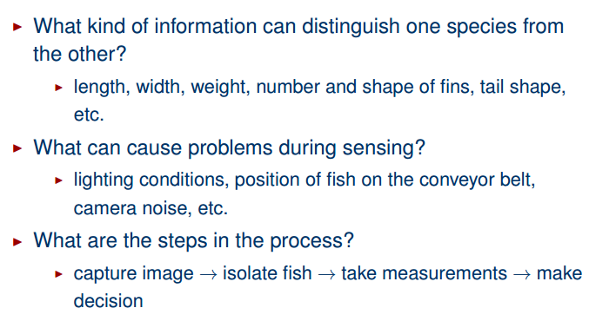
Decision process

Slide 51
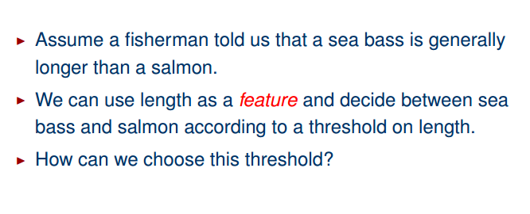
Selecting features

Slide 52
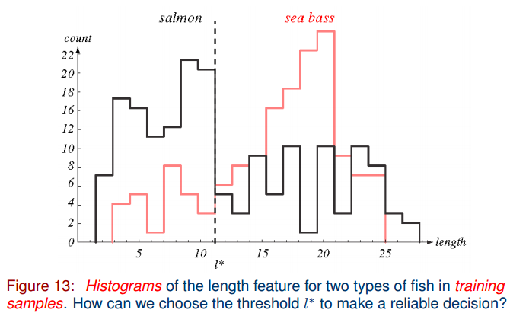
Selecting features

Slide 53
Selecting features

Slide 54
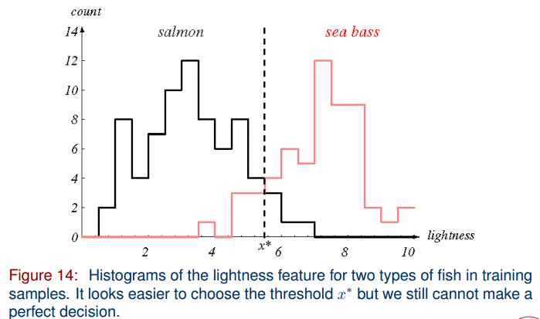
Selecting features

Slide 55
Cost of error

Slide 56
Multiple features

Slide 57
Multiple features

Slide 58
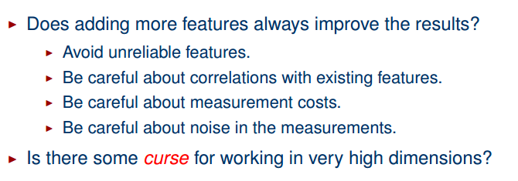
Multiple features

Slide 59
Decision boundaries

Slide 60
Decision boundaries

Slide 61
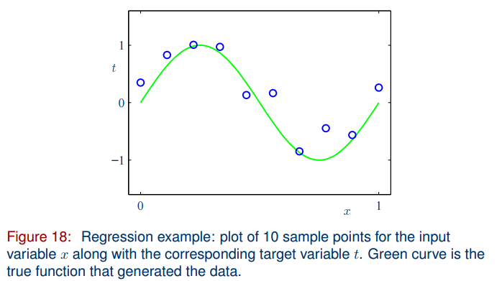
More on complexity

Slide 62
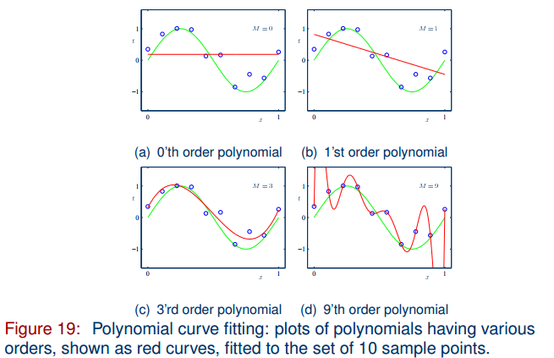
More on complexity

Slide 63
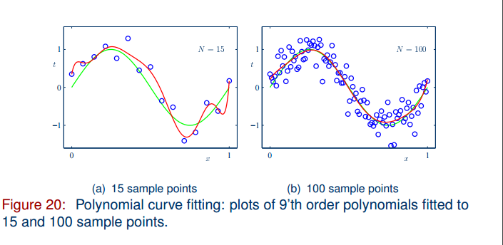
More on complexity

Slide 64
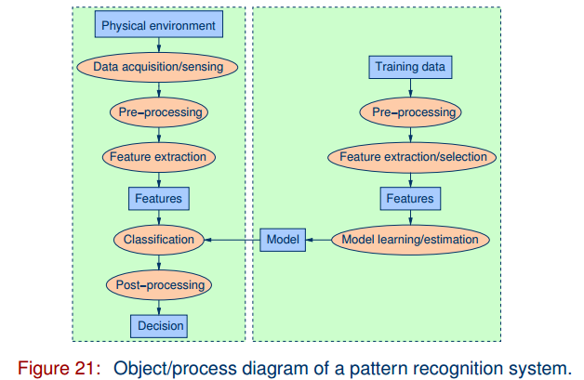
Pattern Recognition systems

Slide 65
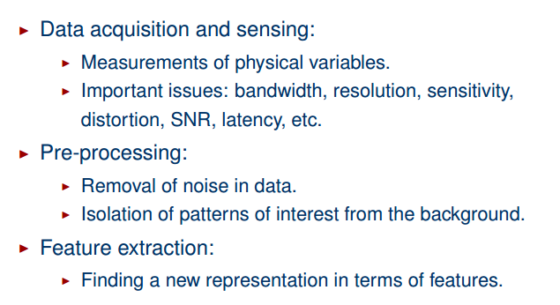
Pattern Recognition systems

Slide 66
Pattern Recognition systems

Slide 67
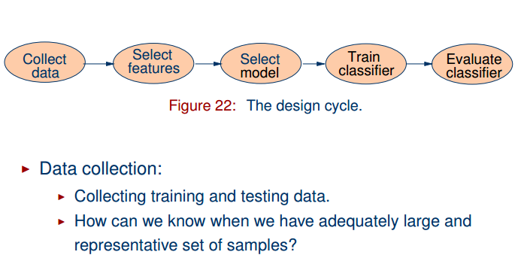
The design cycle

Slide 68
The design cycle

Slide 69
The design cycle

Slide 70
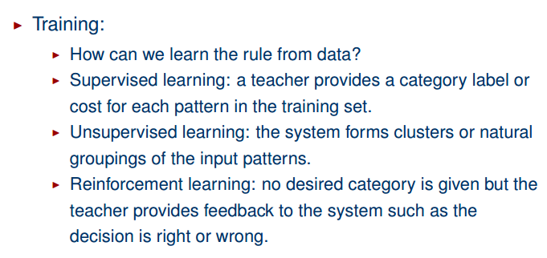
The design cycle

Slide 71
The design cycle

