Slide 1
Naïve Bayes
Slides are adapted from Sebastian Thrun (Udacity ),
Ke Chen
Jonathan Huang and
H. Witten’s and E. Frank’s “Data Mining” and Jeremy Wyatt,

Slide 2
Background
There are three methods to establish a classifier
a) Model a classification rule directly
Examples: k-NN, decision trees, perceptron, SVM
b) Model the probability of class memberships given input data
Example: perceptron with the cross-entropy cost
c) Make a probabilistic model of data within each class
Examples: naive Bayes, model based classifiers
a) and b) are examples of discriminative classification
c) is an example of generative classification
b) and c) are both examples of probabilistic classification

Slide 3
Probability Basics
Prior, conditional and joint probability for random variables
Prior probability:
Conditional probability:
Joint probability:
Relationship:
Independence:
Bayesian Rule
Discriminative
Generative

Slide 4
Probabilistic Classification
Establishing a probabilistic model for classification
Discriminative model
To train a discriminative classifier regardless its probabilistic or non-probabilistic nature, all training examples of different classes must be jointly used to build up a single discriminative classifier.
Output L probabilities for L class labels in a probabilistic classifier while a single label is achieved by a non-probabilistic classifier .
Discriminative
Probabilistic Classifier

Slide 5
Probabilistic Classification
Establishing a probabilistic model for classification (cont.)
Generative model (must be probabilistic)
L probabilistic models have to be trained independently
Each is trained on only the examples of the same label
Output L probabilities for a given input with L models
“Generative” means that such a model produces data subject to the distribution via sampling.
Generative
Probabilistic Model
for Class 1
Generative
Probabilistic Model
for Class L

Slide 6
Probabilistic Classification
Maximum A Posterior (MAP) classification rule
For an input x, find the largest one from L probabilities output by a discriminative probabilistic classifier
Assign x to label c* if is the largest.
Generative classification with the MAP rule
Apply Bayesian rule to convert them into posterior probabilities
Then apply the MAP rule to assign a label
Common factor for all L probabilities

Slide 7
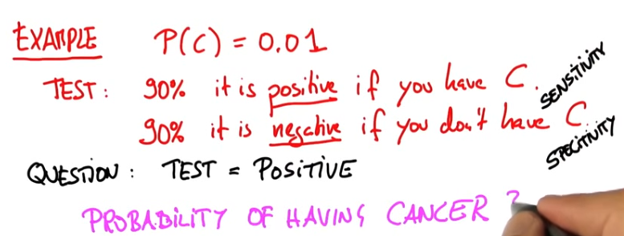
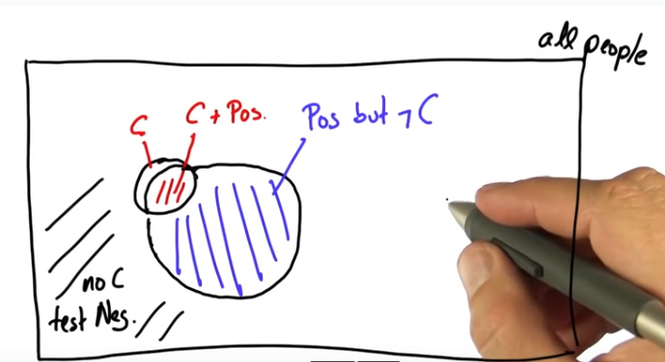

Slide 8
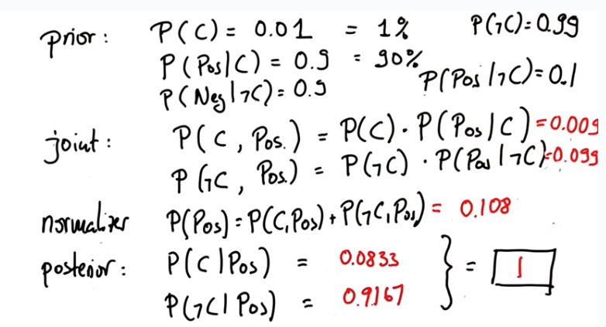

Slide 9
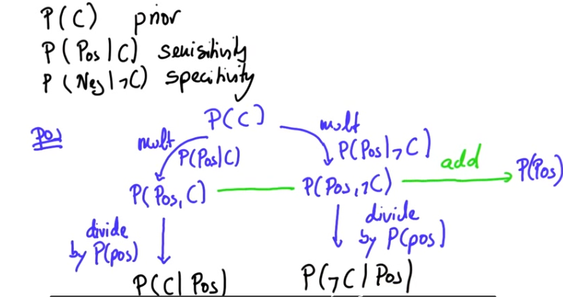

Slide 10
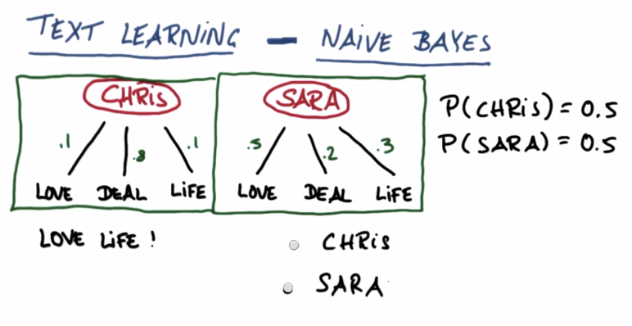

Slide 11
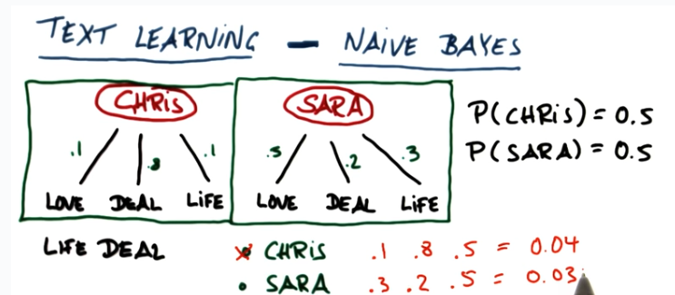
Naïve Bayes

Slide 12
Things We’d Like to Do
Spam Classification
Given an email, predict whether it is spam or not
Medical Diagnosis
Given a list of symptoms, predict whether a patient has disease X or not
Weather
Based on temperature, humidity, etc… predict if it will rain tomorrow

Slide 13
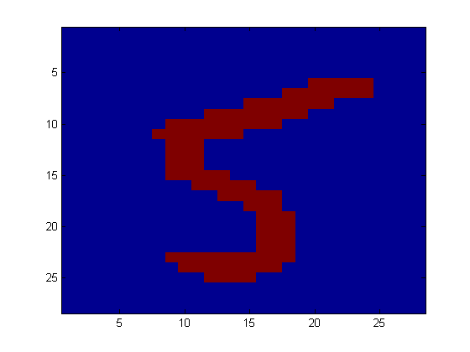
Bayesian Classification
Problem statement:
Given features X₁,X₂,…,X_{n}
Predict a label Y
Digit Recognition
X₁,…,X_{n} ∈ {0,1} (Black vs. White pixels)
Y ∈ {5,6} (predict whether a digit is a 5 or a 6)
Classifier
5

Slide 14
The Bayes Classifier
we saw that a good strategy is to predict:
(for example: what is the probability that the image represents a 5 given its pixels?)
So … How do we compute that?

Slide 15
The Bayes Classifier
Use Bayes Rule!
Why did this help? Well, we think that we might be able to specify how features are “generated” by the class label
Likelihood
Prior
Normalization Constant

Slide 16
The Bayes Classifier
Let’s expand this for our digit recognition task:
To classify, we’ll simply compute these two probabilities and predict based on which one is greater

Slide 17
Model Parameters
For the Bayes classifier, we need to “learn” two functions, the likelihood and the prior
How many parameters are required to specify the prior for our digit recognition example?
(Supposing that each image is 30x30 pixels)
The problem with explicitly modeling P(X₁,…,X_{n}|Y) is that there are usually way too many parameters:
We’ll run out of space
We’ll run out of time
And we’ll need tons of training data (which is usually not available)

Slide 18
The Naïve Bayes Model
The Naïve Bayes Assumption: Assume that all features are independent given the class label Y
Equationally speaking:
(We will discuss the validity of this assumption later)

Slide 19
Why is this useful?
# of parameters for modeling P(X₁,…,X_{n}|Y):
2(2^{n}-1)
# of parameters for modeling P(X₁|Y),…,P(X_{n}|Y)
2n

Slide 20
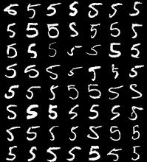
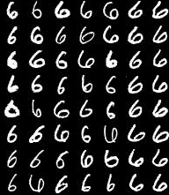
Naïve Bayes Training
Now that we’ve decided to use a Naïve Bayes classifier, we need to train it with some data:
MNIST Training Data

Slide 21
Naïve Bayes Training
Training in Naïve Bayes is easy:
Estimate P(Y=v) as the fraction of records with Y=v
Estimate P(X_{i}=u|Y=v) as the fraction of records with Y=v for which X_{i}=u
(This corresponds to Maximum Likelihood estimation of model parameters)

Slide 22
Naïve Bayes Training
In practice, some of these counts can be zero
Fix this by adding “virtual” counts:
(This is like putting a prior on parameters and doing MAP estimation instead of MLE)
This is called Smoothing

Slide 23
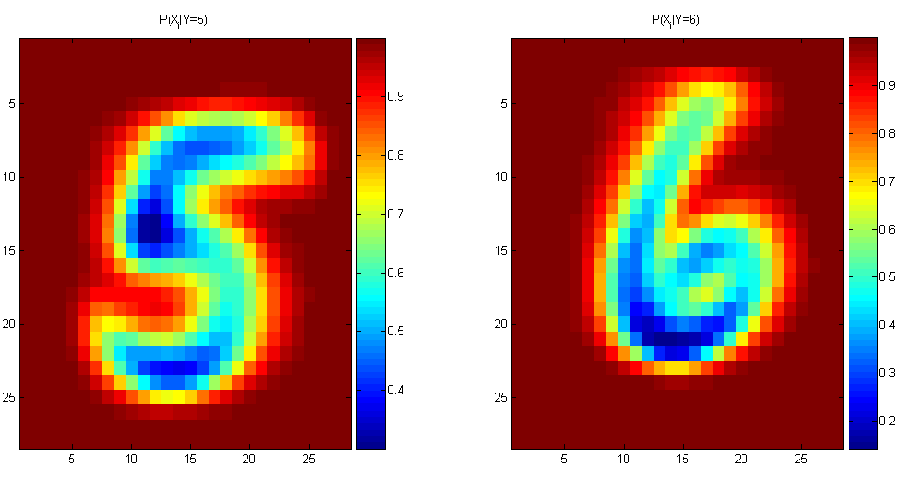
Naïve Bayes Training
For binary digits, training amounts to averaging all of the training fives together and all of the training sixes together.

Slide 24
Naïve Bayes Classification

Slide 25
Naïve Bayes Assumption
Recall the Naïve Bayes assumption:
that all features are independent given the class label Y
X₁ | X₂ | P(Y=0|X₁,X₂) | P(Y=1|X₁,X₂)
0 | 0 | 1 | 0
0 | 1 | 0 | 1
1 | 0 | 0 | 1
1 | 1 | 1 | 0
For an example where conditional independence fails:
Y=XOR(X₁,X₂)
Actually, the Naïve Bayes assumption is almost never true
Still… Naïve Bayes often performs surprisingly well even when its assumptions do not hold

Slide 26
Naïve Bayes
Bayes classification
Difficulty: learning the joint probability is infeasible!
Naïve Bayes classification
Assume all input features are class conditionally independent!
Apply the MAP classification rule: assign to c* if
Applying the independence assumption
Notes:
For a class, the previous generative model can be decomposed by n generative models of a single input.

Slide 27
Naïve Bayes

Slide 28
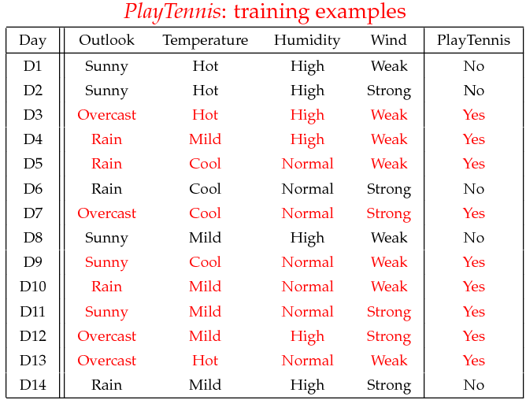
Example
Example: Play Tennis

Slide 29
Example
Learning Phase
Outlook | Play=Yes | Play=No
Sunny | 2/9 | 3/5
Overcast | 4/9 | 0/5
Rain | 3/9 | 2/5
Temperature | Play=Yes | Play=No
Hot | 2/9 | 2/5
Mild | 4/9 | 2/5
Cool | 3/9 | 1/5
Humidity | Play=Yes | Play=No
High | 3/9 | 4/5
Normal | 6/9 | 1/5
Wind | Play=Yes | Play=No
Strong | 3/9 | 3/5
Weak | 6/9 | 2/5
P(Play=Yes) = 9/14
P(Play=No) = 5/14

Slide 30
Example
Test Phase
Given a new instance, predict its label
x’=(Outlook=Sunny, Temperature=Cool, Humidity=High, Wind=Strong)
Look up tables achieved in the learning phrase
Decision making with the MAP rule
P(Outlook=Sunny|Play=Yes) = 2/9
P(Temperature=Cool|Play=Yes) = 3/9
P(Huminity=High|Play=Yes) = 3/9
P(Wind=Strong|Play=Yes) = 3/9
P(Play=Yes) = 9/14
P(Outlook=Sunny|Play=No) = 3/5
P(Temperature=Cool|Play==No) = 1/5
P(Huminity=High|Play=No) = 4/5
P(Wind=Strong|Play=No) = 3/5
P(Play=No) = 5/14
P(Yes|x’) ≈ [P(Sunny|Yes)P(Cool|Yes)P(High|Yes)P(Strong|Yes)]P(Play=Yes) = 0.0053
P(No|x’) ≈ [P(Sunny|No) P(Cool|No)P(High|No)P(Strong|No)]P(Play=No) = 0.0206
Given the fact P(Yes|x’) < P(No|x’), we label x’ to be “No”.

Slide 31
Naïve Bayes
Algorithm: Continuous-valued Features
Numberless values taken by a continuous-valued feature
Conditional probability often modeled with the normal distribution
Learning Phase:
Output: normal distributions and
Test Phase: Given an unknown instance
Instead of looking-up tables, calculate conditional probabilities with all the normal distributions achieved in the learning phrase
Apply the MAP rule to assign a label (the same as done for the discrete case)

Slide 32
Naïve Bayes
Example: Continuous-valued Features
Temperature is naturally of continuous value.
Yes: 25.2, 19.3, 18.5, 21.7, 20.1, 24.3, 22.8, 23.1, 19.8
No: 27.3, 30.1, 17.4, 29.5, 15.1
Estimate mean and variance for each class
Learning Phase: output two Gaussian models for P(temp|C)

Slide 33
Zero conditional probability
If no example contains the feature value
In this circumstance, we face a zero conditional probability problem during test
For a remedy, class conditional probabilities re-estimated with
(m-estimate)

Slide 34
Zero conditional probability
Example: P(outlook=overcast|no)=0 in the play-tennis dataset
Adding m “virtual” examples (m: up to 1% of #training example)
In this dataset, # of training examples for the “no” class is 5.
We can only add m=1 “virtual” example in our m-esitmate remedy.
The “outlook” feature can takes only 3 values. So p=1/3.
Re-estimate P(outlook|no) with the m-estimate

Slide 35
Numerical Stability
It is often the case that machine learning algorithms need to work with very small numbers
Imagine computing the probability of 2000 independent coin flips
MATLAB thinks that (.5)²⁰⁰⁰=0

Slide 36
Underflow Prevention
Multiplying lots of probabilities
➔ floating-point underflow.
Recall: log(xy) = log(x) + log(y),
➔ better to sum logs of probabilities rather than multiplying probabilities.

Slide 37
Underflow Prevention
Class with highest final un-normalized log probability score is still the most probable.

Slide 38
Numerical Stability
Instead of comparing P(Y=5|X₁,…,X_{n}) with P(Y=6|X₁,…,X_{n}),
Compare their logarithms

Slide 39
Recovering the Probabilities
What if we want the probabilities though??
Suppose that for some constant K, we have:
And
How would we recover the original probabilities?

Slide 40
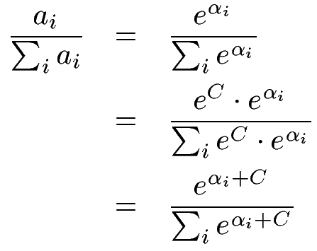
Recovering the Probabilities
Given:
Then for any constant C:
One suggestion: set C such that the greatest α_{i} is shifted to zero:

Slide 41
Recap
We defined a Bayes classifier but saw that it’s intractable to compute P(X₁,…,X_{n}|Y)
We then used the Naïve Bayes assumption – that everything is independent given the class label Y
A natural question: is there some happy compromise where we only assume that some features are conditionally independent?
Stay Tuned…

Slide 42
Conclusions
Naïve Bayes is:
Really easy to implement and often works well
Often a good first thing to try
Commonly used as a “punching bag” for smarter algorithms

Slide 43
Evaluating classification algorithms
You have designed a new classifier.
You give it to me, and I try it on my image dataset

Slide 44
Evaluating classification algorithms
I tell you that it achieved 95% accuracy on my data.
Is your technique a success?

Slide 45
Types of errors
But suppose that
The 95% is the correctly classified pixels
Only 5% of the pixels are actually edges
It misses all the edge pixels
How do we count the effect of different types of error?

Slide 46
Types of errors
Prediction
Edge Not edge
Ground Truth
Not Edge Edge
True Positive | False Negative
False Positive | True Negative

Slide 47
Two parts to each: whether you got it correct or not, and what you guessed. For example for a particular pixel, our guess might be labelled…
True Positive
Did we get it correct? True, we did get it correct.
What did we say? We said ‘positive’, i.e. edge.
or maybe it was labelled as one of the others, maybe…
False Negative
Did we get it correct? False, we did not get it correct.
What did we say? We said ‘negative, i.e. not edge.

Slide 48
Sensitivity and Specificity
Count up the total number of each label (TP, FP, TN, FN) over a large dataset. In ROC analysis, we use two statistics:
TP
Can be thought of as the likelihood of spotting a positive case when presented with one.
Or… the proportion of edges we find.
Sensitivity =
TP+FN
TN
Can be thought of as the likelihood of spotting a negative case when presented with one.
Or… the proportion of non-edges that we find
Specificity =
TN+FP

Slide 49
TP
TN
Sensitivity = = ?
Specificity = = ?
TP+FN
TN+FP
Prediction
1
0
60+30 = 90 cases in the dataset were class 1 (edge)
1
60
30
Ground Truth
0
80+20 = 100 cases in the dataset were class 0 (non-edge)
80
20
90+100 = 190 examples (pixels) in the data overall

Slide 50
The ROC space
1.0
This is edge detector A
This is edge detector B
Sensitivity
0.0
1.0
1 - Specificity
Note

Slide 51
The ROC Curve
Draw a ‘convex hull’ around many points:
Sensitivity
This point is not on the convex hull.
1 - Specificity

Slide 52
ROC Analysis
All the optimal detectors lie on the convex hull.
Which of these is best depends on the ratio of edges to non-edges, and the different cost of misclassification
Any detector on this side can lead to a better detector by flipping its output.
sensitivity
1 - specificity
Take-home point : You should always quote sensitivity and specificity for your algorithm, if possible plotting an ROC graph. Remember also though, any statistic you quote should be an average over a suitable range of tests for your algorithm.

Slide 53
Holdout estimation
What to do if the amount of data is limited?
The holdout method reserves a certain amount for testing and uses the remainder for training
➔Usually: one third for testing, the rest for training

Slide 54
Holdout estimation
Problem: the samples might not be representative
Example: class might be missing in the test data
Advanced version uses stratification
Ensures that each class is represented with approximately equal proportions in both subsets

Slide 55
Repeated holdout method
Repeat process with different subsamples
➔ more reliable
In each iteration, a certain proportion is randomly selected for training (possibly with stratificiation)
The error rates on the different iterations are averaged to yield an overall error rate

Slide 56
Repeated holdout method
Still not optimum: the different test sets overlap
Can we prevent overlapping?
Of course!

Slide 57
Cross-validation
Cross-validation avoids overlapping test sets
First step: split data into k subsets of equal size
Second step: use each subset in turn for testing, the remainder for training
Called k-fold cross-validation

Slide 58
Cross-validation
Often the subsets are stratified before the cross-validation is performed
The error estimates are averaged to yield an overall error estimate

Slide 59
More on cross-validation
Standard method for evaluation: stratified ten-fold cross-validation
Why ten?
Empirical evidence supports this as a good choice to get an accurate estimate
There is also some theoretical evidence for this
Stratification reduces the estimate’s variance
Even better: repeated stratified cross-validation
E.g. ten-fold cross-validation is repeated ten times and results are averaged (reduces the variance)

Slide 60
Leave-One-Out cross-validation
Leave-One-Out: a particular form of cross-validation:
Set number of folds to number of training instances
I.e., for n training instances, build classifier n times
Makes best use of the data
Involves no random subsampling
Very computationally expensive
(exception: NN)

Slide 61
Leave-One-Out-CV and stratification
Disadvantage of Leave-One-Out-CV: stratification is not possible
It guarantees a non-stratified sample because there is only one instance in the test set!

Slide 62
Bayesian Networks
Slides are adapted from Jason Corso

Slide 63
Bayes Nets

Slide 64
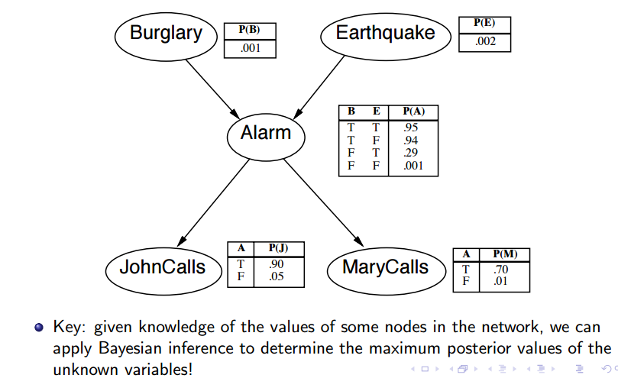
Example

Slide 65
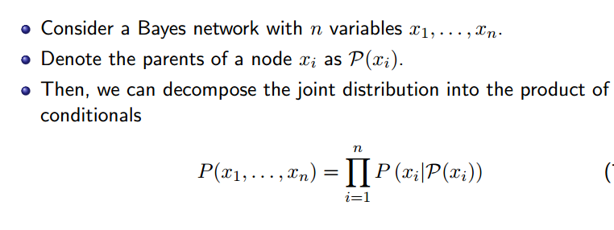
Full Joint distribution

Slide 66
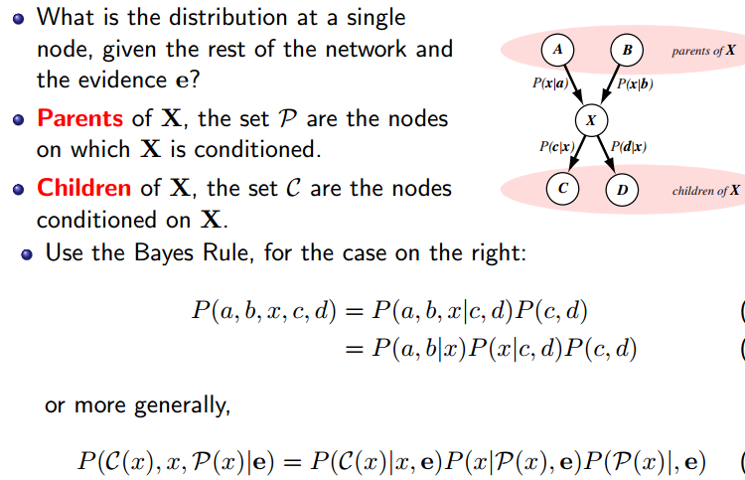

Slide 67
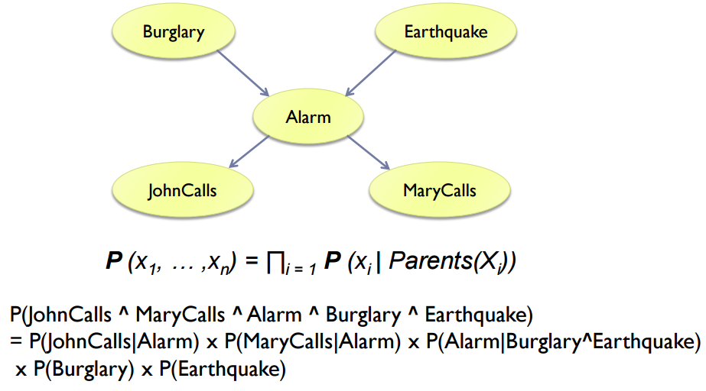

Slide 68
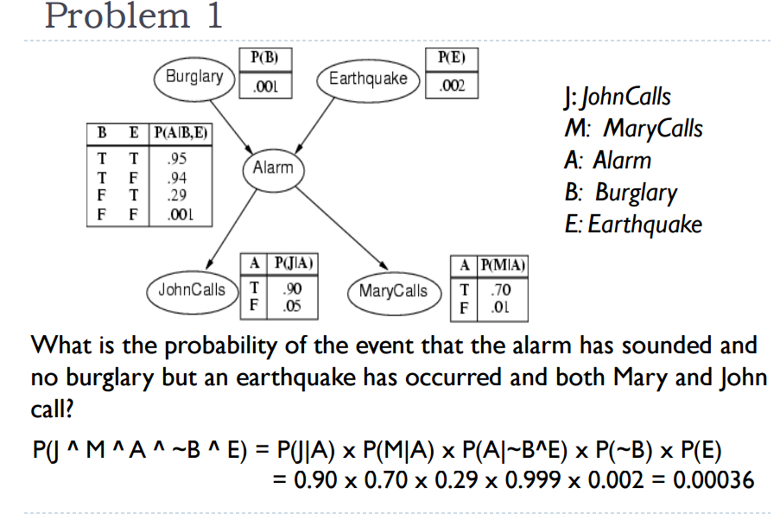

Slide 69
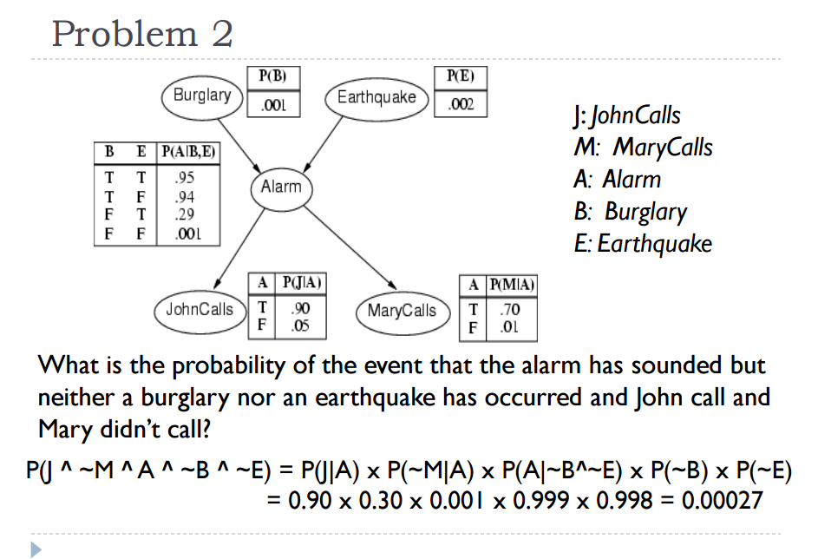

Slide 70
