Slide 1
Introduction to Probability
Slides are adapted from STAT414 course at PennState
https://onlinecourses.science.psu.edu/stat414/

Slide 2
Research questions
What is the probability of students that took probability course?
What is the probability that a randomly selected graduate student gets more than seven hours of sleep each night?
Do women typically cry more than men?
How can we answer our research questions if we can't ask every person in the population our research question?

Slide 3
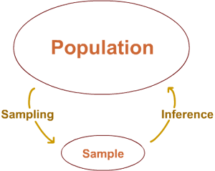
Population versus sample
Take a random sample from the population, and use the resulting sample to learn something, or make an inference, about the population

Slide 4
Sample space
The sample space (or outcome space), denoted S, is the collection of all possible outcomes of a random study.
S = {yes, no} did you take probability course before?
S = {h: h ≥ 0 hours} h: number of hours slept
S = {0, 1, 2, ..., 31} how many times have you cried last month?
For each of the research questions you created:
Formulate the question you would ask (or describe the measurement technique you would use).
Define the resulting sample space.

Slide 5
Types of data
Did you take probability course before?
Quantitative data are called discrete if the sample space contains a finite or countably infinite number of values.
S = {0, 1, 2, ...} countably infinite
Quantitative data are called continuous if the sample space contains an interval or continuous span of real numbers.
S = {h: h ≥ 0 hours}
Qualitative data are called categorical if the sample space contains objects that are grouped or categorized based on some qualitative trait. When there are only two such groups or categories, the data are considered binary.
S = {yes, no}
yes yes yes no no no yes yes yes yes yes no no yes yes no yes yes yes yes

Slide 6
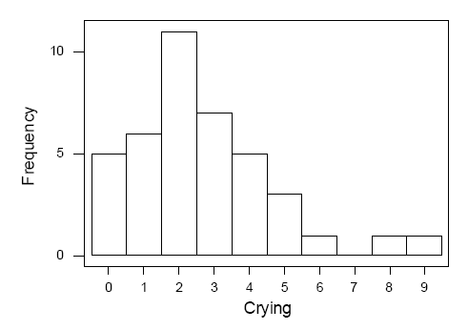
Frequency histogram
How many times have you cried this month?
a histogram gives a nice picture of the
"distribution" of the data
The most common number of times that the women cried in the month was two
(called the "mode").
The numbers ranged from 0 to 9
(that is, the "range" of the data is 9).
A majority of women (22 out of 40) cried two or fewer times, but a few cried as much as six or more times.
9 5 3 2 6 3 2 2 3 4 2 8 4 4 5 0 3 0 2 4 2 1 1 2 2 1 3 0 2 1 3 0 0 2 2 3 4 1 1 5

Slide 7
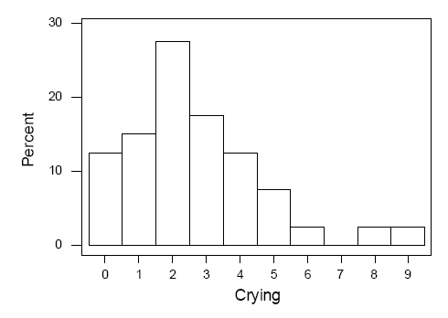
Relative frequency histogram
What percentage of the surveyed women reported not crying at all in the month?
What percentage of the surveyed women reported crying two times in the month? and three times?
Determine the number, n, in the sample.
Determine the frequency, f_{i}, of each outcome i.
Calculate the relative frequency (proportion) of each outcome i by
dividing the frequency of outcome i by the total number in the sample n
— that is, calculate f_{i} ÷ n for each outcome i.

Slide 8
(Discrete) probability mass function
h(x₀) = f₀/n is the relative frequency (or proportion) of students, in a sample of size n, crying x₀ times
As the sample size n increases, f₀/n tends to stabilize and approach some limiting probability p₀ = f(x₀)

Slide 9
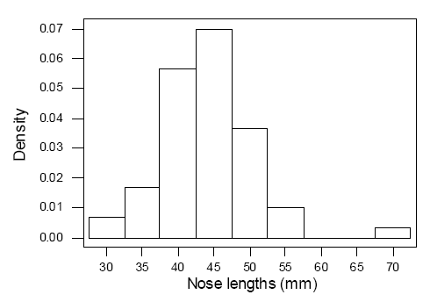
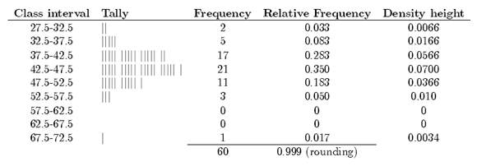
Density histogram Histogram of continuous data
Measured nose lengths
(error in measurement)
38 50 38 40 35 52 45 50 40 32 40 47 70 55 51 43 40 45 45 55 37 50 45 45 55 50 45 35 52 32 45 50 40 40 50 41 41 40 40 46 45 40 43 45 42 45 45 48 45 45 35 45 45 40 45 40 40 45 35 52
Determine the number, n, in the sample.
Define k class intervals (c₀, c₁] , (c₁, c₂] , ..., (c_{k-1}, c_{k}] .
Determine the frequency, f_{i}, of each class i.
Calculate the relative frequency (proportion) of each class by dividing the class frequency by the total number in the sample — that is, f_{i} ÷ n.
For a frequency histogram: draw a rectangle for each class with the class interval as the base and the height equal to the frequency of the class.
For a relative frequency histogram: draw a rectangle for each class with the class interval as the base and the height equal to the relative frequency of the class.
For a density histogram: draw a rectangle for each class with the class interval as the base and the height equal to
h(x)=fi / n(ci−ci-1) for ci−1<x≤ci i = 1, 2,..., k.
the area of the
entire histogram
equals 1.

Slide 10
Event
An event — denoted with capital letters A, B, C, ... — is just a subset of the sample space S. That is, for example A ⊂ S, where "⊂" denotes "is a subset of.“
"how many pairs of jeans do you own?". Sample space S is S = {0, 1, 2, 3, ...}
A is the event that a randomly selected student owns no jeans:
A = student owns none = {0}
B is the event that a randomly selected student owns some jeans:
B = student owns some = {1, 2, 3, ...}
C is the event that a randomly selected student owns no more than five pairs of jeans:
C = student owns no more than five pairs = {0, 1, 2, 3, 4, 5}
D is the event that a randomly selected student owns an odd number of pairs of jeans:
D = student owns an odd number = {1, 3, 5, ...}

Slide 11
Set review
Ø is the "null set" (or "empty set")
C ∪ D = "union" = the elements in C or D or both
A ∩ B = "intersection" = the elements in A and B. If A ∩ B = Ø, then A and B are called "mutually exclusive events" (or "disjoint events").
D' = D^{c} = "complement" = the elements not in D
If E ∪ F ∪ G ∪ ... = S, then E, F, G, and so on are called "exhaustive events."

Slide 12
Examples
The union of events C and D is the event that a randomly selected student either owns no more than five pairs or owns an odd number. That is:
C ∪ D = {0, 1, 2, 3, 4, 5, 7, 9, ...}
The intersection of events A and B is the event that a randomly selected student owes no pairs and owes some pairs of jeans. That is:
A ∩ B = {0} ∩ {1, 2, 3, ...} = the empty set Ø
The complement of event D is the event that a randomly selected student owes an even number of pairs of jeans. That is:
D^{c} = {0, 2, 4, 6, ...}
If E = {0, 1}, F = {2, 3}, G = {4, 5} and so on, so that:
E ∪ F ∪ G ∪ ... = S
then E, F, G, and so on are exhaustive events.

Slide 13
Probability
Probability is a number between 0 and 1, where:
a number close to 0 means "not likely"
a number close to 1 means "quite likely"
If the probability of an event is exactly 0, then the event can't occur. If the probability of an event is exactly 1, then the event will definitely occur.

Slide 14
How does an event get assigned a particular probability value?
the personal opinion approach
"I think there is an 80% chance of rain today."
What about?
one day you will die?
you can swim around the world in 30 hours?
you will win the lottery some day?
a randomly selected student will get an A in this course?
you will get an A in this course?
the relative frequency approach
the classical approach

Slide 15
The Relative Frequency Approach
To determine P(A), the probability of an event A:
Perform an experiment a large number of times, n, say.
Count the number of times the event A of interest occurs, call the number N(A), say.
Then, the probability of event A equals: P(A) = N(A) / n
When you toss a fair coin with one side designated as a "head" and the other side designated as a "tail", what is the probability of getting a head?
Coin Tosser | n, the number of tosses made | N(H), the number of heads tossed | P(H)
Count Buffon | 4,040 | 2,048 | 0.5069
Karl Pearson | 24,000 | 12,012 | 0.5005
John Kerrich | 10,000 | 5,067 | 0.5067

Slide 16
Examples
Some trees in a forest were showing signs of disease.
What is the probability that one tree selected at random is large? 68/200 = 0.34.
What is the probability that one tree selected at random is diseased?
37/200 = 0.185.
What is the probability that one tree selected at random is both small and diseased?
8/200 = 0.04.
What is the probability that one tree selected at random is either small or disease-free?
(35 + 46 + 24 + 8 + 8) /200 = 121 / 200 = 0.605.
What is the probability that one tree selected at random from the population of medium trees is doubtful of disease?
2/92 = 0.348.

Slide 17
Classical approach
the probability of event A is: P(A) = N(A) / N(S)
N(A) is the number of elements in the event A, and N(S) is the number of elements in the sample space S.
Suppose you draw one card at random from a standard deck of 52 cards
13 face values (Ace, 2, 3, 4, 5, 6, 7, 8, 9, 10, Jack, Queen, and King) in 4 different suits (Clubs, Diamonds, Hearts, and Spades) for a total of 52 cards.
A = {x: x is a 2, 3, or 7}
B = {x: x is 2H, 3D, 8S, or KC}

Slide 18
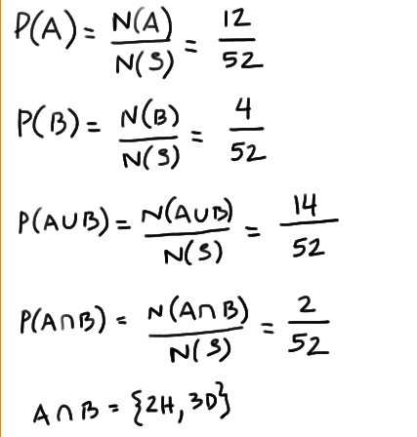
Example
What is the probability that a 2, 3, or 7 is drawn?
What is the probability that the card is a 2 of hearts, 3 of diamonds, 8 of spades or king of clubs?
What is the probability that the card is either a 2, 3, or 7 or a 2 of hearts, 3 of diamonds, 8 of spades or king of clubs?
What is P(A∩B)?

Slide 19
Axioms of probability
The probability of any event A must be nonnegative, that is, P(A) ≥ 0.
The probability of the sample space is 1, that is, P(S) = 1.
Given mutually exclusive events A₁, A₂, A₃, ... that is, where A_{i} ∩ A_{j} = Ø, for i ≠ j,
the probability of a finite union of the events is the sum of the probabilities of the individual events, that is:
P(A1∪A2∪⋯∪Ak)=P(A1)+P(A2)+⋯+P(Ak)
the probability of a countably infinite union of the events is the sum of the probabilities of the individual events, that is:
P(A1∪A2∪⋯)=P(A1)+P(A2)+⋯

Slide 20
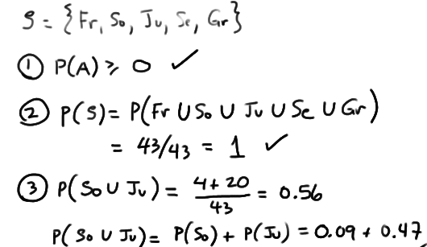
Example
Status | Fresh | Soph | Jun | Sen | Grad | Total
Count | 1 | 4 | 20 | 9 | 9 | 43
Proportion | 0.02 | 0.09 | 0.47 | 0.21 | 0.21
Randomly select one student from the class.
Defining the following events:
Fr = the event that a Freshman is selected
So = the event that a Sophomore is selected
Ju = the event that a Junior is selected
Se = the event that a Senior is selected
Gr = the event that a Graduate student is selected
The sample space is S = (Fr, So, Ju, Se, Gr}. Using the relative frequency approach to assigning probability to the events:
P(Fr) = 0.02
P(So) = 0.09
P(Ju) = 0.47
P(Se) = 0.21
P(Gr) = 0.21

Slide 21
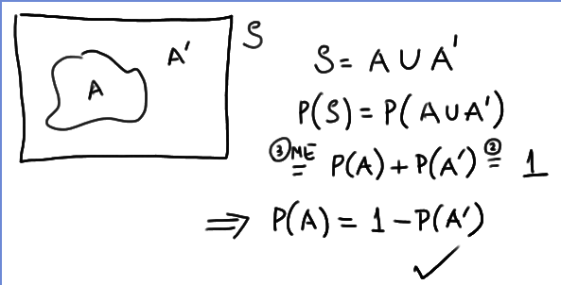
Theorems of probability
P(A) = 1 − P(A').

Slide 22
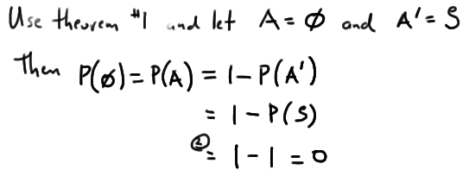
Theorems of probability
P(Ø) = 0.

Slide 23
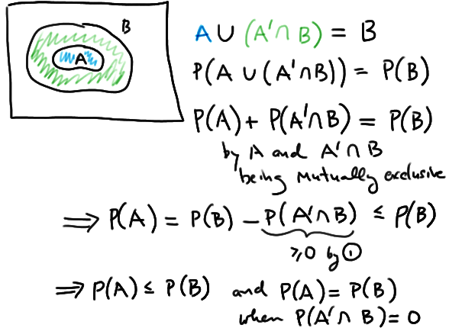
Theorems of probability
If events A and B are such that A ⊆ B, then P(A) ≤ P(B).

Slide 24
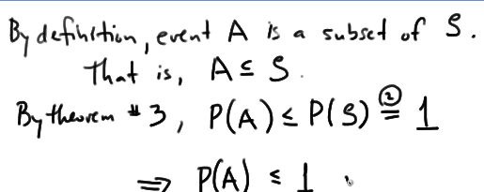
Theorems of probability
P(A) ≤ 1.

Slide 25
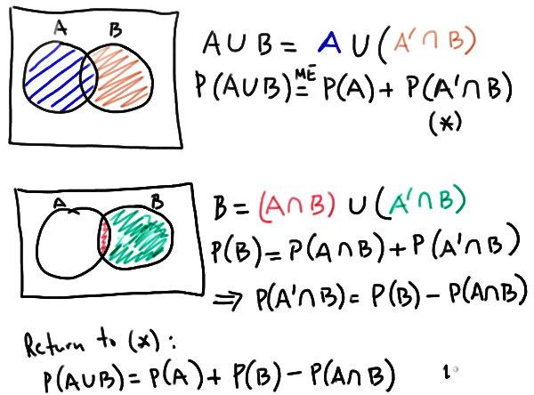
Theorems of probability
For any two events A and B, P(A ∪ B) = P(A) + P(B) − P(A ∩ B).

Slide 26
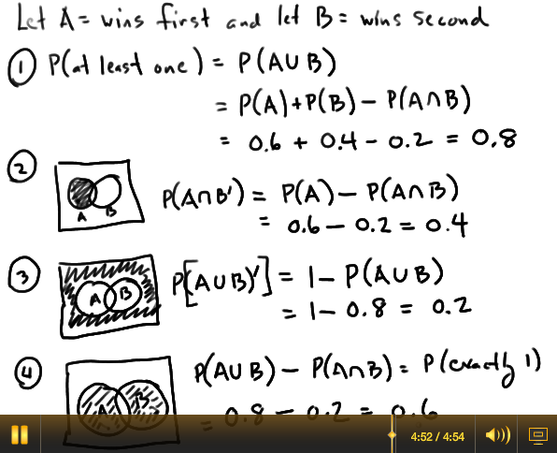
Example
A company has bid on two large construction projects. The company president believes that the probability of winning the first contract is 0.6, the probability of winning the second contract is 0.4, and the probability of winning both contracts is 0.2.
What is the probability that the company wins at least one contract?
What is the probability that the company wins the first contract but not the second contract?
What is the probability that the company wins neither contract?
What is the probability that the company wins exactly one contract?

Slide 27
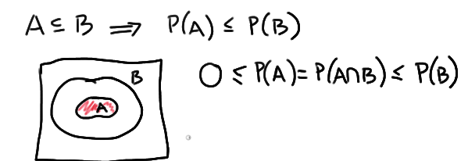
Example
f it is known that A ⊆ B, what can be definitively said about P(A ∩ B)?

Slide 28
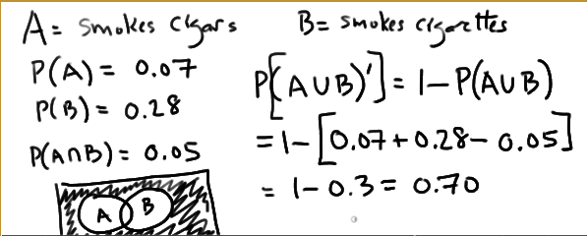
Example
If 7% of the population smokes cigars, 28% of the population smokes cigarettes, and 5% of the population smokes both, what percentage of the population smokes neither cigars nor cigarettes?

Slide 29
Multiplication principle
A Six and a head
S = {1H, 1T, 2H, 2T, ...}
6 x 2 = 12 possible outcomes
P(A) = N(A) / N(S)
The Multiplication Principle. If there are:
n₁ outcomes of a random experiment E₁
n₂ outcomes of a random experiment E₂
... and ...
n_{m} outcomes of a random experiment E_{m}
then there are n₁ × n₂ × ... × n_{m} outcomes of the composite experiment E₁E₂ ... E_{m}.

Slide 30
Permutations
Suppose there are n positions to be filled with n different objects, in which there are:
n choices for the 1st position
n − 1 choices for the 2nd position
n − 2 choices for the 3rd position
... and ...
1 choice for the last position
The Multiplication Principle tells us there are then in general:
n × (n − 1) × (n − 2) × ... × 1 = n!
ways of filling the n positions.
Definition. A permutation of n objects is an ordered arrangement of the n objects.
Example: If there are 4 positions and 4 people to take them, for the first position there are 4 options, for the next there are 3 options since the first one is already chosen, etc.
4x3x2x1 possible ways

Slide 31
Permutations
Suppose there are r positions to be filled with n different objects, in which there are:
n choices for the 1st position
n − 1 choices for the 2nd position
n − 2 choices for the 3rd position
... and ...
n − (r − 1) choices for the last position
The Multiplication Principle tells us there are in general:
n × (n − 1) × (n − 2) × ... × [n − (r − 1)]
ways of filling the r positions.
A permutation of n objects taken r at a time
nPr=n! / (n−r)!
Example:
If there are 4 people but 2 positions to take:
4x3 ways

Slide 32
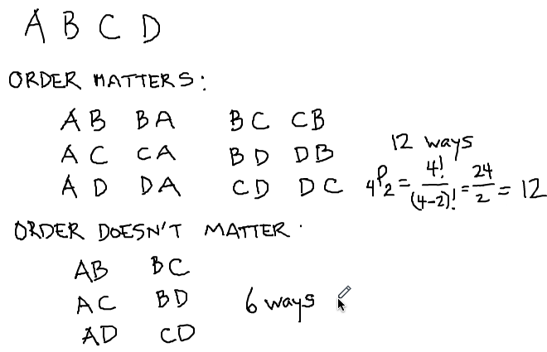
Combinations
Example:
Maria has three tickets for a concert. She'd like to use one of the tickets herself. She could then offer the other two tickets to any of four friends (Ann, Beth, Chris, Dave). How many ways can 2 people be selected from 4 to go to a concert?

Slide 33
Combinations
Definition. The number of unordered subsets, called a combination of n objects taken r at a time, is:
We say “n choose r.”
The r represents the number of objects you'd like to select (without replacement and without regard to order) from the n objects you have.

Slide 34
Example
Twelve (12) patients are available for use in a research study. Only seven (7) should be assigned to receive the study treatment. How many different subsets of seven patients can be selected?

Slide 35
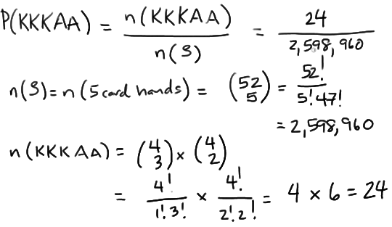
Example
Let's use a standard deck of cards containing 13 face values (Ace, 2, 3, 4, 5, 6, 7, 8, 9, 10, Jack, Queen, and King) and 4 different suits (Clubs, Diamonds, Hearts, and Spades) to play five-card poker. If you are dealt five cards, what is the probability of getting a "full-house" hand containing three kings and two aces (KKKAA)?

Slide 36
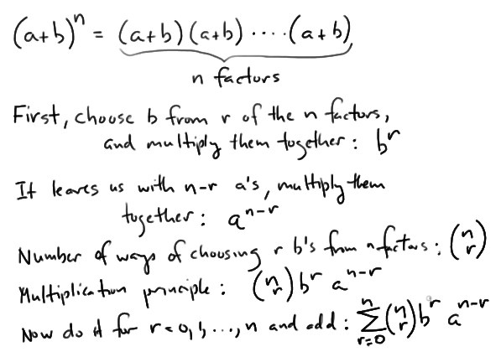
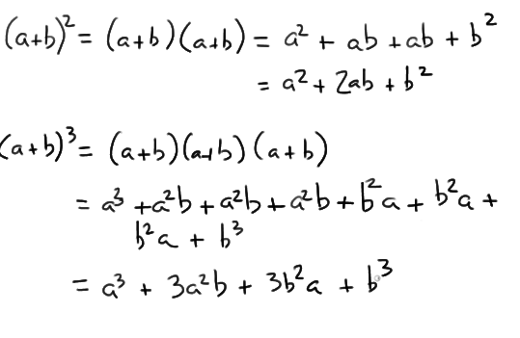
Binomial coefficients

Slide 37
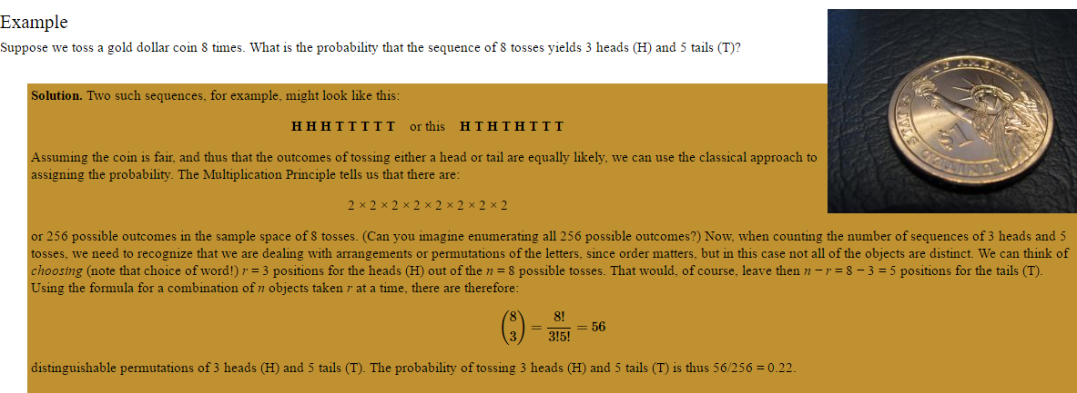
Distinguishable permutations

Slide 38
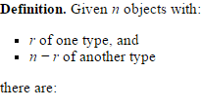
Distinguishable permutations
distinguishable permutations of the n objects.

Slide 39
Distinguishable permutations

Slide 40
Conditional probability
P(T+) = 54/137
P(D) = 67/137
If a person has renal disease, what is the probability that he/she tests positive for the disease?
P(T+ | D) = 44/67 = 0.65

Slide 41
Conditional Probability

Slide 42
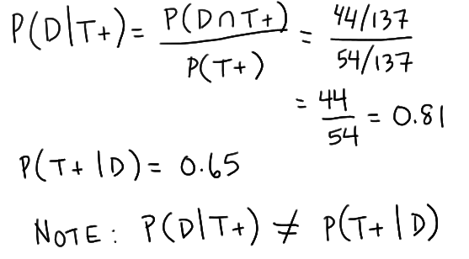
Conditional probability
Sensitivity
If a person has renal disease, what is the probability of testing positive?
"positive predictive value" of a diagnostic test
If I receive a positive test, what is the probability that I actually have the disease?

Slide 43
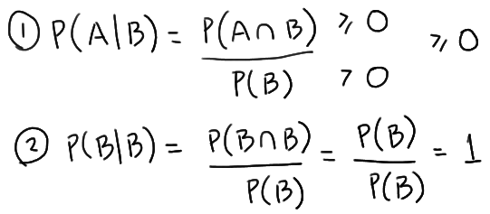
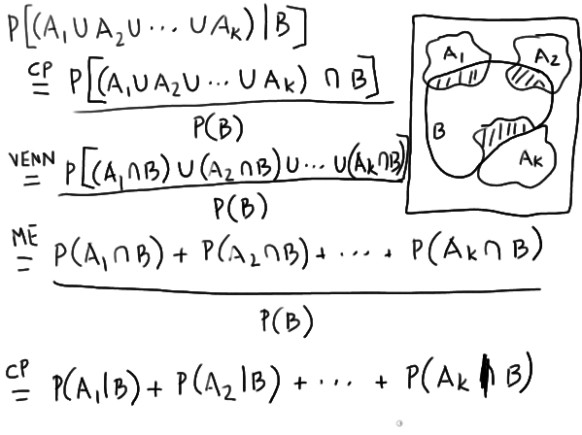
Properties of conditional probability
Because conditional probability is just a probability, it satisfies the three axioms of probability. That is, as long as P(B) > 0:
P(A | B) ≥ 0
P(B | B) = 1
If A₁, A₂, ... A_{k} are mutually exclusive events, then P(A₁ ∪ A₂ ∪ ... ∪ A_{k}| B) = P(A₁ | B) + P(A₂ | B) + ... + P( A_{k}| B) and likewise for infinite unions.

Slide 44
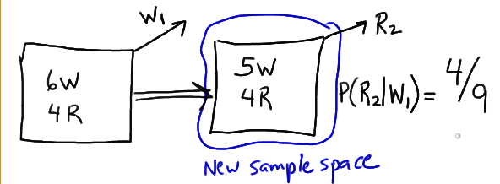
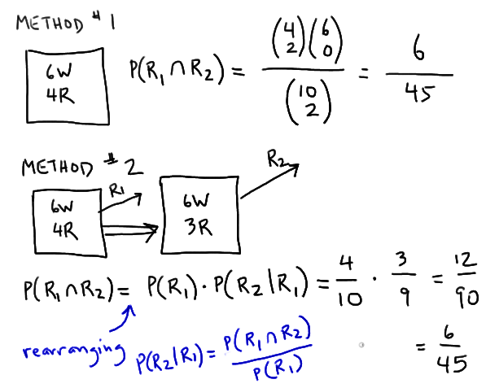
Examples
A box contains 6 white balls and 4 red balls. We randomly (and without replacement) draw two balls from the box. What is the probability that the second ball selected is red, given that the first ball selected is white?
What is the probability that both balls selected are red?

Slide 45
Multiplication rule
Definition. The probability that two events A and B both occur is given by the multiplication rule as:
P(A ∩ B) = P(A | B) × P(B)
or by:
P(A ∩ B) = P(B | A) × P(A)

Slide 46
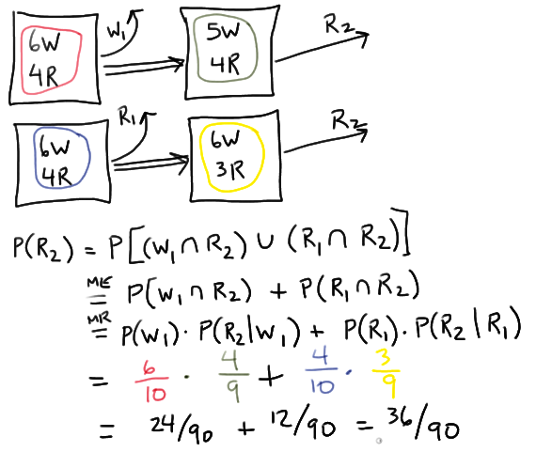
Example
A box contains 6 white balls and 4 red balls. We randomly (and without replacement) draw two balls from the box. What is the probability that the second ball selected is red?

Slide 47
Extended multiplication rule

Slide 48
Example
Medical records reveal that of the 937 men who died in a particular region in 1999:
212 of the men died of causes related to heart disease,
312 of the men had at least one parent with heart disease
Of the 312 men with at least one parent with heart disease, 102 died of causes related to heart disease. Using this information, if we randomly select a man from the region, what is the probability that he dies of causes related to heart disease given that neither of his parents died from heart disease? If we define two events as such:
Let H = the event that at least one of the parents of a randomly selected man died of causes related to heart disease
Let D = the event that a randomly selected man died of causes related to heart disease
then we are looking for the following conditional probability:
P(D | H')

Slide 49
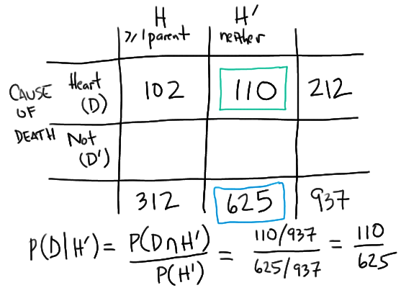
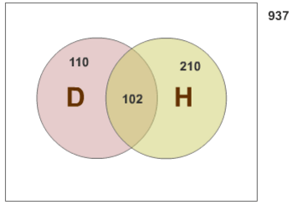
Solution

Slide 50
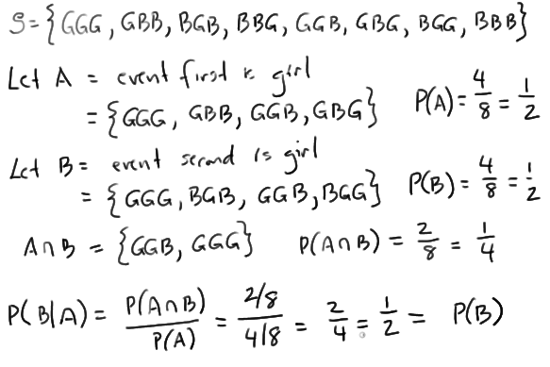
Independent Events
A couple plans to have three children. What is the probability that the second child is a girl? And, what is the probability that the second child is a girl given that the first child is a girl?

Slide 51
Independent events
Definition. Events A and B are independent events if the occurrence of one of them does not affect the probability of the occurrence of the other. That is, two events are independent if either: P(B|A) = P(B)
(provided that P(A) > 0) or:
P(A|B) = P(A)
(provided that P(B) > 0).

Slide 52
Independent events
Now, since independence tells us that P(B|A) = P(B), we can substitute P(B) in for P(B|A) in the formula given to us by the multiplication rule:
P(A ∩ B) = P(A) × P(B |A)
yielding:
P(A ∩ B) = P(A) × P(B).
Definition. Events A and B are independent events if and only if :
P(A ∩ B) = P(A) × P(B)
Otherwise, A and B are called dependent events.

Slide 53
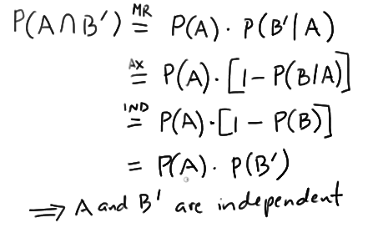
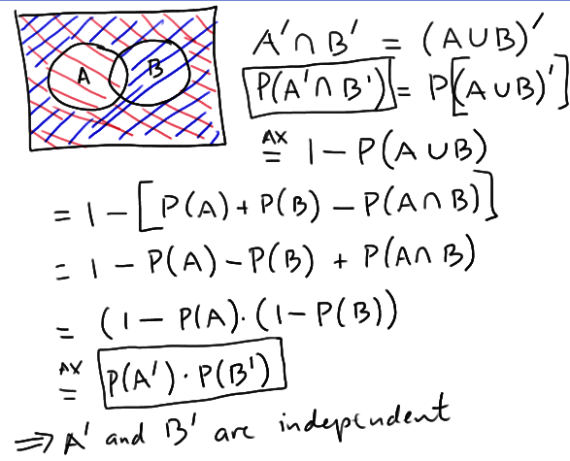
Theorems
If A and B are independent events, then the events A and B' are also independent.
If A and B are independent events, then the events A' and B are also independent.
If A and B are independent events, then the events A' and B' are also independent.

Slide 54
Example
A nationwide poll determines that 72% of the American population loves eating pizza. If two people are randomly selected from the population, what is the probability that the first person loves eating pizza, while the second one does not?
P(A ∩ B') = 0.72 × (1 − 0.72) = 0.202

Slide 55
Mutual independence
Definition. Three events A, B, and C are mutually independent if and only if the following two conditions hold:
(1) The events are pairwise independent. That is,
P(A ∩ B) = P(A) × P(B) and...
P(A ∩ C) = P(A) × P(C) and...
P(B ∩ C) = P(B) × P(C)
(2) P(A ∩ B ∩ C) = P(A) × P(B) × P(C)

Slide 56
Bayes’ theorem
A desk lamp produced by The Luminar Company was found to be defective (D). There are three factories (A, B, C) where such desk lamps are manufactured. A Quality Control Manager (QCM) is responsible for investigating the source of found defects. This is what the QCM knows about the company's desk lamp production and the possible source of defects:
If a randomly selected lamp is defective, what is the probability that the lamp was manufactured in factory C?
Factory | % of total production | Probability of defective lamps
A | 0.35 = P(A) | 0.015 = P(D | A)
B | 0.35 = P(B) | 0.010 = P(D | B)
C | 0.30 = P(C) | 0.020 = P(D | C)

Slide 57
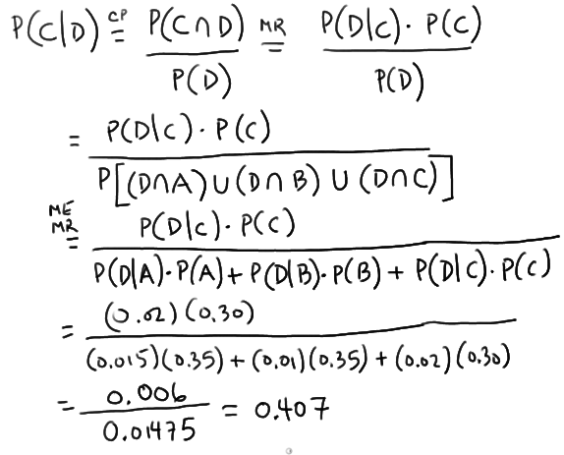
Bayes’ theorem

Slide 58
Bayes’ theorem
if a randomly selected lamp is defective, what is the probability that the lamp was manufactured in factory A? And, if a randomly selected lamp is defective, what is the probability that the lamp was manufactured in factory B?

Slide 59
Bayes’ theorem
The probabilities P(A), P(B) and P(C) are often referred to as prior probabilities, because they are the probabilities of events A, B, and C that we know prior to obtaining any additional information. The conditional probabilities P(A | D),P(B | D), and P(C | D) are often referred to as posterior probabilities, because they are the probabilities of the events after we have obtained additional information.
As a result of our work, we determined:
P(C | D) = 0.407
P(B | D) = 0.237
P(A | D) = 0.356

Slide 60
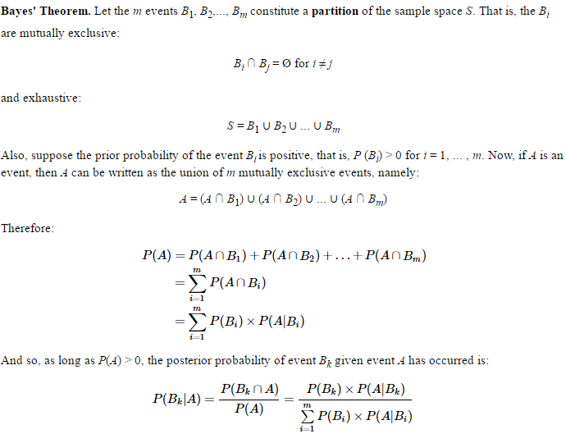

Slide 61
Example
A common blood test indicates the presence of a disease 95% of the time when the disease is actually present in an individual. Joe's doctor draws some of Joe's blood, and performs the test on his drawn blood. The results indicate that the disease is present in Joe.
One-percent (that is, 1 in 100) people have the disease. That is, if D is the event that a randomly selected individual has the disease, then P(D) = 0.01.
If H is the event that a randomly selected individual is disease-free, that is, healthy, then P(H) = 1−P(D) = 0.99.
The sensitivity of the test is 0.95. That is, if a person has the disease, then the probability that the diagnostic blood test comes back positive is 0.95. That is, P(T+ | D) = 0.95.
The specificity of the test is 0.95. That is, if a person is free of the disease, then the probability that the diagnostic test comes back negative is 0.95. That is, P(T− | H) = 0.95.
If a person is free of the disease, then the probability that the diagnostic test comes back positive is 1 − P(T− | H) = 0.05. That is, P(T+ | H) = 0.05.
What is the positive predictive value of the test? That is, given that the blood test is positive for the disease, what is the probability that Joe actually has the disease?

Slide 62
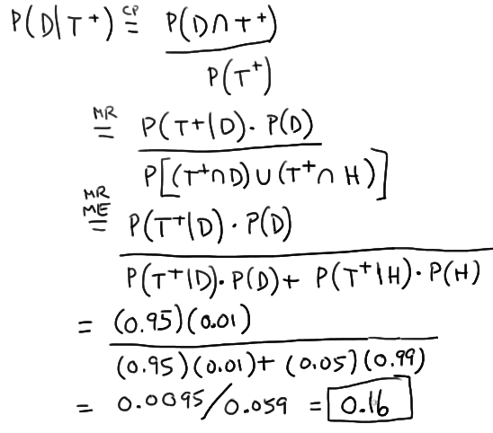

Slide 63
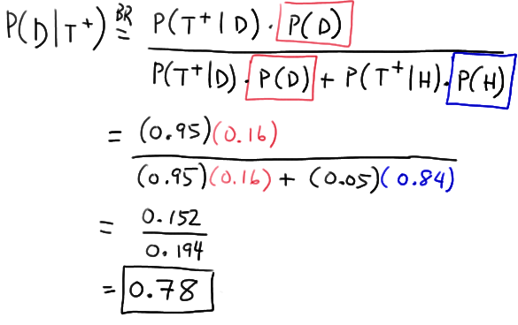
If a second blood test on Joe comes back positive for the disease, what is the probability that Joe actually has the disease now?

Slide 64
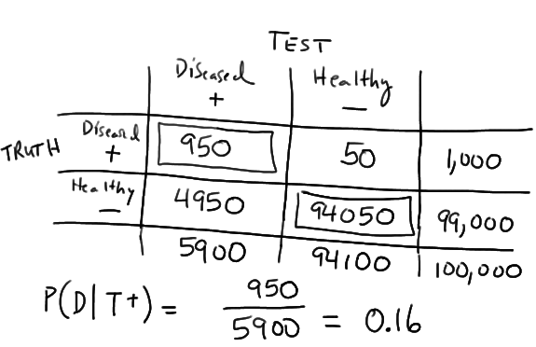
Alternative way

