Slide 1
Random variables, Expectation, Mean and Variance
Slides are adapted from STAT414 course at PennState
https://onlinecourses.science.psu.edu/stat414/

Slide 2
Random variable
Definition. Given a random experiment with sample space S, a random variable X is a set function that assigns one and only one real number to each element s that belongs in the sample space S.
The set of all possible values of the random variable X, denoted x, is called the support, or space, of X.

Slide 3
Example
A rat is selected at random from a cage of male (M) and female rats (F). Once selected, the gender of the selected rat is noted. The sample space is thus:
S = {M, F}
Define the random variable X as follows:
Let X = 0 if the rat is male.
Let X = 1 if the rat is female.
Note that the random variable X assigns one and only one real number (0 and 1) to each element of the sample space (M and F). The support, or space, of X is {0, 1}.
Note that we don't necessarily need to use the numbers 0 and 1 as the support. For example, we could have alternatively (and perhaps arbitrarily?!) used the numbers 5 and 15, respectively. In that case, our random variable would be defined as X = 5 of the rat is male, and X = 15 if the rat is female.

Slide 4
Discrete random variable
Definition. A random variable X is a discrete random variable if:
there are a finite number of possible outcomes of X, or
there are a countably infinite number of possible outcomes of X.
Examples of discrete data include the number of siblings a randomly selected person has, the total on the faces of a pair of six-sided dice

Slide 5
Probability mass function
Definition. The probability mass function,
P(X = x) = f(x), of a discrete random variable X is a function that satisfies
the following properties:
(1) P(X = x) = f(x) > 0 if x ∈ the support S
(2) ∑x∈Sf(x)=1
(3) P(X∈A)=∑x∈Af(x)

Slide 6
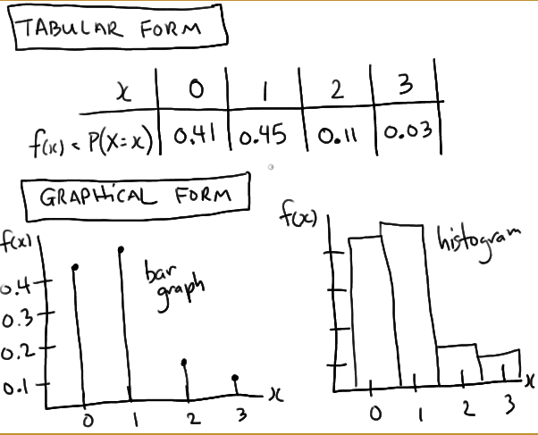
Example
Let X equal the number of siblings of students in a class. The support of X is, of course, 0, 1, 2, 3, ... Because the support contains a countably infinite number of possible values, X is a discrete random variable with a probability mass function. Find f(x) = P(X = x), the probability mass function of X, for all x in the support.

Slide 7
Cumulative Distribution Function
FX(t)=P(X≤t)
The cdf of random variable X has the following properties:
FX(t) is a nondecreasing function of t, for −∞<t<∞.
The cdf, FX(t), ranges from 0 to 1. This makes sense since FX(t) is a probability.
If X is a discrete random variable whose minimum value is a,
then FX(a)=P(X≤a)=P(X=a)=fX(a). If c is less than a, then FX(c)=0.
If the maximum value of X is b, then FX(b)=1.
Also called the distribution function.
All probabilities concerning X can be stated in terms of F.

Slide 8
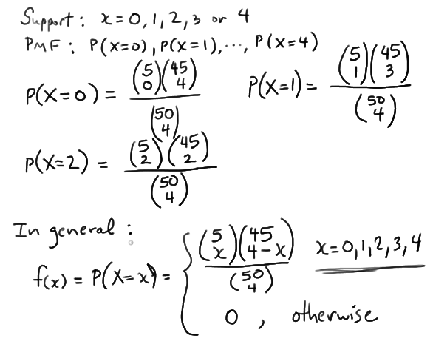
Hypergeometric Distribution
A crate contains 50 light bulbs of which 5 are defective and 45 are not. A Quality Control Inspector randomly samples 4 bulbs without replacement. Let X = the number of defective bulbs selected. Find the probability mass function, f(x), of the discrete random variable X.

Slide 9
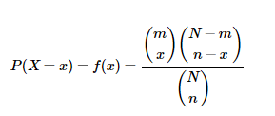
Hypergeometric Distribution
If we randomly select n items without replacement from a set of N items of which:
m of the items are of one type
and N − m of the items are of a second type
then the probability mass function of the discrete random variable X is called the
hypergeometric distribution and is of the form:
where the support S is the collection of nonnegative integers x that satisfies the inequalities:
x ≤ n
x ≤ m
n − x ≤ N − m

Slide 10
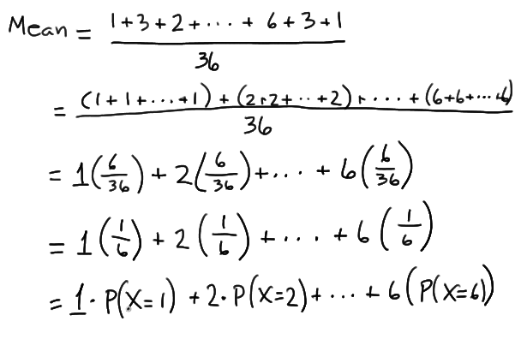
Mean
Toss a fair, six-sided die many times. In the long run , what would the average (or "mean") of the tosses be?
The mean is a weighted average, that is, an average of the values weighted by their respective individual probabilities.
The mean is called the expected value of X, denoted E(X) or by μ,

Slide 11
Expected value

Slide 12
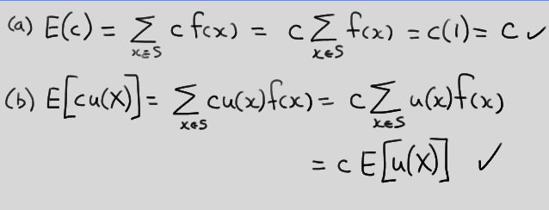
Expectation
Theorem. When it exists, the mathematical expectation E
satisfies the following properties:
(a) If c is a constant, then E(c) = c.
(b) If c is a constant and u is a function, then:
E[cu(X)]=cE[u(X)]

Slide 13
Expectation

Slide 14
Mean

Slide 15
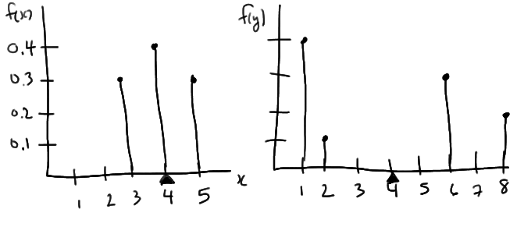
Example
μ_{X} = E(X) = 3(0.3) + 4(0.4) + 5(0.3) = 4
μ_{Y} = E(Y) = 1(0.4) + 2(0.1) + 6(0.3) + 8(0.2) = 4

Slide 16
Variance

Slide 17
Example

Slide 18
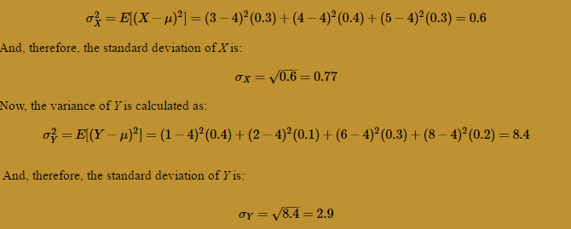
Example

Slide 19
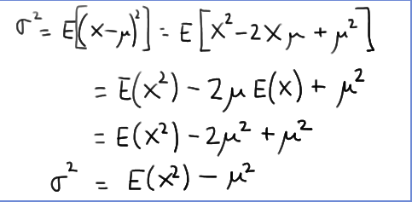
Variance

Slide 20
Sample Mean and Variance

Slide 21
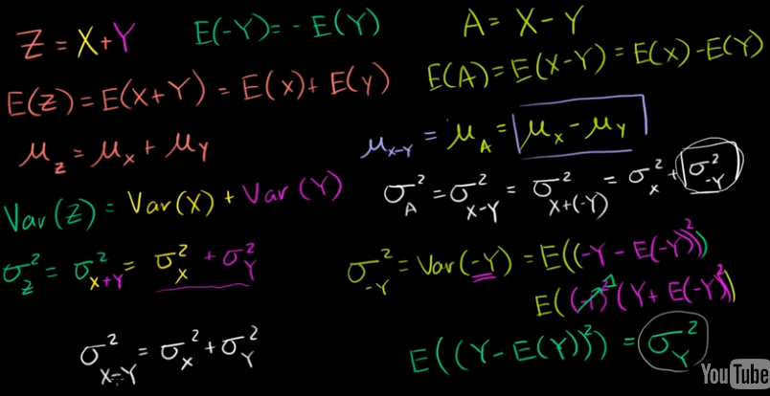
KhanAcademy, Random Variables

Slide 22
Moments
The expected values E(X), E(X²), E(X³), ..., and E(X^{r}) are called moments
Recall that:
μ = E(X)
σ² = Var(X) = E(X²) − μ²

Slide 23
Moment Generating Function
Let X be a discrete random variable with probability mass function f(x) and support S. Then:
is the moment generating function of X as long as the summation is finite for some interval of t around 0.

Slide 25
The moment generation function for a binomial variable is

Slide 26
Binomial Random variable

Slide 27
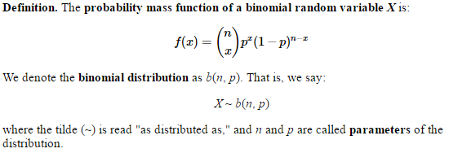
Binomial Distribution

Slide 28
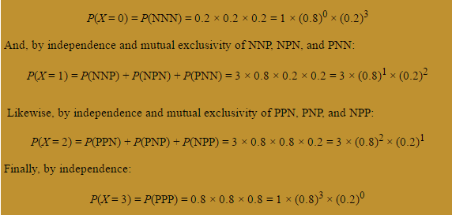
Example

Slide 29
Cumulative Probability Distribution

Slide 30
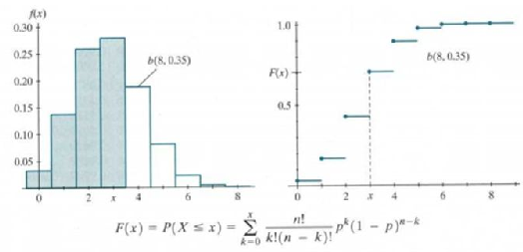
Cumulative Probability Function

Slide 31
Mean and Variance of a Binomial R.V.

Slide 32
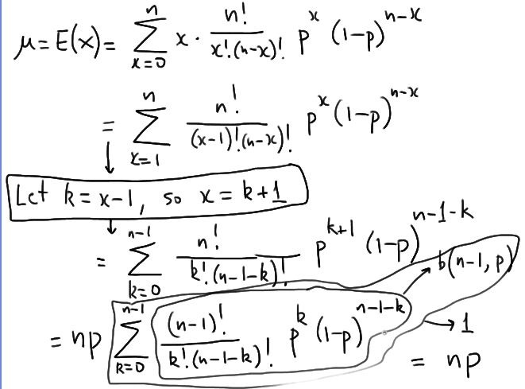

Slide 33
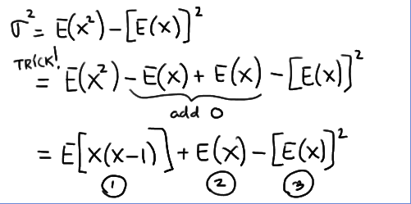
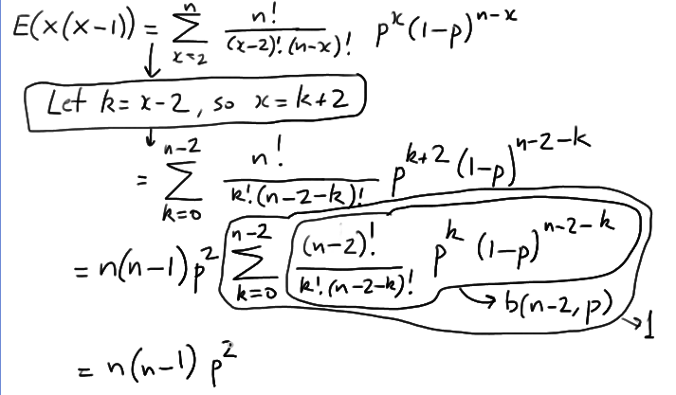
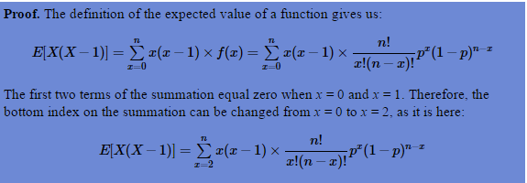
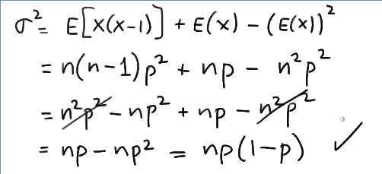

Slide 34
Continuous Random Variable
the amount of rain, in inches, that falls in a randomly selected storm
the weight, in pounds, of a randomly selected student
the square footage of a randomly selected three-bedroom house
13 mm rain drop may be 13.456789 or 13.00000000012

Slide 35
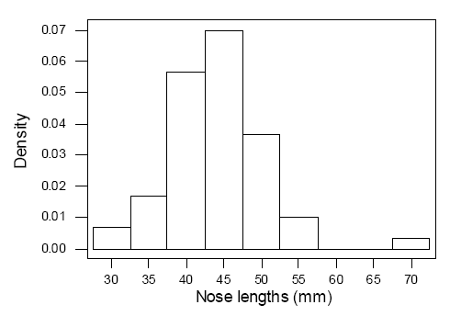
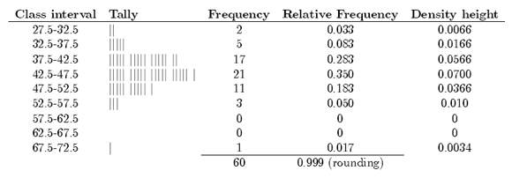
Density histogram Histogram of continuous data
Measured nose lengths
(error in measurement)
38 50 38 40 35 52 45 50 40 32 40 47 70 55 51 43 40 45 45 55 37 50 45 45 55 50 45 35 52 32 45 50 40 40 50 41 41 40 40 46 45 40 43 45 42 45 45 48 45 45 35 45 45 40 45 40 40 45 35 52
Determine the number, n, in the sample.
Define k class intervals (c₀, c₁] , (c₁, c₂] , ..., (c_{k-1}, c_{k}] .
Determine the frequency, f_{i}, of each class i.
Calculate the relative frequency (proportion) of each class by dividing the class frequency by the total number in the sample — that is, f_{i} ÷ n.
For a frequency histogram: draw a rectangle for each class with the class interval as the base and the height equal to the frequency of the class.
For a relative frequency histogram: draw a rectangle for each class with the class interval as the base and the height equal to the relative frequency of the class.
For a density histogram: draw a rectangle for each class with the class interval as the base and the height equal to
h(x)=fi / n(ci−ci-1) for ci−1<x≤ci i = 1, 2,..., k.
the area of the
entire histogram
equals 1.

Slide 36
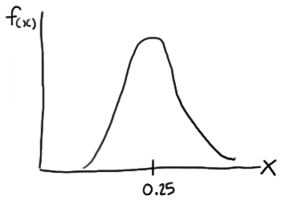
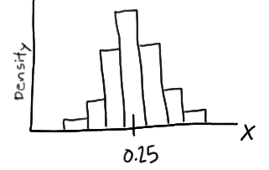
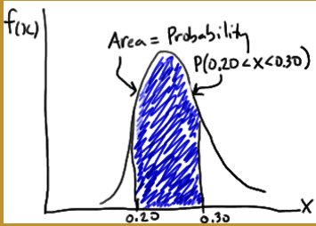
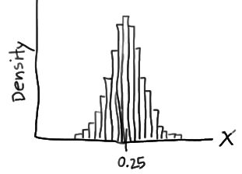
Probability Density Function

Slide 37
Probability Density Function (p.d.f)

Slide 38
Notes
when X is continuous, P(X = x) = 0 for all x in the support.
P(a ≤ X ≤ b) = P(a < X ≤ b) = P(a ≤ X < b) = P(a < X < b) for any constants a and b.

Slide 39
Cumulative Distribution Function
Recall that c.d.f for discrete R.V. :

Slide 40
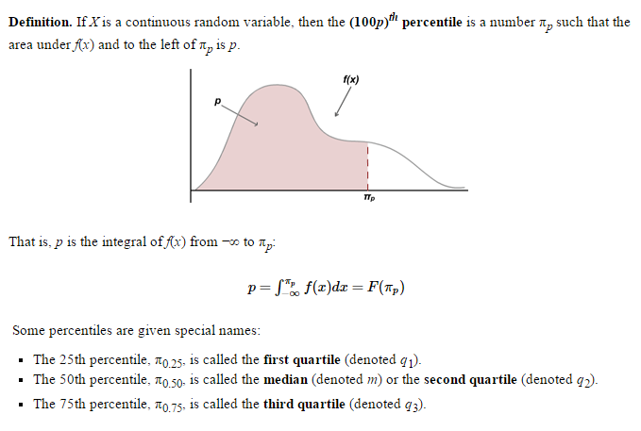
Percentiles

Slide 41
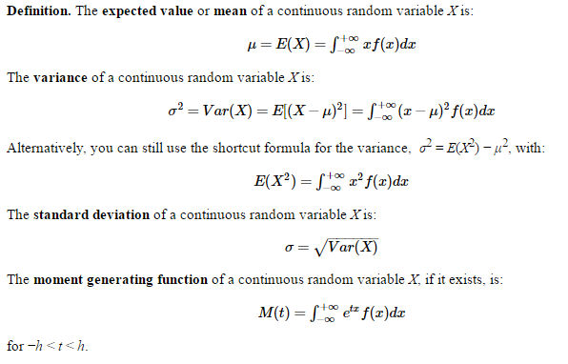
Expectations

Slide 42
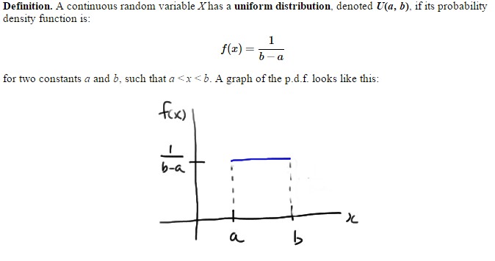
Uniform Distributions

Slide 43
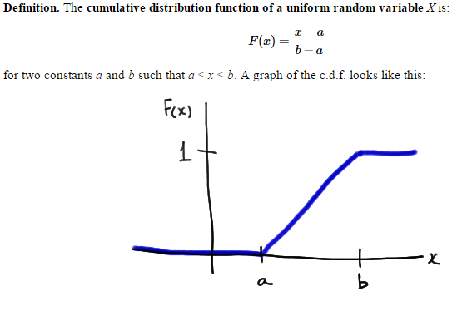
CDF of a uniform R.V.

Slide 44
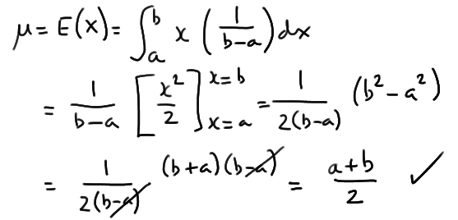
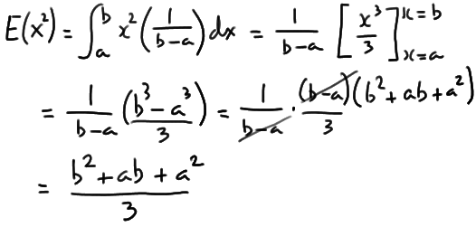
Properties of Uniform variables

Slide 45
Normal distributions

Slide 46
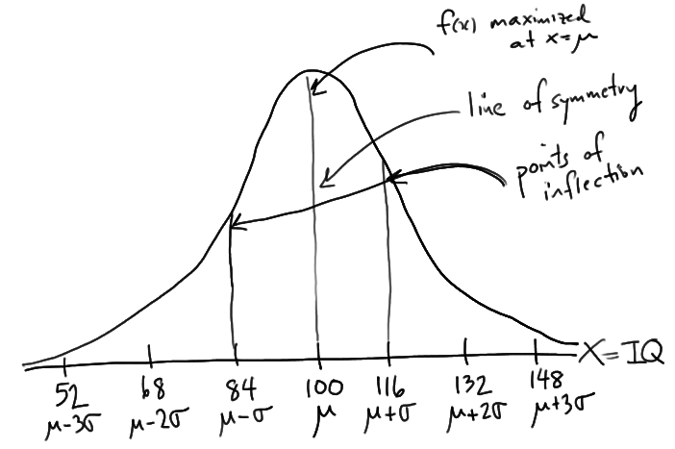
Example

Slide 47
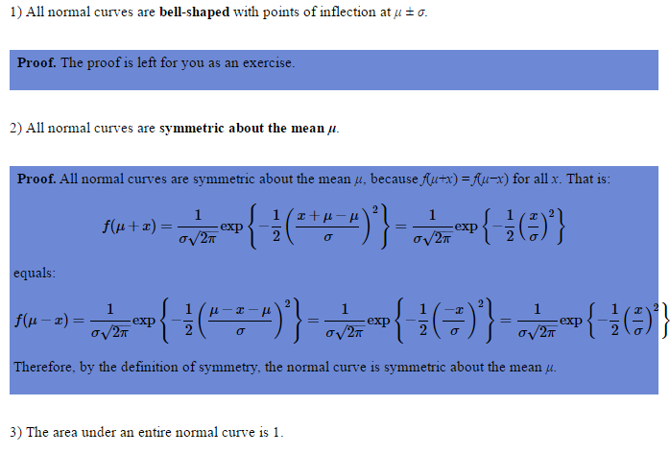
Characteristics

Slide 48
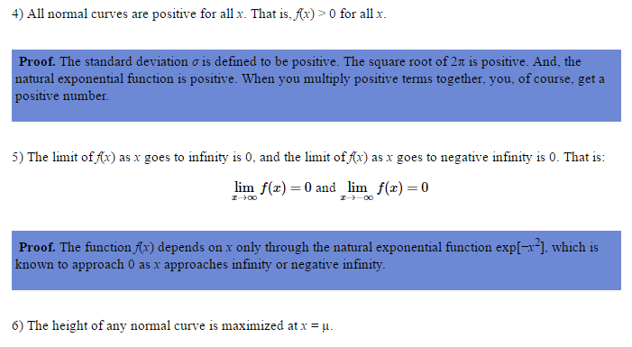
Characteristics

Slide 49
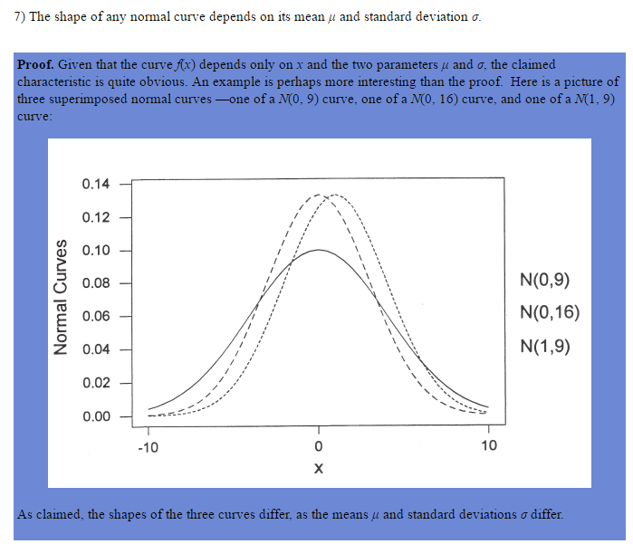
Characteristics

Slide 50
Example

Slide 51
Standard Normal distribution

Slide 52
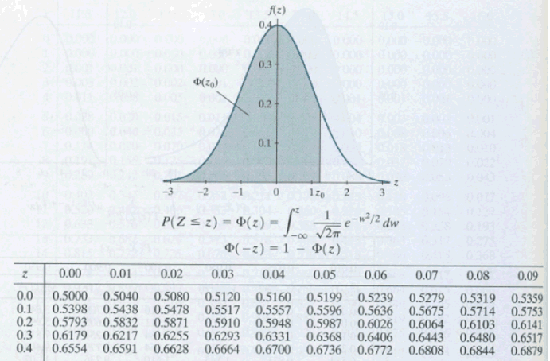
z-table

Slide 53
Properties of normal distributions

