Slide 1
Regression

Slide 2
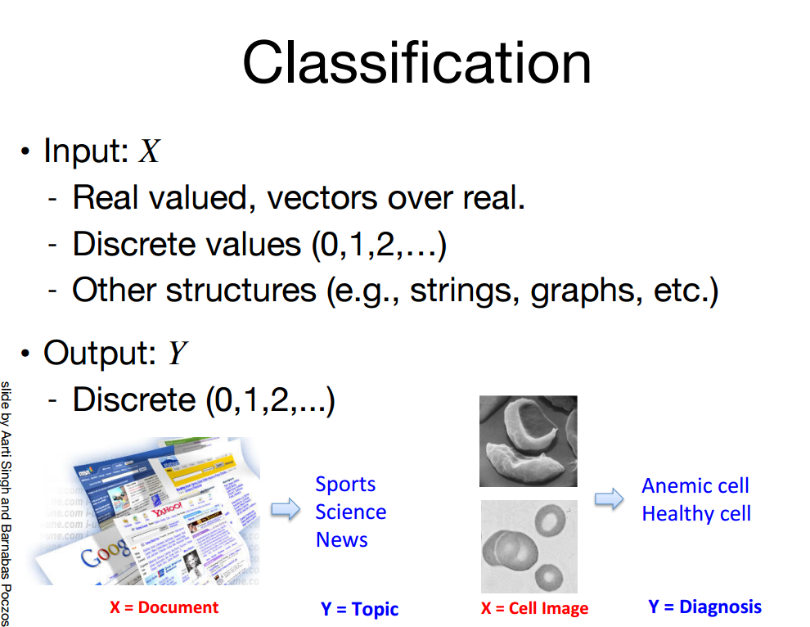

Slide 3
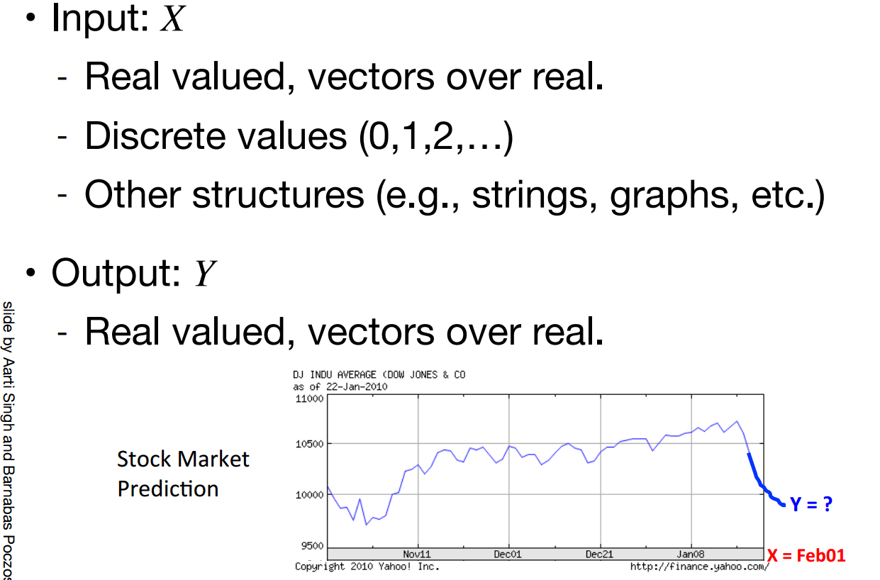

Slide 4
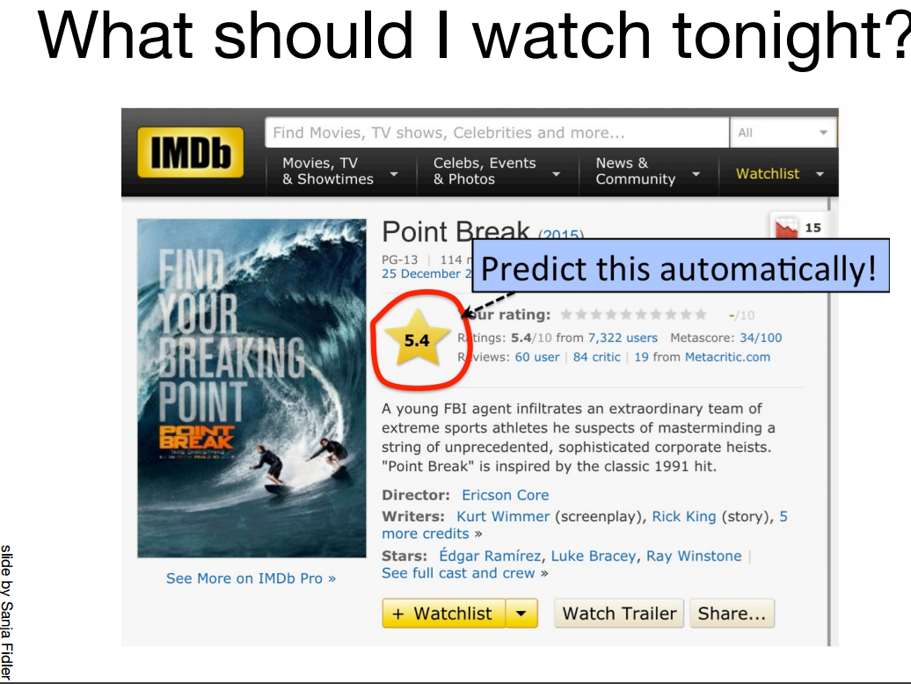

Slide 5
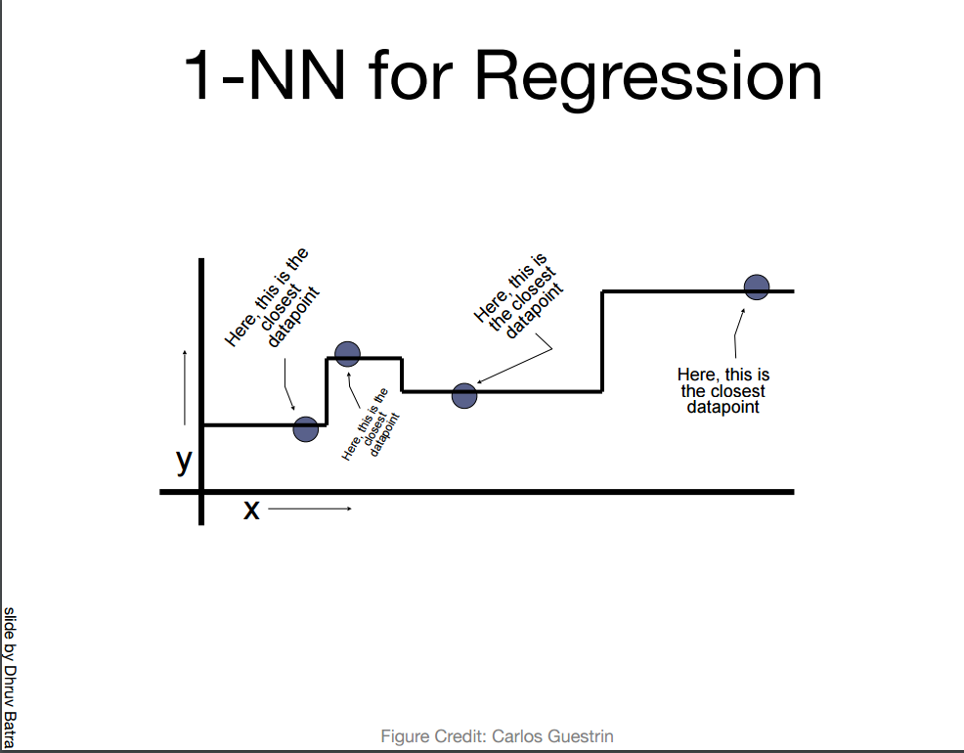

Slide 6
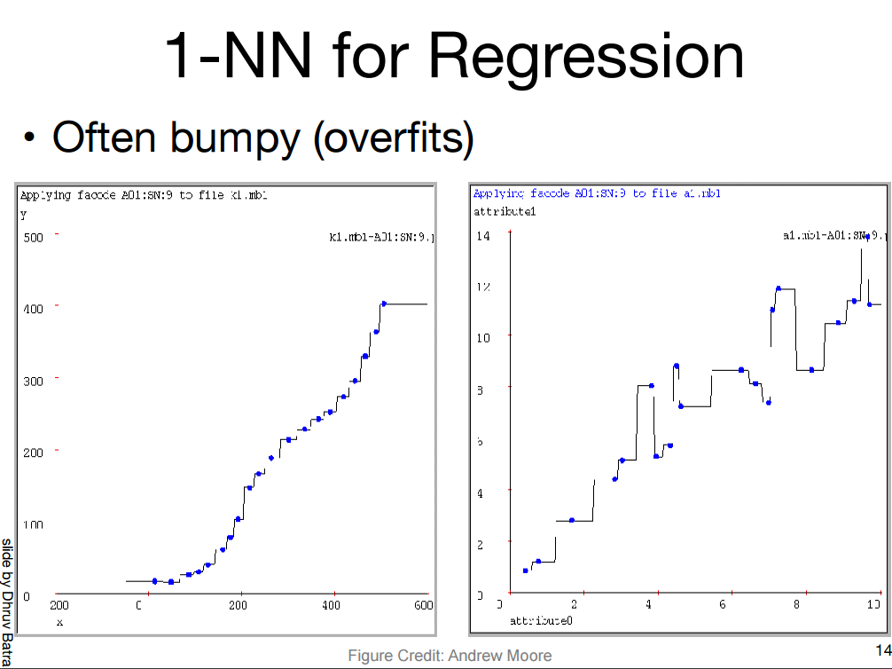

Slide 7
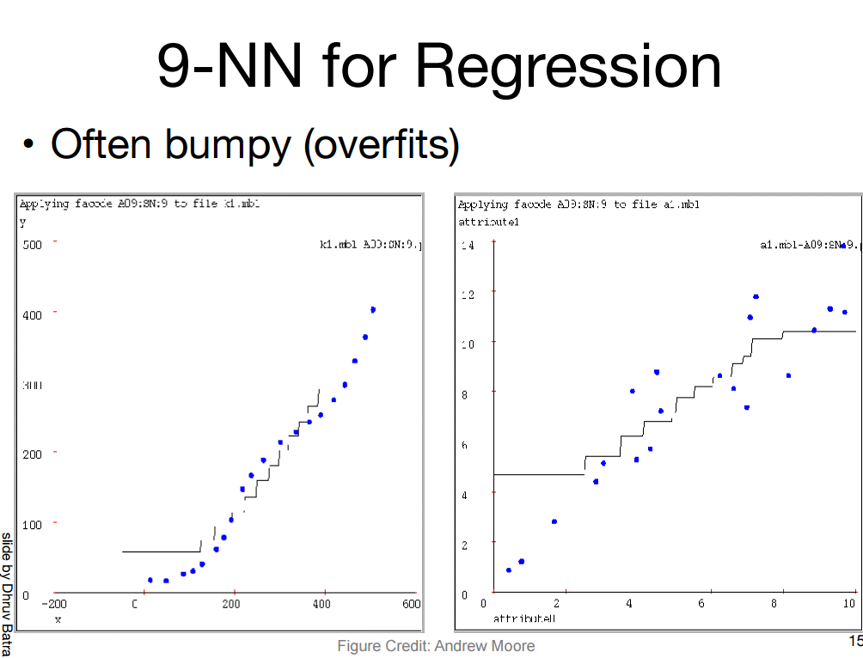

Slide 8
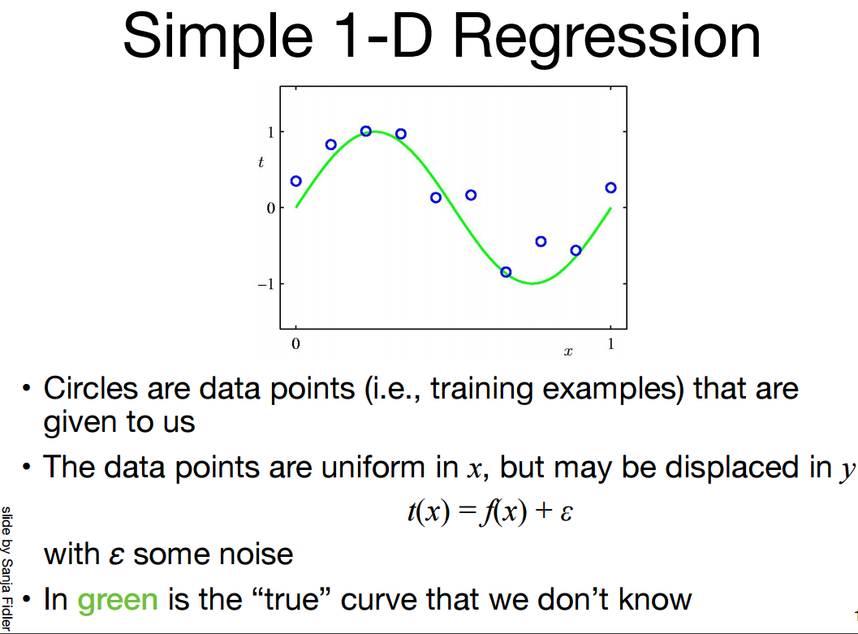

Slide 9
What is a Model?
Often Describe Relationship between Variables
Types
    Deterministic Models (no randomness)
    Probabilistic Models (with randomness)
Notes:
.

Slide 10
Deterministic Models
Hypothesize Exact Relationships
Suitable When Prediction Error is Negligible
Example: Body mass index (BMI) is measure of body fat based
  BMI = Weight in Kilograms
  (Height in Meters)²

Slide 11
Probabilistic Models
Hypothesize 2 Components
    Deterministic
    Random Error
Example: Systolic blood pressure of newborns Is 6 Times the Age in days + Random Error
    SBP = 6 x age(d) + ε
    Random Error May Be Due to Factors Other Than age in days (e.g. Birthweight)

Slide 12
Simple Regression
Simple regression analysis is a statistical tool that gives us the ability to estimate the mathematical relationship between a dependent variable (usually called y) and an independent variable (usually called x).
The dependent variable is the variable for which we want to make a prediction.
While various non-linear forms may be used, simple linear regression models are the most common.

Slide 13
Introduction
The primary goal of quantitative analysis is to use current information about a phenomenon to predict its future behavior.
Current information is usually in the form of a set of data.
In a simple case, when the data form a set of pairs of numbers, we may interpret them as representing the observed values of an independent (or predictor or explanatory) variable X and a dependent ( or response or outcome) variable Y.
Notes:
In the table on the right the response variable Y represents the man-hours of labor for manufacturing a certain product in lots (X) that vary in size as demand fluctuates.

Slide 14
Introduction
The goal of the analyst who studies the data is to find a functional relation
between the response variable y and the predictor variable x.
Notes:
The data in this example concerns 10 recent production runs of a spare part manufactured by the Westwood company.
Notice that for some values of X (X=30 and X=60) there correspond more than one value of Y. This is not an ordinary functional relationship between X and Y, where to each value of X a unique value of Y must correspond.
Question: What is a plausible way of thinking about this situation that would still lead to a model y=F(X) in which we would have a unique value y for each value of X?

Slide 15
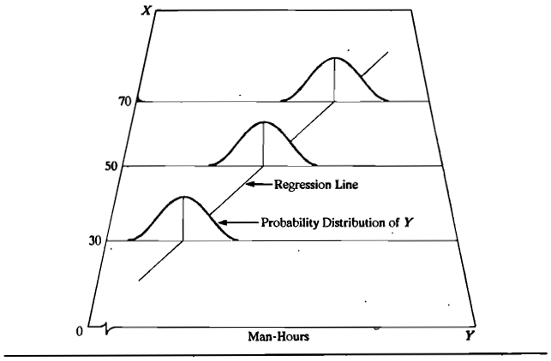
Pictorial Presentation of Linear Regression Model
Notes:
The number of man-hours Y is treated in a regression model as a random variable.
For each lot size, there is postulated a probability distribution of Y.
This figure shows a probability distribution for X= 30, X=50, and X=70.
The actual number of man-hours Y is then viewed as a random selection from this probability distribution.
The means of the probability distributions have a systematic relation to the level of X. This systematic relationship is called the regression function of Y on X. The graph of regression function is called regression curve.
In this figure the regression function is linear. This implies that the mean number of man-hours varies linearly with lot size.

Slide 16
Linear Regression Model
Notes:
26

Slide 17
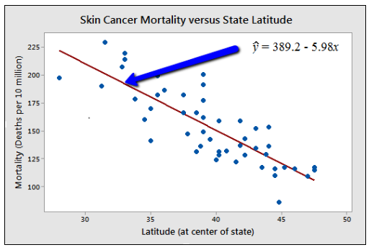

Slide 18
Assumptions
Linear regression assumes that…
  1. The relationship between X and Y is linear
  2. Y is distributed normally at each value of X
  3. The variance of Y at every value of X is the same (homogeneity of variances)
  4. The observations are independent

Slide 19
Linear Equations
© 1984-1994 T/Maker Co.
Notes:
28

Slide 20
Linear Regression Model
1. Relationship Between Variables Is a Linear Function
Population
Y-Intercept
Population Slope
Random Error
Y
=
β
+
β
X
+
ε
i
0
1
i
i
Dependent (Response) Variable
(e.g., CD+ c.)
Independent (Explanatory) Variable
(e.g., Years s. serocon.)

Slide 21
Meaning of Regression Coefficients
General regression model
    β₀, and β₁ are parameters
    X is a known constant
    Deviations ε are independent N(o, σ²)
The values of the regression parameters β₀, and β₁ are not known. We estimate them from data.
β₁ indicates the change in the mean response per unit increase in X.

Slide 22
Population Linear Regression Model
Observed
value
ε_{i} = Random error
Observed value
Notes:
35

Slide 23
Estimating Parameters:
Least Squares Method
Notes:
40

Slide 24
Scatter plot
1. Plot of All (X_{i}, Y_{i}) Pairs
2. Suggests How Well Model Will Fit
Y
60
40
20
0
X
0
20
40
60

Slide 25
Thinking Challenge
How would you draw a line through the points? How do you determine which line ‘fits best’?
Y
60
40
20
0
X
0
20
40
60
Notes:
42

Slide 26
Thinking Challenge
How would you draw a line through the points? How do you determine which line ‘fits best’?
Slope changed
Y
60
40
20
0
X
0
20
40
60
Intercept unchanged
Notes:
43

Slide 27
Thinking Challenge
How would you draw a line through the points? How do you determine which line ‘fits best’?
Slope unchanged
Y
60
40
20
0
X
0
20
40
60
Intercept changed
Notes:
44

Slide 28
Thinking Challenge
How would you draw a line through the points? How do you determine which line ‘fits best’?
Slope changed
Y
60
40
20
0
X
0
20
40
60
Intercept changed
Notes:
45

Slide 29
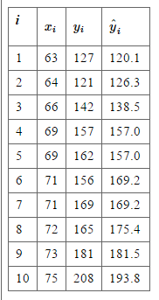
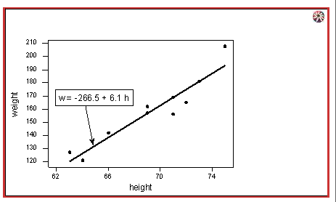


What is the best fitting line

Slide 30
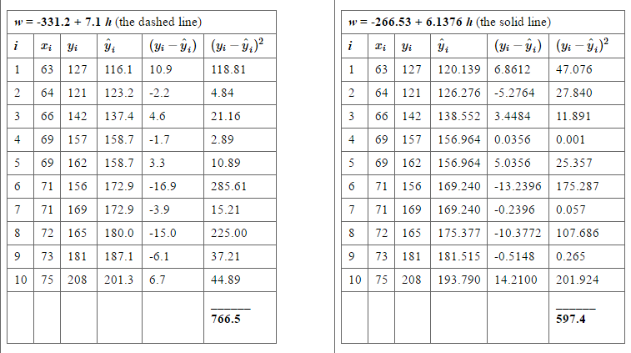
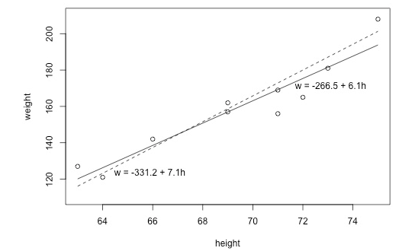


Prediction Error

Slide 31
Least Squares
1. ‘Best Fit’ Means Difference Between Actual Y Values & Predicted Y Values Are a Minimum. But Positive Differences Off-Set Negative. So square errors!
2. LS Minimizes the Sum of the Squared Differences (errors) (SSE)
Notes:
51

Slide 32
Least Squares Graphically
Notes:
52

Slide 33

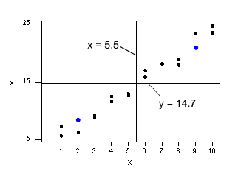


How to estimate parameters

Slide 34
Estimating the intercept and slope: least squares estimation
** Least Squares Estimation
A little calculus….
What are we trying to estimate? β, the slope, from
What’s the constraint? We are trying to minimize the squared distance (hence the “least squares”) between the observations themselves and the predicted values , or (also called the “residuals”, or left-over unexplained variability)
Differencei = yi – (βx + α) Differencei² = (yi – (βx + α)) ²
Find the β that gives the minimum sum of the squared differences. How do you maximize a function? Take the derivative; set it equal to zero; and solve. Typical max/min problem from calculus….
From here takes a little math trickery to solve for β…

Slide 35
The standard error of Y given X is the average variability around the regression line at any given value of X. It is assumed to be equal at all values of X.
Sy/x
Sy/x
Sy/x
Sy/x
Sy/x
Sy/x

Slide 36
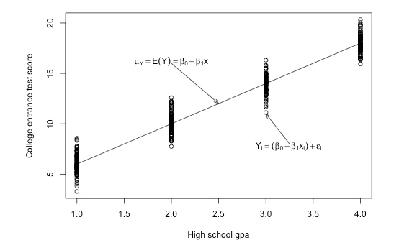

Slide 37
Regression Picture
y_{i}
C
A
B
y
B
A
C
y_{i}
*Least squares estimation gave us the line (β) that minimized C²
x
R²=SSreg/SStotal
A² B² C²
SS_{total}
Total squared distance of observations from naïve mean of y
Total variation
SS_{reg}
Distance from regression line to naïve mean of y
Variability due to x (regression)
SS_{residual}
Variance around the regression line
Additional variability not explained by x—what least squares method aims to minimize

Slide 38
Regression Line
If the scatter plot of our sample data suggests a linear relationship between two variables i.e.
we can summarize the relationship by drawing a straight line on the plot.
Least squares method give us the “best” estimated line for our set of sample data.

Slide 39
Regression Line
We will write an estimated regression line based on sample data as
The method of least squares chooses the values for b₀, and b₁ to minimize the sum of squared errors

Slide 40
Regression Line
Using calculus, we obtain estimating formulas:
or

Slide 41
Estimation of Mean Response
Fitted regression line can be used to estimate the mean value of y for a given value of x.
Example
  The weekly advertising expenditure (x) and weekly sales (y) are presented in the following table.

Slide 42
Point Estimation of Mean Response
  From previous table we have:
  The least squares estimates of the regression coefficients are:

Slide 43
Point Estimation of Mean Response
  The estimated regression function is:
  This means that if the weekly advertising expenditure is increased by $1 we would expect the weekly sales to increase by $10.8.

Slide 44
Point Estimation of Mean Response
Fitted values for the sample data are obtained by substituting the x value into the estimated regression function.
For example if the advertising expenditure is $50, then the estimated Sales is:
This is called the point estimate (forecast) of the mean response (sales).

Slide 45
Linear correlation and linear regression

Slide 46
Covariance

Slide 47
Interpreting Covariance
cov(X,Y) > 0 X and Y are positively correlated
cov(X,Y) < 0 X and Y are inversely correlated
cov(X,Y) = 0 X and Y are independent

Slide 48
Correlation coefficient
Pearson’s Correlation Coefficient is standardized covariance (unitless):

Slide 49
Correlation
Measures the relative strength of the linear relationship between two variables
Unit-less
Ranges between –1 and 1
The closer to –1, the stronger the negative linear relationship
The closer to 1, the stronger the positive linear relationship
The closer to 0, the weaker any positive linear relationship

Slide 50
Scatter Plots of Data with Various Correlation Coefficients
Y
Y
Y
X
X
X
r = -1
r = -.6
r = 0
Y
Y
Y
X
X
X
r = +1
r = +.3
r = 0
Slide from: Statistics for Managers Using Microsoft® Excel 4th Edition, 2004 Prentice-Hall

Slide 51
Linear Correlation
Linear relationships
Curvilinear relationships
Y
Y
X
X
Y
Y
X
X
Slide from: Statistics for Managers Using Microsoft® Excel 4th Edition, 2004 Prentice-Hall

Slide 52
Linear Correlation
Strong relationships
Weak relationships
Y
Y
X
X
Y
Y
X
X
Slide from: Statistics for Managers Using Microsoft® Excel 4th Edition, 2004 Prentice-Hall

Slide 53
Linear Correlation
No relationship
Y
X
Y
X
Slide from: Statistics for Managers Using Microsoft® Excel 4th Edition, 2004 Prentice-Hall

Slide 54
Calculating by hand…

Slide 55
Simpler calculation formula…
Numerator of covariance
Numerators of variance

Slide 56
Least Square estimation
Slope (beta coefficient) =
Intercept=
Regression line always goes through the point:

Slide 57
Relationship with correlation
In correlation, the two variables are treated as equals. In regression, one variable is considered independent (=predictor) variable (X) and the other the dependent (=outcome) variable Y.

Slide 58
Residual Analysis: check assumptions
The residual for observation i, e_{i}, is the difference between its observed and predicted value
Residuals are highly useful for studying whether a given regression model is appropriate for the data at hand.
Check the assumptions of regression by examining the residuals
  Examine for linearity assumption
  Examine for constant variance for all levels of X (homoscedasticity)
  Evaluate normal distribution assumption
  Evaluate independence assumption
Graphical Analysis of Residuals
  Can plot residuals vs. X

Slide 59
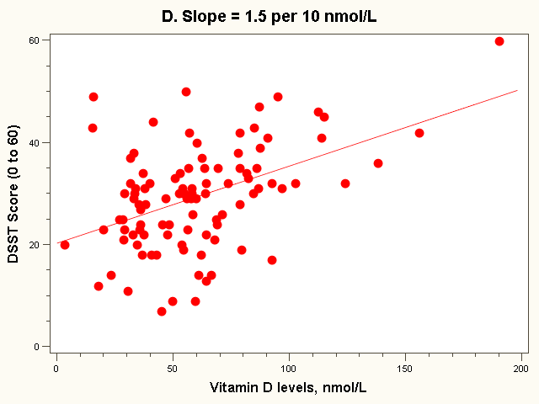
Residual = observed - predicted
X=95 nmol/L
34

Slide 60
Residual Analysis for Linearity
Y
Y
x
x
residuals
x
x
residuals
Not Linear
✓
Linear
Slide from: Statistics for Managers Using Microsoft® Excel 4th Edition, 2004 Prentice-Hall

Slide 61
Residual Analysis for
Homoscedasticity
Y
Y
x
x
residuals
x
x
residuals
✓
Non-constant variance
Constant variance
Slide from: Statistics for Managers Using Microsoft® Excel 4th Edition, 2004 Prentice-Hall

Slide 62
Residual Analysis for Independence
Not Independent
✓
Independent
residuals
X
residuals
X
residuals
X
Slide from: Statistics for Managers Using Microsoft® Excel 4th Edition, 2004 Prentice-Hall

Slide 63
Example: weekly advertising expenditure

Slide 64
Estimation of the variance of the error terms, σ²
The variance σ² of the error terms ε_{i} in the regression model needs to be estimated for a variety of purposes.
  It gives an indication of the variability of the probability distributions of y.
  It is needed for making inference concerning regression function and the prediction of y.

Slide 65
Regression Standard Error
To estimate σ we work with the variance and take the square root to obtain the standard deviation.
For simple linear regression the estimate of σ² is the average squared residual.
To estimate σ , use
s estimates the standard deviation σ of the error term ε in the statistical model for simple linear regression.

Slide 66
Regression Standard Error

Slide 67
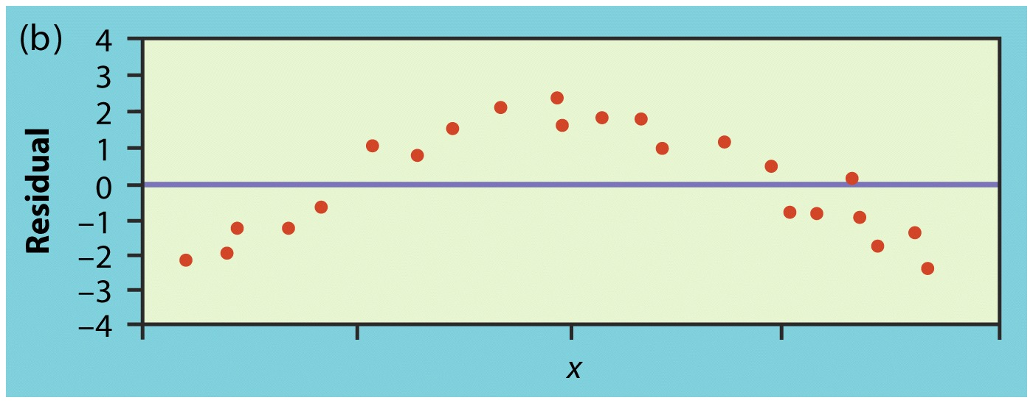
Residual plots
The points in this residual plot have a curve pattern, so a straight line fits poorly

Slide 68
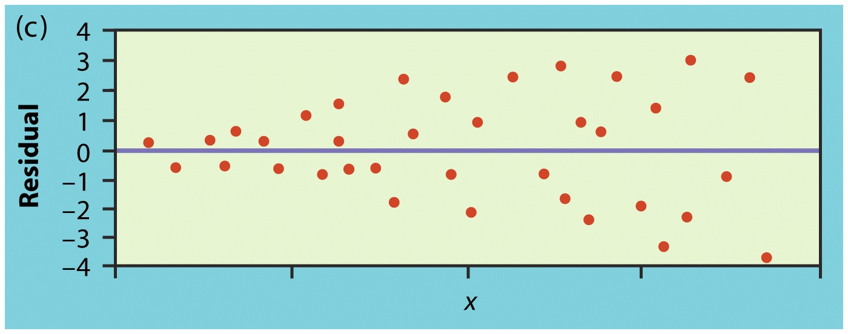
Residual plots
The points in this plot show more spread for larger values of the explanatory variable x, so prediction will be less accurate when x is large.

Slide 69
Variable transformations
If the residual plot suggests that the variance is not constant, a transformation can be used to stabilize the variance.
If the residual plot suggests a non linear relationship between x and y, a transformation may reduce it to one that is approximately linear.
Common linearizing transformations are:
Variance stabilizing transformations are:

Slide 70
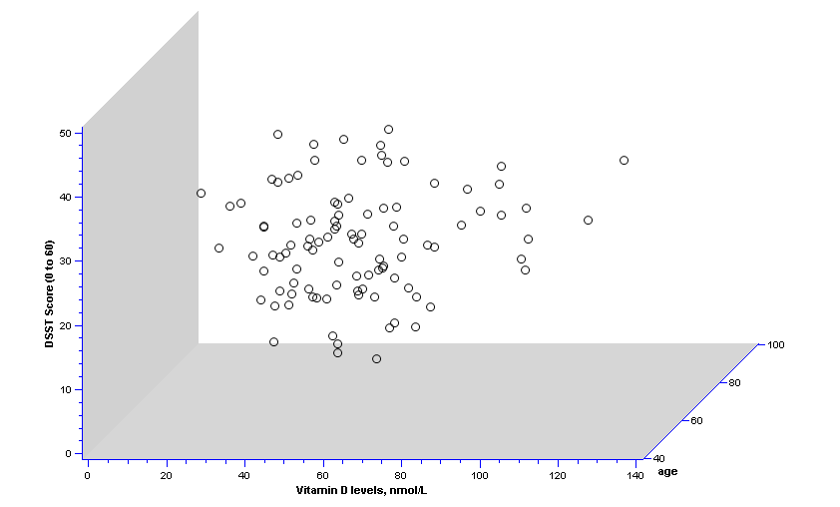
2 predictors: age and vit D…

Slide 71
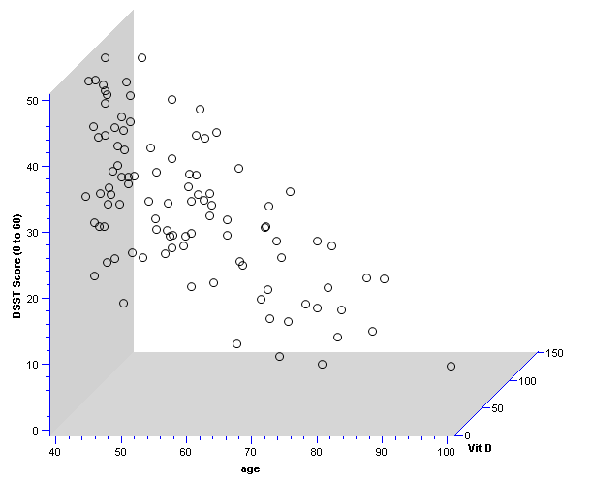
Different 3D view…

Slide 72
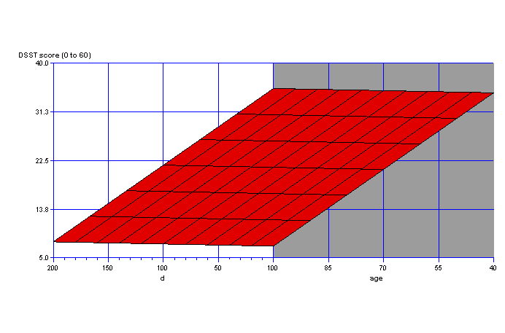
Fit a plane rather than a line…
On the plane, the slope for vitamin D is the same at every age; thus, the slope for vitamin D represents the effect of vitamin D when age is held constant.

