Slide 1
Subprograms
BBM 301 – Programming Languages

Slide 2
Fundamentals of Subprograms
1-2
Each subprogram has a single entry point
The calling program is suspended during execution of the called subprogram
Therefore, only one subprogram is in execution at a given time
Control always returns to the caller when the called subprogram’s execution terminates
Notes:
2

Slide 3
Basic Definitions
A subprogram definition describes the interface to and the actions of the subprogram abstraction
In Python, function definitions are executable; in all other languages, they are non-executable
if ….
def fun1(…);
else
def fun2(…);
…
1-3
Notes:
3

Slide 4
Basic Definitions
A subprogram header is the first part of the definition, including the name, the kind of subprogram, and the formal parameters
FORTRAN example:
SUBROUTINE name (parameters)
C example:
void adder(parameters)
A subprogram call is an explicit request that the subprogram be executed
A subprogram is said to be active if it has begun execution, but has not yet completed.
1-4
Notes:
4

Slide 5
Basic Definitions (cont’d.)
The parameter profile (aka signature) of a subprogram is the number, order, and types of its parameters
The protocol is a subprogram’s parameter profile and, if it is a function, its return type
1-5

Slide 6
Basic Definitions (cont’d.)
int myFunc(int x, int y, char z) // formal parameters
myFunc(4, 10, ’a’) // actual parameters
1-6
A subprogram declaration provides the protocol, but not the body, of the subprogram
A formal parameter is a dummy variable listed in the subprogram header and used in the subprogram
An actual parameter represents a value or address used in the subprogram call statement
Notes:
6

Slide 7
Actual/Formal Parameter Correspondence
Positional
The binding of actual parameters to formal parameters is by position: the first actual parameter is bound to the first formal parameter and so forth
Safe and effective
Keyword
The name of the formal parameter to which an actual parameter is to be bound is specified with the actual parameter
Advantage: Parameters can appear in any order, thereby avoiding parameter correspondence errors
Disadvantage: User must know the formal parameter’s names
1-7
Notes:
7

Slide 8
Parameters
Example in Ada,
SUMER (LENGTH => 10,
LIST => ARR,
SUM => ARR_SUM);
Formal parameters: LENGTH, LIST, SUM.
Actual parameters: 10, ARR, ARR_SUM.
The programmer doesn’t have to know the order of the formal parameters.
But, must know the names of the formal parameters.
Python example:
sumer( length = my_length,
list = my_array,
sum = my_sum)
1-8

Slide 9
Formal Parameter Default Values
1-9
In certain languages (e.g., C++, Python, Ruby, Ada, PHP), formal parameters can have default values (if no actual parameter is passed)
In C++, default parameters must appear last because parameters are positionally associated
Ada example:
function Comp_Pay (Income: Float;
Examptions: Integer := 1;
Tax_Rate: Float) return Float;
Therefore, the call doesn’t have to provide values for all parameters.
A sample call may be
Pay := Comp_Pay (2000.0, Tax_Rate => 0.23);
Notes:
9

Slide 10
Formal Parameters
C# allows methods to accept a variable number of parameters, as long as they are of the same type.
The call can send either an array or a list of expressions, whose values are placed in an array by the compiler
public void DisplayList(params int[] list) {
foreach (int next in list) {
Console.WriteLine("Next value {0}", next);
}
}
Myclass myObject = new Myclass;
int[] myList = new int[6] {2, 4, 6, 8, 10, 12};
DisplayList could be called with either of the following:
myObject.DisplayList(myList);
myObject.DisplayList(2, 4, 3 * x - 1, 17);

Slide 11
Formal Parameters
Lua uses a simple mechanism for supporting a variable number of parameters—represented by an ellipsis (. . .).
This ellipsis can be treated as an array or as a list of values that can be assigned to a list of variables.
function multiply (. . .)
local product = 1
for i, next in ipairs{. . .} do
product = product * next
end
return sum
end
function myFunc (. . .)
local a, b, c = . . .
. . .
End
myFunc(4,7,3)

Slide 12
Procedures and Functions
There are two categories of subprograms
Procedures are collection of statements that define parameterized computations, they do not return values
Functions structurally resemble procedures but are semantically modeled on mathematical functions, they return values
They are expected to produce no side effects
In practice, program functions have side effects
In most languages that do not include procedures as a separate form of subprogram, functions can be defined not to return values and they can be used as procedures.
1-12
Notes:
12

Slide 13
Design Issues for Subprograms
1-13
Are local variables static or dynamic?
Can subprogram definitions appear in other subprogram definitions?
What parameter passing methods are provided?
Are parameter types checked?
If subprograms can be passed as parameters and subprograms can be nested, what is the referencing environment of a passed subprogram?
Can subprograms be overloaded?
Can subprogram be generic?
Notes:
13

Slide 14
Semantic Models of Parameter Passing
1-14
In mode
Out mode
Inout mode
Notes:
14

Slide 15
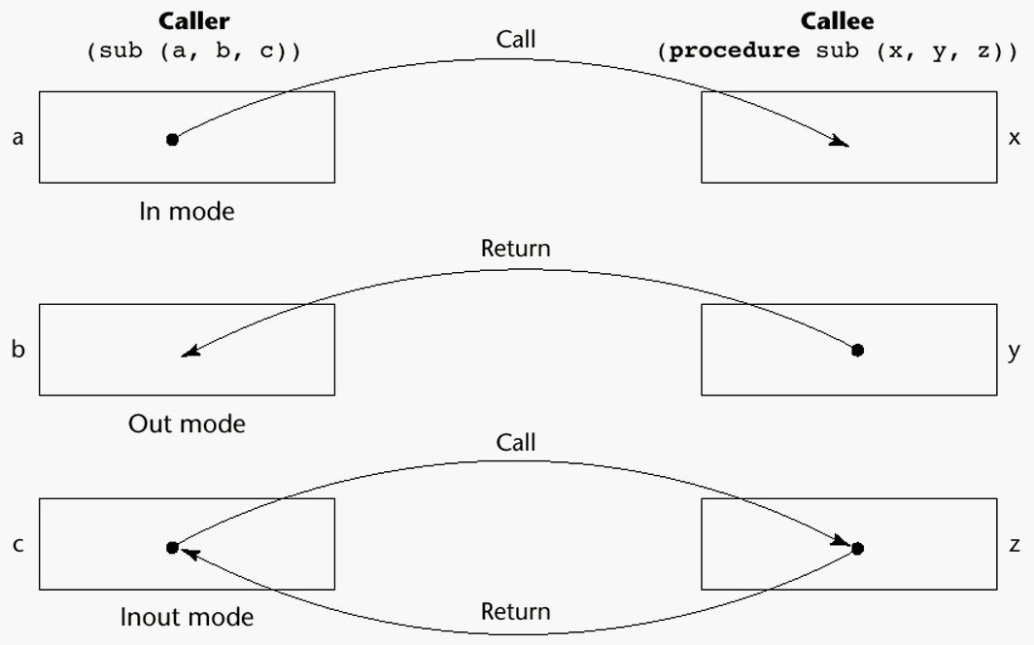
Models of Parameter Passing
1-15
Notes:
15

Slide 16
Parameter Passing Methods
Ways in which parameters are transmitted to and/or from called subprograms
Pass-by-value
Pass-by-result
Pass-by-value-result
Pass-by-reference
Pass-by-name
1-16

Slide 17
Pass-by-Value (In Mode)
The value of the actual parameter is used to initialize the corresponding formal parameter, which then acts as a local variable
Normally implemented by copying
Can be implemented by transmitting an access path but not recommended (enforcing write protection is not easy)
Advantages: Actual variable is protected.
Disadvantages: additional storage is required (stored twice) and the actual move can be costly (for large parameters – such as arrays)
1-17
Notes:
17

Slide 18
Pass-by-Result (Out Mode)
No value is transmitted to the subprogram
The corresponding formal parameter acts as a local variable
its value is transmitted to caller’s actual parameter when control is returned to the caller
Require extra storage location and copy operation
Potential problems: Parameter collision
sub(p1, p1); whichever formal parameter is copied back will represent the current value of p1
sub(list[x], x); Compute address of list[x] at the beginning of the subprogram or end?
1-18
Notes:
18

Slide 19
Pass-by-Result (Out Mode)
Problem: Actual parameter collision definition:
subprogram sub(x, y) { x <- 3 ; y <-5;}
call:
sub(p, p)
what is the value of p here ? (3 or 5?)
• The values of x and y will be copied back to p. Which ever is assigned last will determine the value of p.
• The order is important
• The order is implementation dependent ⇒ Portability problems.

Slide 20
Pass-by-Result (Out Mode)
Problem: Time to evaluate the address of the actual parameter
– at the time of the call
– at the time of the return
• The decision is up to the implemention.
void DoIt(int x, int index){
x = 17;
index = 42;
}
. . .
sub = 21;
f.DoIt(list[sub], sub);
Is list[21] or list[42] is changed?
An obvious way to avoid this problem is for the language designer to specify when the address to return the parameter value must be computed.

Slide 21
Pass-by-Result (Out Mode)
Problem: Time to evaluate the address of the actual parameter
– at the time of the call
– at the time of the return
• The decision is up to the implemention.
Definition:
subprogram sub(x)
i <-5 is changed as a global variable here
x <- ..
call:
i <- 3
sub(A[i])
Is A[3] or A[5] is changed?
The decision is up to the implemention.
sub(A[3])

Slide 22
Pass-by-Value-Result (inout Mode)
A combination of pass-by-value and pass-by-result
Sometimes called pass-by-copy
Formal parameters have local storage
Disadvantages:
Those of pass-by-result
Those of pass-by-value
The value of the actual parameter is used to initialize the corresponding formal parameter
the formal parameter acts as a local parameter
At termination, the value of the formal parameter is copied back.
Notes:
22

Slide 23
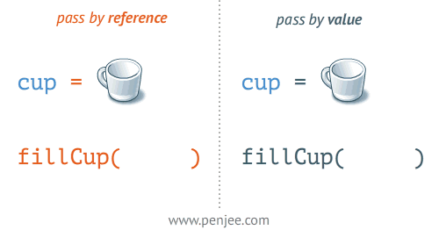
Pass-by-Reference (Inout Mode)
Pass an access path
Also called pass-by-sharing
Advantage:
Passing process is efficient
no copying
no duplicated storage
Disadvantages
Slower accesses (compared to pass-by-value) to formal parameters
Potentials for unwanted side effects (collisions)
Unwanted aliases (access broadened)
fun(total, total); fun(list[i], list[j]);
fun1(list[i], list);
1-23
Notes:
23

Slide 24
Pass-by-Reference
Dangerous: Actual parameter may be modified unintentionally.
Aliasing:
definition: subprogram sub(x, y)
call: sub(p, p)
Here, x and y in the subprogram are aliases.
• Another way of aliasing:
int * global;
void main() {
. . .
sub(global);
}
void sub(int * param) {
. . .
}
Here, global and param in the subprogram are aliases.
1-24

Slide 25
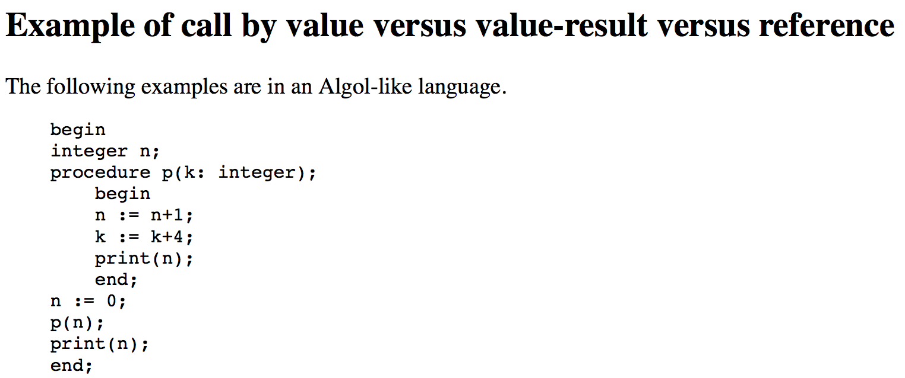
Pass by : Example
OUTPUT:
call by value:
call by value-result:
call by reference:
1 1
1 4
5 5
1-25

Slide 26
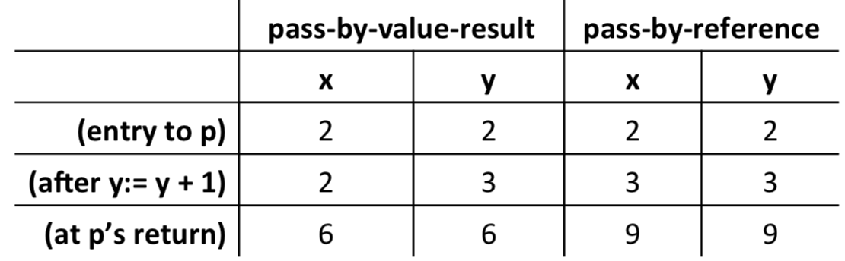
An Example: pass-by-value-result vs. pass-by-reference
program foo;
var x: int;
procedure p(y: int);
begin
y := y + 1;
y := y * x;
end
begin x := 2;
p(x);
print(x);
end
1-26

Slide 27
Pass-by-Name (Inout Mode)
By textual substitution: Actual parameter is textually substituted for the corresponding formal parameter in all occurrences in the subprogram.
Late binding: actual binding to a value or an address is delayed until the formal parameter is assigned or referenced.
Allows flexibility in late binding
1-27
Notes:
27

Slide 28
Pass-by-name
If the actual parameter is a scalar variable, then it is equivalent to pass-by-reference.
If the actual parameter is a constant expression, then it is equivalent to pass-by-value.
Advantage: flexibility
Disadvantage: slow execution, difficult to implement, confusing.
1-28

Slide 29
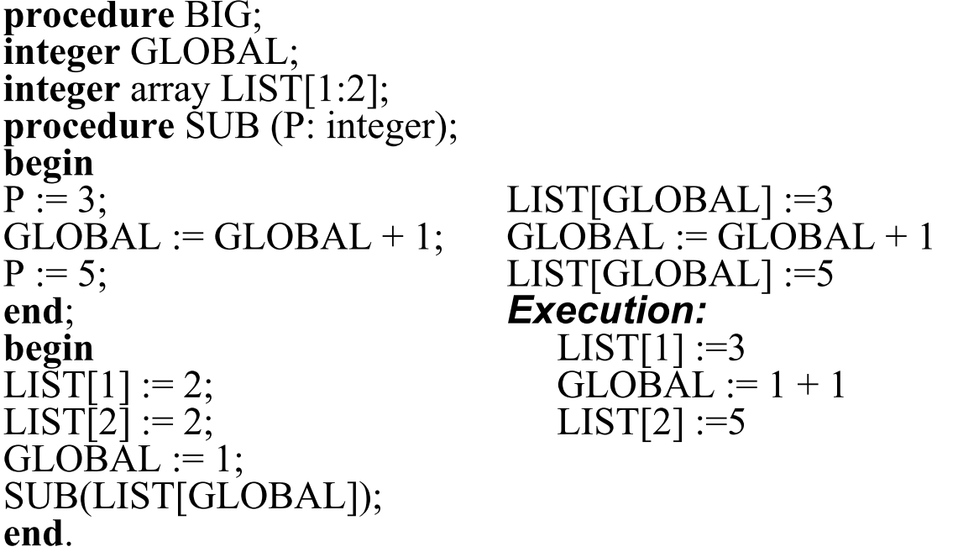
Pass-by-name
1-29

Slide 30
Pass-by-Name Elegance: Jensen's Device
Passing expressions into a routine so they can be repeatedly evaluated has some valuable applications.
Consider calculations of the form: "sum xi × i for all i from 1 to n." How could a routine Sum be written so that we could express this as
sum(i, 1, n, x[i]*i) ?
Using pass-by-reference or pass-by-value, we cannot do this because we would be passing in only a single value of x[i]*i, not an expression which can be repeatedly evaluated as "i" changes.
Using pass-by-name, the expression x[i]*i is passed in without evaluation.
1-30

Slide 31
Pass-by-Name Elegance: Jensen's Device
real procedure Sum(j, lo, hi, Ej);
value lo, hi;
integer j, lo, hi;
real Ej;
begin
real S; S := 0;
for j := lo step 1 until hi do
S := S + Ej;
Sum := S
end;
Each time through the loop, evaluation of Ej is actually the evaluation of the expression x[i]*i = x[j]*j.
1-31

Slide 32

Pass-By-Name Security Problem (Severe)
A sample program:
procedure swap (a, b);
integer a, b, temp;
begin temp := a; a := b; b:= temp end;
Effect of the call swap(x, y):
temp := x; x := y; y := temp
Effect of the call swap(i, x[i]):
temp := i; i := x[i]; x[i] := temp
It doesn't work! For example:
It is very difficult to write a correct swap procedure in Algol.
1-32

Slide 33
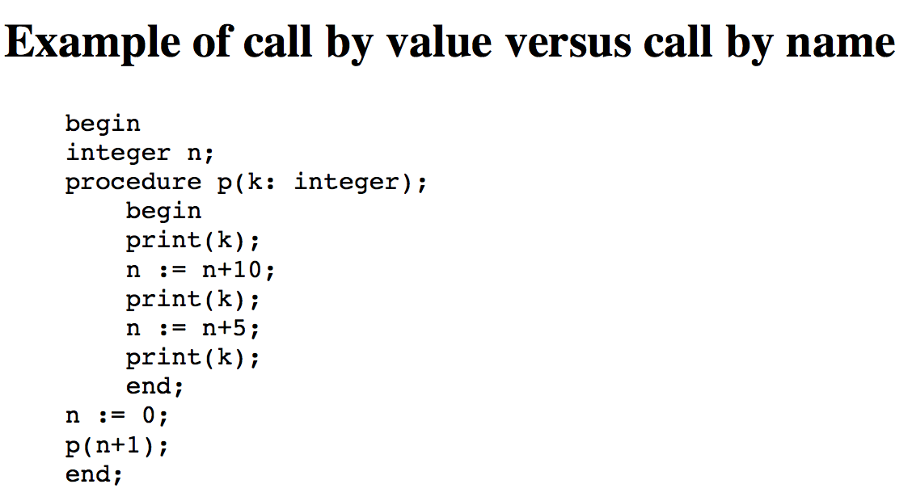
Pass by : Example
OUTPUT
call by value: 1 1 1
call by name: 1 11 16
1-33

Slide 34
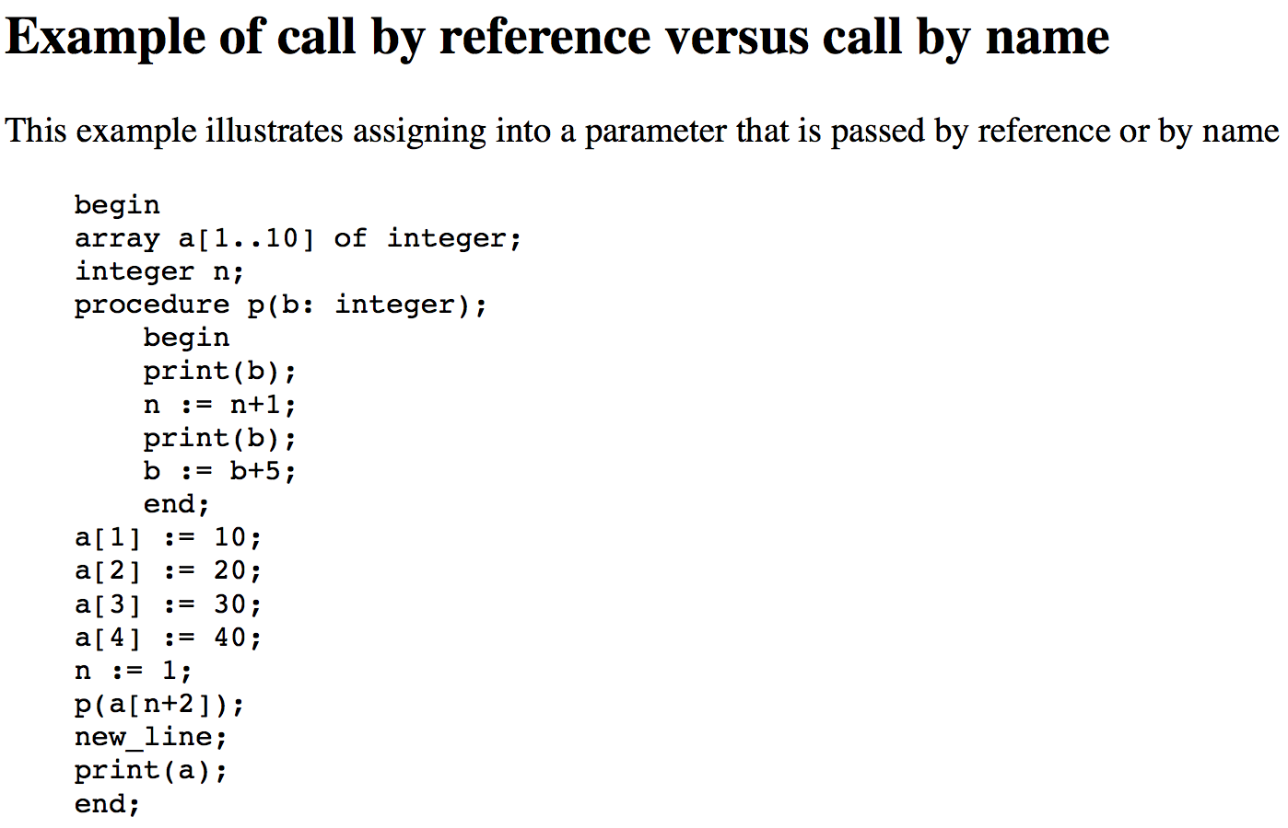
Pass by : Example
OUTPUT
call by reference: 30 30 10 20 35 40 call by name: 30 40 10 20 30 45
1-34

Slide 35
Implementing Parameter-Passing Methods
1-35
In most language parameter communication takes place thru the run-time stack
Pass-by-reference is the simplest to implement; only an address is placed in the stack
A subtle but fatal error can occur with pass-by-reference and pass-by-value-result:
A formal parameter corresponding to a constant can mistakenly be changed
Notes:
35

Slide 36
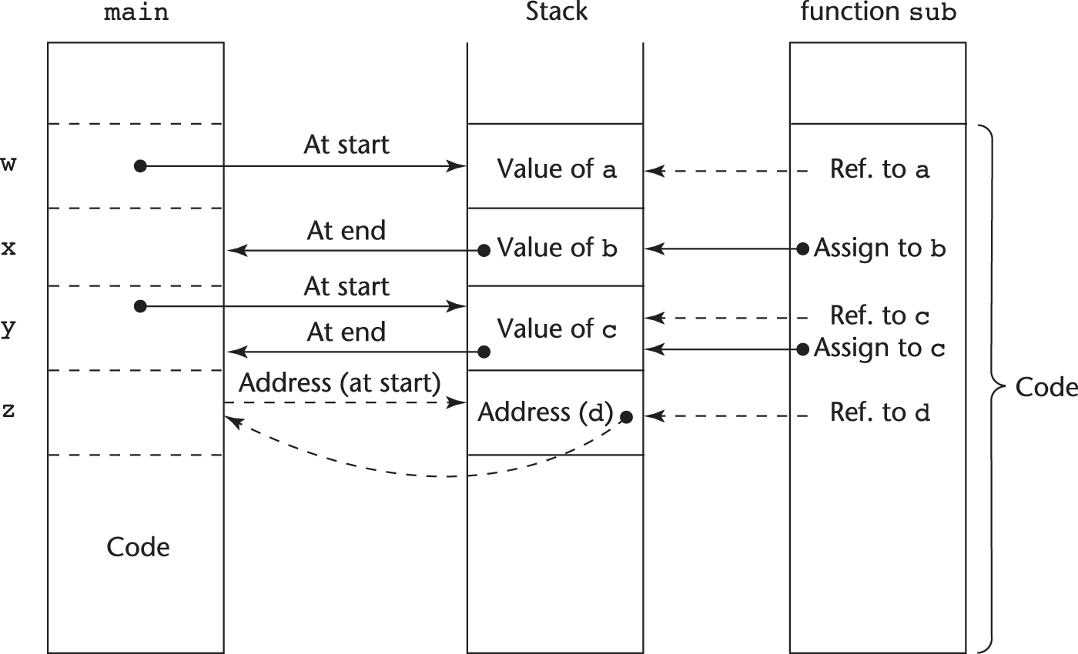
Implementing Parameter-Passing Methods
Function header: void sub(int a, int b, int c, int d)
Function call in main: sub(w, x, y, z)
(pass w by value, x by result, y by value-result, z by reference)
1-36

Slide 37

Parameter Passing Methods of Major Languages
C
Pass-by-value
Pass-by-reference is achieved by using pointers as parameters
C++
A special pointer type called reference type for pass-by-reference
Java
All parameters are passed are passed by value
Object parameters are passed by reference
Ada
Three semantics modes of parameter transmission: in, out, in out; in is the default mode
Formal parameters declared out can be assigned but not referenced; those declared in can be referenced but not assigned; in out parameters can be referenced and assigned
1-37
Notes:
37

Slide 38
Design Considerations for Parameter Passing
1-38
Two important considerations
Efficiency
One-way or two-way data transfer
But the above considerations are in conflict
Good programming suggest limited access to variables, which means one-way whenever possible
But pass-by-reference is more efficient to pass structures of significant size
Notes:
38

Slide 39
Parameters that are Subprogram Names
It is sometimes convenient to pass subprogram names as parameters
Issues:
Are parameter types checked?
What is the correct referencing environment for a subprogram that was sent as a parameter?
1-39
Notes:
39

Slide 40
Parameters that are Subprogram Names: Referencing Environment
Q: What is the referencing environment for executing the passed subprogram? (For non local variables)
Shallow binding: The environment of the call statement that enacts the passed subprogram - Most natural for dynamic-scoped languages
Deep binding: The environment of the definition of the passed subprogram - Most natural for static-scoped languages
Ad hoc binding: The environment of the call statement that passed the subprogram
1-40
Notes:
40

Slide 41
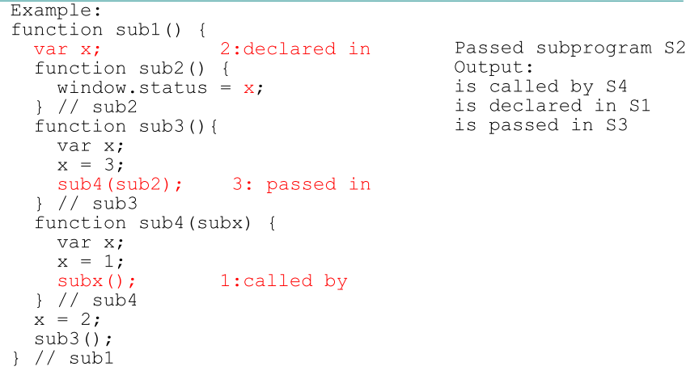
Parameters that are Subprograms
1- Shallow binding
2- Deep binding
3- Ad hoc binding
1-41

Slide 42
Overloaded Subprograms
An overloaded subprogram is one that has the same name as another subprogram in the same referencing environment
Every version of an overloaded subprogram has a unique protocol (different number of arguments,etc)
The correct meaning (the correct code) to be invoked is determined by the actual parameter list.
In case of functions, the return type may be used to distinguish.
Ada, Java, C++, and C# allow users to write multiple versions of subprograms with the same name
1-42
Notes:
42

Slide 43
Generic Subprograms
1-43
A generic or polymorphic subprogram takes parameters of different types on different activations
The same formal parameter can get values of different types.
Ada and C++ provide Generic (Polymorphic) Subprograms
Notes:
43

Slide 44
Design Issues for Functions
Are side effects allowed?
Parameters should always be in-mode to reduce side effect (like Ada)
What types of return values are allowed?
Most imperative languages restrict the return types
C allows any type except arrays and functions
C++ is like C but also allows user-defined types
Ada subprograms can return any type (but Ada subprograms are not types, so they cannot be returned)
Java and C# methods can return any type (but because methods are not types, they cannot be returned)
Python and Ruby treat methods as first-class objects, so they can be returned, as well as any other class
1-44
Notes:
44

Slide 45
Coroutines
A coroutine is a special kind of a subprogram that has multiple entries and controls them itself
Also called symmetric control: caller and called coroutines are on a more equal basis
Coroutines call is a resume. The first resume of a coroutine is to its beginning, but subsequent calls enter at the point just after the last executed statement in the coroutine
Coroutines provide quasi-concurrent execution of program units (the coroutines); their execution is interleaved, but not overlapped
Coroutines are history sensitive, thus they have static variables.
Couroutines are created in an application by a special unit called master unit, which is not a coroutine.
A coroutine may have an initialization code that is executed only when it is created.
Only one coroutine executes at a given time.
1-45
Notes:
45

Slide 46
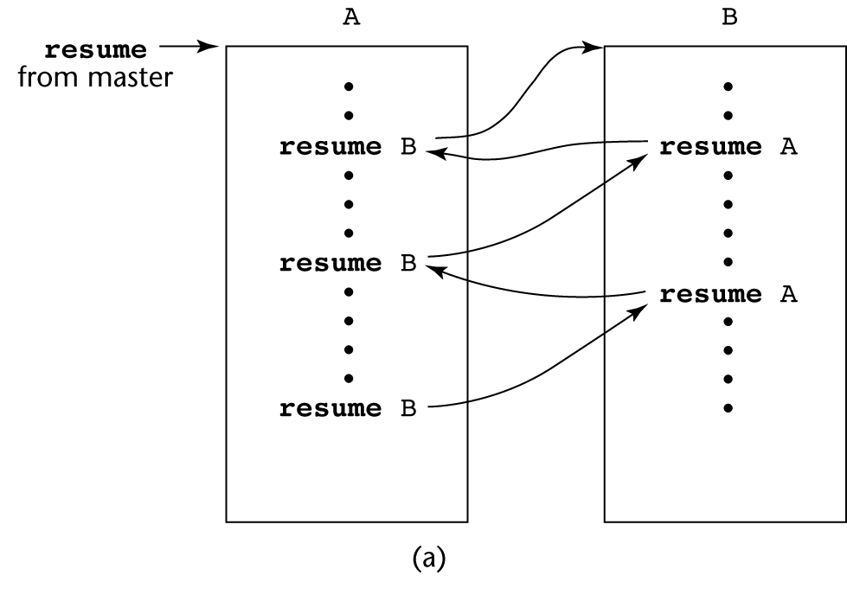
Coroutines Illustrated: Possible Execution Controls
1-46
Notes:
46
This sort of interleaved execution sequence is
related to the way multiprogramming operating systems work. Although there
may be only one processor, all of the executing programs in such a system
appear to run concurrently while sharing the processor. In the case of coroutines,
this is sometimes called quasi-concurrency .

Slide 47
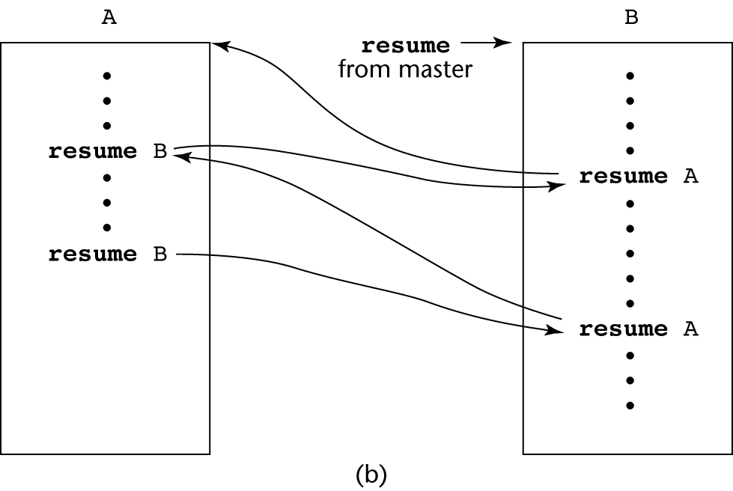
Coroutines Illustrated: Possible Execution Controls
1-47
Notes:
47

Slide 48
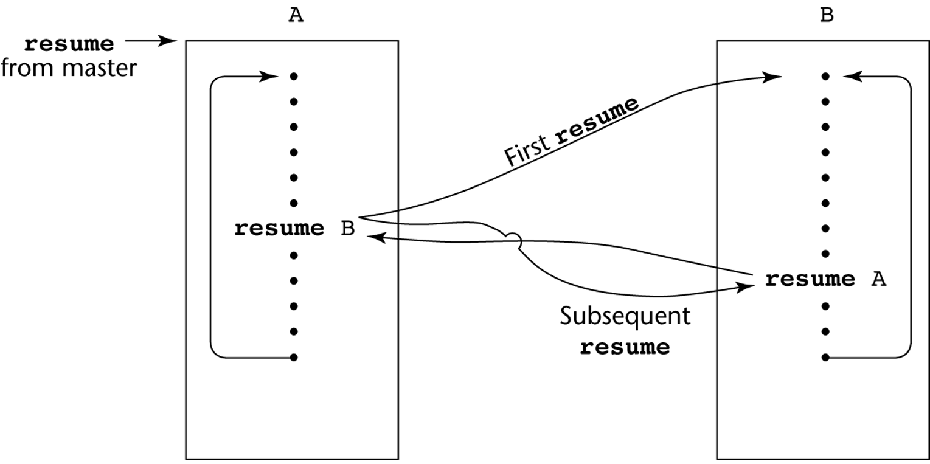
Coroutines Illustrated: Possible Execution Controls with Loops
1-48
Notes:
48
Among contemporary languages, only Lua fully supports coroutines.
However, the generators of Python are a form of coroutines.

Slide 49
Summary
Copyright © 2009 Addison-Wesley. All rights reserved.
1-49
A subprogram definition describes the actions represented by the subprogram
Subprograms can be either functions or procedures
Local variables in subprograms can be stack-dynamic or static
Three models of parameter passing: in mode, out mode, and inout mode
Some languages allow operator overloading
Subprograms can be generic
A coroutine is a special subprogram with multiple entries
Notes:
49

