Slide 1
Implementing Subprograms
BBM 301 – Programming Languages

Slide 2
The General Semantics of Calls and Returns
The subprogram call and return operations of a language are together called its subprogram linkage
General semantics of subprogram calls
Parameter passing methods
Stack-dynamic allocation of local variables
Save the execution status of calling program
Transfer of control and arrange for the return
If subprogram nesting is supported, access to nonlocal variables must be arranged
1-2
Notes:
2

Slide 3
The General Semantics of Calls and Returns
General semantics of subprogram returns:
Out mode and inout mode parameters must have their values returned
Deallocation of stack-dynamic locals
Restore the execution status
Return control to the caller
1-3
Notes:
3

Slide 4
Implementing “Simple” Subprograms
Simple Programs:
Subprograms cannot be nested
All local variables are static
Ex: Early versions of Fortran
Call Semantics:
Save the execution status of the caller (caller/callee)
Pass the parameters (caller)
Pass the return address to the subprogram (caller)
Transfer control to the subprogram (caller)
1-4
Notes:
4

Slide 5
Implementing “Simple” Subprograms
Return Semantics:
If pass-by-value-result or out mode parameters are used, move the current values of those parameters to their corresponding actual parameters (callee)
If it is a function, move the functional value to a place the caller can get it (callee)
Restore the execution status of the caller (caller/callee)
Transfer control back to the caller (callee)
1-5
Notes:
5

Slide 6
Storage required for call/return actions
Required storage:
Status information about the caller
Parameters
return address
return value for functions
These along with local variables and the subprogram code, form the complete collection of information a subprogram needs to execute and then return to the caller
1-6

Slide 7
Implementing “Simple” Subprograms: Parts
Two separate parts: the actual code (constant) and the non-code part (local variables and data that can change)
The format, or layout, of the non-code part of an executing subprogram is called an activation record
The form of an activation record is static.
An activation record instance (ARI) is a concrete example of an activation record (the collection of data for a particular subprogram activation)
1-7
Notes:
7

Slide 8
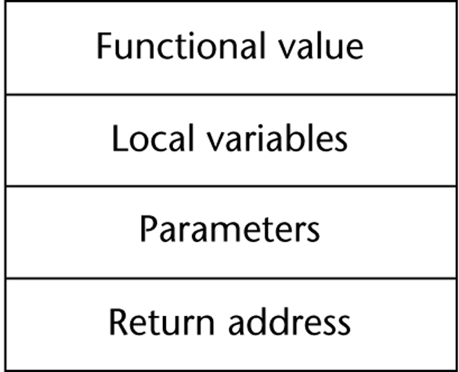
An Activation Record for “Simple” Subprograms
Because languages with simple
subprograms do not support
recursion, there can be only one
active version of a given subprogram
at a time
Therefore, there can be only a single instance of the activation record for a subprogram
Since activation record instance of a simple subprogram has fixed size it can be statically allocated. It could be also attached to the code part
1-8
Notes:
8

Slide 9
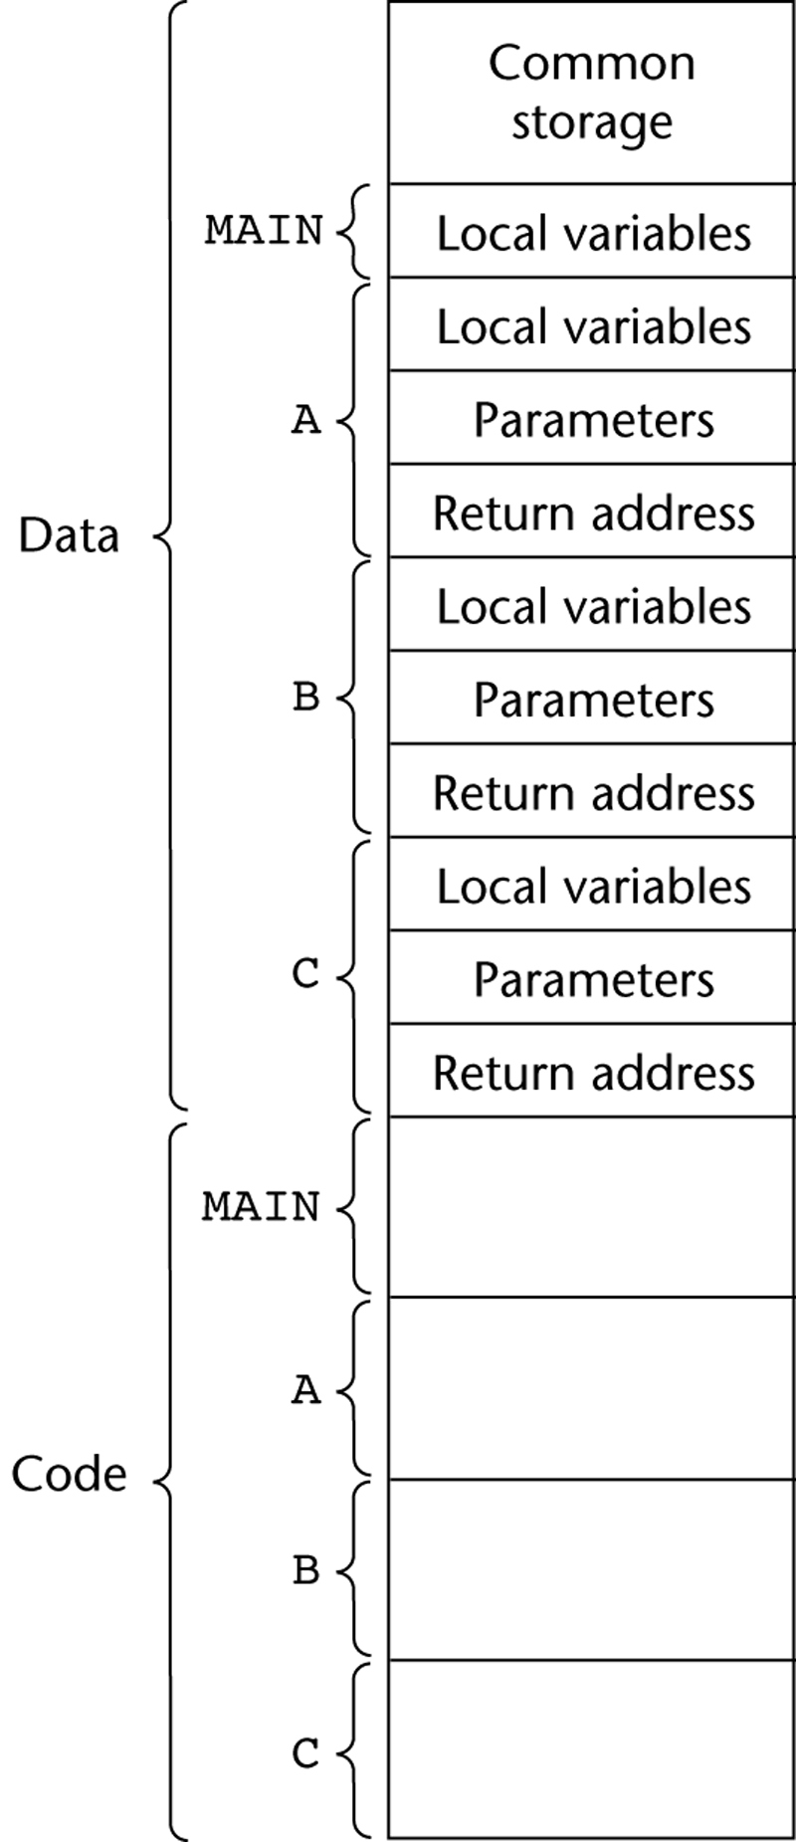
Code and Activation Records of a Program with “Simple” Subprograms
Note that code could be attached to ARIs
Also, the four program units could be compiled at different times
Linker put the compiled parts together when it is called for the main program
1-9
Notes:
9

Slide 10
Implementing Subprograms with Stack-Dynamic Local Variables
Advantage of Stack-Dynamic Local Variables
Support for recursion
More complex activation record
The compiler must generate code to cause implicit allocation and deallocation of local variables
Recursion must be supported (adds the possibility of multiple simultaneous activations of a subprogram)
Each activation needs its own activation record and the number of activations is limited only by the memory size of the machine.
1-10
Notes:
10

Slide 11
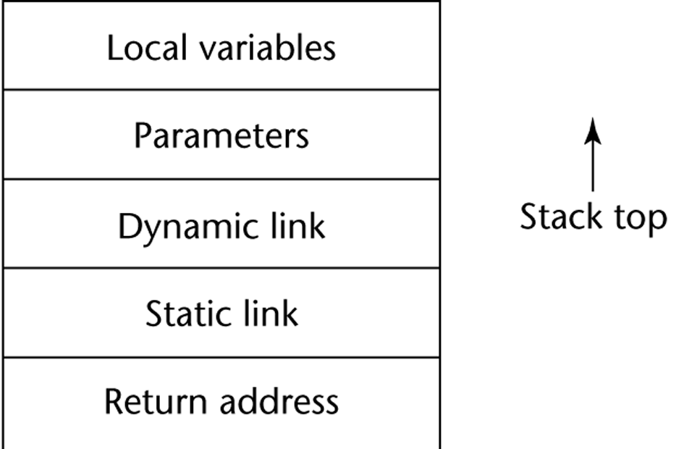
Typical Activation Record for a Language with Stack-Dynamic Local Variables
Return address: pointer to the code segment of the caller and an offset address in that code segment of the instruction following the call
Dynamic link: pointer to the base of the activation record instance of the caller
In static scoped languages this link is used to provide traceback information when a run-time error occurs.
In dynamic-scoped languages, the dynamic link is used to access non-local variables
Because the return address, dynamic link, and parameters are placed in the activation record instance by the caller, these entries must appear first.
1-11
Notes:
11

Slide 12
Implementing Subprograms with Stack-Dynamic Local Variables
In most languages,
The format of the activation record is known at compile time
In many cases, the size is also known, because all the local data are of fixed size.
In some languages, like Ada, the size of a local array can depend on the value of an actual parameter, so in those cases the format is static, but the size can be dynamic.
1-12
Notes:
12

Slide 13
Implementing Subprograms with Stack-Dynamic Local Variables: Activation Record
An activation record instance is dynamically created when a subprogram is called
Because the call and return semantics specify that the subprogram last called is the first to complete, it is reasonable to use a stack, so
Activation record instances reside on the run-time stack
Every subprogram activation (recursive or non-recursive) creates a new instance of an activation record on the stack.
The Environment Pointer (EP) must be maintained by the run-time system. It always points at the base of the activation record instance of the currently executing program unit.
1-13
Notes:
13

Slide 14
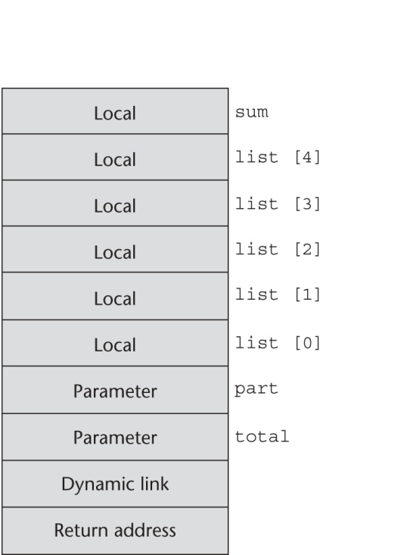
An Example: C Function
void sub(float total, int part)
{
int list[5];
float sum;
…
}
1-14
Notes:
14

Slide 15
Revised Semantic Call/Return Actions
Create an activation record instance
Save the execution status of the current program unit
Compute and pass the parameters
Pass the return address of the callee
Transfer the control to the callee
1-15

Slide 16
Revised Semantic Call/Return Actions
Before (Prologue)
Save the old EP to the stack as the dynamic link and create the new value
Allocate local variables
After (Epilogue)
If pass-by-value-result or out mode parameters are used, move the current values of those parameters to their corresponding actual parameters
If it is a function, move the functional value to a place the caller can get it
Restore the stack pointer by setting it to the value of the current EP minus one and set the EP to the old dynamic link
Restore the execution status of the caller
Transfer control back to the caller
1-16

Slide 17
An Example Without Recursion
Point 1
Point 2
main calls fun1
fun1 calls fun2
fun2 calls fun3
Point 3
1-17
void fun1(float r) {
int s, t;
...
fun2(s);
...
}
void fun2(int x) {
int y;
...
fun3(y);
...
}
void fun3(int q) {
...
}
void main() {
float p;
...
fun1(p);
...
}
Notes:
17

Slide 18
An Example Without Recursion
main calls fun1
fun1 calls fun2
fun2 calls fun3
1-18
1-18
Notes:
18

Slide 19
Dynamic Chain and Local Offset
Dynamic chain (call chain): The collection of dynamic links in the stack at a given time
Local variables can be accessed by their offset from the beginning of the activation record, whose address is in the EP. This offset is called the local_offset
The local_offset of a local variable can be determined by the compiler at compile time
How?
1-19
Notes:
19

Slide 20
Local offset
The local_offset of a variable in an activation record can be determined at compile time, using the order, types, and sizes of variables.
For simplicity, we assume that all variables take one position in the activation record.

Slide 21
An Example Without Recursion
main calls fun1
fun1 calls fun2
fun2 calls fun3
In fun1, the local_offset of s is 3; for t it is 4.
In fun2, the local_offset of y is 3.
1-21
1-21
Notes:
21

Slide 22
Recursion
int factorial (int n) {
<-----------------------------1
if (n <= 1)
return 1;
else return (n * factorial(n - 1));
<-----------------------------2
}
void main() {
int value;
value = factorial(3);
<-----------------------------3
}
1-22
Notes:
22

Slide 23
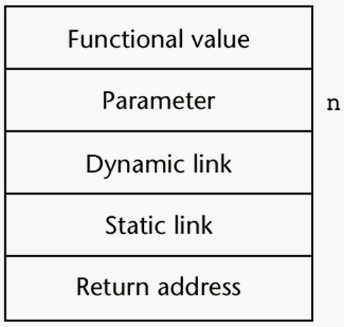
Activation Record for factorial
1-23
Notes:
23

Slide 24
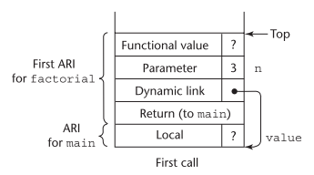
Stack contents during execution of main and factorial
1-24

Slide 25
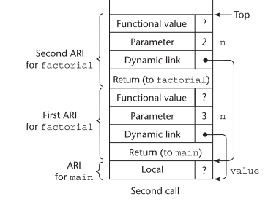
Stack contents during execution of main and factorial
1-25

Slide 26
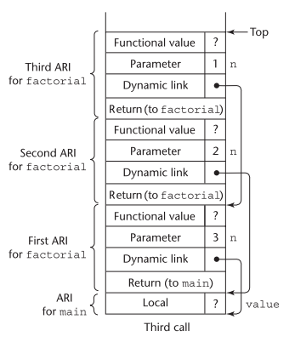
Stack contents during execution of main and factorial
1-26

Slide 27
Stack contents during execution of main and factorial
1-27

Slide 28
Stack contents during execution of main and factorial
1-28

Slide 29
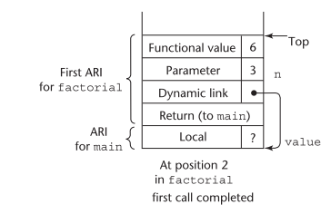
Stack contents during execution of main and factorial
1-29

Slide 30
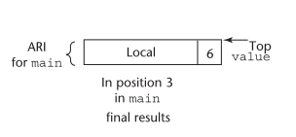
Stack contents during execution of main and factorial
1-30

Slide 31
Nested Subprograms
Some non-C-based static-scoped languages (e.g., Fortran 95, Ada, Python, JavaScript, Ruby, and Lua) use stack-dynamic local variables and allow subprograms to be nested
All variables that can be non-locally accessed reside in some activation record instance in the stack
The process of locating a non-local reference:
Find the correct activation record instance
Determine the correct offset within that activation record instance
1-31
Notes:
31

Slide 32
Locating a Non-local Reference
Finding the offset is easy
Finding the correct activation record instance
Static semantic rules guarantee that all non-local variables that can be referenced have been allocated in some activation record instance that is on the stack when the reference is made
1-32
Notes:
32

Slide 33
Implementing Static Scoping
The static link in an activation record instance for subprogram A points to the bottom of one of the activation record instances of A's static parent
A static chain is a chain of static links that connects certain activation record instances
The static chain from an activation record instance connects it to all of its static ancestors
Static_depth is an integer associated with a static scope whose value is the depth of nesting => indicates how deeply it is nested in the outermost scope
1-33
Notes:
33

Slide 34
Static Scoping (continued)
A program unit that is not nested inside any other unit has a static_depth of 0.
A subprogram A is defined in a nonnested program unit, its static_depth is 1.
If subprogram A contains the definition of a nested subprogram B , then B ’s static_depth is 2.
The chain_offset or nesting_depth of a nonlocal reference is the difference between the static_depth of the reference and static_depth of the procedure containing its declaration
A reference to a variable can be represented by the pair:
(chain_offset, local_offset),
where local_offset is the offset in the activation record of the variable being referenced
1-34

Slide 35
Example in Python
# Global scope
. . .
def f1():
def f2():
def f3():
. . .
# end of f3
. . .
# end of f2
. . .
# end of f1
Static depth of f1 = 0
Static depth of f2 = 1
Static depth of f3 = 2

Slide 36
Example Ada Program*
procedure Main_2 is
X : Integer;
procedure Bigsub is
A, B, C : Integer;
procedure Sub1 is
A, D : Integer;
begin -- of Sub1
A := B + C; <-----------------------1
end; -- of Sub1
procedure Sub2(X : Integer) is
B, E : Integer;
procedure Sub3 is
C, E : Integer;
begin -- of Sub3
Sub1;
E := B + A: <--------------------2
end; -- of Sub3
begin -- of Sub2
Sub3;
A := D + E; <-----------------------3
end; -- of Sub2 }
begin -- of Bigsub
Sub2(7);
end; -- of Bigsub
begin
Bigsub;
end; of Main_2 }
1-36
Notes:
36

Slide 37
Example Ada Program (continued)
1-37
Call sequence for Main_2
Main_2 calls Bigsub
Bigsub calls Sub2
Sub2 calls Sub3
Sub3 calls Sub1
Notes:
37

Slide 38
Stack Contents at Position 1
1-38
Notes:
38

Slide 39
Example Ada Program
Variable | Chain offset | Local offset
A at position 1 | 0 | 3
B at position 1 | 1 | 4
C at position 1 | 1 | 5
E at position 2 | 0 | 4
B at position 2 | 1 | 4
A at position 2 | 2 | 3
A at position 3 | 1 | 3
D at position 3 | Not in scope - Error | Not in scope - Error
E at position 3 | 0 | 5
procedure Main_2 is
X : Integer;
procedure Bigsub is
A, B, C : Integer;
procedure Sub1 is
A, D : Integer;
begin -- of Sub1
A := B + C; <-----------------------1
end; -- of Sub1
procedure Sub2(X : Integer) is
B, E : Integer;
procedure Sub3 is
C, E : Integer;
begin -- of Sub3
Sub1;
E := B + A: <--------------------2
end; -- of Sub3
begin -- of Sub2
Sub3;
A := D + E; <-----------------------3
end; -- of Sub2 }
begin -- of Bigsub
Sub2(7);
end; -- of Bigsub
begin
Bigsub;
end; of Main_2 }
1-39
Notes:
39

Slide 40
Evaluation of Static Chains
1-40
Problems: 1. A nonlocal reference is slow if the nesting depth is large 2. Time-critical code is difficult: a. Costs of nonlocal references are difficult to determine b. Code changes can change the nesting depth, and therefore the cost
Notes:
40

Slide 41
Blocks
1-41
Recall that blocks are user-specified local scopes for variables
An example in C
{int temp;
temp = list [upper];
list [upper] = list [lower];
list [lower] = temp
}
The lifetime of temp in the above example begins when control enters the block
An advantage of using a local variable like temp is that it cannot interfere with any other variable with the same name
Notes:
41

Slide 42
Implementing Blocks
1-42
Two Methods:
Treat blocks as parameter-less subprograms that are always called from the same location
Every block has an activation record; an instance is created every time the block is executed
2. Since the maximum storage required for a block can be statically determined, this amount of space can be allocated after the local variables in the activation record
Notes:
42

Slide 43
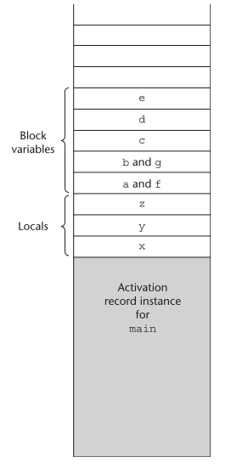
Implementing Blocks
Block variable storage when blocks are not treated as parameterless procedures
1-43

Slide 44
Implementing Dynamic Scoping
1-44
Deep Access: non-local references are found by searching the activation record instances on the dynamic chain - Length of the chain cannot be statically determined - Every activation record instance must have variable names
Shallow Access: put locals in a central place
One stack for each variable name
Central table with an entry for each variable name
Notes:
44

Slide 45
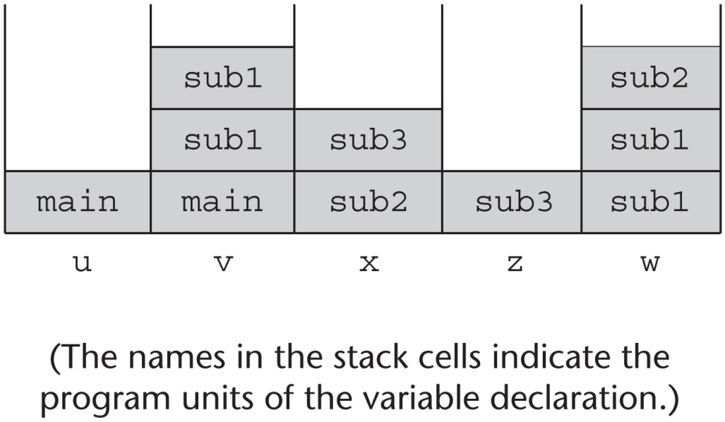
Using Shallow Access to Implement Dynamic Scoping
void sub3() {
int x, z;
x = u + v;
…
}
void sub2() {
int w, x;
…
}
void sub1() {
int v, w;
…
}
void main() {
int v, u;
…
}
main calls sub1
sub1 calls sub1
sub1 calls sub2
sub2 calls sub3
1-45
Notes:
45

Slide 46
Summary
Subprogram linkage semantics requires many action by the implementation
Simple subprograms have relatively basic actions
Stack-dynamic languages are more complex
Subprograms with stack-dynamic local variables and nested subprograms have two components
actual code
activation record
1-46
Notes:
46

Slide 47
Summary (continued)
1-47
Activation record instances contain formal parameters and local variables among other things
Static chains are the primary method of implementing accesses to non-local variables in static-scoped languages with nested subprograms
Access to non-local variables in dynamic-scoped languages can be implemented by use of the dynamic chain or thru some central variable table method
Notes:
47

