Slide 1
Game Engine Components
Barkın Zorlu

Slide 2
Graphic Engine (Rendering Engine)
- Visualization of objects in Game Engines
- Reduced to triangles and drawn based on camera what camera can see
- Camera; frustrum, culling.
- Most Game engines use graphics API’s:
Unity: DirectX, Metal, OpenGL, and Vulkan
Unreal Engine: Vulkan
Godot: Vulkan, OpenGL ES 2.0 – 3.0 (Only Vulkan after Godot 4.0 Update)
- Works with shaders; GLSL, HLSL, etc.
- Shading
- Materials
- Shadows
- Occlusion
- AA, MSAA

Slide 3
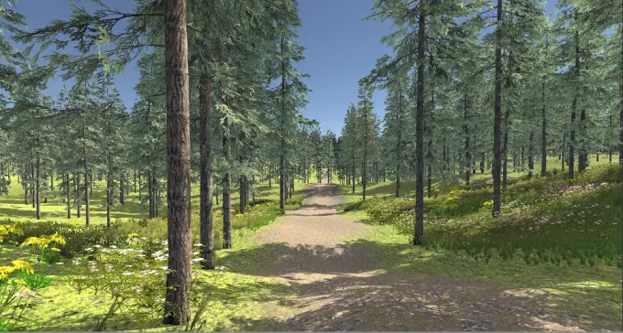
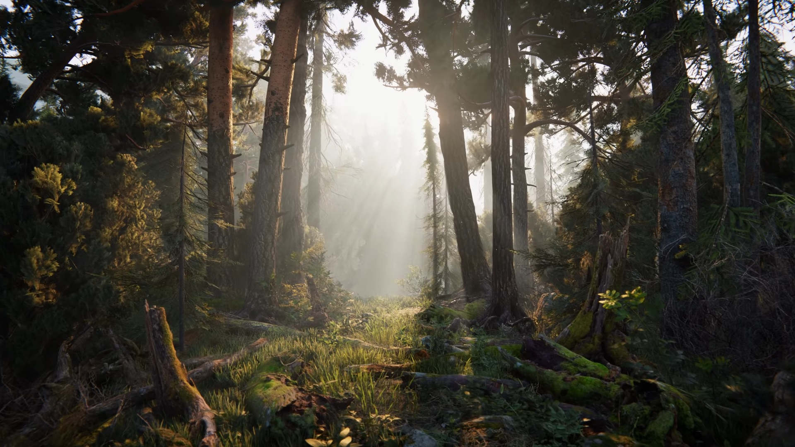
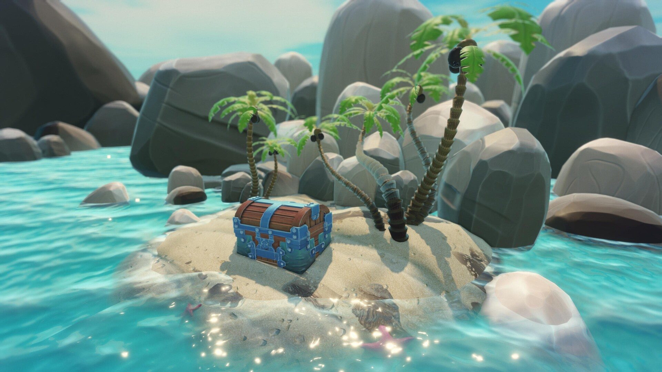
Unity Render Pipelines:
Unity SRP:
Unity HDRP:
Unity URP:

Slide 4
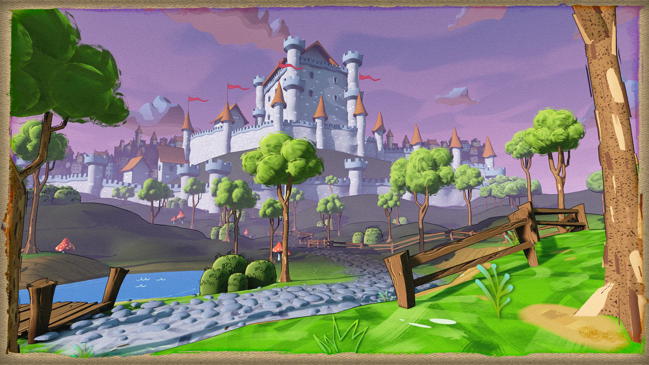
Unreal Engine 5 Examples:
Photo Realistic Render
Stylized Render

Slide 5
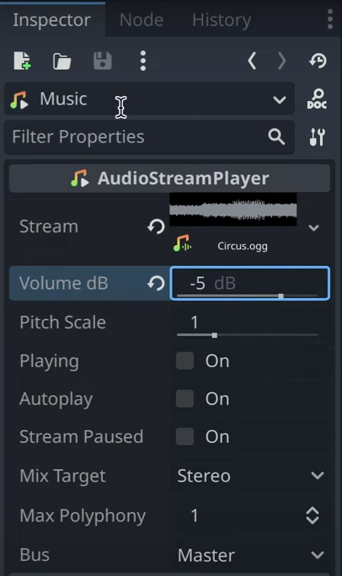
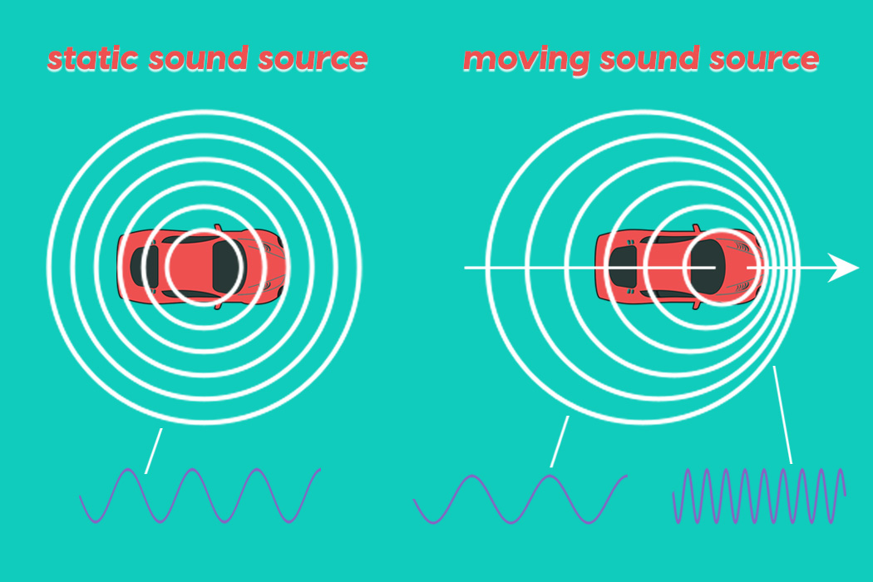
Audio Engine
Godot: (Integrated in Inspector)
Unity: (Separate Window)
- Sound is mixed and processed here.
- Processed separately from game functions and Game Loop.
- Directional Audio
- Sound Effects (Reverb, echo etc.)
- Doppler Effect

Slide 6
Input Engine
- Ques the input from user, deques them when available.
- Always checks for player input unless closed or not listening.
Buffering can eliminate input stuttering.
- Multiple axis (joystick, mouse, etc.), keys and buttons.
- Mapped or Key checked. (Unreal Engine, Godot vs Unity)
- Inputs can be processed in game loop (Unity)
- Inputs can be event based (Unreal Engine)
- Inputs can be mapped and processed in game loop (Godot)

Slide 7
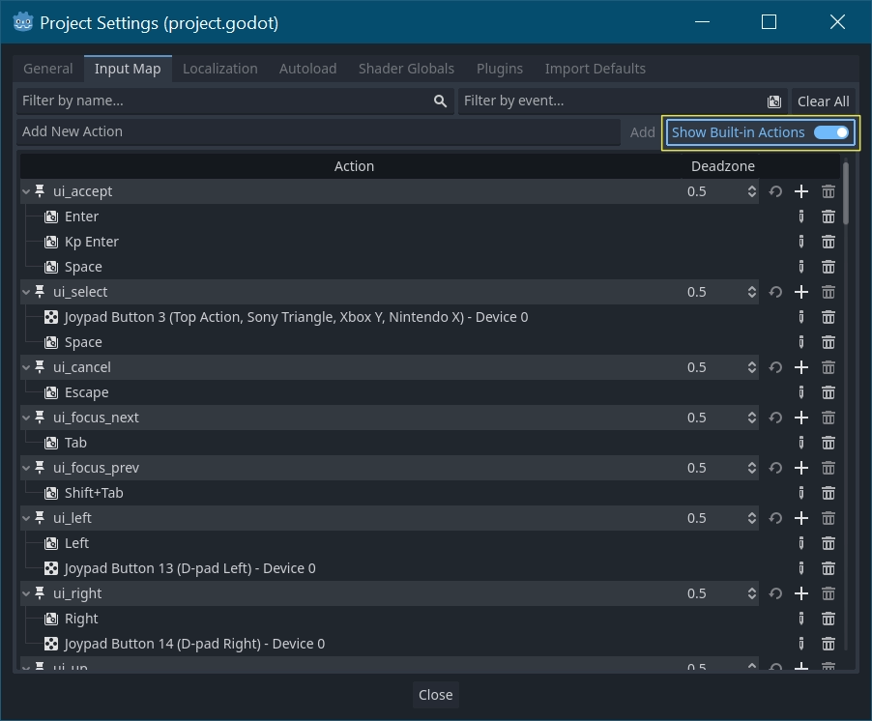
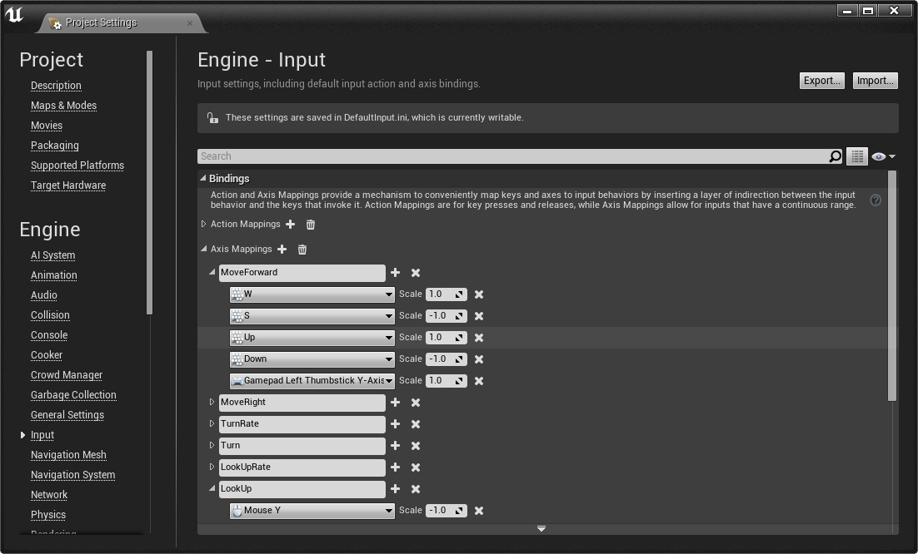
Input Mapping examples:
Godot:
Unreal Engine 5.3: Event based, only triggered once pressed

Slide 8
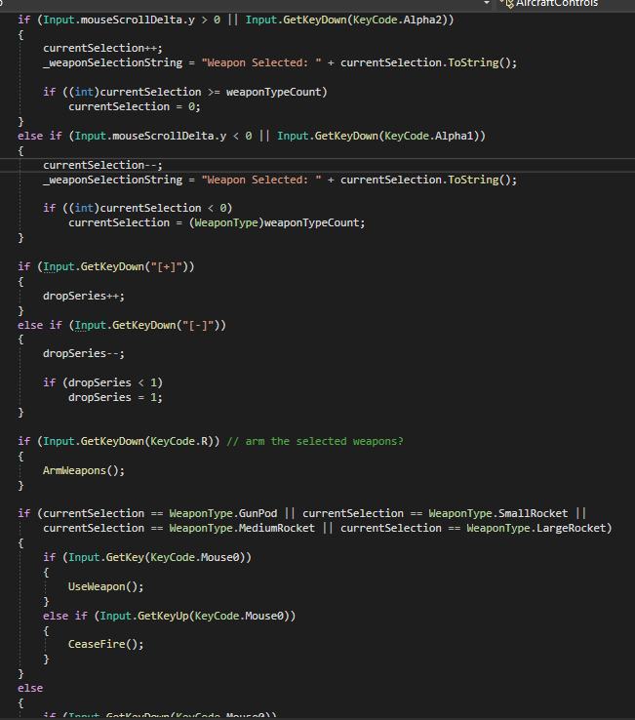
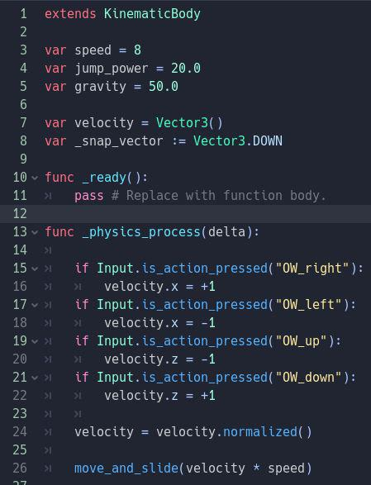
Input Game Loop Processed Examples:
Unity: Checked every Frame
Godot: Mapped but still processed in game loop

Slide 9
AI
- Navigation Mesh (NavMesh in Unity)
Where AI can go represented via a mesh, can be baked or dynamic.
- State Tree (Blend Tree in Unity)
Animation or action state for AI
- Smart Objects
Interactable objects that can be interacted by AI
Unreal Engine 5 Noteworthy Abilities:
- Ai perception: Perceptive query for AI used for generating awareness.
- Environment Query System: Query for environment, example dynamic cover system (combat).
- MassEntity: Mass population simulation. https://www.youtube.com/watch?app=desktop&v=F-v6Xz6-pf4
Uses Arrays and query's to achieve high performance for simulation, Mass LOD, Mass Avoidance, Culling
MassEntity example

Slide 10
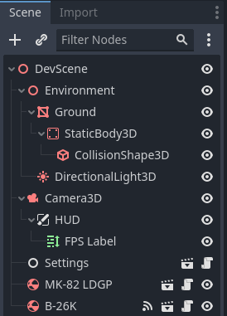
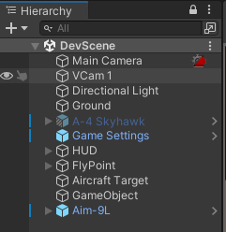
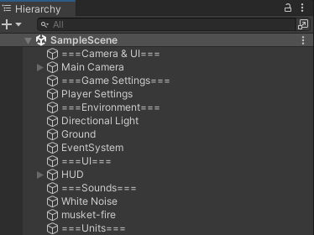
Scene Graph
Object oriented programming.
Unreal Engine 5:
Godot 4.11:
Unity:

Slide 11
Scripting
- Override or add to game functions
- Integrated in game loop
- Object Oriented Programming
- Where we add mechanics into the game
- CPU is used for these calculations
- GPU can be reached via Compute Shaders
- Mostly written via external IDEs (Counter Example: Godot has internal IDE Option)
VSCode (Godot), Visual Studio (Unity), JetBrains Rider (Unreal Engine)
These are all optional and can be changed based on preference

Slide 12
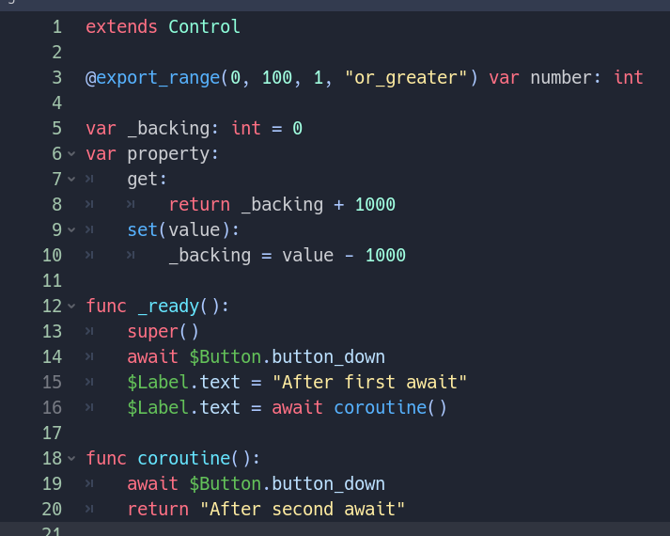
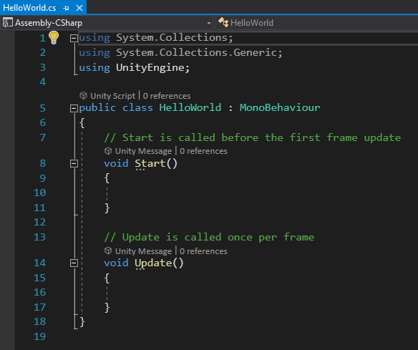
Scripting Examples:
These two examples of scripting are direct, the code is directly on the object.
Godot: (GDScript)
Unity: C#
Unity visual Scripting (New)

Slide 13
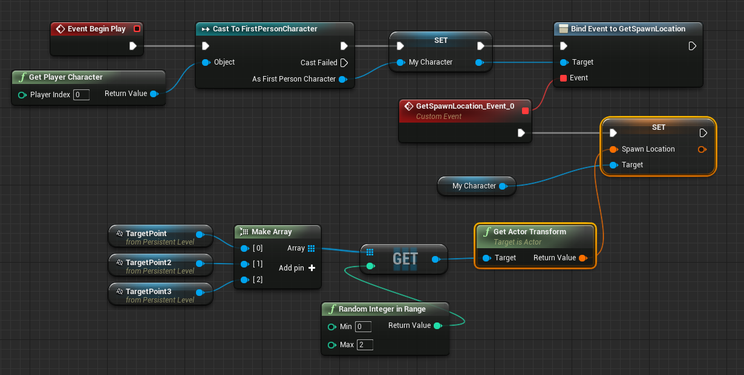
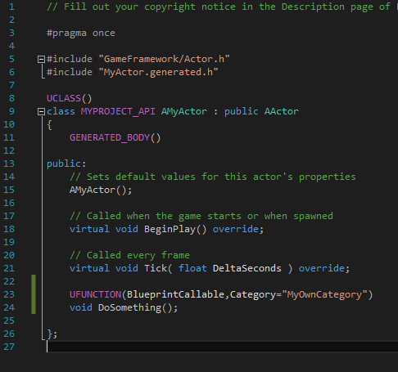
Unreal Engine Scripting
Unreal engine scripting is first integrated on to a blueprint then its used.
Blueprints:
C++

