Slide 1
Roles ın gamıng ındustry

Slide 2
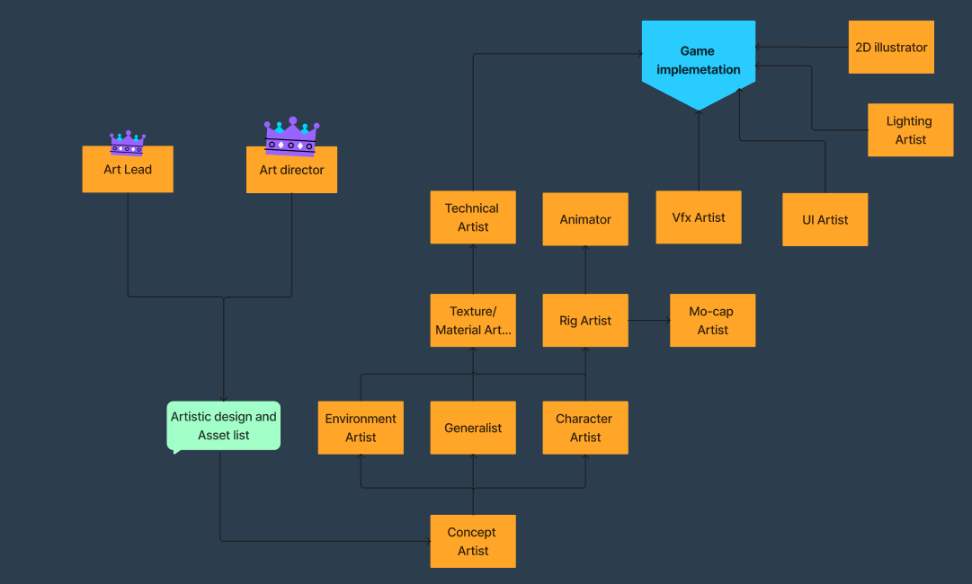
ART DEPARTMENT

Slide 3
Art Leader (aka Art lead.)
Handle the technical aspects of the art team such as art processes, tools, geometric budgets, texture budgets, task definitions, and scheduling of tasks.
Needs to have an experience or opinion on most of the used pipeline tools.

Slide 4
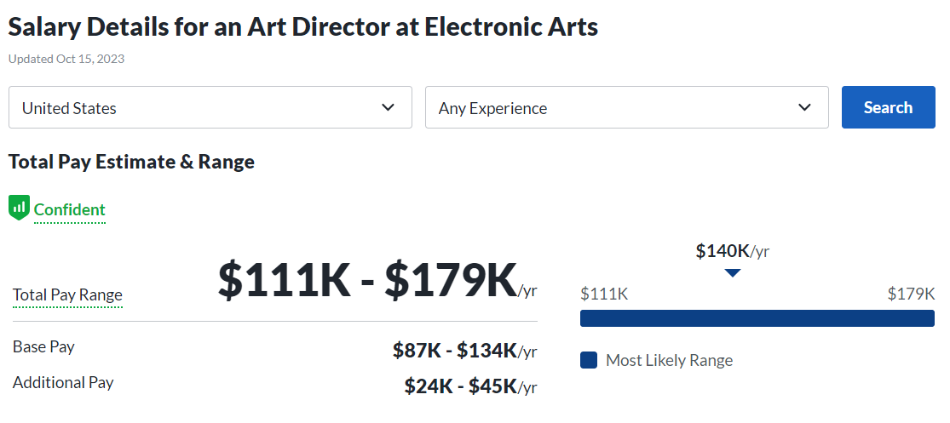
Art Director
The role of the Art Director is focused on maintaining the overall game aesthetics and ensuring the creative process runs efficiently.
Ensure game quality with executive level

Slide 5
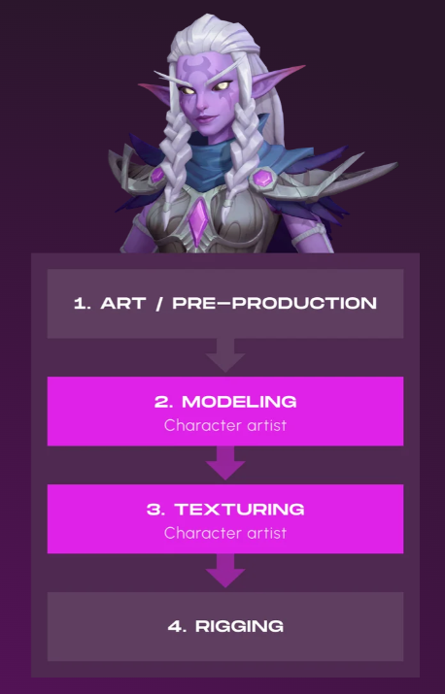
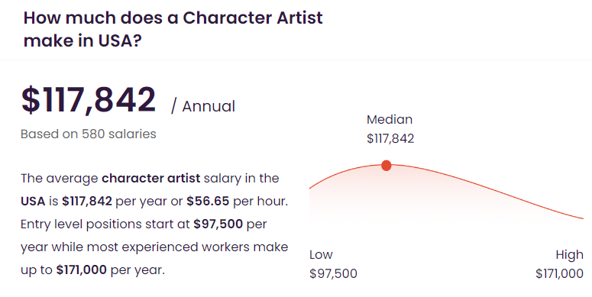
Character Artist
These folks’ job is to model and texture the characters. The flow of work usually looks that they get concept art from the concept artist (accepted by the Art Director ofc – you can’t work without the approval of an art honcho).
2D - 3D

Slide 6
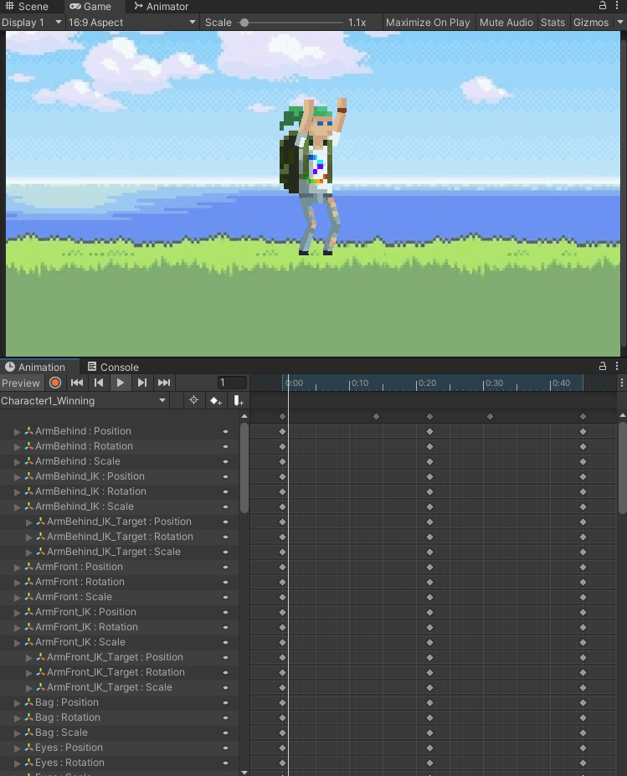
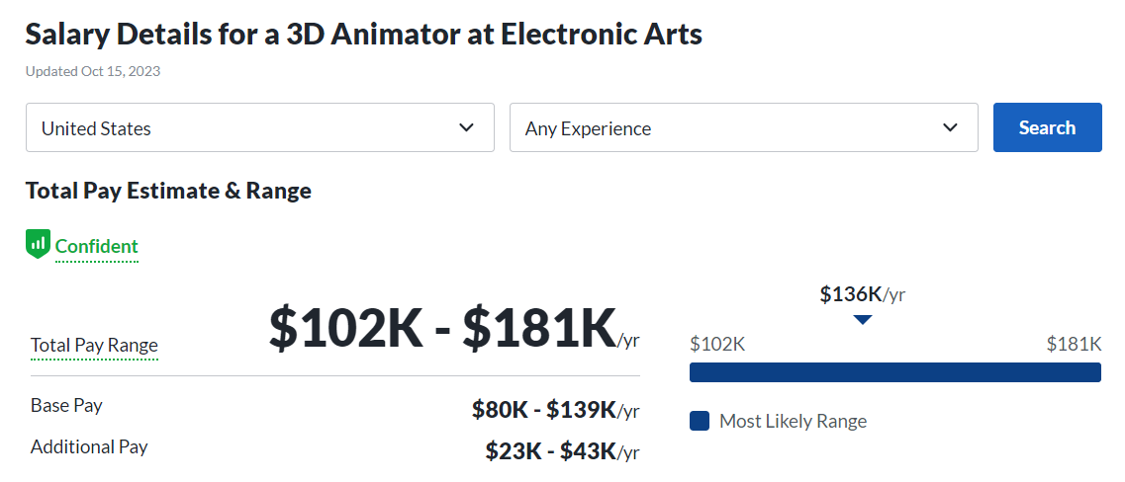
Animator
Characters, monsters, machines, vehicles. Someone has to breathe some life into all static models. These guys are adding motion to objects in the gameplay or in the cutscenes.
Besides knowledge about animation software, you should dive deep into the principles of movement. Learn how different objects are moving, how important the weight of an object is. Observe and practice

Slide 7
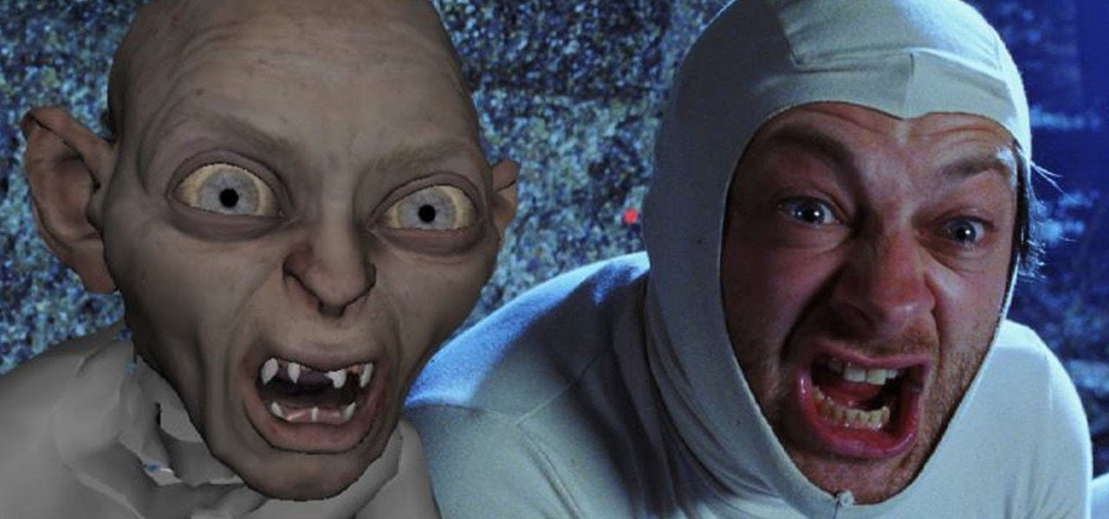
Mo-Cap Artist
A Motion Capture Artist is often someone who comes with an Animation background. These guys and gals oversee the mocap sessions (you know – people wearing special suits with sensors).
Motion Capture Artist checks if the sensors read all movement correctly during the recording. They also take care of cleaning the animation in case of any errors.

Slide 8
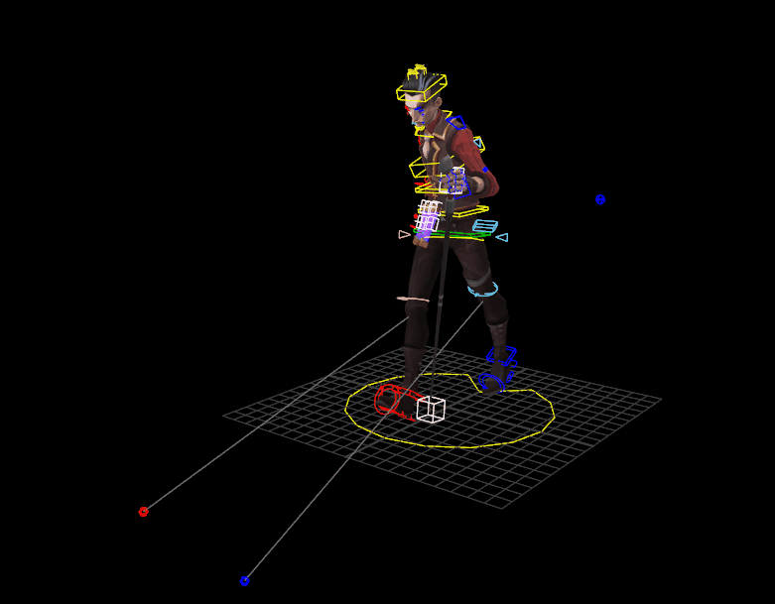
Rig Artist
Before animators start their job, a model needs something called the rig.
The rig is basically a “skeleton” of the model. Thanks to these “bones,” the animator knows which parts can move.
In smaller gamedev teams animator also takes care of the rig.

Slide 9
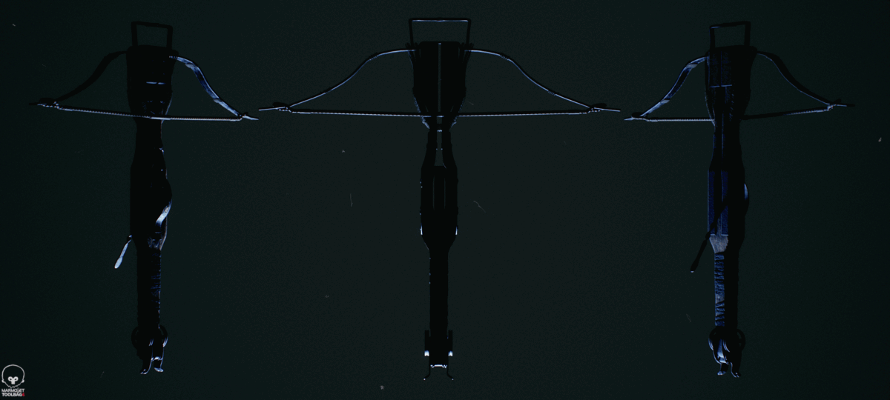
Generalist 2D - 3D
Prop Artists create all these little elements that are used by Environment Artists to fill the world with!
Crates, chests, trees, exploding barrels, trash, you name it 😉
These guys are either modeling these from scratch or pimp-up stock-bought models.
Prop Artists are often texturing their own models, so besides 3d modeling – add texturing to the list of needed skills.

Slide 10
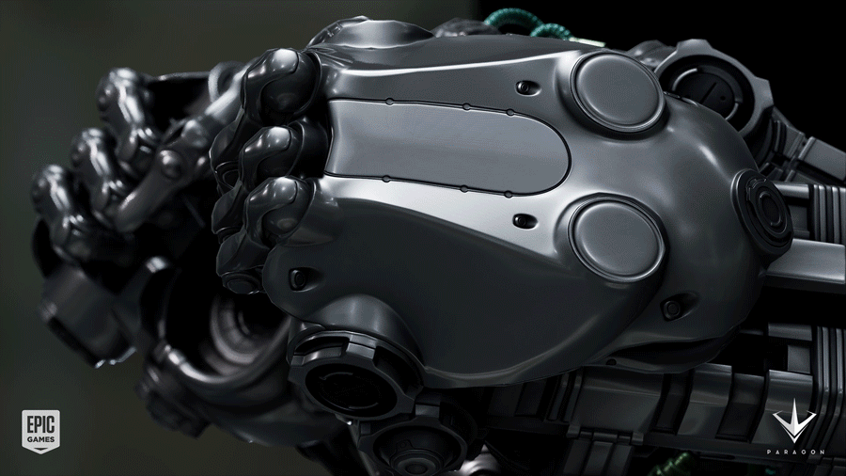
Texture Material Artist
Models without textures would be like Doom without the BFG. 😉 No flava.
Textures are 2D images wrapped around 3D models. You might think of it as creating skin for each model.
Texture artists often combine different textures to create believable materials to sell what an object should look like to the player.

Slide 11
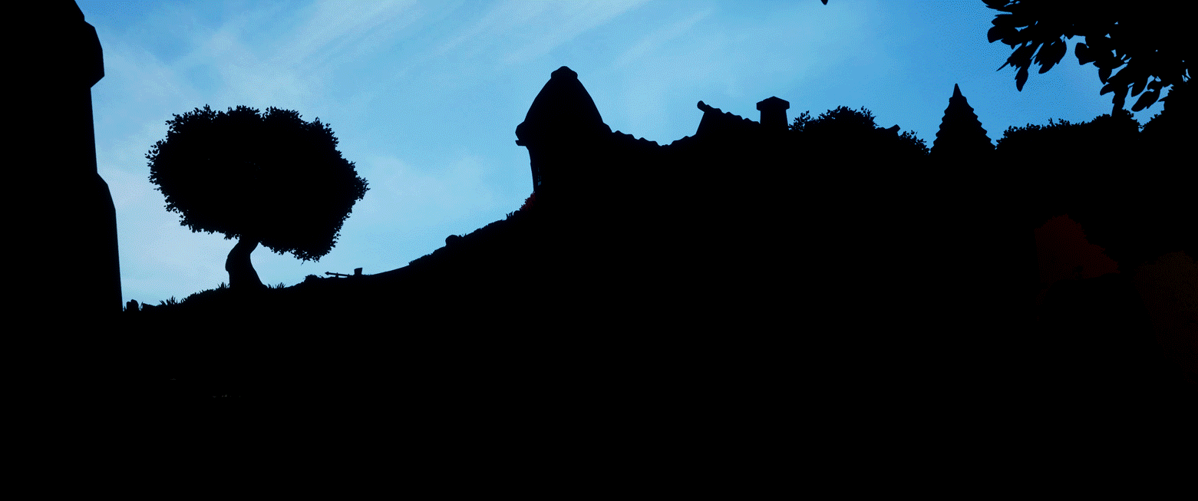
Lighting Artist
Lightning artists work with the game engine (they need technical knowledge) to place and set up light in the game. That means in the world, on the levels, in the rooms.

Slide 12
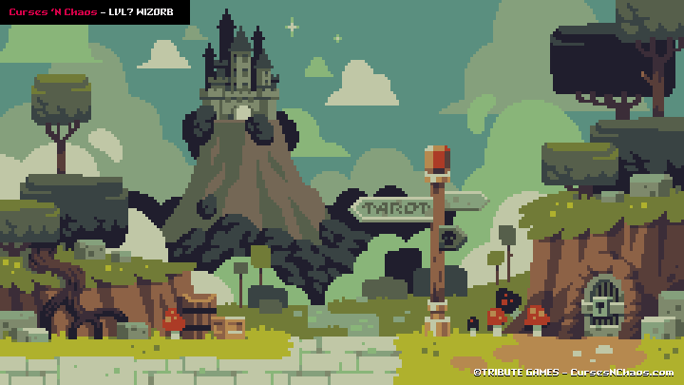
Concept Artist
Concept artists’ job is to create a visual interpretation of the design team’s ideas, so everyone knows what the game (and in-game elements) would look like. So their work is more of a blueprint, a guidance for the other team members. (Like 3D Artists, animators, etc.)
They’re working according to the brief they were given by the Art Director (or the Design team). They need to produce art fast to check the different variations.
Concept Artists can specialize in different topics. Like some people design only the environments or characters. Others may work only on vehicles.

Slide 13
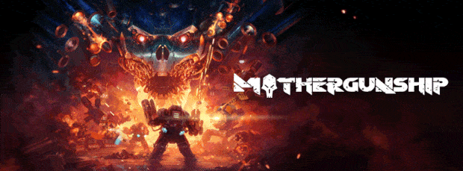
2D illustrator
While Concept Artist’s job is to produce more of a sketch of an idea, Illustrators are spending their time creating finished game art pieces.
They make all those very detailed box arts that you can admire on the covers of boxes or promotional art that you can often see on the banners. They are the digital artists who create all posters that could be added to the collector’s editions. You get the idea.
To explain the difference:
It’s completely fine to spend a week creating a promo Illustration. However, concept artists taking the same amount of time drawing a variant of some clothing could be in trouble.

Slide 14
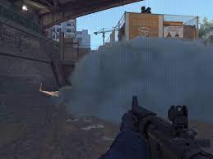
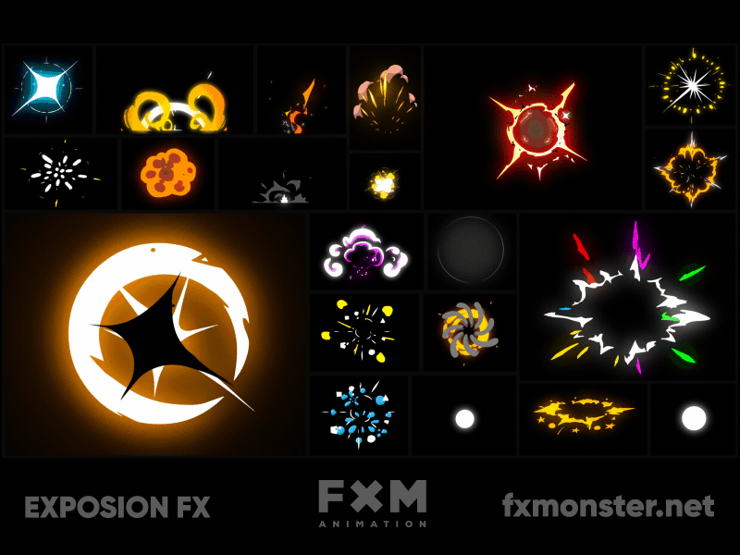
VFX Artist
Smoke, fog, explosions, magical auras. It’s all in the game, thanks to your friendly neighborhood VFX artists.
3D VFX artists create and place particles, which are eating up your precious FPS’. 😉
2D VFX artists create tons of custom animations.

Slide 15
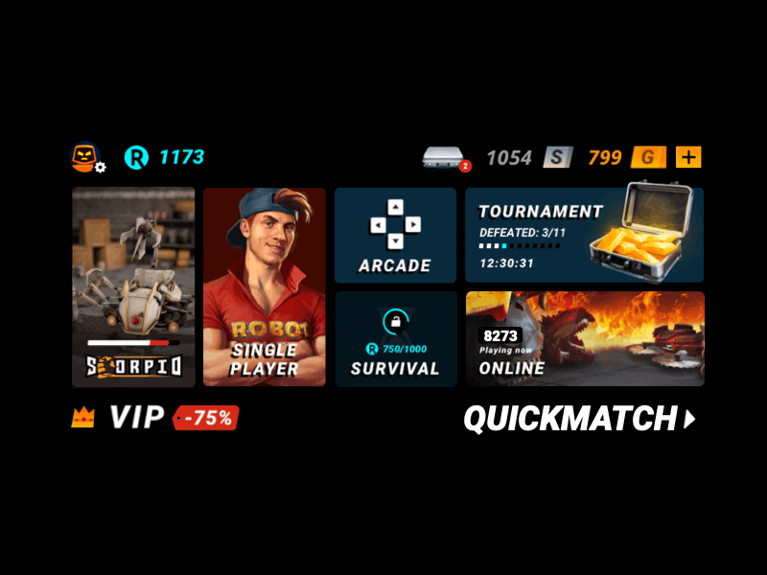
UI Artist
UI Artist makes all the menus and on-screen indicators that assist the player’s playthrough.
Health bars, Score, Progression bars – everything that is needed to give players proper feedback.
UI Artist’s responsibility is to create clear, readable images fitting the game’s art style.
UI Artists may be asked to implement their work in the engine, which needs technical knowledge.
It’s required from UI Artist to know about User Experience (UX) Design. Which is basically thinking about how people will interact with the interface and respond to certain elements.
These two roles are often mixed with each other, so it’s essential to know the difference.

Slide 16
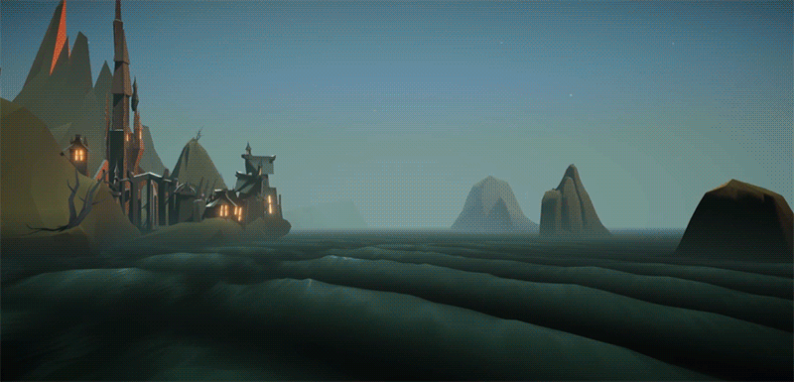
Technical Artist
This is where the world of art and programming collide 😉
Their job is to build/integrate tools to the game engines that make others artists’ work less painful.
Technical Artist supports the art team in finding ways to improve their workflow and save some time on mundane tasks.
Having a technical artist in the team also frees up the programmers’ time and focuses on more pressing matters.
Technical artists need to have both technical and artistic skills, but they are not required to create art assets themselves)

Slide 17
AUDİO DEPARTMENT

Slide 18
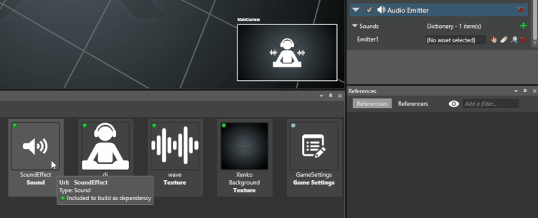
Audio Programmer (Video Games)
Professional Skills
Audio APIs like Wwise, FMOD, or Miles
DAWs
MIDI
Knowledge of C# or C/C++
Max/MSP
Software and tool development
Audio engineering (editing and mixing)
Sound design
Collaboration
Communication
Technical Sound Designer, Audio Implementer
An audio programmer is a coder and sound engineer who implements audio assets into a video game engine or similar interactive media project.

Slide 19
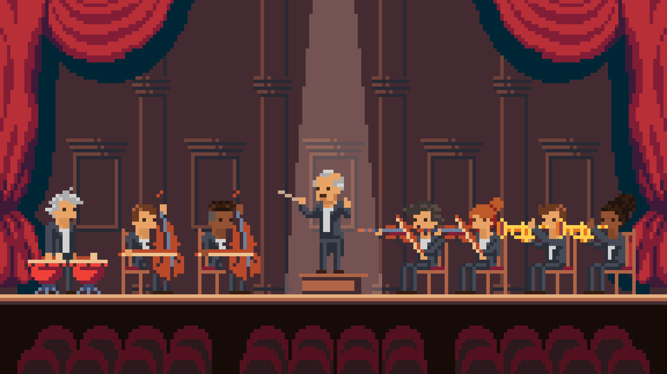
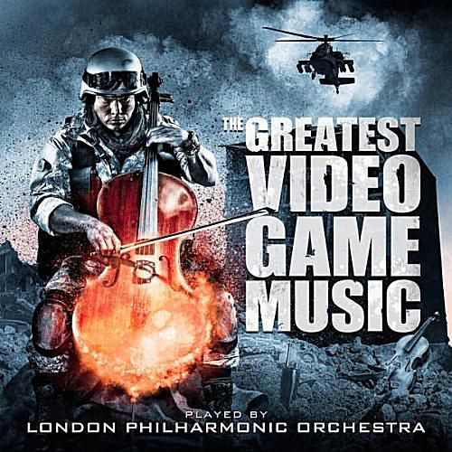
Music Composer
Professional Skills
Orchestration and arranging
Composing character themes
Composing loops
Home studio setup
DAWs
Synthesizers and samplers
Audio editing
Video game design
Compositional flexibility
Video game composers create the musical scores for video games on a variety of platforms, including consoles, mobile phones, personal computers, and virtual and augmented reality systems.

Slide 20
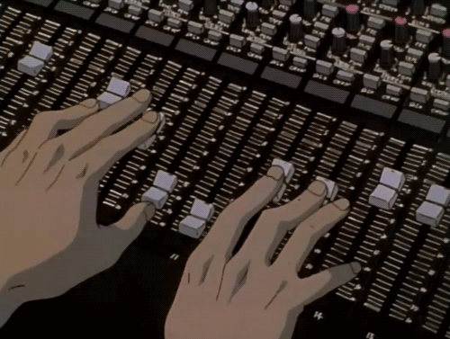
Music Composer
Professional Skills
Sound design
Audio implementation (Wwise, FMod)
Audio production
Audio recording
Audio editing
Sound libraries
Coding (C or C++)
Audio Developer, Audio Designer, Sound Developer, Video Game Audio Engineer, Sound Effect Designer
Sound designers collect, edit, and create sound effects, ambient effects, and even music for video games, applications, or any other form of interactive media.

Slide 21
Thanks for listening
Additional resources

