Slide 1
Networks-on-Chip (NoC)
Suleyman TOSUN
Computer Engineering Deptartment
Hacettepe University, Turkey

Slide 2
Outline
Introduction – Network-on-Chip (NoC)
Mapping on Mesh-based NoCs
Results
Possible Research Directions
Conclusions

Slide 3
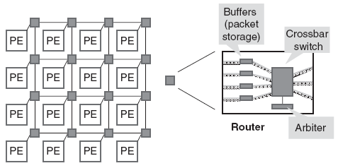
Introduction
Network-on-chip (NoC) is a packet switched on-chip communication network designed using a layered methodology
“routes packets, not wires”
NoCs use packets to route data from the source to the destination PE via a network fabric that consists of
switches (routers)
interconnection links (wires)

Slide 4
Introduction
NoCs are an attempt to scale down the concepts of largescale networks, and apply them to the embedded system-on-chip (SoC) domain
NoC Properties
Regular geometry that is scalable
Flexible QoS guarantees
Higher bandwidth
Reusable components
Buffers, arbiters, routers
No long global wires (or global clock tree)
No problematic global synchronization
GALS: Globally asynchronous, locally synchronous design
Reliable and predictable electrical and physical properties

Slide 5
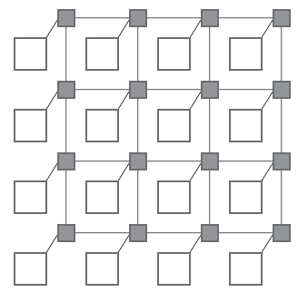
NoC Topology
2D mesh is most popular topology
all links have the same length
eases physical design
area grows linearly with the number of nodes
must be designed in such a way as to avoid traffic accumulating in the center of the mesh

Slide 6
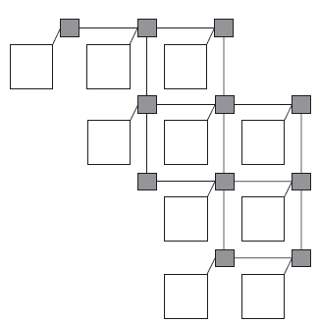
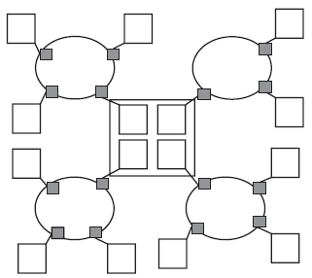
NoC Topology
Irregular or ad hoc network topologies
customized for an application
usually a mix of shared bus, direct, and indirect network topologies
e.g. reduced mesh, cluster-based hybrid topology

Slide 7
Energy Consumption in NoCs
Proportional to total bit transitions
Energy of one bit transition:
Total energy consumption

Slide 8
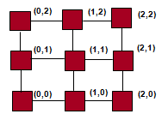
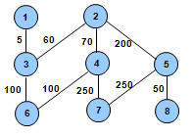
Application Graph and Topology
Mapping

Slide 9
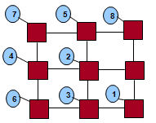
Mapping Problem
Given a WCTG and a TG that satisfy
Find a one to one mapping function
such that
and energy is minimized:

Slide 10
Proposed Methods
Integer Linear Programming
Genetic Algorithms and Simulated Annealing
Heuristic Method
Voltage/Frequency Islands

Slide 11
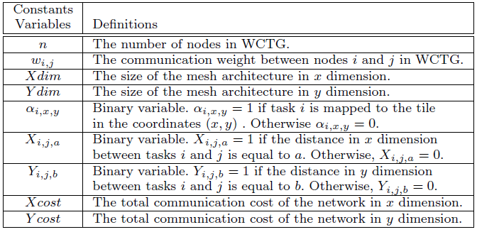
ILP-based method

Slide 12
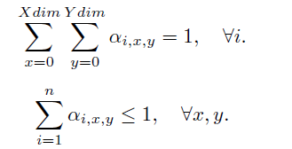
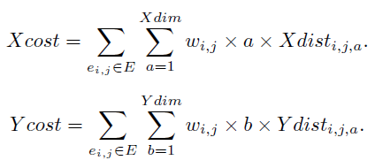
ILP-based method

Slide 13
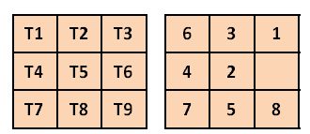
Genetic Algorithm based Method
Chromosome representation of each mapping

Slide 14
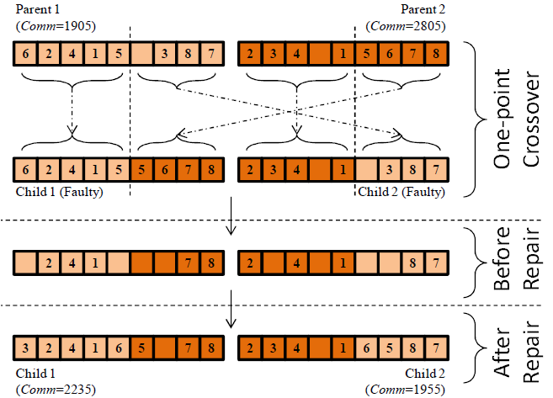
Crossover

Slide 15
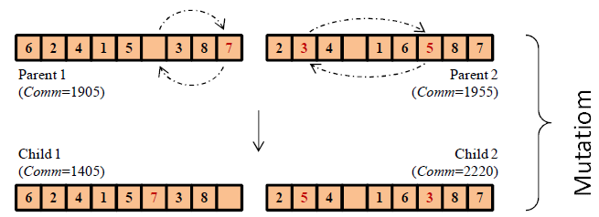
Mutation

Slide 16
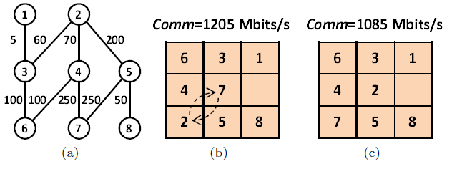
Simulated Annealing
Find an initial map
Find a new mapping neighbor to current
Calculate ∆C
If ∆C < 0 \\local refinement
or random(0,1)<exp(- ∆C/T) \\uphill move
Accept new mapping
Return best mapping

Slide 17
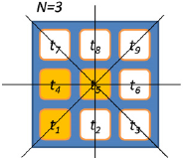
CastNet – A Heuristic
Map each node considering the communication weights between neighbors.
Use the symmetry feature of tiles of mesh
Mapping result for each symmetry groups.

Slide 18
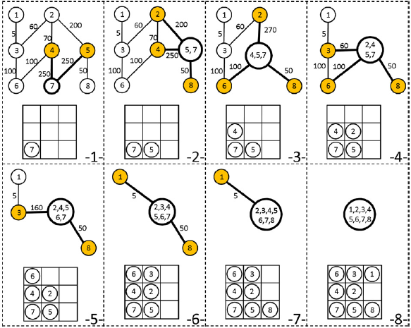
Example

Slide 19
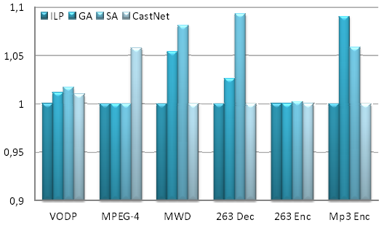
Results

Slide 20
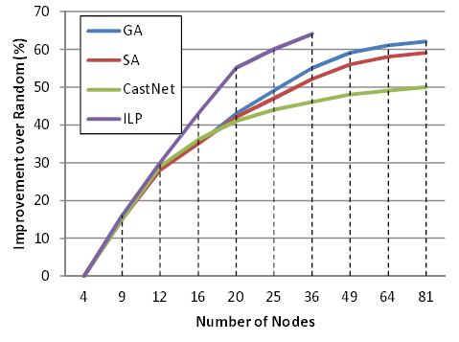
Energy consumption impr.ovement over random mapping

Slide 21
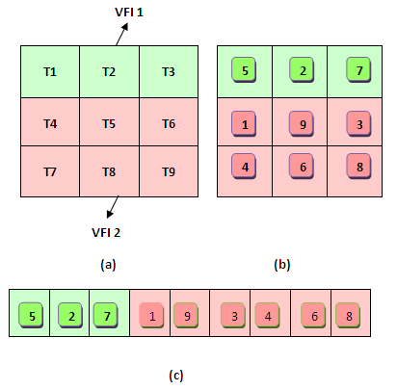
Voltage/Frequency Islands
GA based method
Select tasks that can run under low. voltage level. Assign different groups into different islands

Slide 22
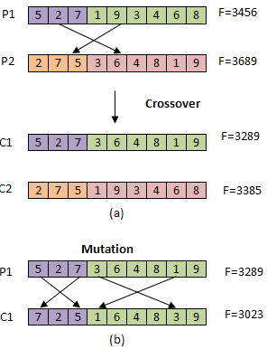
Crossover and Mutation

Slide 23
Experimental Results
To test the effectiveness of VFI based genetic algorithm, we conducted several experiments on both multimedia benchmarks and randomly generated task graphs.
The selected video applications are Video Object Plane Decoder (VOPD) and MPEG-4 decoder, Multi-Window Display (MWD) , 263 Decoder (263 Dec), 263 Encoder (263 Enc), and Mp3 Encoder (Mp3 Enc) .

Slide 24
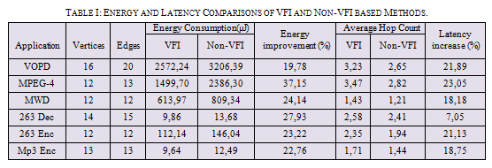
Experimental Results

Slide 25
Application Specific Topologies
Advantages
More options for energy minimization
Less area than regular counterparts
Disadvantages
Difficult to design
Not enough methods for topology generation
Not reusable

Slide 26
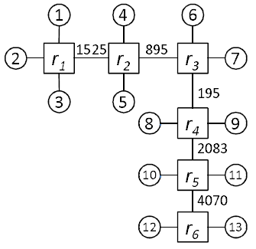
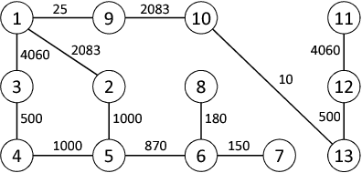
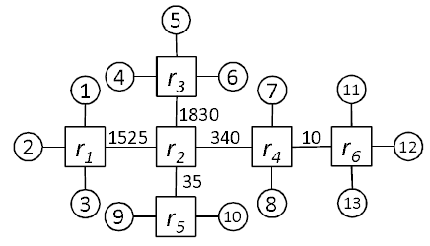
Topology Generation Problem
Given a CFG with n nodes and infinite set of routers with p ports, determine a topology that the total energy consumed by communication is minimized.
An example topology 1
(CommCost=8778 Kbits/s)
Core Flow Graph (CFG) of MP3 Decoder
An example topology 2
(CommCost=3740 Kbits/s)

Slide 27
Possible Research Directions
Fault tolerance
There must be alternative routing options
1
4
6
2
r₁
r₂
r₃
7
3
5
8
r₄
9
10
r₅
11
12
r₆
13

Slide 28
Possible Research Directions
3D NoC and 3D application specific topology generation
Adaptive topology generation for varying application behaviour

Slide 29
Conclusion
Energy efficient application mapping methods for mesh NoCs
ILP for small scale – metaheuristics for large ones
Application specific topology generation
Metaheuristics do well against heuristics
Better methods needed

