Slide 1
Introduction
Artificial Intelligence
slides are adapted from
Percy Liang and Dorsa Sadigh (Stanford), Dan Klein (UC Berkeley), Lana Lazebnik (UIUC)
Tuomas Sandholm and Vincent Conitzer (CMU) and Hal Daumé III (UMD)

Slide 3
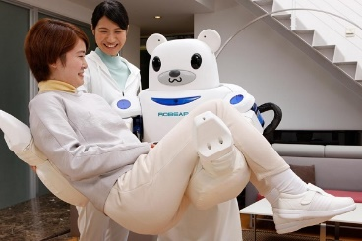
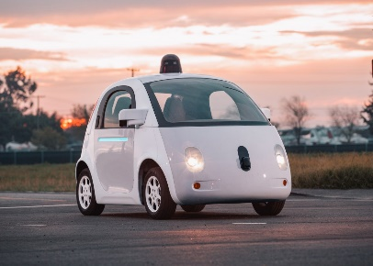
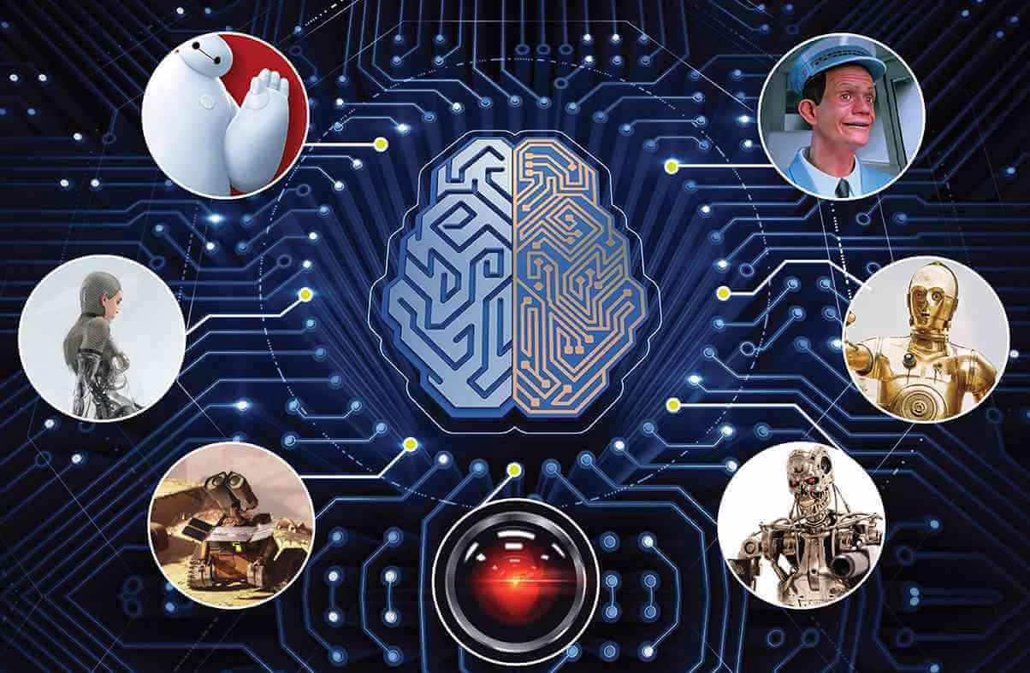
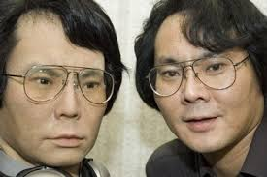
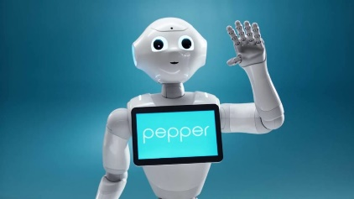
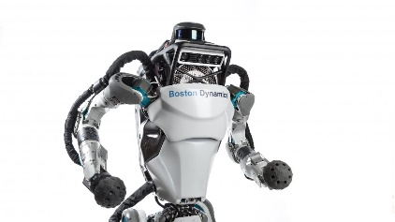
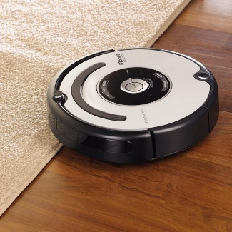
Johnny Cab - Google self-driving car
Baymax - RIBA II
Ava – Geminoid
(Hiroshi İshiguro)
C-3PO - Pepper
HAL – IBM Watson
Terminator - Atlas robots
WALL-E - Roomba
https://medium.com/@hackerearth/7-artificial-intelligence-based-movie-characters-that-are-now-a-reality-d2b91b97d9be

Slide 4
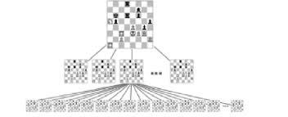
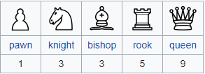
Chess
1989 : first chess program Deep Thought
1996 : IBM’s supercomputer Deep Blue won against
World champion Gary Kasparov
2006 : Deep Fritz that works on a PC won against
Vladimir Kramnik
https://en.wikipedia.org/wiki/Deep_Blue_(chess_computer)n-76882

Slide 7
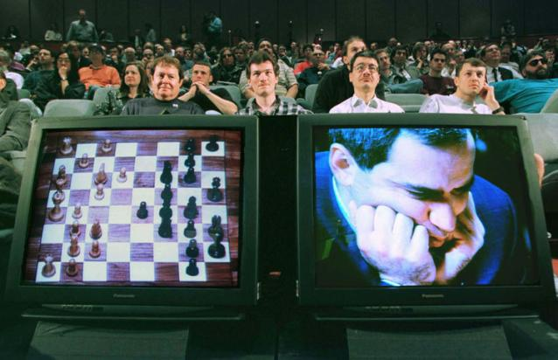
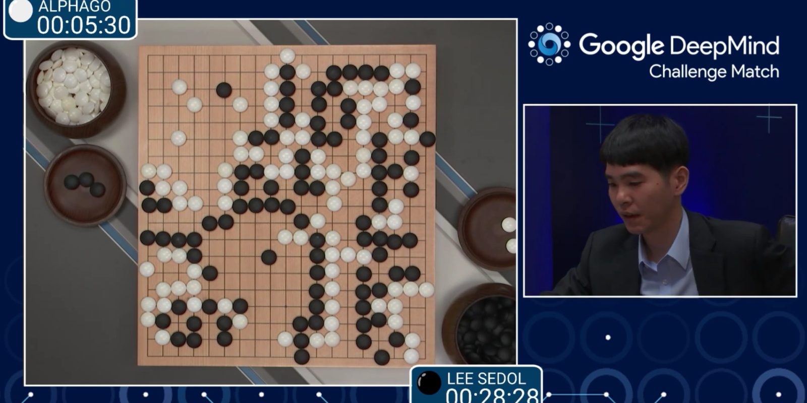
Games
1997: IBM’s Deep Blue defeats the reigning world chess champion Garry Kasparov
1996: Kasparov Beats Deep Blue “I could feel – I could smell – a new kind of intelligence across the table.”
1997: Deep Blue Beats Kasparov “Deep Blue hasn't proven anything.”
2007: Checkers is solved
Though checkers programs had already been beating the best humans for at least a decade
2016: AlphaGo computer beats Go grandmaster Lee Sedol 4-1
2017: CMU’s Libratus system beats four of the best human players at no-limit Texas Hold’em poker
Notes:
From the checkers article:
Perfection implies solving a game—determining the final result (game-theoretic value) when neither player makes a mistake. There are three levels of solving a game. For the lowest level, ultraweakly solved, the perfect-play result, but not a strategy for achieving that value, is known [e.g., in Hex the first player wins, but for large board sizes the winning strategy is not known]. For weakly solved games, both the result and a strategy for achieving it from the start of the game are known [e.g., in Go Moku the first player wins and a program can demonstrate the win]. Strongly solved games have the result computed for all possible positions that can arise in the game [e.g., Awari ].
With this paper, we announce that checkers has been weakly solved. From the starting position, we have a computational proof that checkers is a draw. The proof consists of an explicit strategy that never loses—the program can achieve at least a draw against any opponent, playing either the black or white pieces.

Slide 8
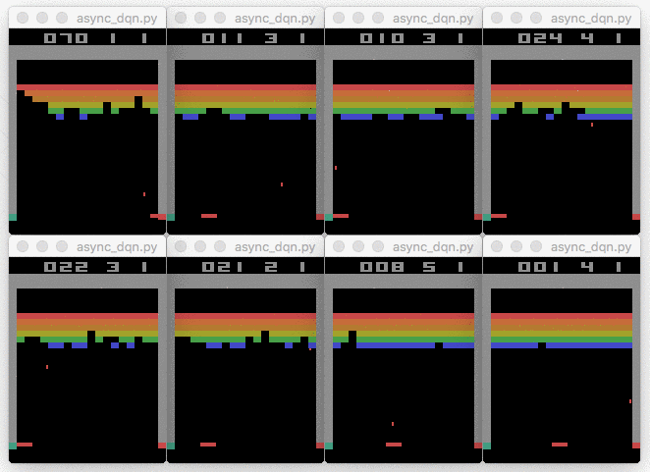
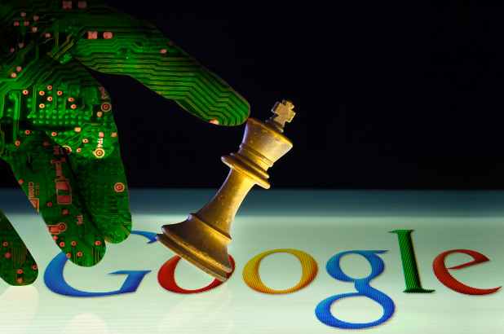
Go
2015-2016: Google DeepMind’s
AlphaGo won against world Go
Champions Lee Sedol and Ke Jie
19x19 game board,
10¹⁷⁰ possible combinations
https://deepmind.com/research/alphago/
Expert chess player only
in 4 hours

Slide 9
The Artificial Intelligence That Solved Go
Nineteen years after Deep Blue won a chess match against a grand master, a Google team has created an A.I. that's able to win against professional players of the ancient Chinese strategy game of Go.
Last October, DeepMind's program, named AlphaGo, won all five games against Hui.
AlphaGo was built to deal with "any task that has a lot of data that is unstructured and you want to find patterns in the data and then decide what to do.
Even with recent advances, computers don't have the power to run all those possibilities. So, instead, AlphaGo learns smart moves by observing millions of top human games and by playing against itself. Then, when choosing a move during a game, it only searches within a narrower pool of possibilities that seem reasonable.

Slide 10
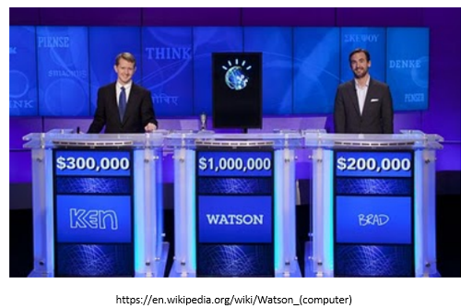
IBM Watson
In 2011, IBM Watson defeated two of the biggest winners (Brad Rutter and Ken Jennings) at the quiz show Jeopardy! (IBM seems to be pretty good at performing these kind of stunts.)
One could have argued that Deep Blue won simply by the sheer force of its computation prowess, whereas winning Jeopardy! involved understanding natural language, and this defeat hit closer to home.
Slide credit: Percy Liang and Dorsa Sadigh, Stanford University, CS221

Slide 11
Perhaps the aspect of AI that captures the public’s imagination the most are in defeating humans at their own game. • In 1997, Deep Blue defeated Gary Kasparov, the world chess champion. In 2011, IBM Watson defeated two of the biggest winners (Brad Rutter and Ken Jennings) at the quiz show Jeopardy! (IBM seems to be pretty good at performing these kind of stunts.) • One could have argued that Deep Blue won simply by the sheer force of its computation prowess, whereas winning Jeopardy! involved understanding natural language, and this defeat hit closer to home.
Slide credit: Percy Liang and Dorsa Sadigh, Stanford University

Slide 12
https://en.wikipedia.org/wiki/Watson_(computer)

Slide 13
What can AI do for you?
Instead of asking what AI is, let us turn to the more pragmatic question of what AI can do for you. We will go through some examples where AI has already had a substantial impact on society.

Slide 14
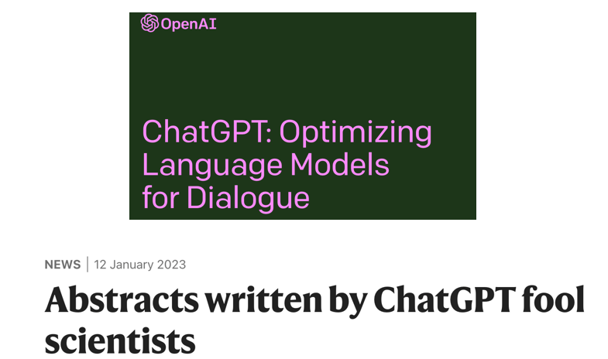
Slide Credit: Tuomas Sandholm and Vincent Conitzer, CMU, CS 15-281

Slide 15
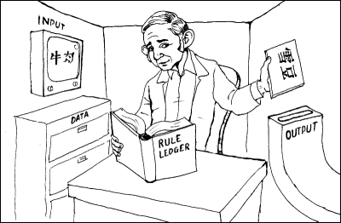
“Chinese room” argument [Searle 1980]
Person who knows English but not Chinese sits in room
Receives notes in Chinese
Has systematic English rule book for how to write new Chinese characters based on input Chinese characters, returns his notes
Person=CPU, rule book=AI program, really also need lots of paper (storage)
Has no understanding of what they mean
But from the outside, the room gives perfectly reasonable answers in Chinese!
Searle’s argument: the room has no intelligence in it!
image from http://www.unc.edu/~prinz/pictures/c-room.gif
Slide Credit: Tuomas Sandholm and Vincent Conitzer, CMU, CS 15-281

Slide 16
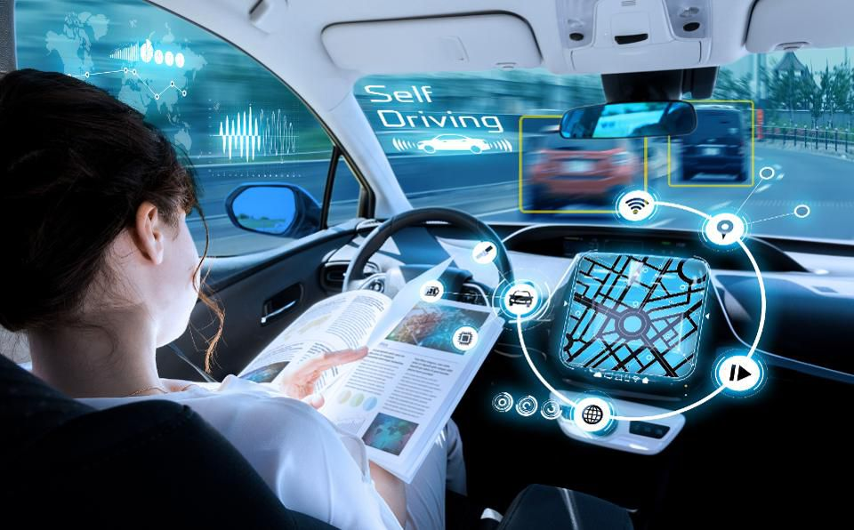
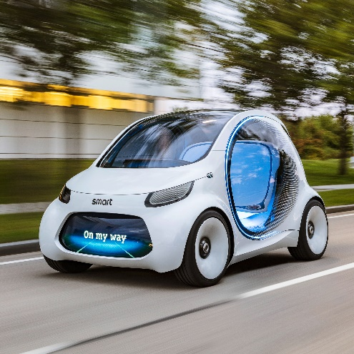
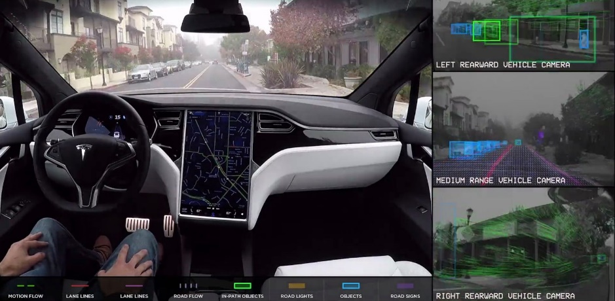
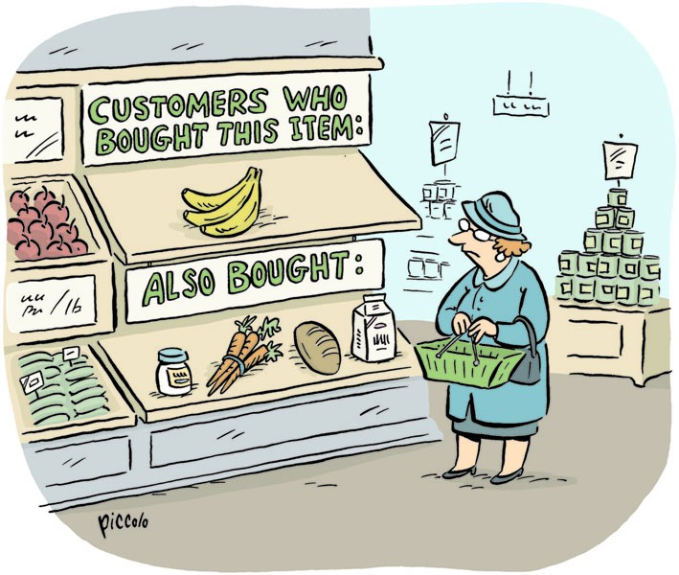
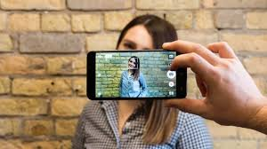
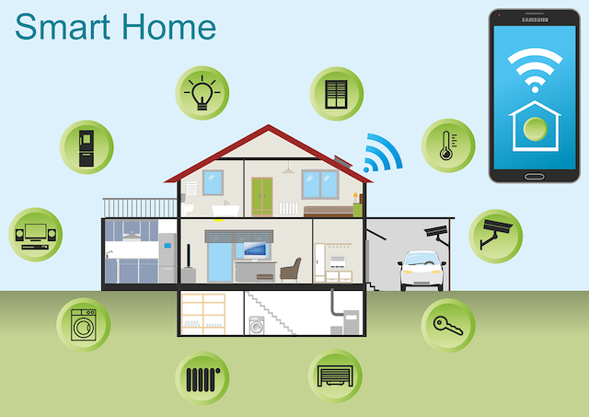
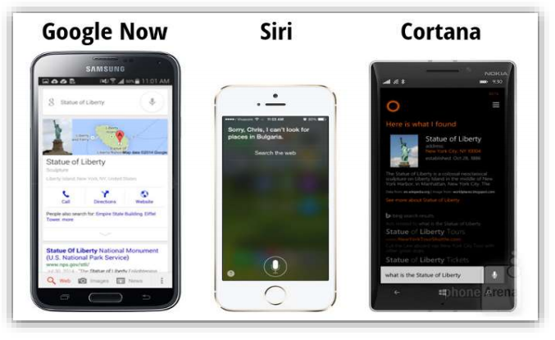
Notes:
It is hard these days to escape hearing about AI | in the news, on social media, in cafe conversations.
A lot of the triumphs of superhuman performance as been in games, such as Jeopardy! (IBM Watson,
2011), Go (DeepMind's AlphaGo, 2016), Dota 2 (OpenAI, 2019), Poker (CMU and Facebook, 2019).
On non-game tasks, we also have systems that achieve or surpass human-level performance on reading
comprehension, speech recognition, face recognition, and medical imaging benchmarks.
Unlike games, however, where the game is the full problem, good performance on a benchmark does not
necessarily translate to good performance on the actual task in the wild. Just because you ace an exam
doesn't necessarily mean you have perfect understanding or know how to apply that knowledge to real
problems.

Slide 17
Slide credit: Percy Liang and Dorsa Sadigh, Stanford University, CS221

Slide 19
If you want to read a news article in another language, you can turn to machine translation.

Slide 20
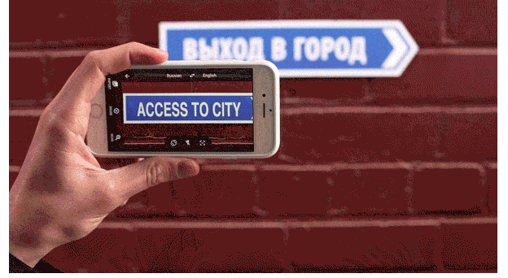
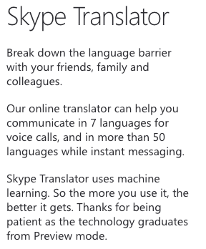
Speech and natural language
Google Translate App
Translate between 103 languages by typing
Offline: Translate 52 languages when you have no Internet
Instant camera translation: Use your camera to translate text instantly in 30 languages
Camera Mode: Take pictures of text for higher-quality translations in 37 languages
Conversation Mode: Two-way instant speech translation in 32 languages
Handwriting: Draw characters instead of using the keyboard in 93 languages
https://www.skype.com/en/features/skype-translator/
https://play.google.com/store/apps/details?id=com.google.android.apps.translate&hl=en

Slide 22
When you deposit a check at an ATM, handwriting recognition is employed
to automatically ﬁgure out the deposit amount.

Slide 23
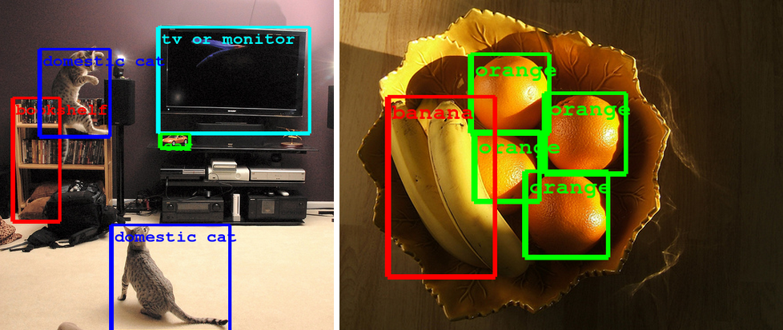
Computer Vision
Computer Eyesight Gets a Lot More Accurate, NY Times Bits blog, August 18, 2014

Slide 24
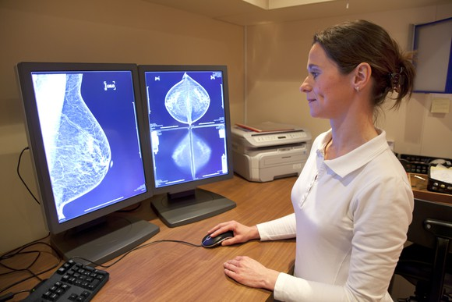
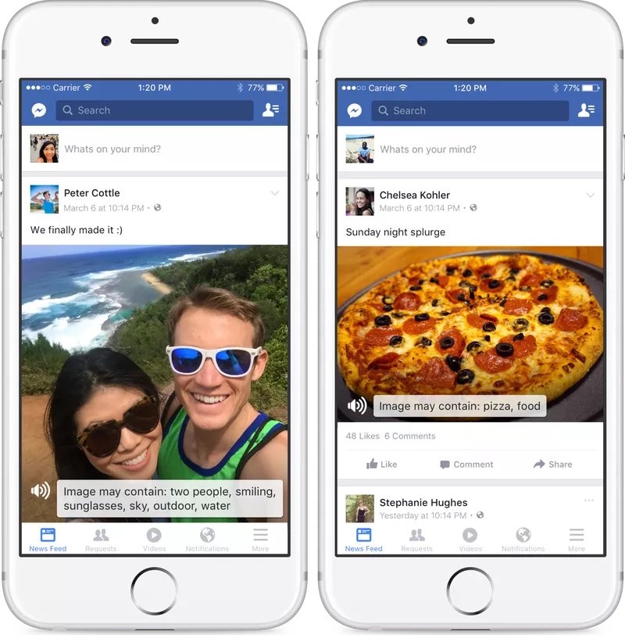
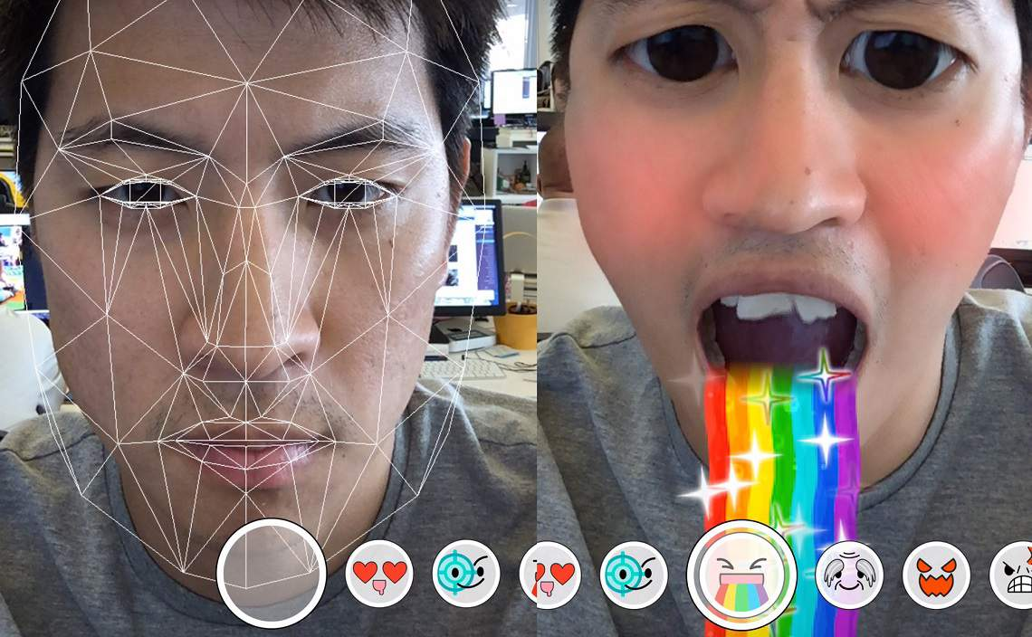
Computer Vision
AI beats human pathologists at detecting cancer
Facebook accessibility tools for the visually impaired
Technology behind Snapchat lenses

Slide 25
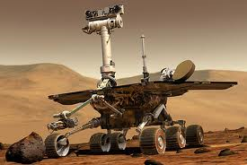
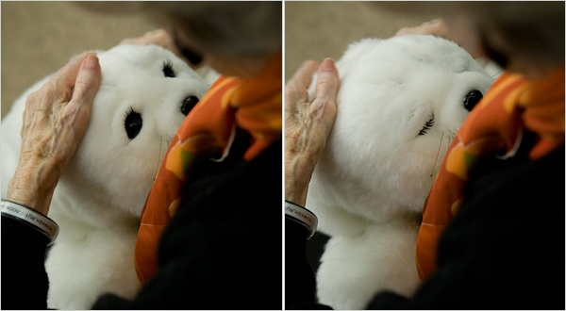

Slide 26
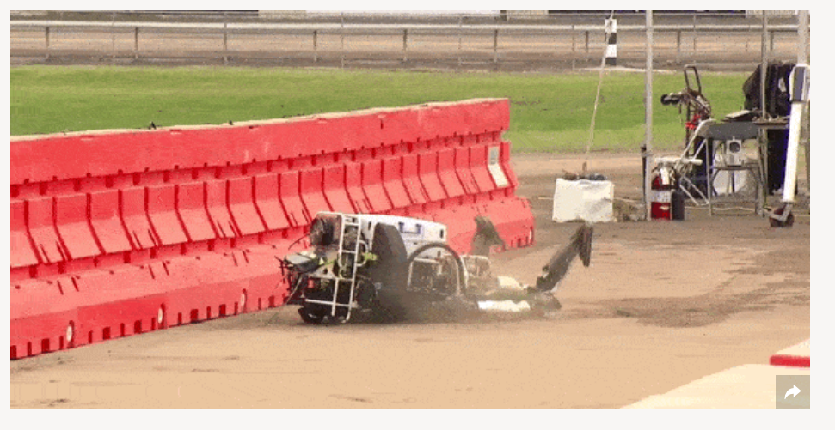
DARPA Robotics Challenge (2015)
http://www.popularmechanics.com/technology/robots/a15907/best-falls-from-darpa-robot-challenge/
https://www.youtube.com/watch?v=g0TaYhjpOfo
Notes:
From Wikipedia: The DARPA Robotics Challenge (DRC) was a prize competition funded by the US Defense Advanced Research Projects Agency. Held from 2012 to 2015, it aimed to develop semi-autonomous ground robots that could do "complex tasks in dangerous, degraded, human-engineered environments."

Slide 27
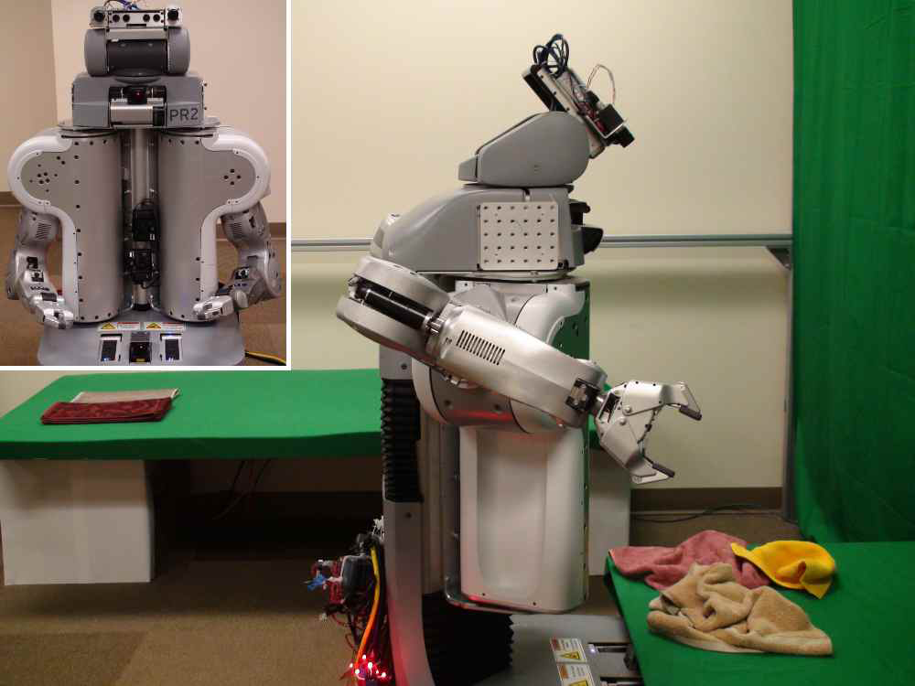
Towel-folding robot
YouTube Video
J. Maitin-Shepard, M. Cusumano-Towner, J. Lei and P. Abbeel, Cloth Grasp Point Detection based on Multiple-View Geometric Cues with Application to Robotic Towel Folding, ICRA 2010
More clothes folding

Slide 28
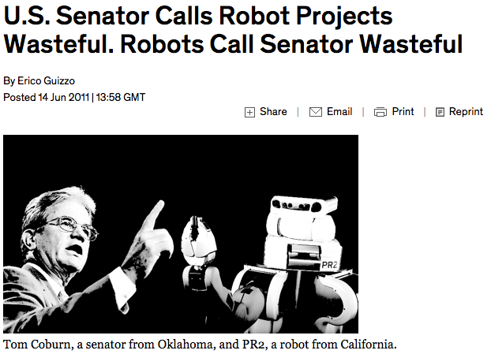
http://spectrum.ieee.org/automaton/robotics/robotics-software/us-senator-calls-robot-projects-wasteful
Notes:
“His report notes that the robot cost 1.5 million dollars and took 25 minutes to fold each towel.”

Slide 29
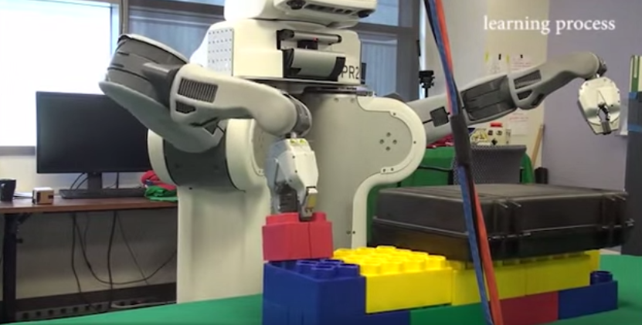
Deep sensorimotor learning
YouTube video
S. Levine, C. Finn, T. Darrell and P. Abbeel, End-to-end training of deep visuomotor policies, JMLR 2016

Slide 30
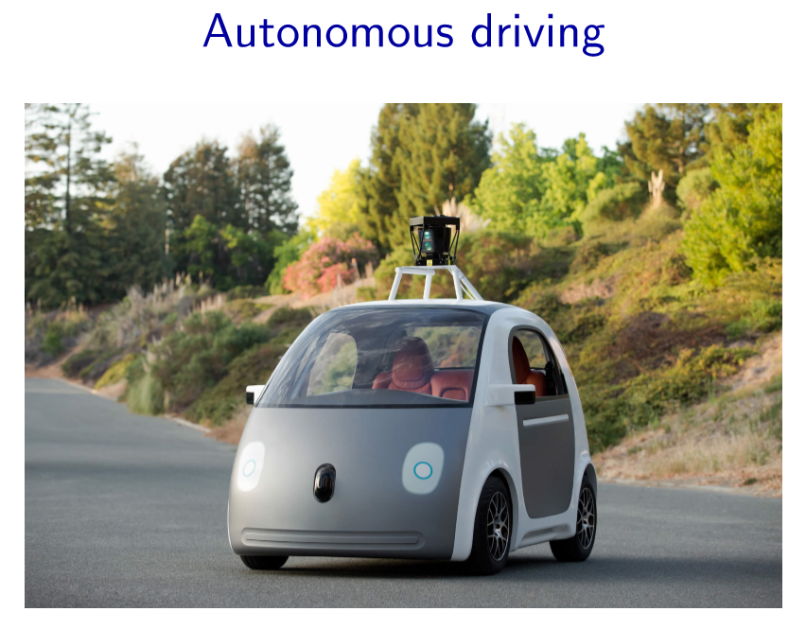
Research in autonomous cars started in the 1980s, but the technology wasn’t there. • Perhaps the ﬁrst signiﬁcant event was the 2005 DARPA Grand Challenge, in which the goal was to have a driverless car go through a 132-mile oﬀ-road course. Stanford ﬁnished in ﬁrst place. The car was equipped with various sensors (laser, vision, radar), whose readings needed to be synthesized (using probabilistic techniques that we’ll learn from this class) to localize the car and then to generate control signals for the steering, throttle, and brake. • In 2007, DARPA created an even harder Urban Challenge, which was won by CMU. • In 2009, Google started a self-driving car program, and since then, their self-driving cars have driven over 1 million miles on freeways and streets. • In January 2015, Uber hired about 50 people from CMU’s robotics department to build self-driving cars. • While there are still technological and policy issues to be worked out, the potential impact on transportation is huge.

Slide 32
With the rise of mobile devices, smart cars and homes, and improvements in speech recognition, we will be able to interact with computers using natural language and gestures. Imagine coming home and saying: ”what do I need to buy for tomorrow’s picnic and where can I do that now?” • Currently, Apple’s Siri, Google Now, and Microsoft Cortana provide a ﬁrst stab at this problem, handling mostly simple utterances and actions (e.g., setting an alarm, sending a text, etc.) The technology is still in its infancy, but it is an exciting and a rapidly moving ﬁeld.

Slide 33
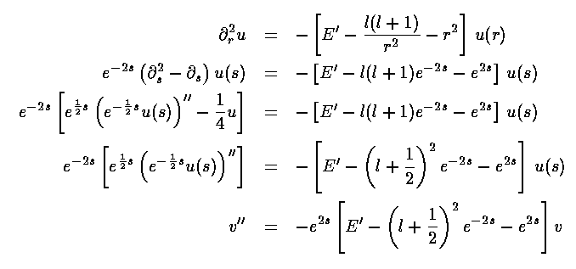
Mathematics
In 1996, a computer program written by researchers at Argonne National Laboratory proved a mathematical conjecture unsolved for decades
NY Times story: “[The proof] would have been called creative if a human had thought of it”
Mathematical software:

Slide 34
Logistics, scheduling, planning
During the 1991 Gulf War, US forces deployed an AI logistics planning and scheduling program that involved up to 50,000 vehicles, cargo, and people
NASA’s Remote Agent software operated the Deep Space 1 spacecraft during two experiments in May 1999
In 2004, NASA introduced the MAPGEN system to plan the daily operations for the Mars Exploration Rovers

Slide 35
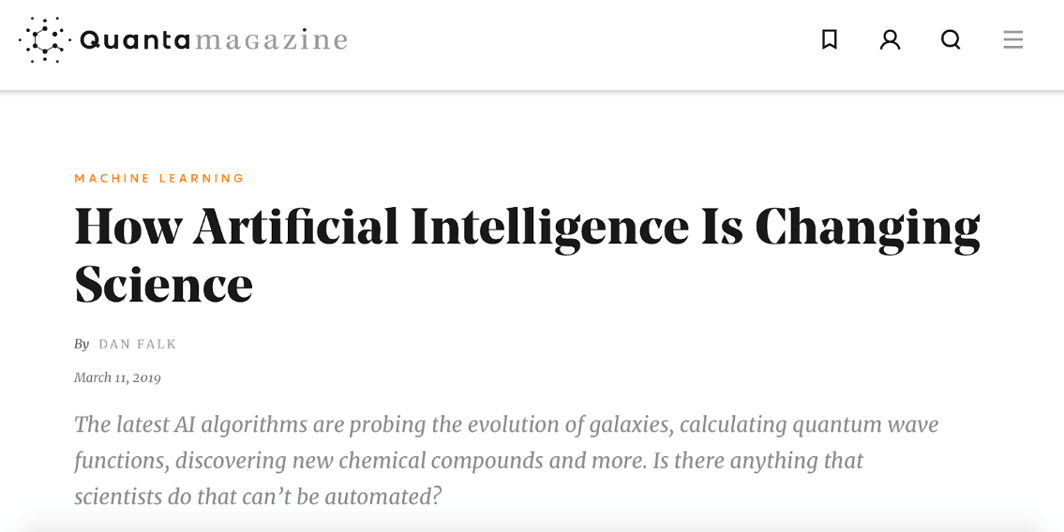
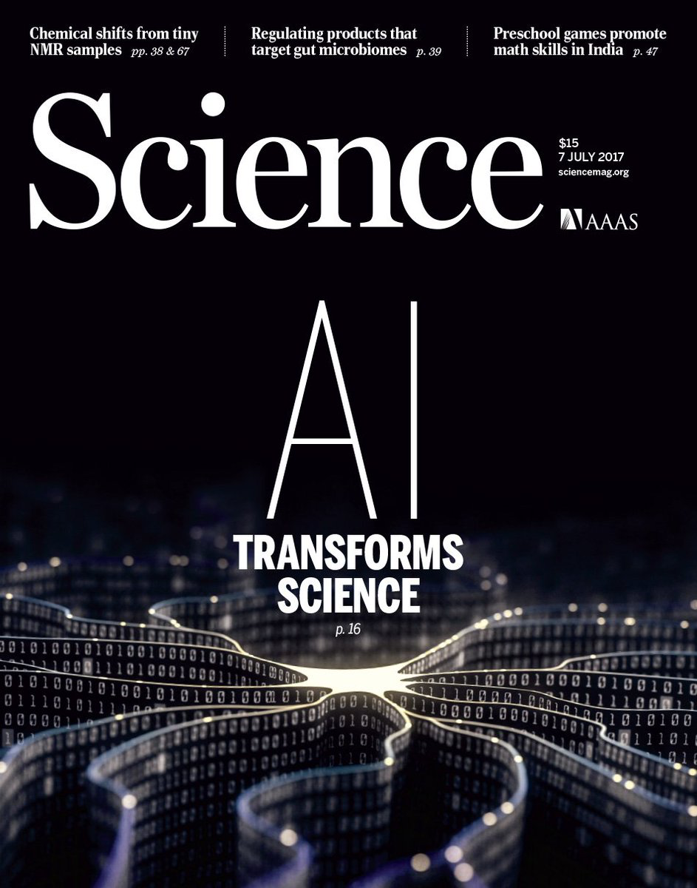
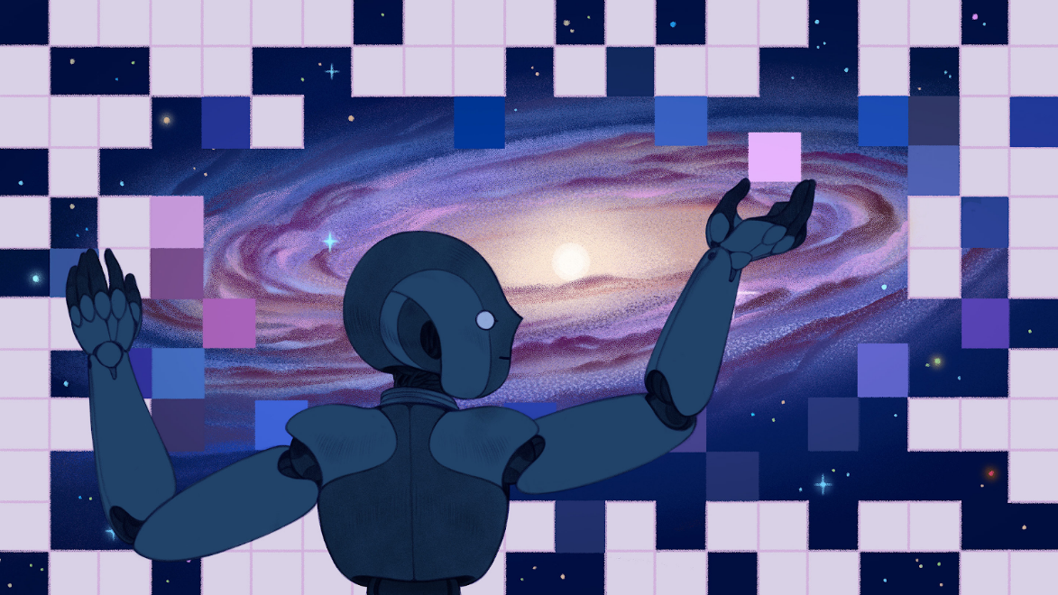

Slide 36
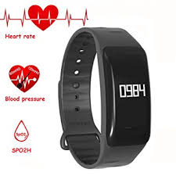
Im2Calories: Towards An Automated Mobile Vision Food Diary
Austin Myers et al. ICCV 2015

Slide 37
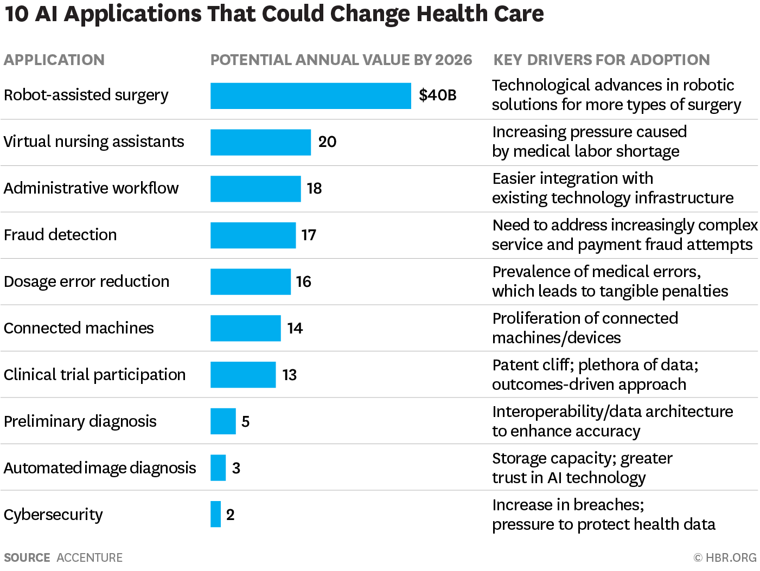
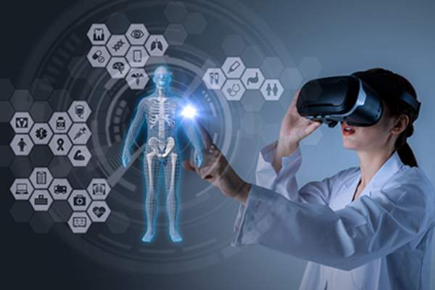
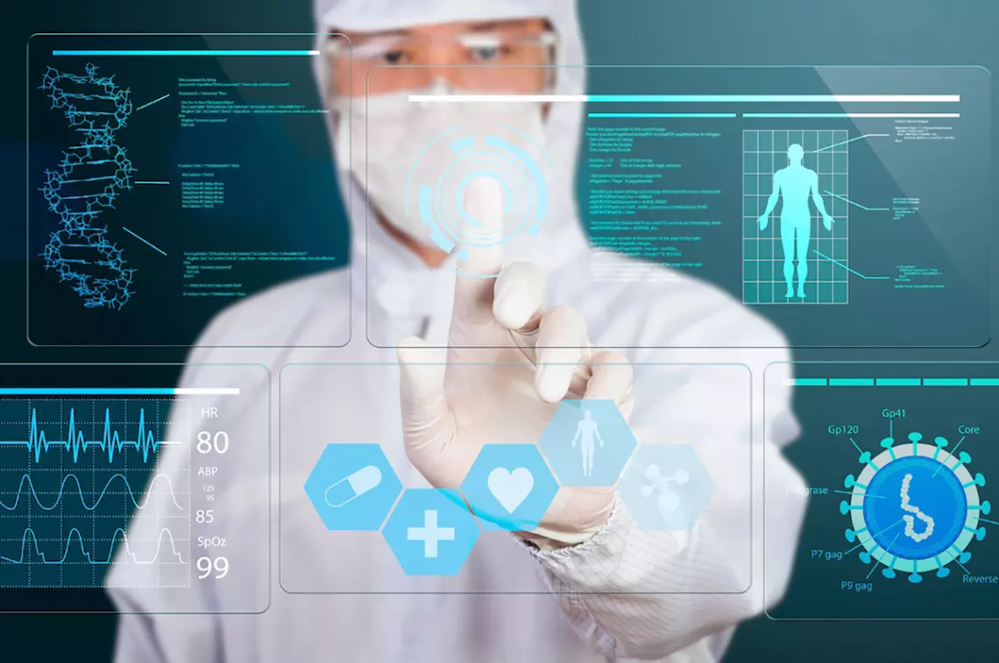
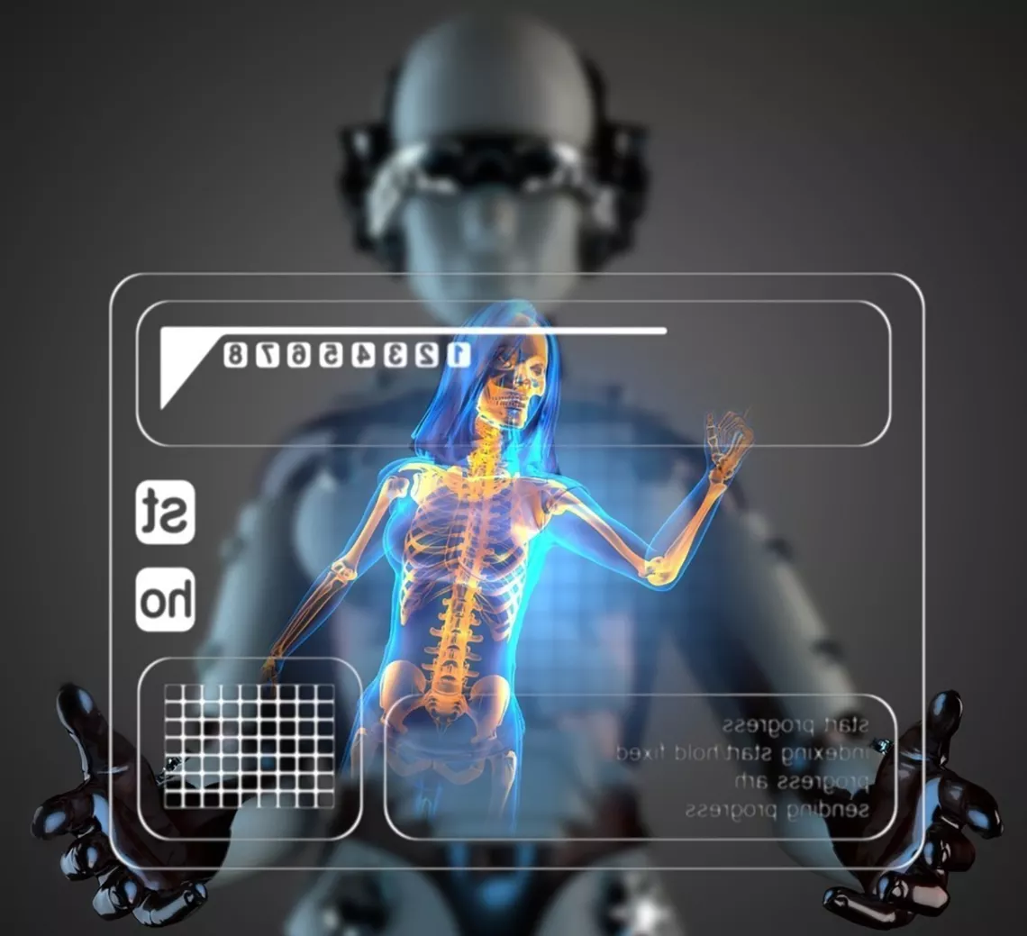
AI in Healthcare
Yapay Zeka Sağlık alanında ne faydalar sağlayabilir?
https://www.healthcentral.com/slideshow/8-ways-artificial-intelligence-is-affecting-the-medical-field
futurism.media/artificial-intelligence-in-medicine

Slide 38
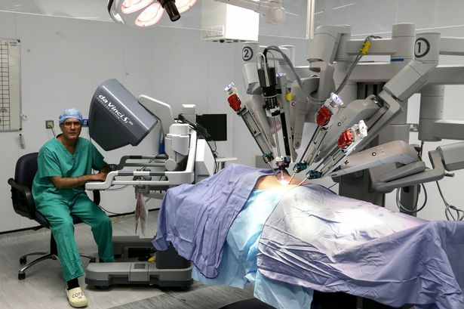
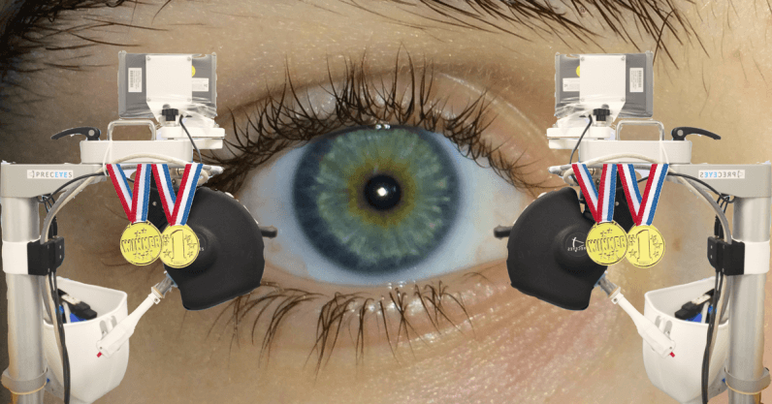
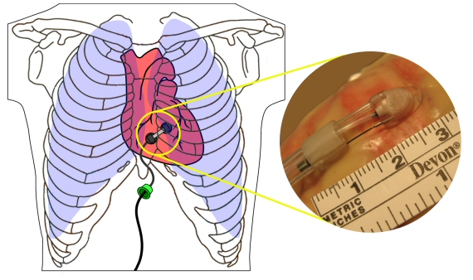
Robotic surgery
Da Vinci robot
Eye surgery in University of Oxford’
Heartlander mini robot on heart
Less invasive
Less complication
Faster recovery
https://thenextweb.com/science/2018/06/19/a-robot-operated-on-a-human-eye-for-the-first-time-ever/
https://www.cs.cmu.edu/~heartlander/index.html

Slide 39
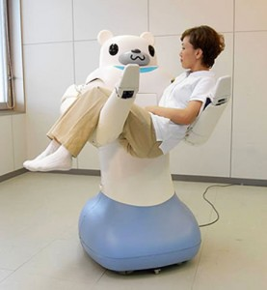
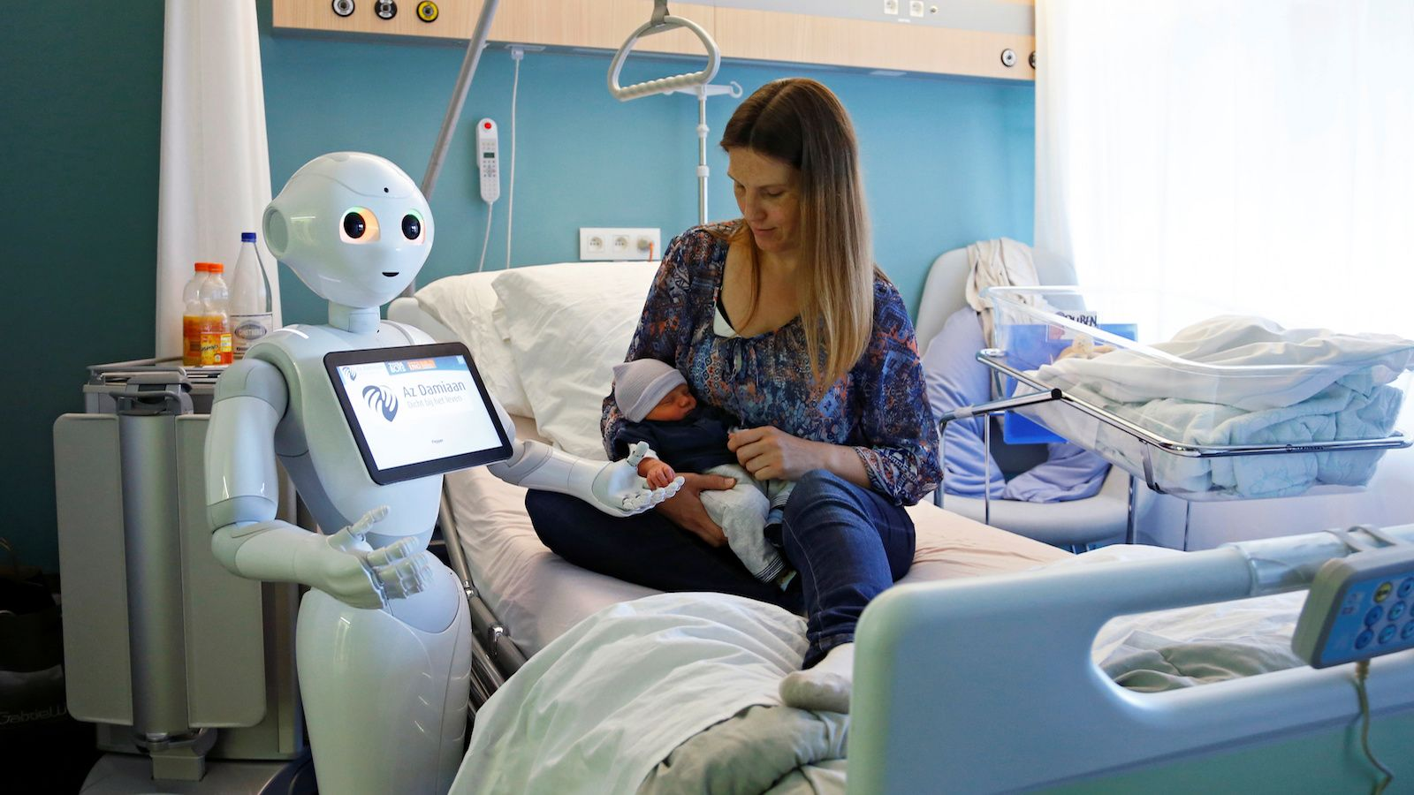
Robotic or Virtual Nurses
Pepper
RIBA
Pearl
Molly

Slide 40
Rehabilitation / physyotherapy
https://medium.com/@coviu/artificial-intelligence-for-physiotherapy-1f22fb4ac5f
https://www.technologyreview.com/s/603614/a-robot-physical-therapist-helps-kids-with-cerebral-palsy/
HAL exoskeleton

Slide 41
Medical Diagnosis
https://en.wikipedia.org/wiki/Medical_diagnosis
http://www.spiegel.de/international/world/bild-1221543-1323685.html

Slide 42
Radiology and
Ultrasound images
“A new feature in Samsung Medison’s ultrasound system uses a deep-learning algorithm to make recommendations about whether a breast abnormality is benign or cancerous. The “S-Detect for Breast” feature is now included in an upgrade to the company’s RS80A ultrasound system and is commercially available in parts of Europe, the Middle East and Korea and is pending FDA approval in the U.S.”
http://www.popsci.com/how-deep-learning-technology-could-be-next-step-in-cancer-detection
http://news.mit.edu/2018/AI-identifies-dense-tissue-breast-cancer-mammograms-1016
Detecting and classifying lesions in mammograms with Deep Learning
Dezső Ribli, Anna Horváth, Zsuzsa Unger, Péter Pollner & István Csabai , 2018

Slide 43
Retina analysis
“Working closely with doctors both in India and the US, we created a development dataset of 128K images which were each evaluated by 3-7 ophthalmologists from a panel of 54 ophthalmologists. This dataset was used to train a deep neural network to detect referable diabetic retinopathy. The results show that our algorithm’s performance is on-par with that of ophthalmologists.”

Slide 44
20 Gigapixel images
Deep Learning for Identifying Metastatic Breast Cancer Dayong Wang et al. 2016
We obtain AUC of 0.925 for whole slide image classification and a score of 0.7051 for tumor localization. Combining our deep learning system’s predictions with the human pathologist’s diagnoses increased his AUC to 0.995, representing an approximately 85% reduction in human error rate.
We showed that it is possible to train a model that either matched or exceeded the performance of a pathologist who had unlimited time to examine the slides.”
Detecting Cancer Metastases on Gigapixel Pathology Images, Yun Liu et al. 2017

Slide 45
Dermatologist-level classification of skin cancer with deep neural networks Andre Esteva et al. Nature 542, 2017
“We train a CNN using a dataset of 129,450 clinical images—two orders of magnitude larger than previous datasets—consisting of 2,032 different diseases. We test its performance against 21 board-certified dermatologists on biopsy-proven clinical images with two critical binary classification use cases: keratinocyte carcinomas versus benign seborrheic keratoses; and malignant melanomas versus benign nevi.”

Slide 46
https://www.ncbi.nlm.nih.gov/pmc/articles/PMC3197108/
Artificial Intelligence and Google’s Radar Technologies to Noninvasively Measure Glucose Levels
https://www.wearable-technologies.com/2018/09/artificial-intelligence-and-googles-radar-technologies-to-noninvasively-measure-glucose-levels/

Slide 47
With activity analysis Parkinson diagnosis can be done in 3 minutes instead of 30 minutes
An example of a therapy session augmented with humanoid robot NAO [SoftBank Robotics], which was used in the EngageMe study. Tracking of limbs/faces was performed using the CMU Perceptual Lab's OpenPose utility.
Image: MIT Media Lab
http://news.mit.edu/2018/personalized-deep-learning-equips-robots-autism-therapy-0627

Slide 48
Detection and Computational Analysis of Psychological Signals (DCAPS)
http://medvr.ict.usc.edu/projects/dcaps/

Slide 49
http://www.brain-power.com/autism/

Slide 51
Characteristics of AI tasks
High societal impact (aﬀect billions of people) Diverse (language, games, robotics) Complex (really hard)

Slide 52
What accounts for recent successes in AI?
Faster computers
The IBM 704 vacuum tube machine that played chess in 1958 could do about 50,000 calculations per second
Deep Blue could do 50 billion calculations per second – a million times faster!
Dominance of statistical approaches, machine learning
Big data
Crowdsourcing

Slide 55
https://licensing.visualcapitalist.com/product/the-top-100-most-valuable-brands-in-2024/

Slide 56
https://www.visualcapitalist.com/top-100-most-valuable-brands-in-2022/

Slide 57
January 2017
https://www.cbinsights.com/research/artificial-intelligence-top-startups/

Slide 59
AI in the real world
Translation
Facial recognition
Autonomous driving
Spam detection
Stock market
Hiring systems
Voice assistant
Slide Credit: Tuomas Sandholm and Vincent Conitzer, CMU, CS 15-281

Slide 60
Large-scale combinatorial multi-attribute sourcing auctions 2001-2010 [Sandholm, Handbook of Market Design, Ch. 16, 2013]
One of the first SaaS analytics companies
Over 800 auctions, totaling over $60 Billion
The most expressive auctions ever conducted
Created 12.6% savings for buy side
Suppliers also benefited
Grew to 130 employees, operations on 4 continents
Acquired in 2010
Key AI technologies:
Winner determination algorithms
Bidding languages
Preference elicitation from multiple agents
Automated mechanism design
Slide Credit: Tuomas Sandholm and Vincent Conitzer, CMU, CS 15-281

Slide 61
Kidney exchange
AI from Prof. Sandholm’s lab has been running the national kidney exchange for UNOS since 2010.
Slide Credit: Tuomas Sandholm and Vincent Conitzer, CMU, CS 15-281

Slide 62
AI and sustainability
Deepmind’s AI reduces Google Data Center’s energy consumption
Combining satellite imagery and machine learning to predict poverty [Jean et al. 2016]
Slide Credit: Tuomas Sandholm and Vincent Conitzer, CMU, CS 15-281

Slide 63
Slide Credit: Tuomas Sandholm and Vincent Conitzer, CMU, CS 15-281

Slide 64
Slide Credit: Tuomas Sandholm and Vincent Conitzer, CMU, CS 15-281

Slide 65
In Prof. Sandholm’s August 2021 IJCAI John McCarthy Award talk, he predicted there will be human-only categories in future art competitions
New York Times
Slide Credit: Tuomas Sandholm and Vincent Conitzer, CMU, CS 15-281
Notes:
Bach and Mahler -> superhuman art: we won’t be able to distinguish better vs worse art.
Atonal music example => bad for development

Slide 66
Deepfakes of Prof. Sandholm Spring 2023-
Slide Credit: Tuomas Sandholm and Vincent Conitzer, CMU, CS 15-281

Slide 67
Some harmful applications of deepfakes
https://www.twitch.tv/trumporbiden2024
Slide Credit: Tuomas Sandholm and Vincent Conitzer, CMU, CS 15-281

Slide 68
New York Times
Slide Credit: Tuomas Sandholm and Vincent Conitzer, CMU, CS 15-281

Slide 69
The Beatles: “Now And Then”
https://www.youtube.com/watch?v=Opxhh9Oh3rg

Slide 70
Large language models (LLMs) 2018-
Generation (e.g., story writing, marketing content creation)
Tim Boucher wrote 97 books in 9 months using ChatGPT from OpenAI and Claude from Anthropic. He used Midjourney to generate images to match the story. Word count 2,000 - 83,000. Price $1.99 - $5.99
Non-AI-assisted record, by Barbara Cartland, is 191 books per year
Summarization (e.g., web search, legal paraphrasing, meeting notes summarization)
E.g., Bing co-pilot, Bard
In the future also question answering from specific corpora
Translation (e.g., between languages, text-to-code, text-to-database)
Classification (e.g., toxicity classification, sentiment analysis)
Chatbot (e.g., open-domain Q+A, virtual assistants)
E.g., Bing co-pilot, Bard
Slide Credit: Tuomas Sandholm and Vincent Conitzer, CMU, CS 15-281

Slide 71
Slide Credit: Tuomas Sandholm and Vincent Conitzer, CMU, CS 15-281

Slide 72
http://www.theguardian.com/technology/2014/aug/06/robots-jobs-artificial-intelligence-pew
Notes:
We also see speculation about the future: that it will bring about sweeping societal change due to au-
tomation, resulting in massive job loss, not unlike the industrial revolution, or that AI could even surpass
human-level intelligence and seek to take control.
While AI is likely to be transformational, what kind of transformation the future will hold, no one knows.

Slide 73
According to many articles and popular books, it seems like human-level AI is right around the corner, for better or for worse.

Slide 74
http://www.v3.co.uk/v3-uk/news/2419567/ai-weapons-are-a-threat-to-humanity-warn-hawking-musk-and-wozniak

Slide 75
Slide credit: Percy Liang and Dorsa Sadigh, Stanford University, CS221

Slide 76
https://deepmind.com/research/alphago/

Slide 77
Historical themes
Boom and bust cycles
Periods of (unjustified) optimism followed by periods of disillusionment and reduced funding
Silver bulletism (Levesque, 2013):
“The tendency to believe in a silver bullet for AI, coupled with the belief that previous beliefs about silver bullets were hopelessly naïve”
Image problems
AI effect: As soon as a machine gets good at performing some task, the task is no longer considered to require much intelligence
AI as a threat?

Slide 78
Historical themes
Moravec’s paradox
“It is comparatively easy to make computers exhibit adult level performance on intelligence tests or playing checkers, and difficult or impossible to give them the skills of a one-year-old when it comes to perception and mobility” [Hans Moravec, 1988]
Why might this be?
Early AI researchers concentrated on the tasks that they themselves found the most challenging, abilities of animals and two-year-olds were overlooked
We are least conscious of what our brain does best
Sensorimotor skills took millions of years to evolve, whereas abstract thinking is a relatively recent development

Slide 79
Two brain systems?
System 1: fast, automatic, subconscious, emotional
Detect hostility on a face or in a voice
Orient to the source of a sudden sound
Answer to 2+2=?
Read words on large billboards
Drive on an empty road
System 2: slow, effortful, logical, calculating, conscious
Focus on the voice of a particular person in a crowded and noisy room
Search memory to identify a melody
Count the occurrences of the letter a on a page
Compare two washing machines for overall value
Fill out a tax form
Check the validity of a complex logical argument
http://en.wikipedia.org/wiki/Thinking,_Fast_and_Slow
Notes:
Conceptual dichotomies (Newell, 1983):
Symbolic vs. continuous
Modeling of high-level vs. low-level mental processes
Serial vs. parallel
Problem solving vs. recognition
Performance vs. learning

Slide 80
Videos
http://www.analyticsvidhya.com/blog/2015/11/7-watch-documentaries-statistics-machine-learning/
https://dotsub.com/view/24206765-772f-4f6d-a040-45477beb4b9c
https://www.youtube.com/watch?v=VBceREwF7SA
https://www.youtube.com/watch?v=J71XWkh80nc
https://www.youtube.com/watch?v=ysU56JzBjTY&list=PLD261577512C9F720&index=1

Slide 81
Reading Assignments
Alan Turing, Computing Machinery and Intelligence, (1950).
Herbert A. Simon, The Architecture of Complexity, In Proc. The American Philosophical Society, 196(6), (1962).
David Marr, Artificial Intelligence -- A Personal View, MIT AIM 355, (1976).
Rodney Brooks, Intelligence without representation, Artificial Intelligence, 47 (1-3): 139–159, (1991).
Randall Davis, Howard Shrobe, Peter Szolovits, What Is a Knowledge Representation?, AI Magazine, 14(1):17-33, (1993).

