Slide 1
Search

Slide 2
Search queues are characterized by the operations that place new paths on the queue and that provide a path when asked for one. For each search below, circle the letter that identifies the queue type, from the list above, you would use to implement the search. If you are more comfortable with the tree method, recall that the queue determines the order that paths are selected to be extended. Here are the options available to you:
Queue A:
Puts new paths on the back of the Queue, in lexical order.
Takes a path off the front of the Queue.
Queue B:
Puts new paths on the front of the Queue, in lexical order.
Takes a path off the front of the Queue.
Queue C:
Puts new paths on the back of the Queue, ordered by their heuristic values.
Takes a path off the front of the Queue.
Queue D:
Puts new elements on the front of the Queue, ordered by their heuristic values.
Take a path off the front of the Queue.
Queue E:
Puts new elements into the Queue.
Take the path in the entire Queue with the best heuristic value.
Queue F:
Puts new elements into the Queue.
Take the path in the entire Queue with the least path length.
Queue G:
Puts new elements into the Queue.
Take the path in the entire Queue with the least (consistent estimate of distance remaining + path length).
Depth first : A B C D E F G
Breadth first : A B C D E F G
Greedy Best First : A B C D E F G
A* : A B C D E F G
Can you spot another search strategy? If yes, name it and match it with the queue type (Use the format : NameOfTheMethod - X, where NameOfTheMethod will be the name of the search strategy and X is the corresponding letter above)
Uniform Cost Search - F

Slide 3
  Consider the following scoring function for heuristic search:
  score(node) = W × g(node) + (1 – W) × h(node) where 0 ≤ W ≤ 1
  Which search algorithm do you get with W set to 0?
  Greedy best first search
  Which search algorithm do you get with W set to 1?
  Uniform cost search

Slide 4
Consider the graph shown in the figure below. We can search it with a variety of different algorithms, resulting in different search trees. Each of the trees (labeled G1 though G7) was generated by searching this graph, but with a different algorithm. Assume that children of a node are visited in alphabetical order. Each tree shows all the nodes that have been visited. Numbers next to nodes indicate the relevant “score” used by the algorithm for those nodes.
In all cases a strict expanded list was used.
• H1: (heuristic 1) = {h(A)=3,h(B)=6,h(C)=4,h(D)=3}
• H2: (heuristic 2) = {h(A)=3,h(B)=3,h(C)=0,h(D)=2}
For each tree, indicate whether it was generated with
• Depth first search (DFS)
• Breadth first search (BFS)
• Uniform cost search (UCS)
• Greedy Best-first search (GBS)
• A* search
If you choose an algorithm that uses a heuristic function, say whether we used H1 or H2.

Slide 5
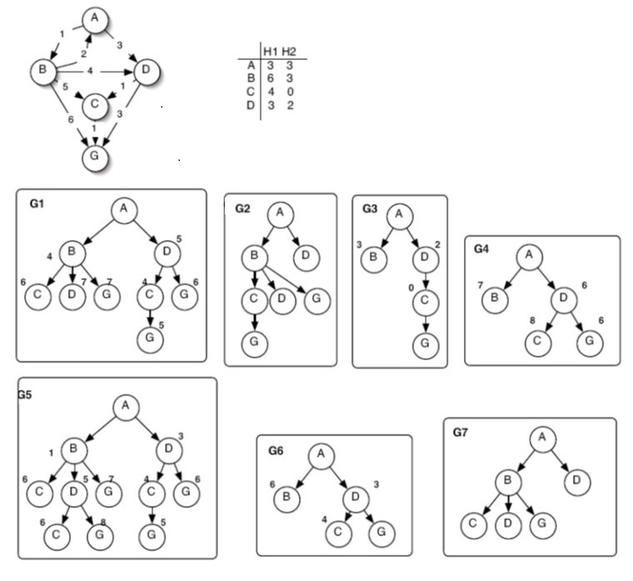
G1:
1.Algorithm: A*
2. Heuristic (if any): H2
G2:
1.Algorithm: Depth First Search
2. Heuristic (if any): None
G3:
1.Algorithm: Greedy Best first search
2. Heuristic (if any): H2
G4:
1.Algorithm: A*
2. Heuristic (if any): H1
G5:
1.Algorithm: Uniform cost search
2. Heuristic (if any): None
G6:
1.Algorithm: Greedy Best first search
2. Heuristic (if any): H1
G7:
1.Algorithm: Breadth First Search
2. Heuristic (if any): None

Slide 6
G1:
1.Algorithm: A*
2. Heuristic (if any): H2
3. Did it find least-cost path? Eplain Yes. A* is guaranteed to find an optimal path when the heuristic is admissible (or consistent with a strict expanded list). H2 is admissible but not consistent, since the link from D to C decreases the heuristic cost by 2, which is greater than the link cost of 1. Still, the optimal path was found.
G2:
1.Algorithm: Depth First Search
2. Heuristic (if any): None
3. Did it find least-cost path? Explain No. Depth first search is an any-path search; it does not consider link cost at all.
G3:
1.Algorithm: Greedy Best first search
2. Heuristic (if any): H2
3. Did it find least-cost path? Explain Yes. Though best first search is not guaranteed to find an optimal path, in this case it did.
G4:
1.Algorithm: A*
2. Heuristic (if any): H1
3. Did it find least-cost path? Explain No. A* is only guaranteed to find an optimal path when the heuristic is admissible (or consistent with a strict expanded list) H1 is neither. The heuristic value for C is not an underestimate of the optimal cost to goal
G5:
1.Algorithm: Uniform cost search
2. Heuristic (if any): None
3. Did it find least-cost path? Explain Yes. Uniform Cost is guaranteed to find a shortest path
G6:
1.Algorithm: Greedy Best first search
2. Heuristic (if any): H1
3. Did it find least-cost path? Explain No. Best first search is not guranteed to find an optimal path. It takes the first path to goal it finds
G7:
1.Algorithm: Breadth First Search
2. Heuristic (if any): None
3. Did it find least-cost path? Explain No. Breadth first search is only guaranteed to find a path with the shortest number of links; it does not consider link cost at all.

Slide 7
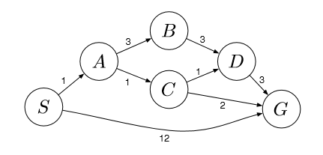
Example 2
What path would breadth-ﬁrst graph search return for this problem?
What path would uniform cost graph search return for this problem?
What path would depth-ﬁrst graph search return for this problem?
What path would iterative-deepening graph search return for this problem?

Slide 8
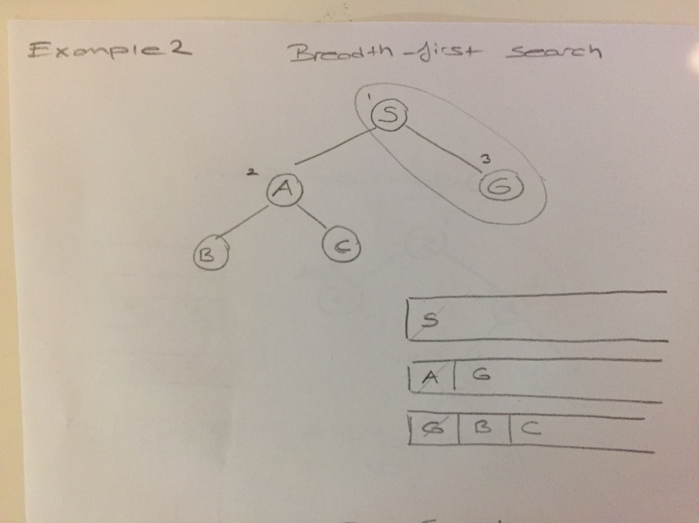

Slide 9
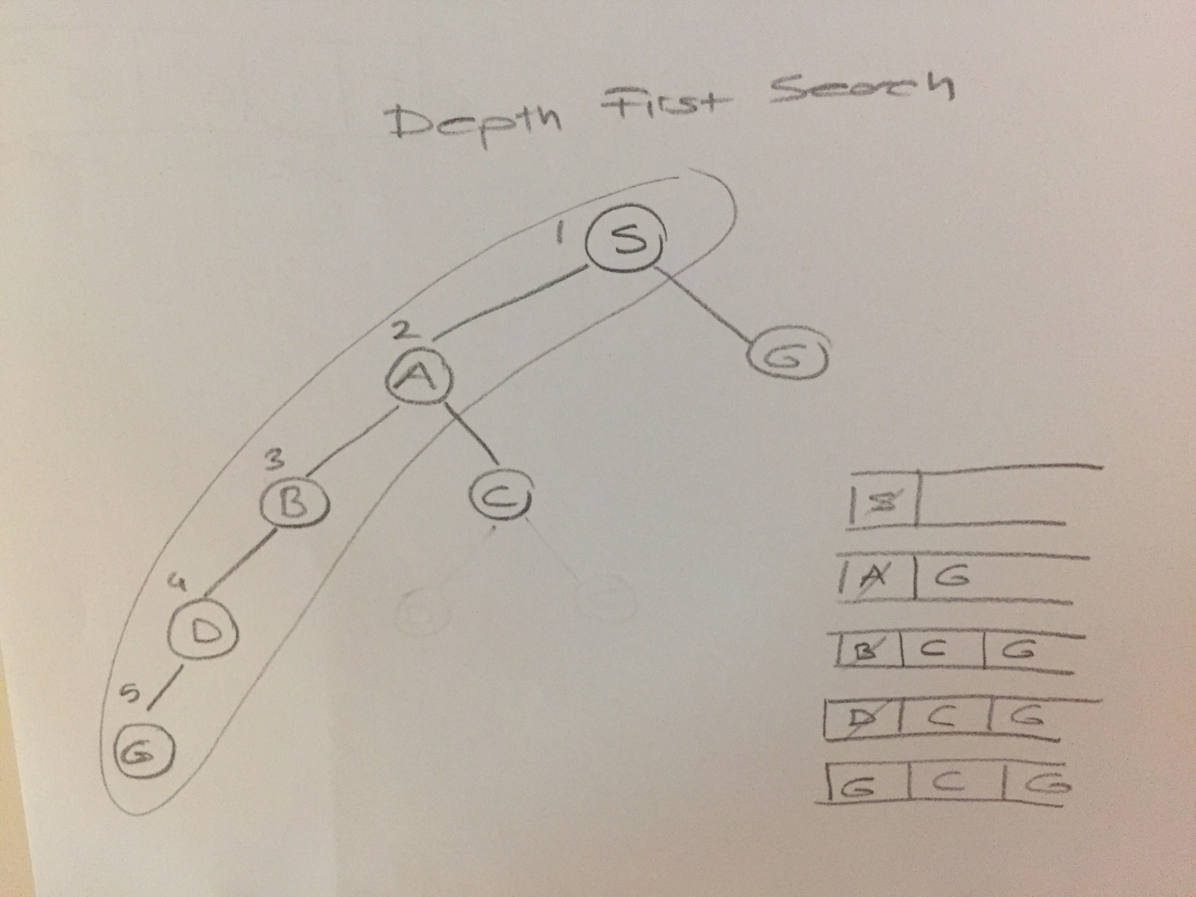

Slide 10
Iterative deepening Search
S – S – A – G
Queue
1st S
2nd S
A G

Slide 11
Iterative deepening Search

Slide 12
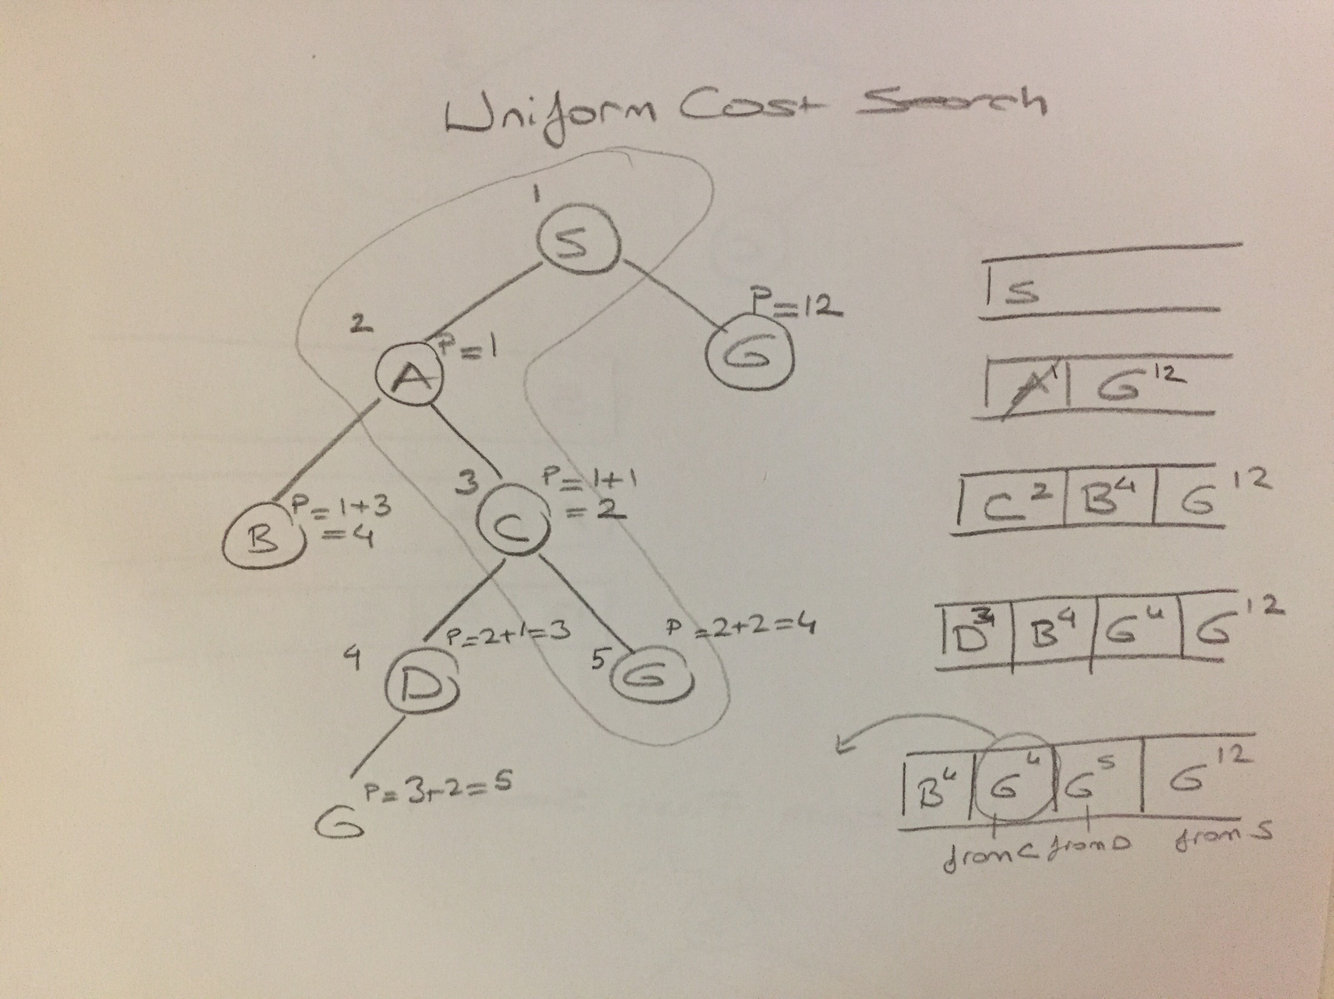

Slide 13
What path would breadth-ﬁrst graph search return for this problem?
S −G
List of exapanded nodes : S – A - G
What path would uniform cost graph search return for this problem?
S −A−C −G
List of expanded nodes: S – A – C – D - G
What path would depth-ﬁrst graph search return for this problem?
S −A−B−D−G
List of expanded nodes : S – A – B - D - G
What path would iterative deepening graph search return for this problem?
S − G
List of expanded nodes: S – S – A - G

Slide 14
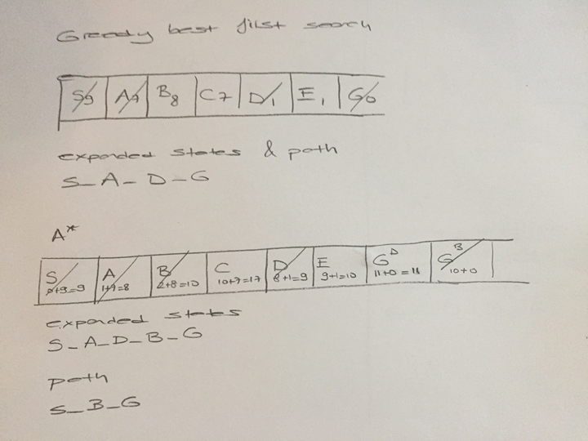
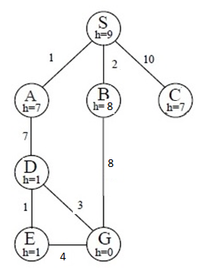

Slide 15
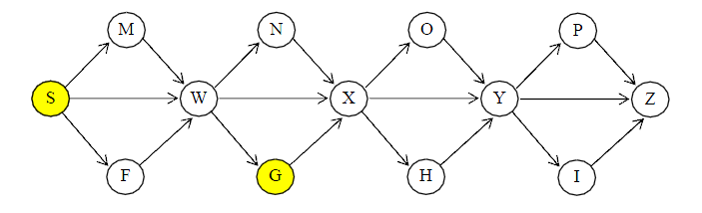
Example1
Your job is to find a path from the Start node, S, to the Goal node, G,
using various algorithms under various conditions.
All streets are one-way, left to right.
In the event any search reaches a point where you need to break a tie,
use this rule: a path that terminates in a node closer to the top of the page
takes precedence over another that terminates in a node that is less close;
if there is still a tie, a path that terminates in a node closer to the
left of the page takes precedence over another that terminates in a node
that is less close.

Slide 16
Breadth first search
You are to perform breadth-first-search.
Use the convention that a path to the goal is only returned when the
goal node is expanded, not as soon as it appears in the queue.
-Write down all the nodes expanded, in the order in they are expanded.
-Give the full path that is returned.

Slide 17
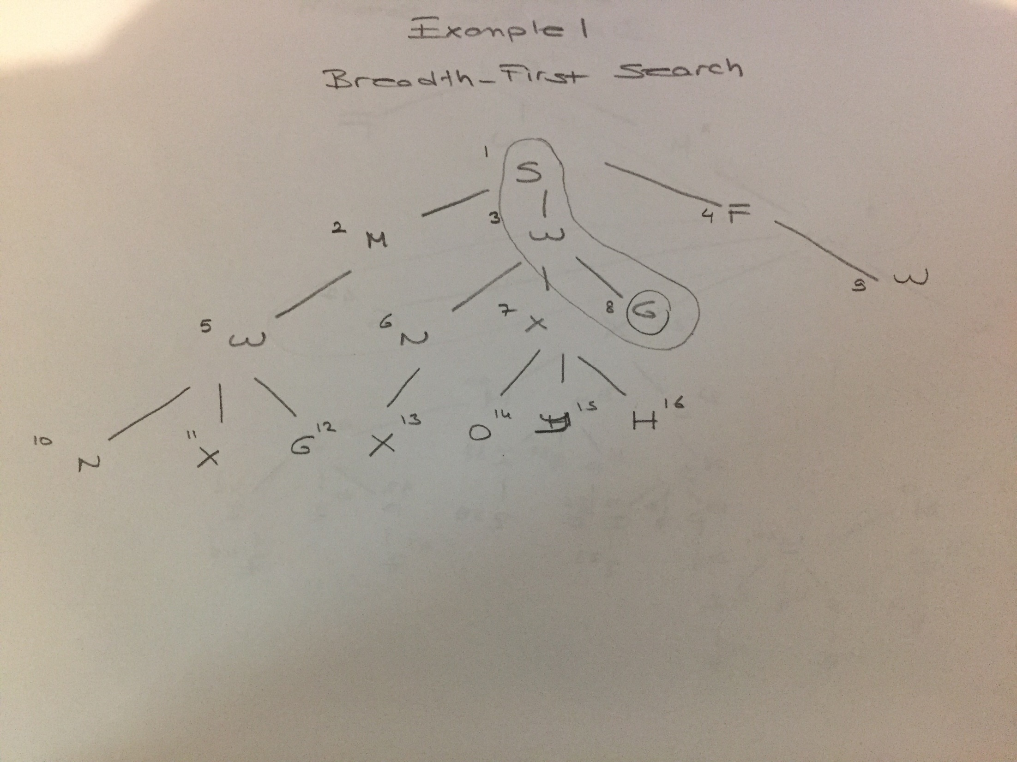

Slide 18
-Write down all the nodes expanded, in the order in they are expanded.
S M W F (W) N X G (W) (X) O Y H G
-Give the full path that is returned.
S W G

Slide 19
Depth first search
Perform depth-first-search.
Use the convention that a path to the goal is only returned when the goal
node is expanded, not as soon as it appears in the queue.
- Write down all the nodes expanded, in the order in they are expanded
- Give the full path that is returned.

Slide 20
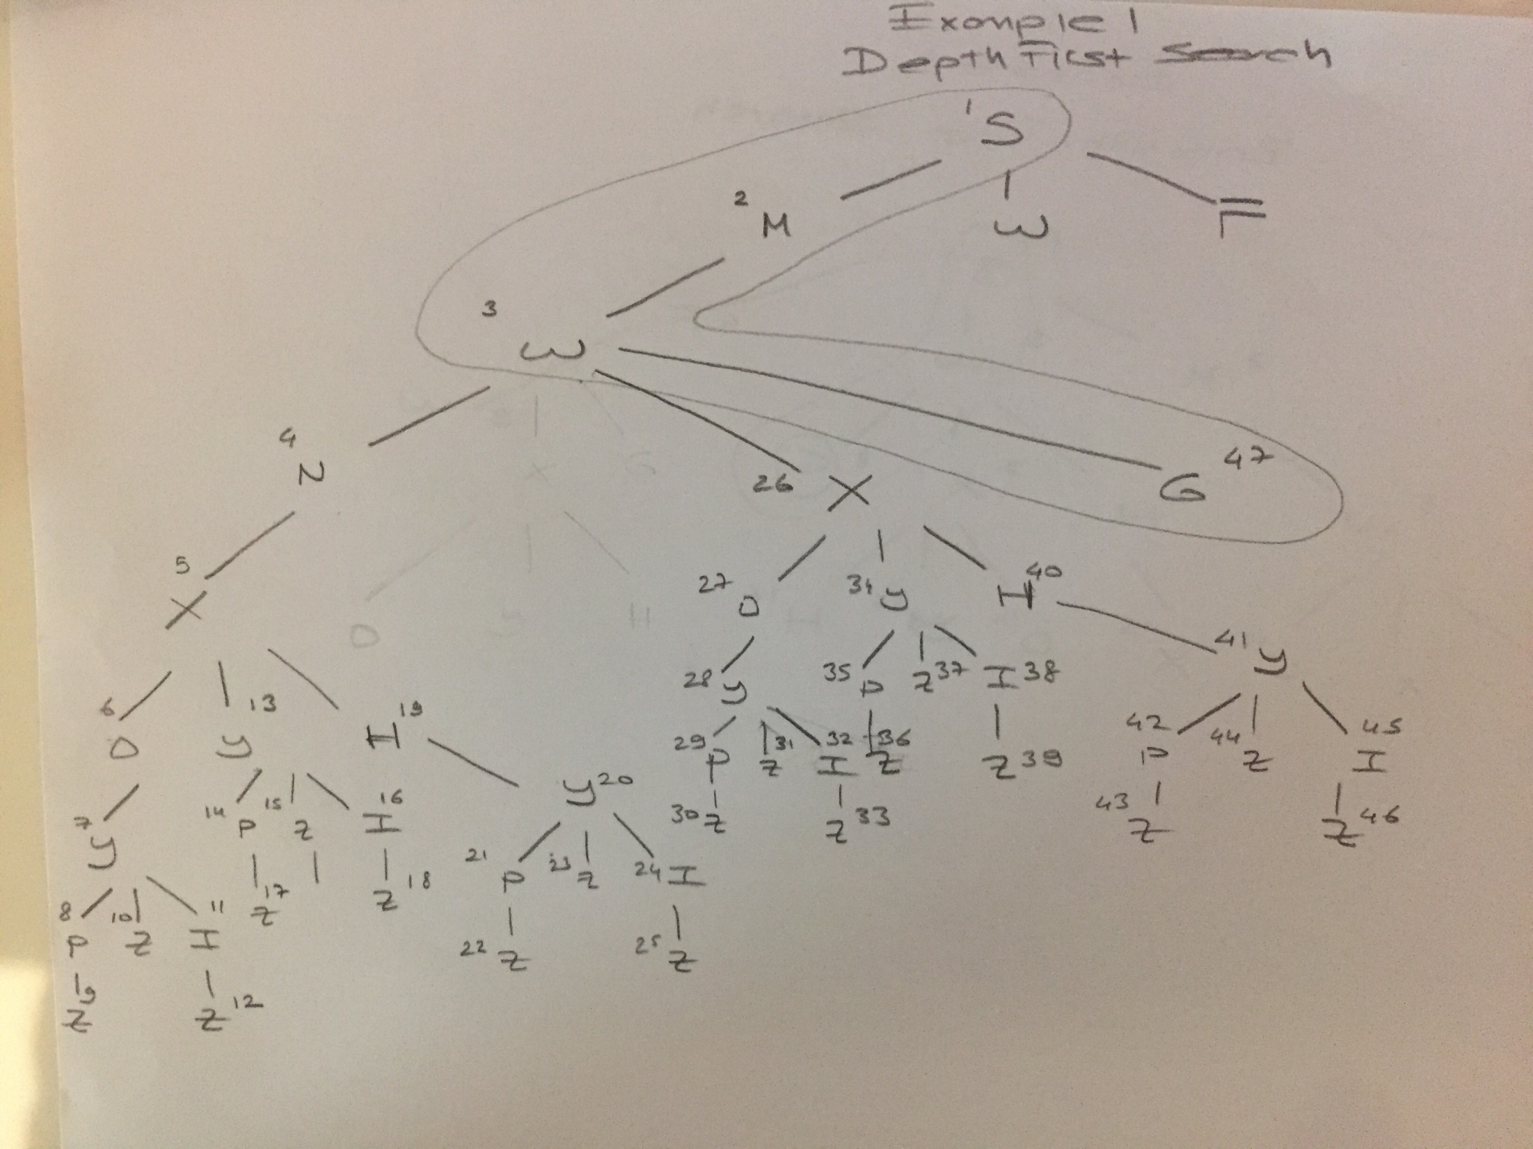

Slide 21
- Write down all the nodes expanded, in the order in they are expanded
S M W N X O Y P Z (Z) I (Z) (Y) H (Y) (X) G
- Give the full path that is returned.
. S M W G

Slide 22
A* search
Find the optimal path using the A* algorithm, using the following heuristic:
h(n) = 8 if n is M, N, O, P
4 if n is W, X, Y, Z
0 otherwise

Slide 23
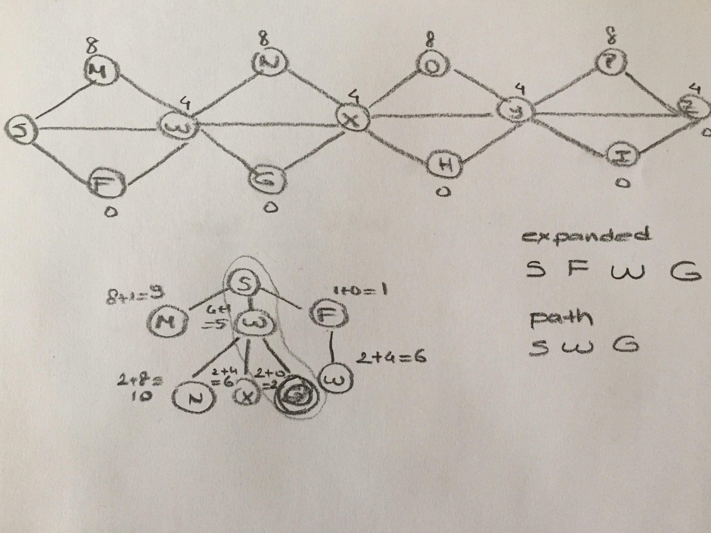

Slide 24
Solution
Write down all the nodes expanded, in the order they are expanded.
S F W G
Give the full path that is returned.
S W G

Slide 25
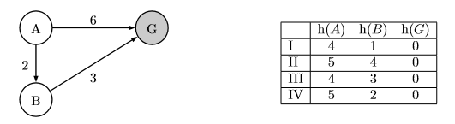
Consider the search problem shown on the left. It has only three states, and three directed edges. A is the start node and G is the goal node. To the right, four diﬀerent heuristic functions are deﬁned, numbered I through IV.
For each heuristic function, circle whether it is admissible and whether it is consistent with respect to the search problem given above. Explain your reasons.

Slide 26
 | Admissible? |  | Consistent?
I | Yes |  |  | No
II |  | No |  | No
III | Yes |  | Yes
IV | Yes |  |  | No
II is the only inadmissible heuristic, as it overestimates the cost from B: h(B) = 4, when the actual cost to G is 3.
To check whether a heuristic is consistent, ensure that for all paths, h(N)−h(L) ≤ path(N → L),
where N and L stand in for the actual nodes. In this problem, h(G) is always 0, so making sure that
the direct paths to the goal (A → G and B → G) are consistent is the same as making sure that the heuristic is admissible.
The path from A to B is a diﬀerent story.
Heuristic I is not consistent: h(A)−h(B) = 4−1 = 3 is not ≤ path(A → B) = 2.
Heuristic III is consistent: h(A)−h(B) = 4−3 = 1 ≤ 2
Heuristic IV is not consistent: h(A)−h(B) = 5−2 = 3 is not ≤2

Slide 27
State whether the following sentences are true or not. Explain your reasons
(True or False) Heuristic function IV dominates III. no
Reason:
(True or False) Heuristic function IV dominates I. yes
Reason:
For one heuristic to dominate another, all of its values must be greater than or equal to the corresponding values of the other heuristic. Simply make sure that this is the case. If it is not, the two heuristics have no dominance relationship.

Slide 28
CSP

Slide 29
The following constraint network represents a coloring problem with five variables and one, two, or three colors in the domain of each variable. Lines represent constraints requiring that two variables have different colors.

Slide 30
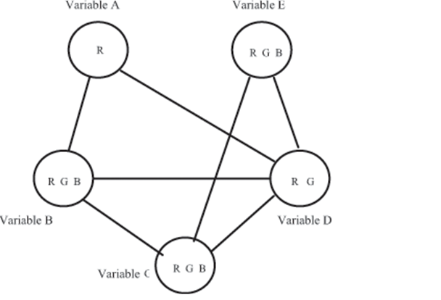

Slide 31
If we run full constraint propagation,
what are the resulting domains of the
variables?
Arcs | A | B | C | D | E
A-B | R | G B
A-D | R |  |  | G
B-C |  | G B | R G B
B-D |  | B |  | G
C-D |  |  | R B | G
C-E |  |  | R B |  | R G B
D-E |  |  |  | G | R B
B-C |  | B | R
C-E |  |  | R |  | B

Slide 33
Apply backtracking to the above figure. Examine variables in alphabetical order (A, B, C, D, E) and values in reverse alphabetical order (R, G, B). For every node in your tree, draw only its valid descendents. Write down the values assigned to each variable satisfying the conditions

Slide 34
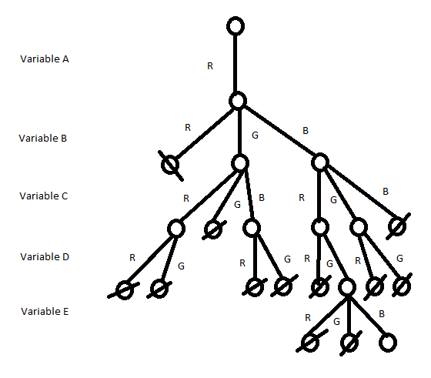

Slide 35
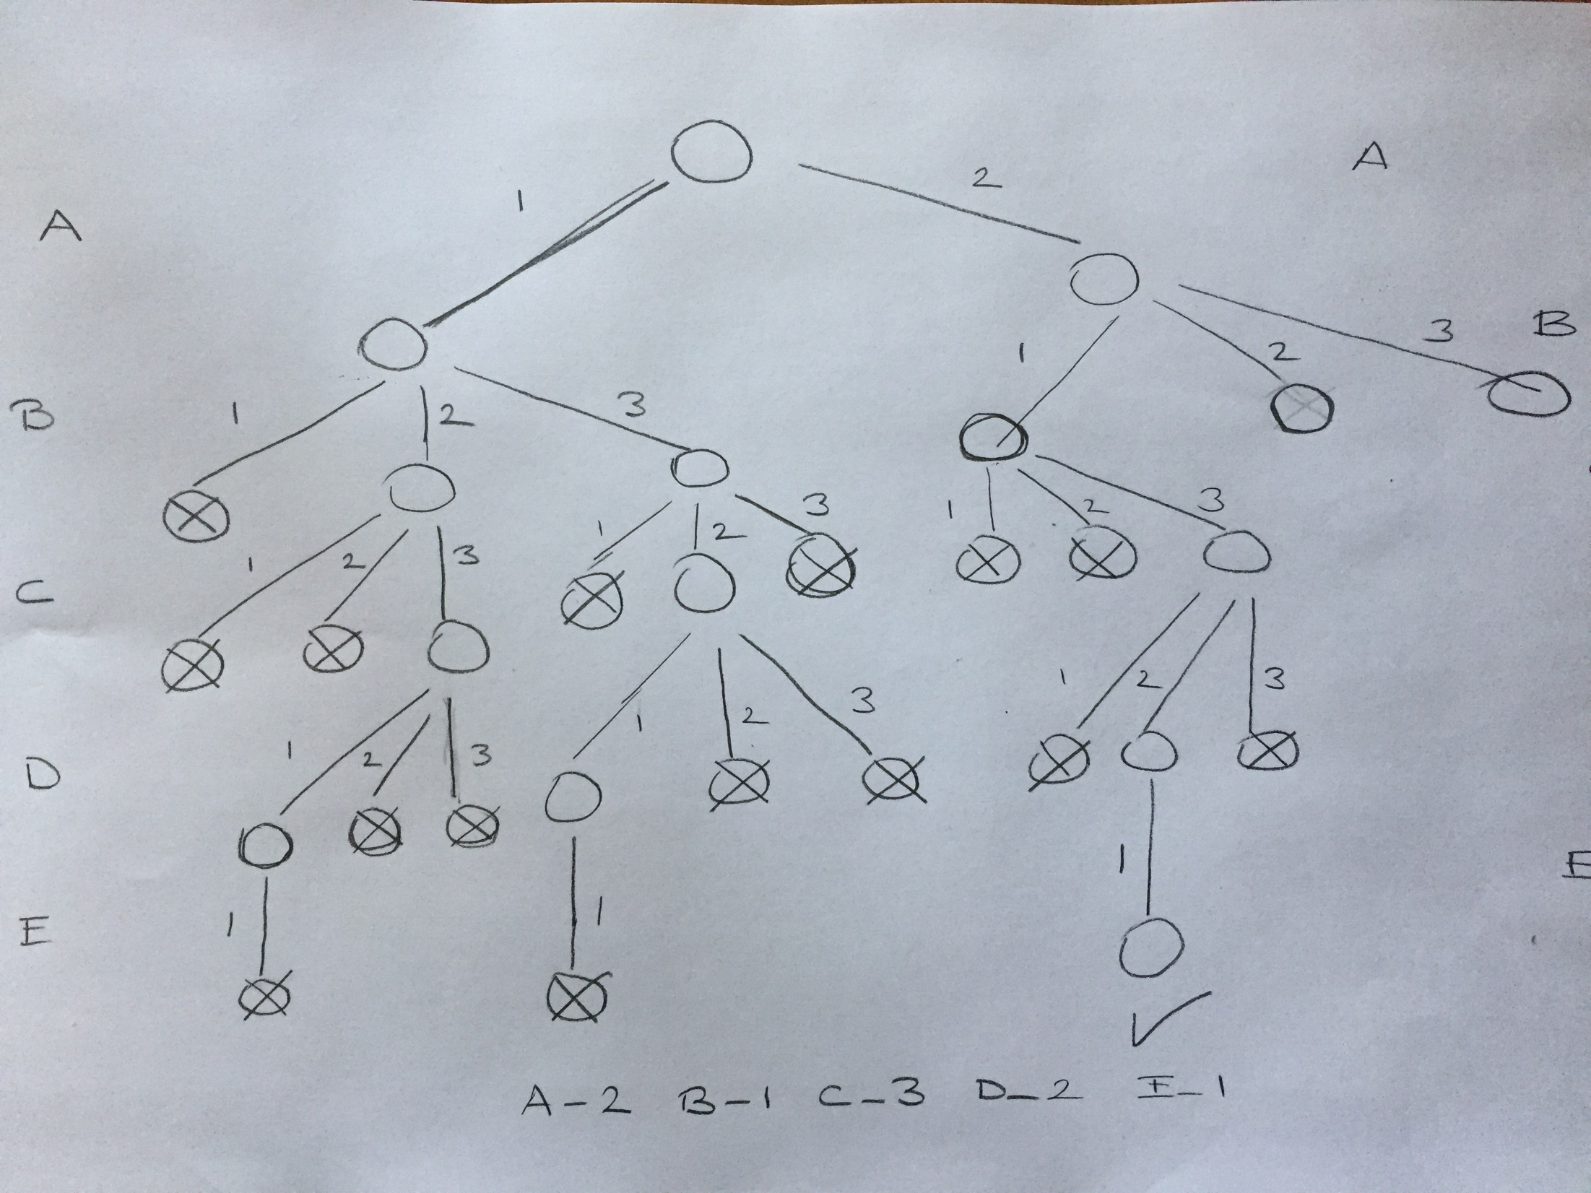
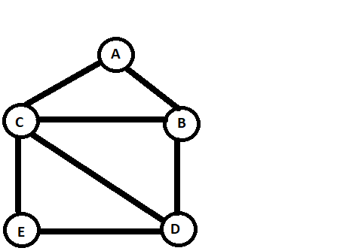
A : {1,2},
B: {1,2,3},
C: {1,2,3},
D: {1, 2 , 3},
E :{1}

Slide 36
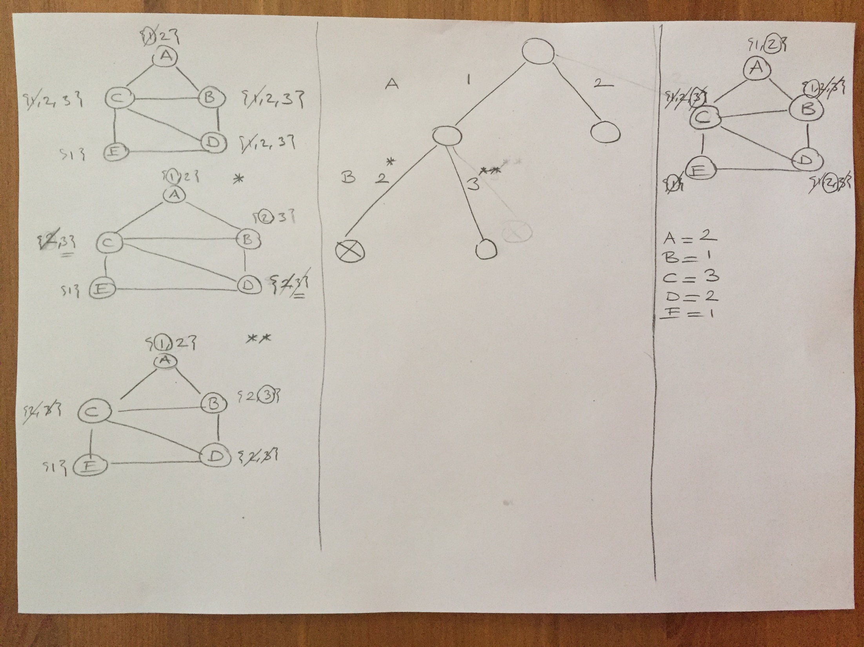

Slide 37
{1,2},
{1,2},
{1,2,3},
{1,2,3},
{1,2,3},
{1,2,3},
{1}
{1, 2 , 3},
{1}
{1, 2 , 3},
{1,2},
{1,2},
{1,2,3},
{1,2,3},
{1,2,3},
{1,2,3},
{1}
{1, 2 , 3},
{1}
{1, 2 , 3},

Slide 38
Which is the most constrained variable?
E
Selecting the variable that has the least number of candidate values is most likely to cause a failure early.
Therefore, it is better to choose the variable with the minimum remaining values.
Which are called as most constrained variables.
Which is the most constraining variable?
C
select a variable which contributes to the larger number of constraints , then the effect on the other variables will be the largest
Therefore, it may help to prune a larger part of the search
This is equivalent to finding the variable that is connected to the largest number of variables
A : {1,2},
B: {1,2,3},
C: {1,2,3},
D: {1, 2 , 3},
E :{1}

Slide 39
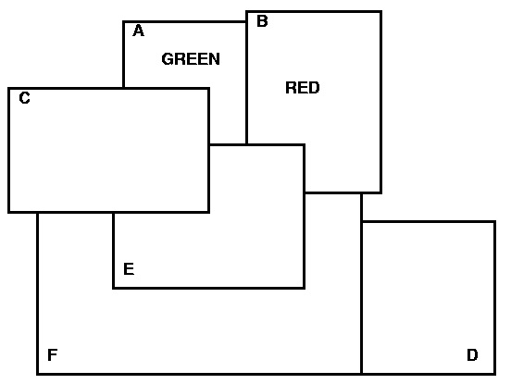
E- BLUE
C- RED
F - GREEN
D – BLUE OR RED

Slide 40
Games

Slide 41
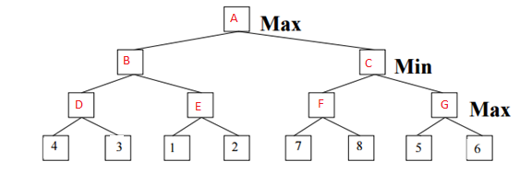
Consider the game tree in which the evaluation function values are shown
below each leaf node. Assume that the root node corresponds to the
maximizing player. Assume that the search always visits children
left-to-right.

Slide 42
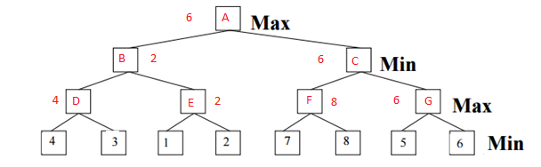
Compute the backed-up values computed by the minimax algorithm.
Show your answer by writing values corresponding to each letter (A-G)

Slide 43
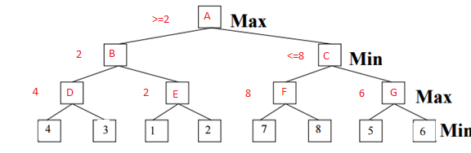
Which nodes will not be examined by the alpha-beta
pruning algorithm? Check the nodes which are pruned
No cut-off

Slide 44
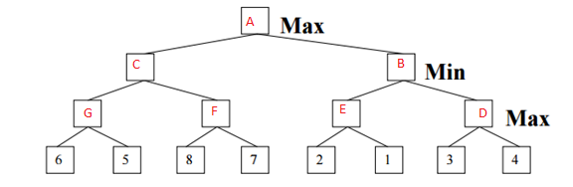
Now consider the tree below where the leaves are reversed.

Slide 45
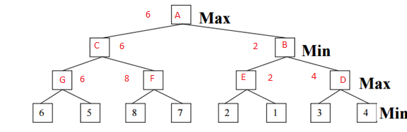
Compute the backed-up values computed by the minimax algorithm.
Show your answer by writing values corresponding to each letter (A-G)

Slide 46
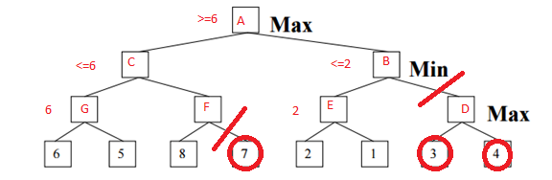
Which nodes will not be examined by the alpha-beta
pruning algorithm? Check the nodes which are pruned

Slide 47
In general (not just for the above tree), if the search always visits children right-to-left instead of left-to-right,
(Yes or No) The minimax value computed at the root will be changed.
FALSE
(Yes or No) The number of nodes pruned will be changed.
TRUE

Slide 48
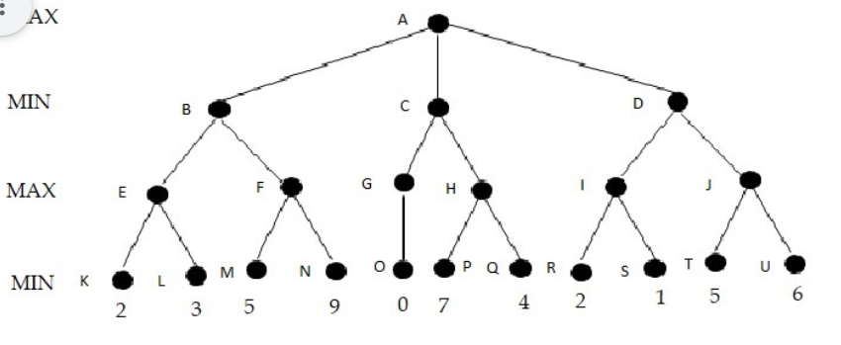
Explore the tree using the alpha-beta procedure. Indicate all parts of the tree that are cut off. [Use the format X-Y where X and Y are the two consecutive nodes in the tree to represent the branch. ] Do not forget to specify the type of the cut-offs (alpha or beta). Indicate only the cutoffs that are higher in the tree, i.e. if there is cutoff at the parent node, check no-cutoff for the children
C-H beta cutoff
D-J Beta cutoff
F-N alpha cutoff

Slide 49
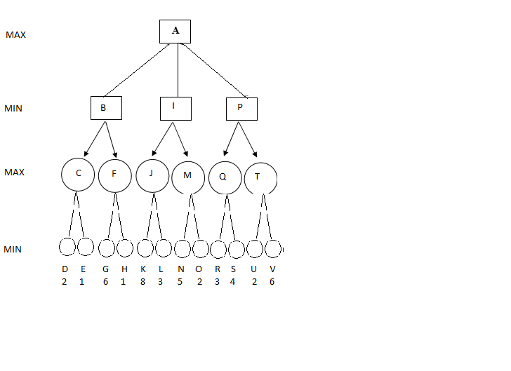
Consider the game tree. Note that, the leaves correspond to MIN's moves.
Apply alpha beta pruning. Write the name of the nodes that are pruned.
How many alpha and beta cut-offs are there? Specify the alpha and beta cutoffs by writing the pair of nodes corresponding to the edge.

Slide 50
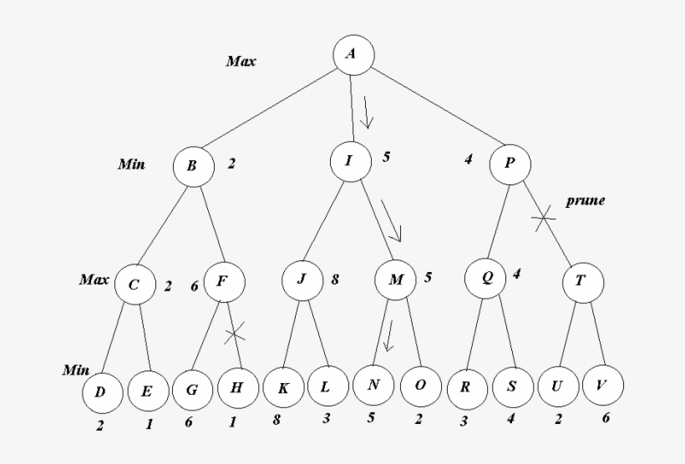

Slide 51
Pruned nodes
H
T U V
Alpha cutoff
F-H
Beta cutoff
P-T

